Slide 1
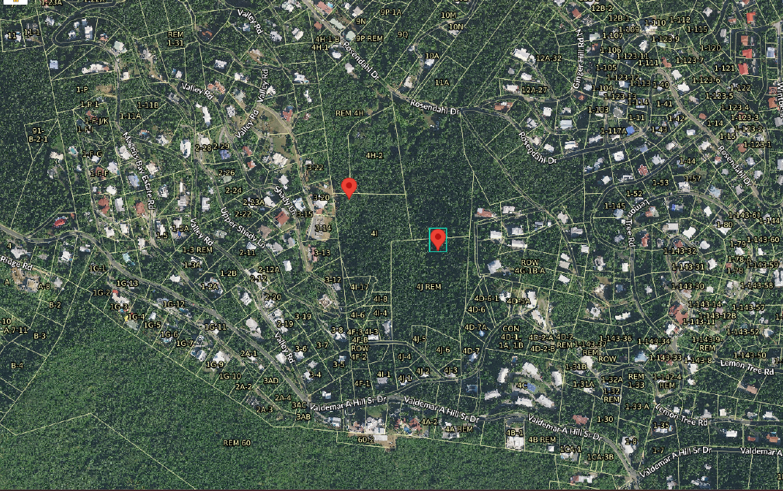
CCZP0003-25: Photo of current site condition- undeveloped land marked in red

Slide 2
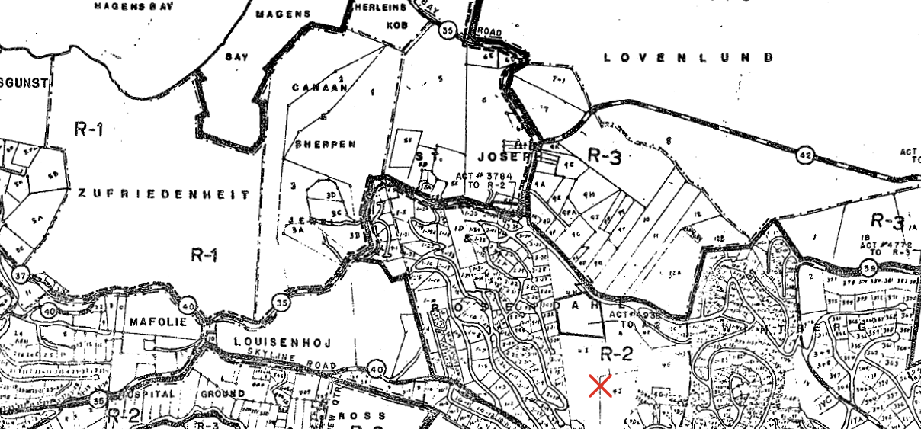
CCZP0003-25: Official Zoning Map No. STZ-6 (properties’ location indicated by red X)

Slide 3
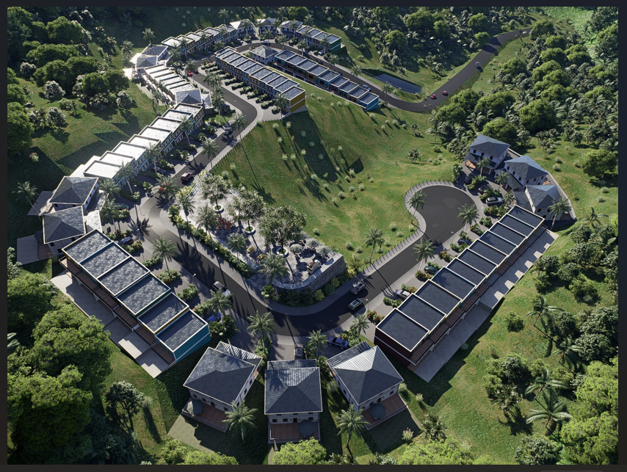
CCZP0003-25: Plan Renderings

Slide 4
CCZP0003-25: Plan Renderings

