Slide 1
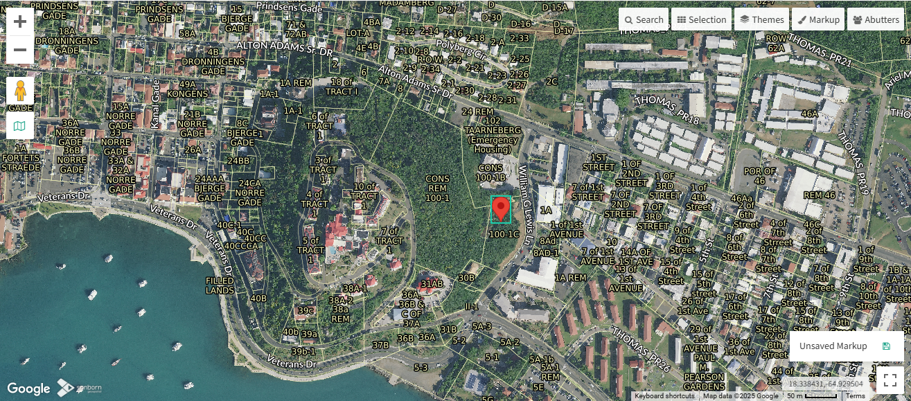
CCZP0020-25: MapGeo aerial view of property (marked in red)

Slide 2
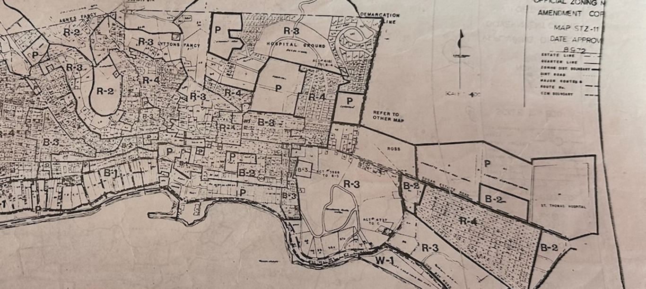
CCZP0020-25: Official Zoning Map No. STZ-11 (property location indicated by red arrow)

Slide 3
CCZP0020-25: Conceptual Site Plan Layout

