Slide 1
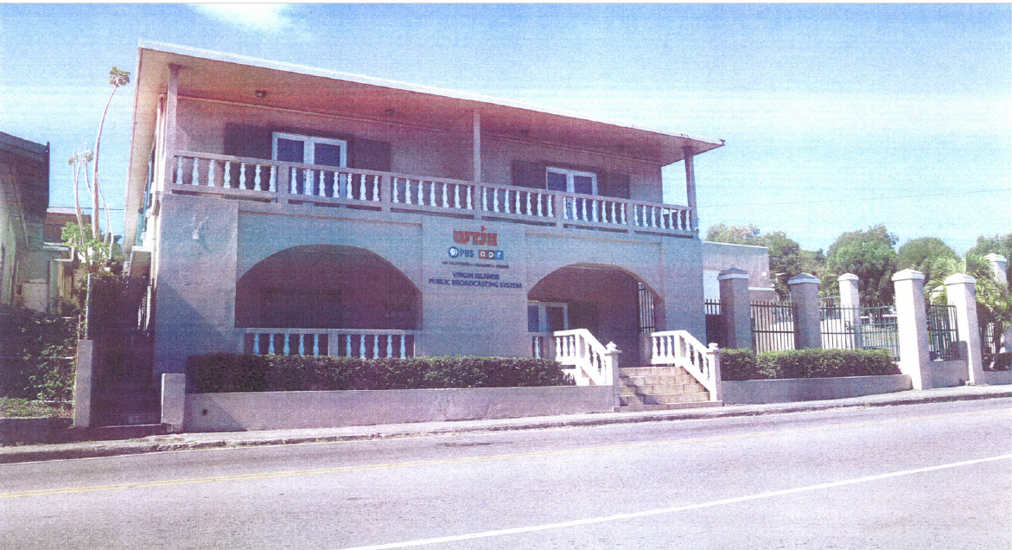
CCZP0025-25: Photo of current site condition- two-story building with parking.

Slide 2
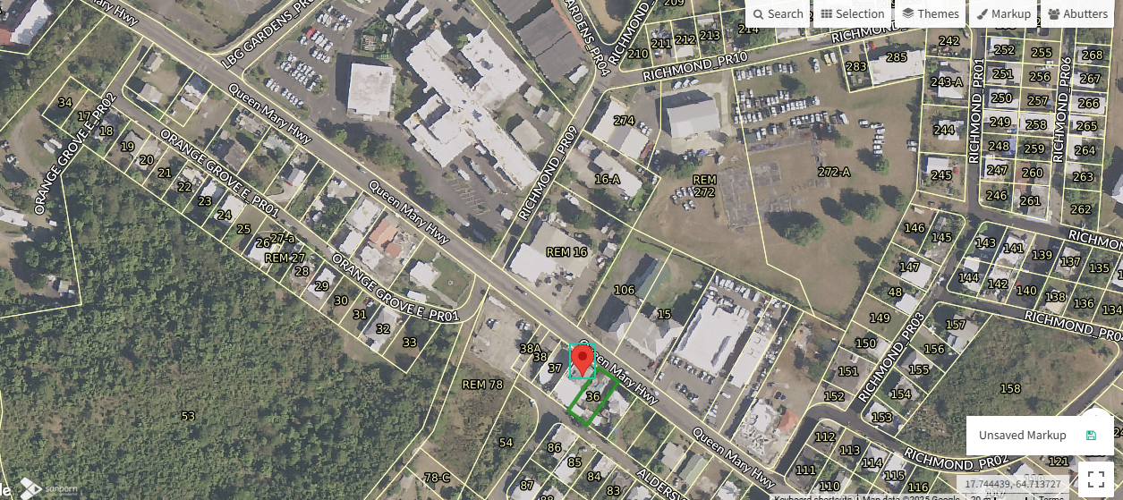
CCZP0025-25: MapGeo aerial view of properties (marked in red)

Slide 3
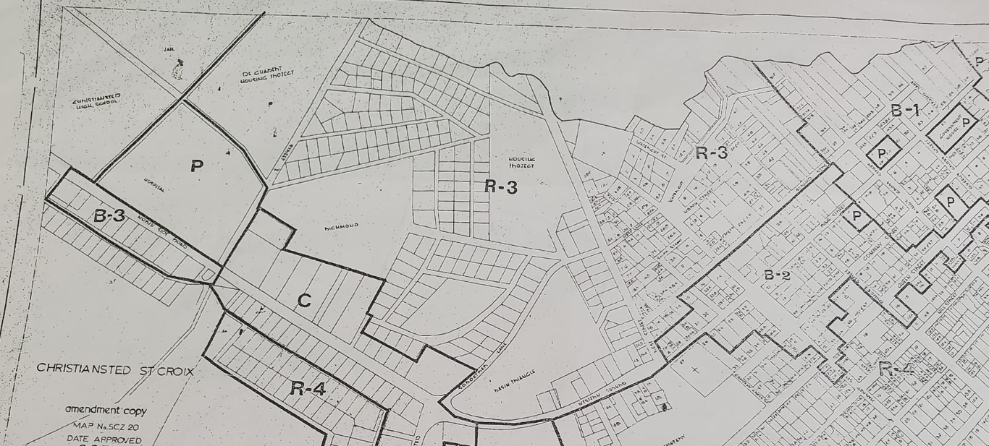
CCZP0025-25: Official Zoning Map No. SCZ-20 (property location indicated by red X)

Slide 4
CCZP0025-25: Conceptual Site Plan Layout

