Slide 1



Cell Phone Signal Quality in the USVI 2023-2024
Gregory Guannel, Ph.D.
Asimian Edmead (former UVI Student now at WAPA)

Slide 2
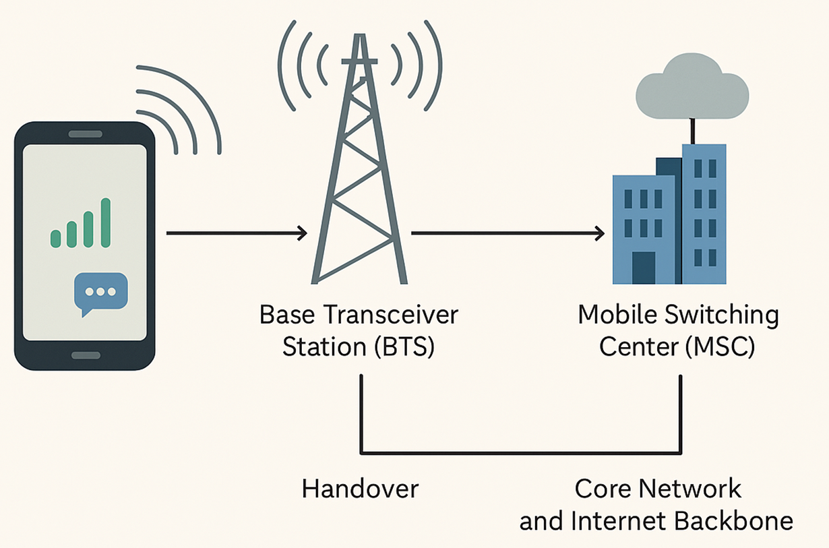
How do cell phones work?
Your phone sends a signal to the nearest cell tower (antenna)
The tower connects your call or data to the network (internet / phone system)
The network sends it to another tower near the other person
That tower sends it to their phone
Prasum Barua

Slide 3
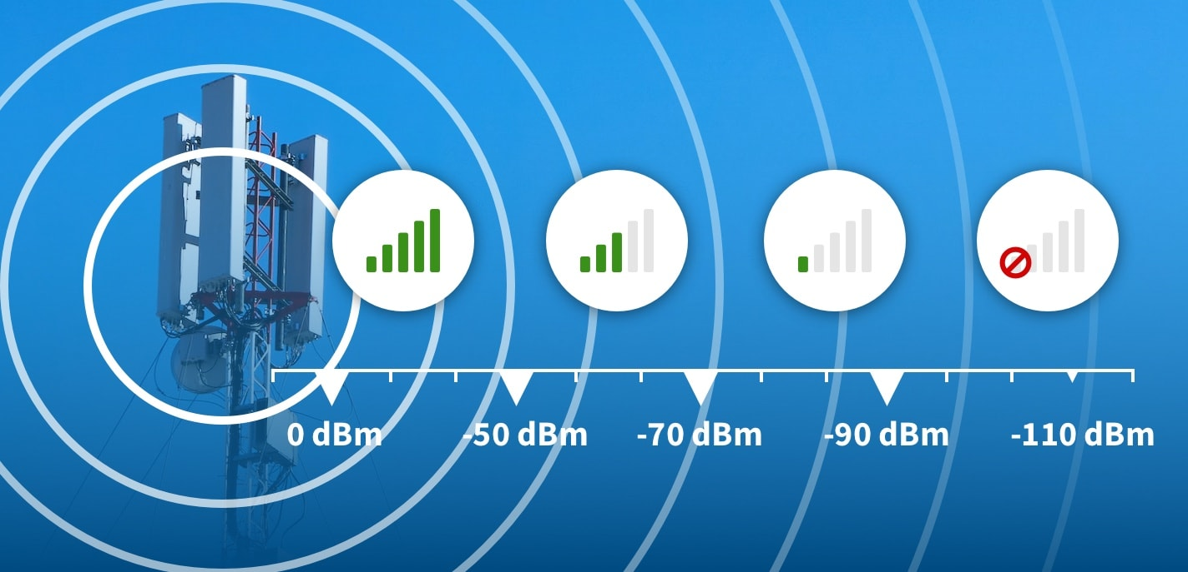
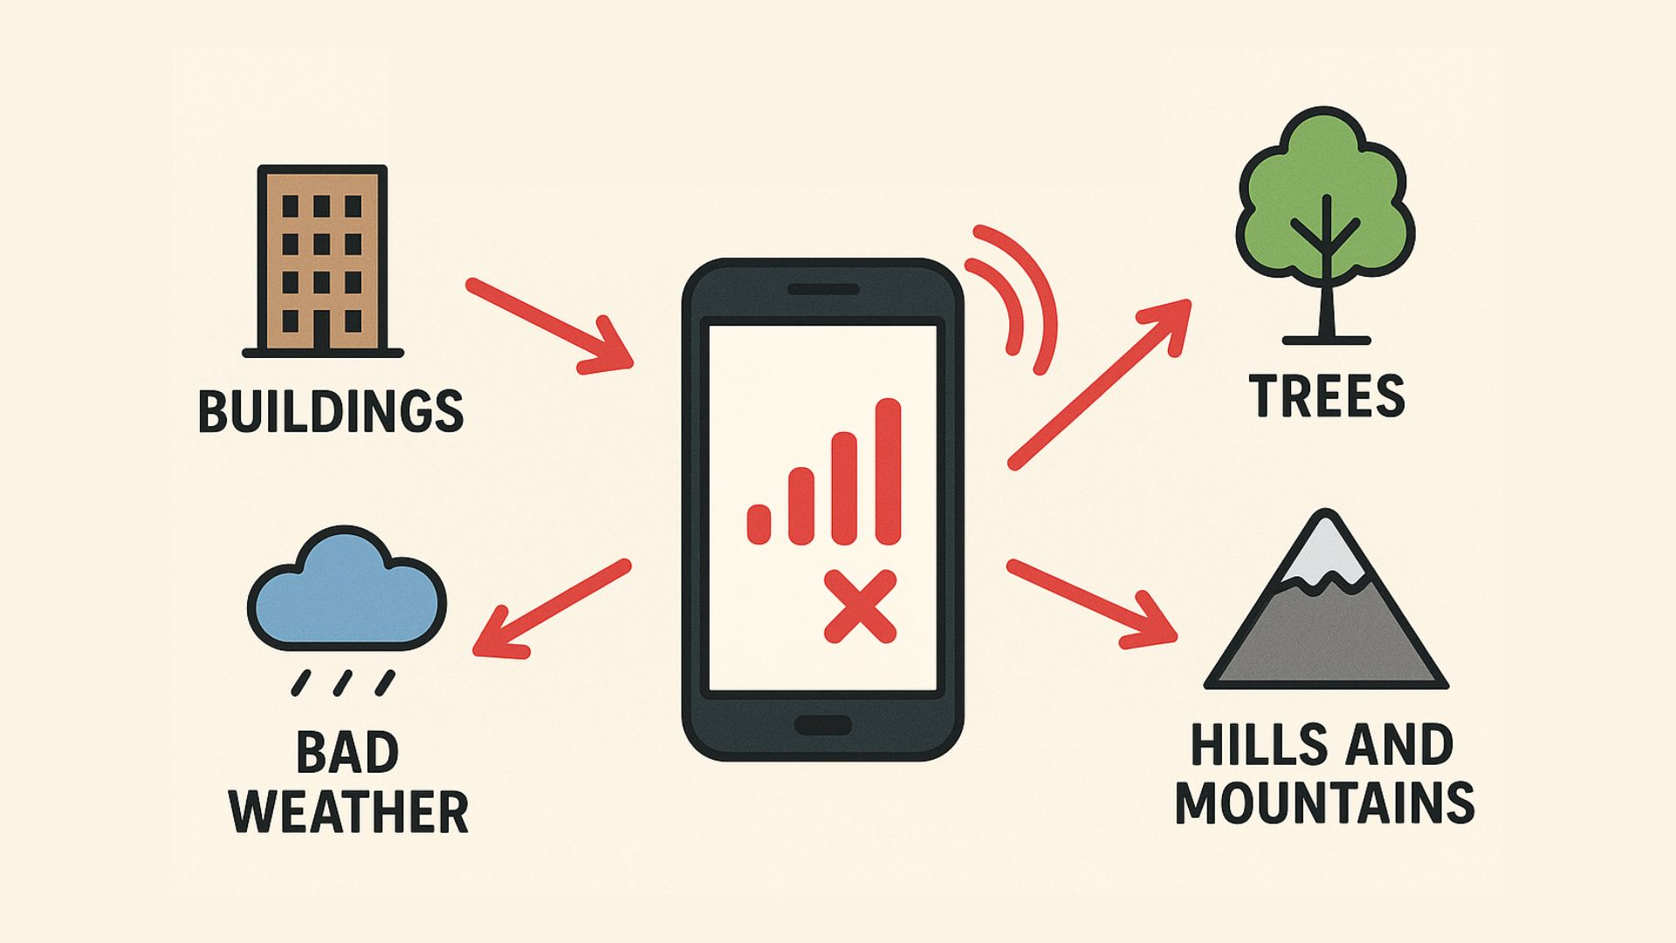
What Drives Quality of Service?
1. Signal strength (how strong the connection is)
Depends on:
  distance to tower
  obstacles (buildings, hills, trees)
2. Interference (how “noisy” the signal is)
Caused by:
  too many users
  nearby towers
  signals bouncing off terrain (water, hills)
Mobile Signal Booster
Mobile Signal Booster

Slide 4
What Do We Measure?
Use an App designed by student at University of Chicago, now at Notre Dame (2023-2024)
UVI part of research group called SpectrumX that looks at various cell phone telecommunication topics
We measure RSRP or Reference Signal Received Power: how much signal power your phone receives from the tower “Do I hear the tower clearly?”
We measure RSRQ or Reference Signal Received Quality: how clean the signal is, or what is the signal quality relative to interference and noise “Is the signal clear, or is there interference?”

Slide 5
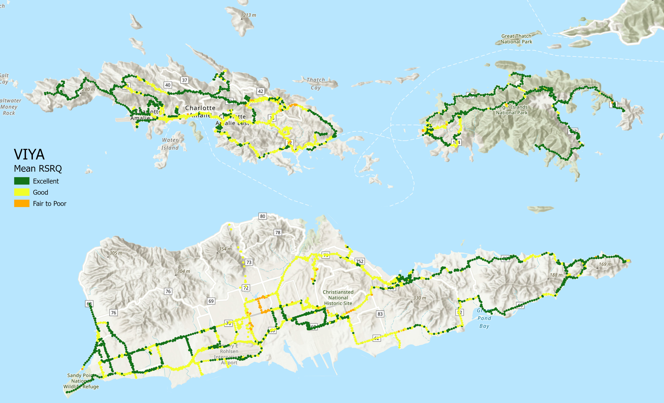
Results
On average, VIYA was generally excellent except central part of St. Croix and Christiansted

Slide 6
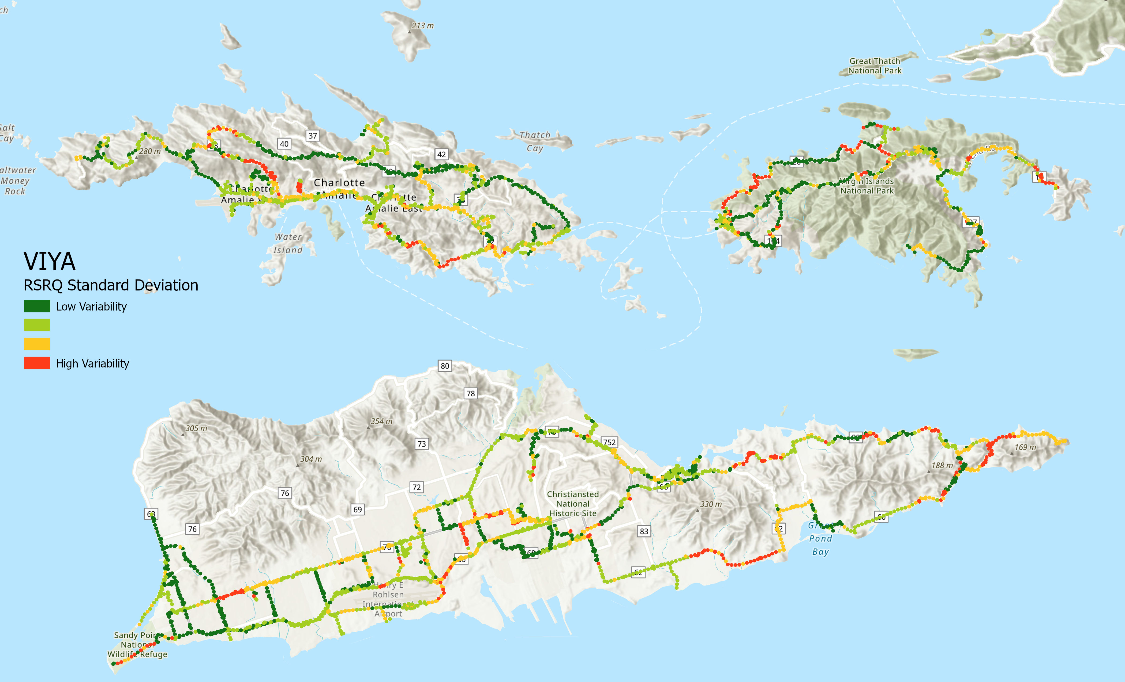
Results
The signal quality varies a lot in east St. Croix, and parts of St. Thomas and St. John

Slide 7
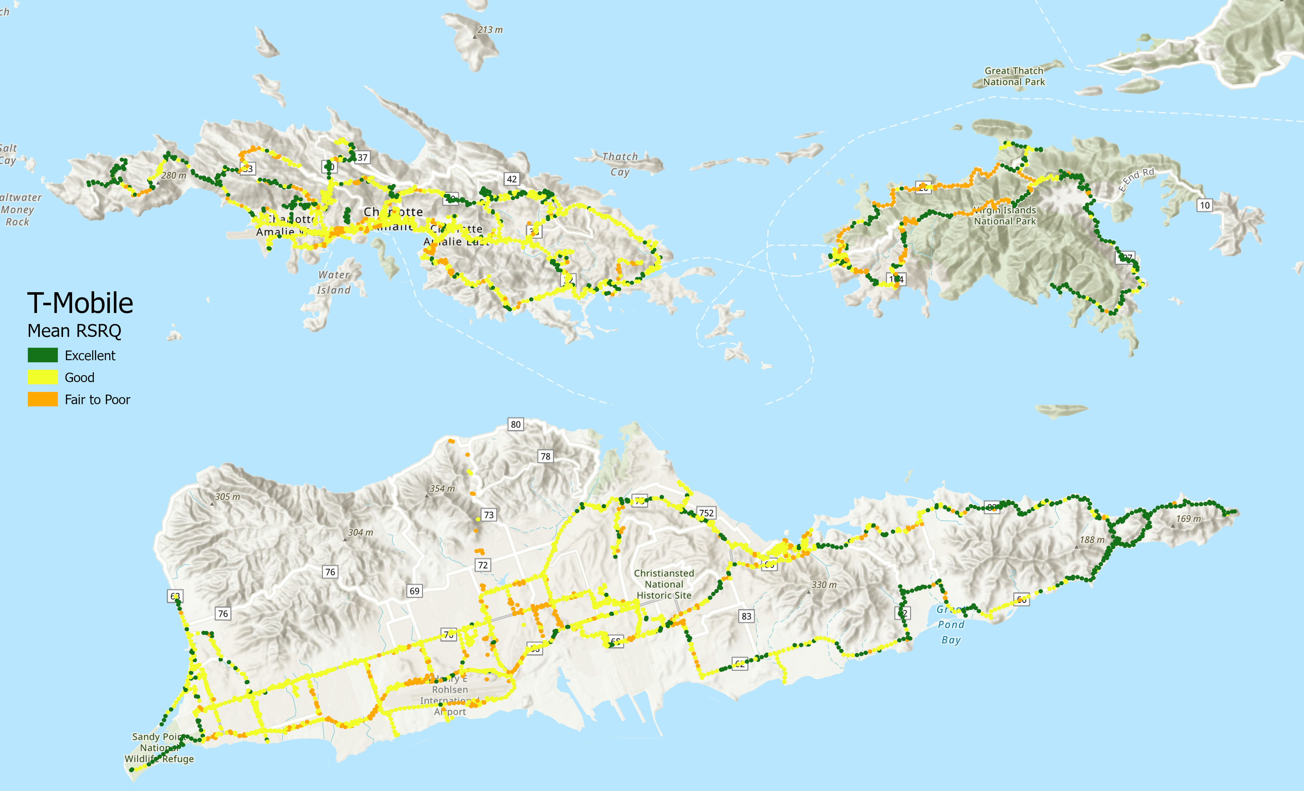
Results
T-Mobile is good to fair on most islands

Slide 8
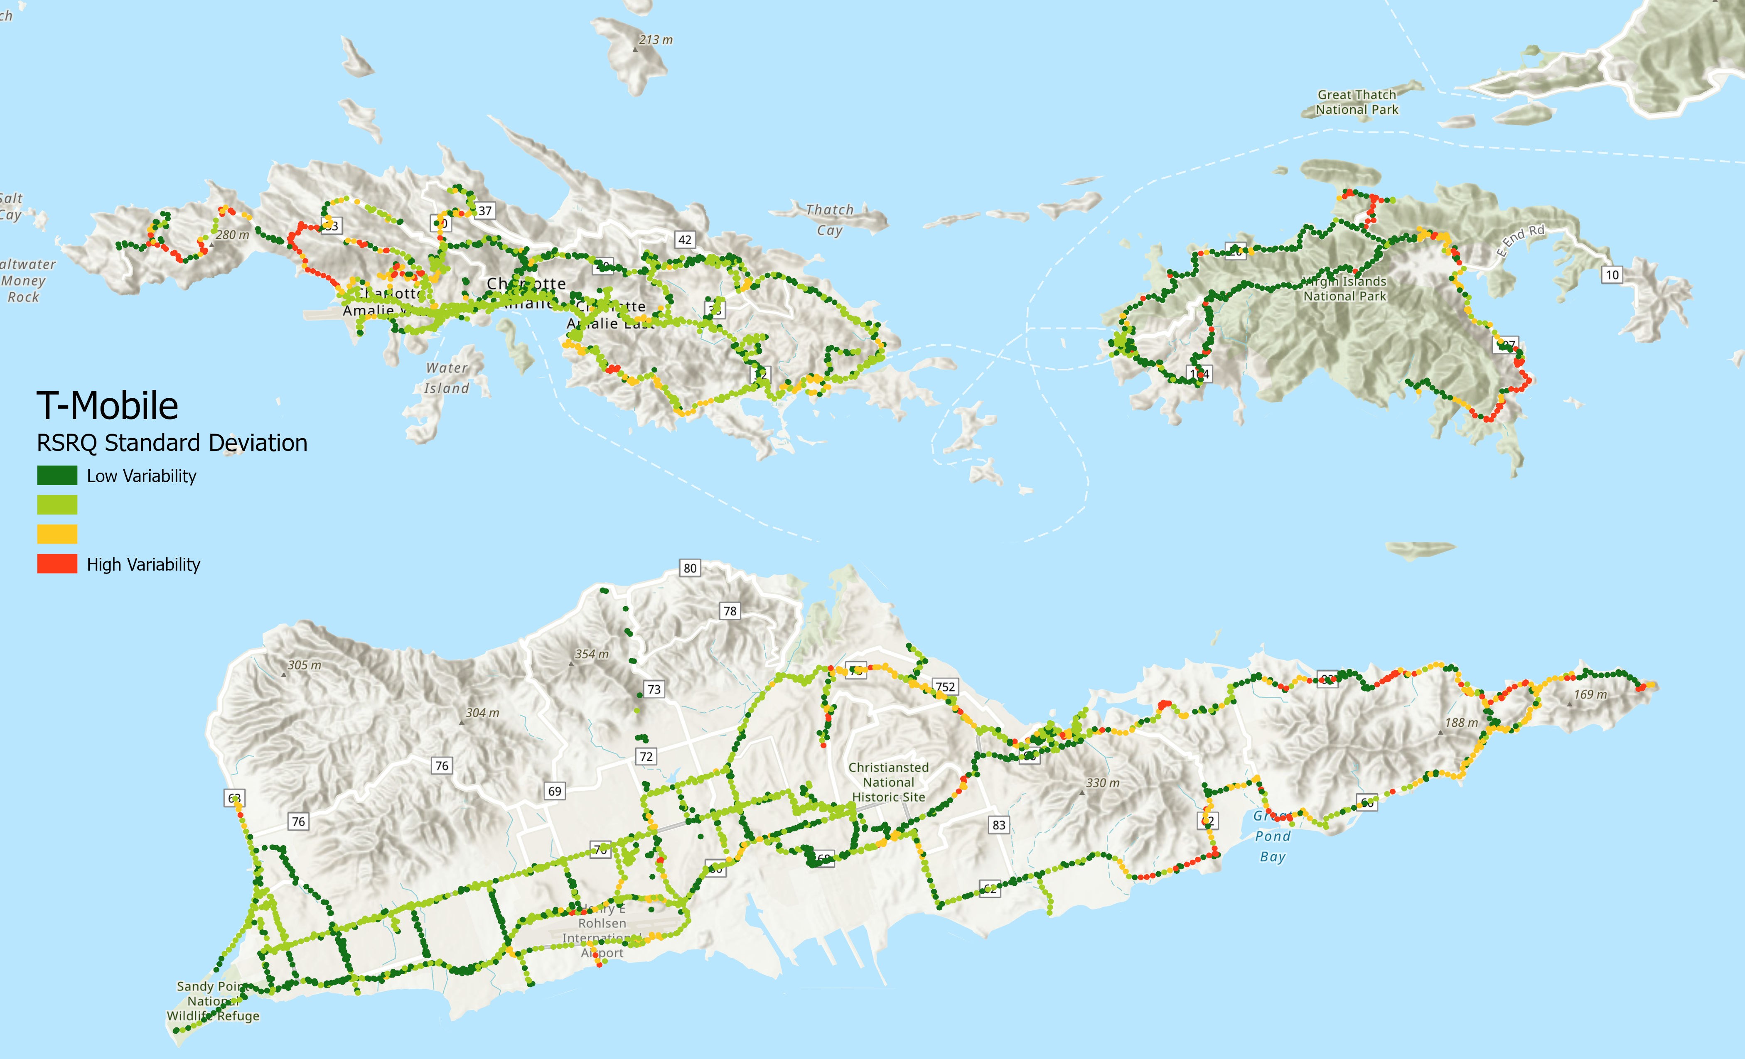
Results
The quality does not vary much, except on parts of St. John

Slide 9
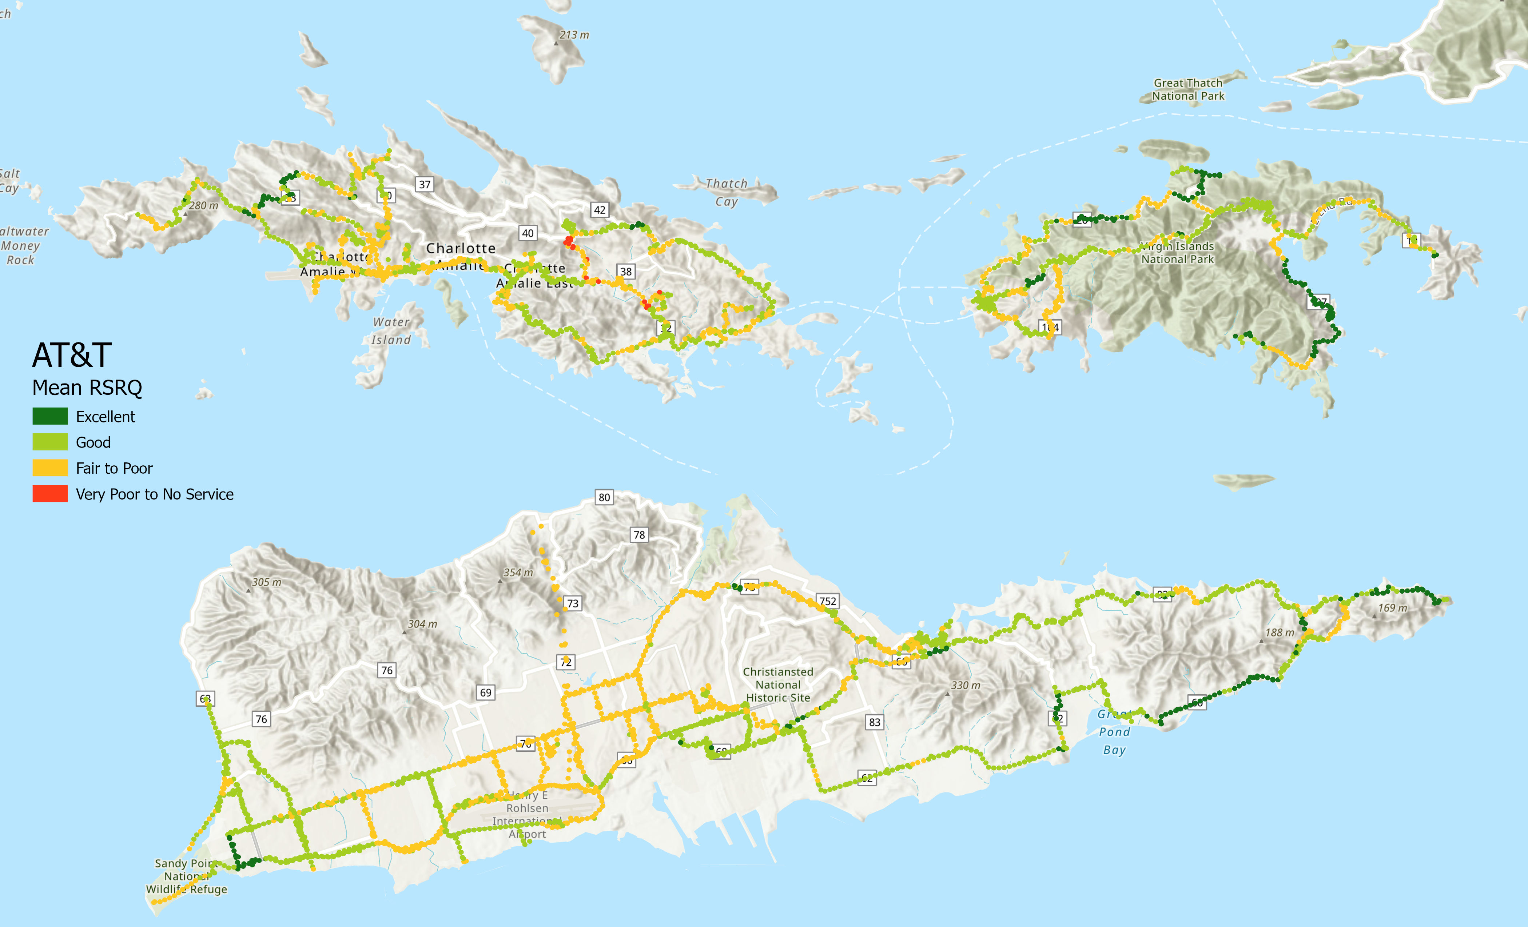
Results
AT&T/Liberty quality is fair to poor in general

Slide 10
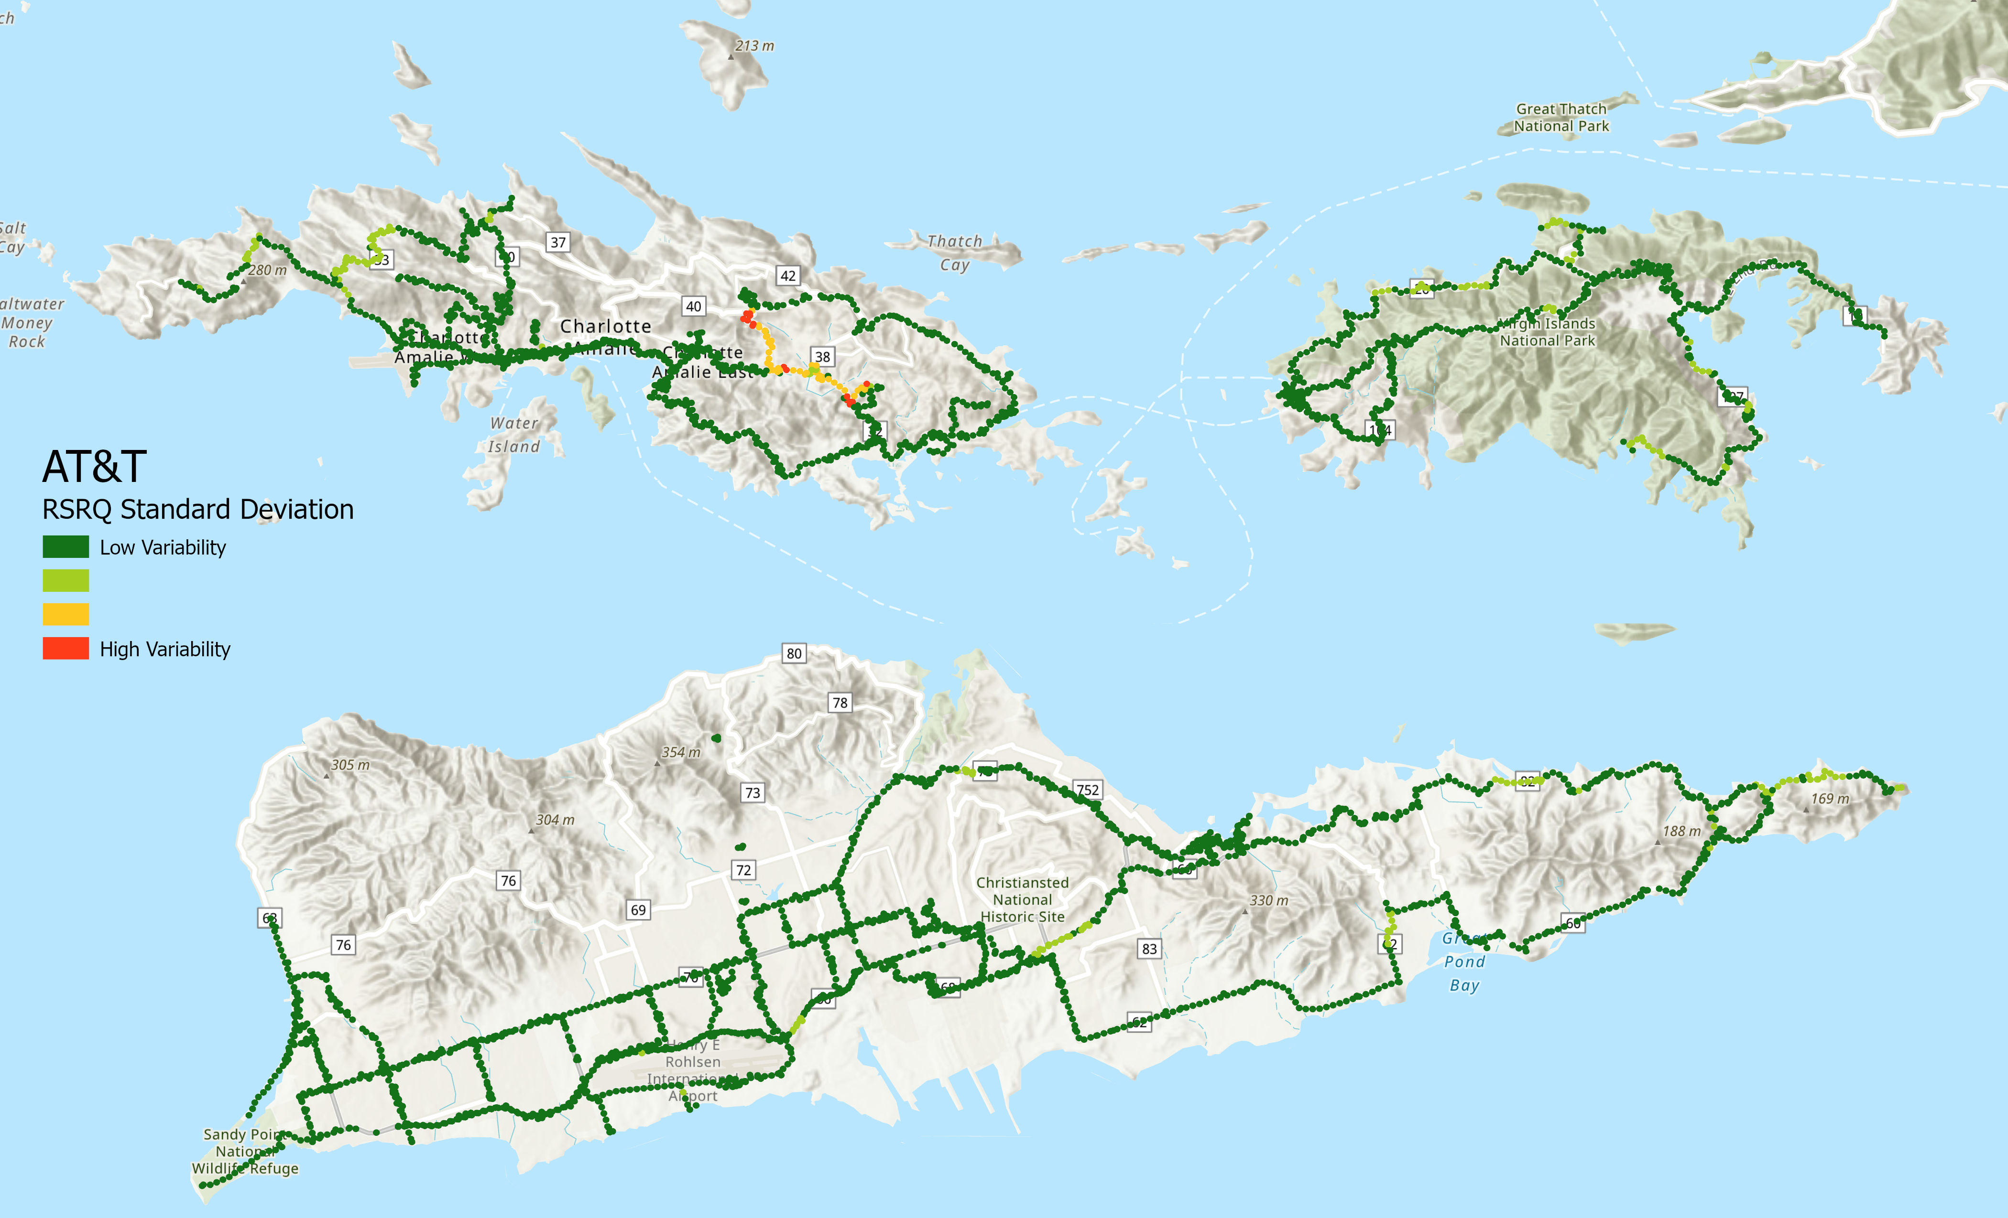
Results
There is not too much variability in the quality of the signal

Slide 11
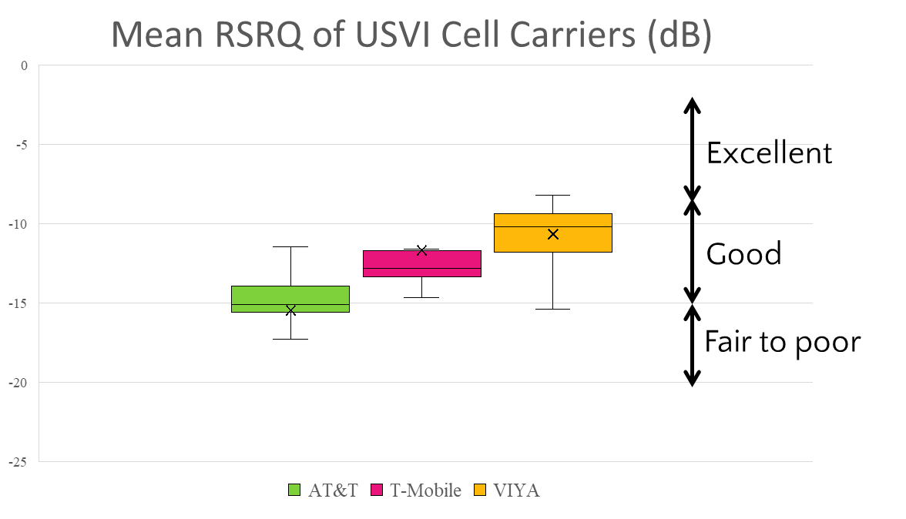
Results
This plot summarizes the results collected over many months. The box represents most of the values measured and the vertical lines represent where overall minimum and maximum are. Overall, there is variability but some networks have better quality signals than others.

Slide 12
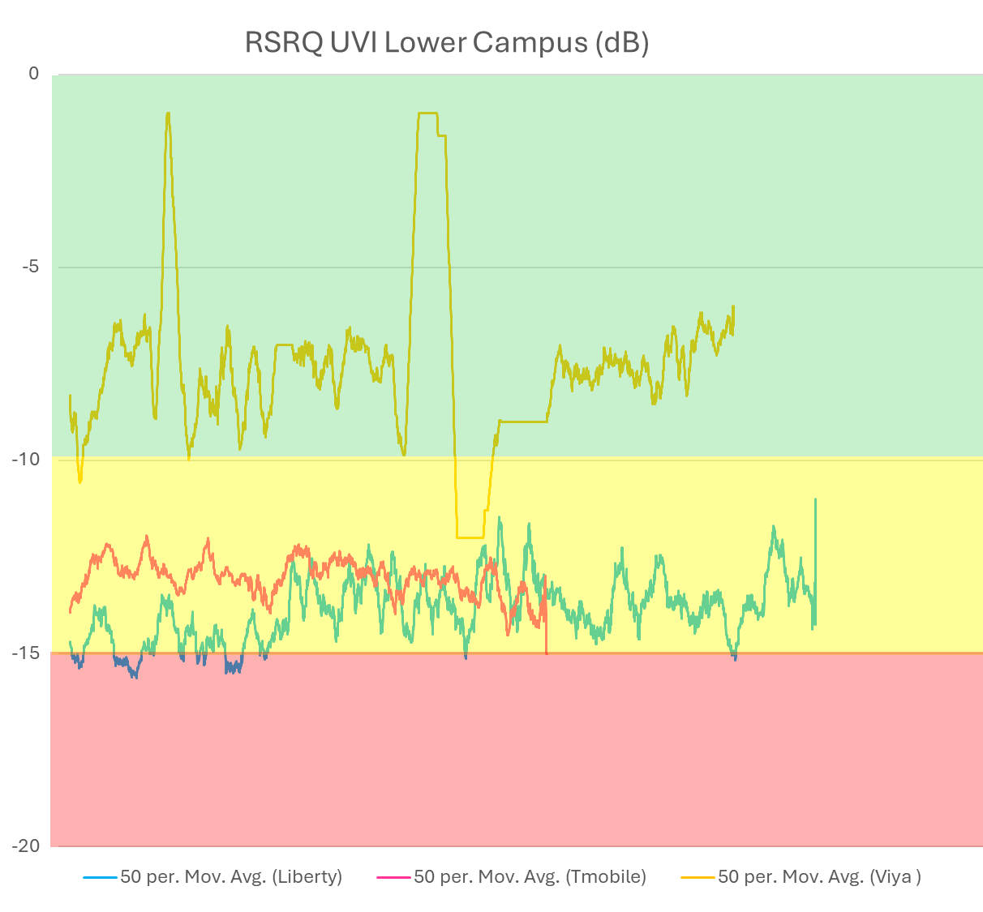
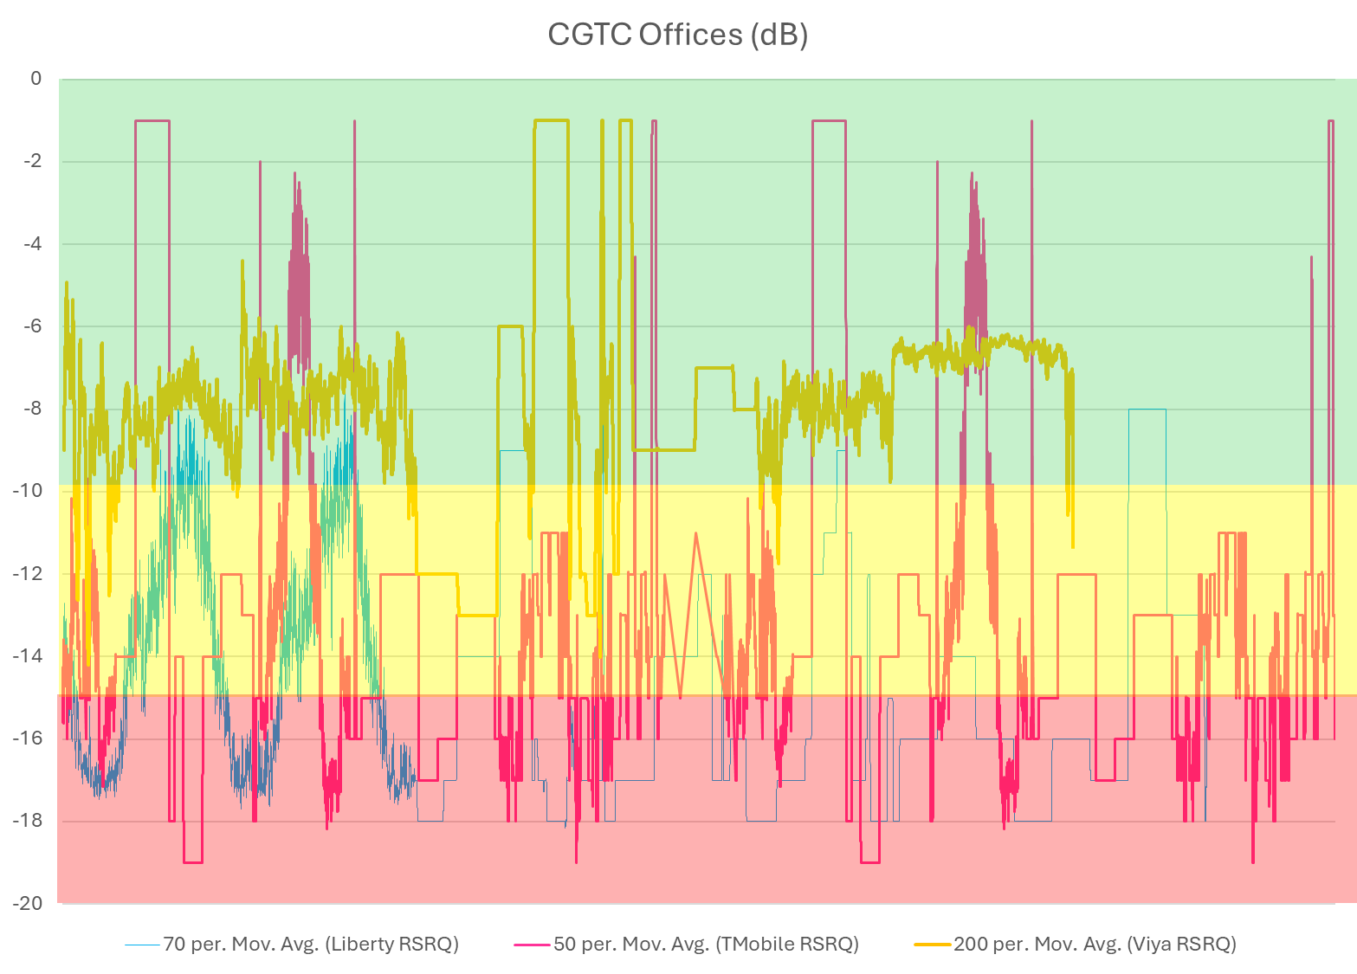
Results
This shows results measured at 1 location through time. The ranking observed through space is still valid. The oscillations show a lot of interference – calls can drop or quality goes down.

Slide 13
Summary
In 2023-2024 Viya seems to have better service than T-Mobile. AT&T/Liberty seems to have the least performing service.
Next steps:
  Impact of weather patterns
  Run the same route multiple times
  Acquire data in more isolated regions, repeatedly
  Investigate why calls routes to Puerto-Rico by looking at which antennas are within range

