Slide 1
Affordable housing strategy & Revitalization plan
REFRESH
Virgin Islands Housing Authority
St. Thomas/St. John
St. Croix

Slide 2
Agenda
Overview
Redevelopment Project Status
Strategic Approach
Williams Delight Homeownership
Future Vision
REFRESH

Slide 3
Overview
Post-Hurricane Challenges
Over $200 million in deferred capital improvements.
$240 million in additional damages from the 2017 storms.
Limited use of approved recovery funds, emphasizing the need for a refreshed strategy.
VIHA Portfolio Status
22 developments across 12 Asset Management Properties (AMPs).
2,426 units, adjusting to approximately 2,000 units due to demolitions and redevelopment.
Annual target of revitalizing or constructing 300 units.
REFRESH

Slide 4
Strategic Approach
2020 Strategy
10-year plan to replace aging infrastructure.
Revised Approach
Shortened to 3-4 years due to high construction & insurance costs.
Prioritizing FEMA funds for disaster-related damages.
Use of annual capital funds for deferred maintenance.
Exploring innovative financing (RAD & Mixed Finance).
REFRESH

Slide 5
Strategic Approach
Physical Improvements & FEMA Funding
Communities Impacted: Estate Bovoni Apartments, Oswald Harris Court, Paul M. Pearson Gardens, H. H. Bergs Home & Additions, Lucinda Millin Home, Michael J. Kirwan Terrace, Knolls at Contant, Joseph E. James Terrace, Mount Pleasant, Marley Homes & Additions and the partial redevelopment of John F. Kennedy Terrace
Improvement Focus: Roofs, exterior doors/windows, and painting.
FEMA Funding: $100 - $120 million allocated.
HUD Capital Fund Program Projects
Capital Fund Renovations: Aureo Diaz Heights & Candido Guadalupe Terrace
CDBG-MIT Applications: Alphonso "Piggy" Gerard and Stoney Ground.
Partial demolition of John F. Kennedy Terrace, new units to be developed at Ludvig Harrigan Court, Nicasio Nico Apartments, and Land Swap parcels for Ralph deChabert Place.
REFRESH

Slide 6
Redevelopment Project Status
Walter I. M. Hodge Pavilion
Units: 248
9% LIHTC
Developer: MDG
Status: Completion 2024
Hamilton Project
Units: 106
4%/9% LIHTC
Developer: MDG
Status: Financial Closing in 2024
Completion: 2026
Estate Donoe (Tutu I)
Units: 84 (Family)
9% LIHTC
Developer: Pennrose
Financial Closing: 2025
Completion: 2027
Estate Tutu North Senior (Tutu II)
Units: 60 (Senior)
4% LIHTC
Developer: Pennrose
Financial Closing: 2025
REFRESH
John F. Kennedy (JFK) Partial Demolition & Redevelopment
Status: Section 18 application to be submitted in 2025
Development Plan: 100-unit building to be pursued by VIHA self-development with 4% tax credits
Alphonso Piggy Gerard Revitalization
Status: Predevelopment
Development Plan: 26-unit rehab to be pursued by VIHA self-development with CDBG-MIT funds.
Stoney Ground Redevelopment
Units: 98 (Senior)
Developer: TBD
Development Plan: New construction

Slide 7
Willams Delight Homeownership
Key Statistics
Homeowners: 44 families have purchased homes
In-Progress Sales: 7 families closed, 5 families working towards closing
Down Payments: 35 families made payments for homeownership
Future Opportunities: 54 residents still have the chance to purchase homes
Funding Support
ARPA Fund Allocation: $300,000 for financial assistance ($15,000 per household).
Awarded Families: 20 families have received assistance, with continued support through 2025-2026.
REFRESH

Slide 8
Future Vision- Refresh
Key Focus Areas
Infrastructure renewal and revitalization.
Increasing affordable housing availability through redevelopment and new units.
Enhancing community resilience and livability across the Territory.
Meeting the growing demand for safe, quality housing for families.
Funding Support
Continuing redevelopment efforts, improving living conditions, and addressing urgent housing needs.
Collaboration with local and federal partners to support sustainable progress and meet long-term goals of affordable housing availability.
REFRESH

Slide 9
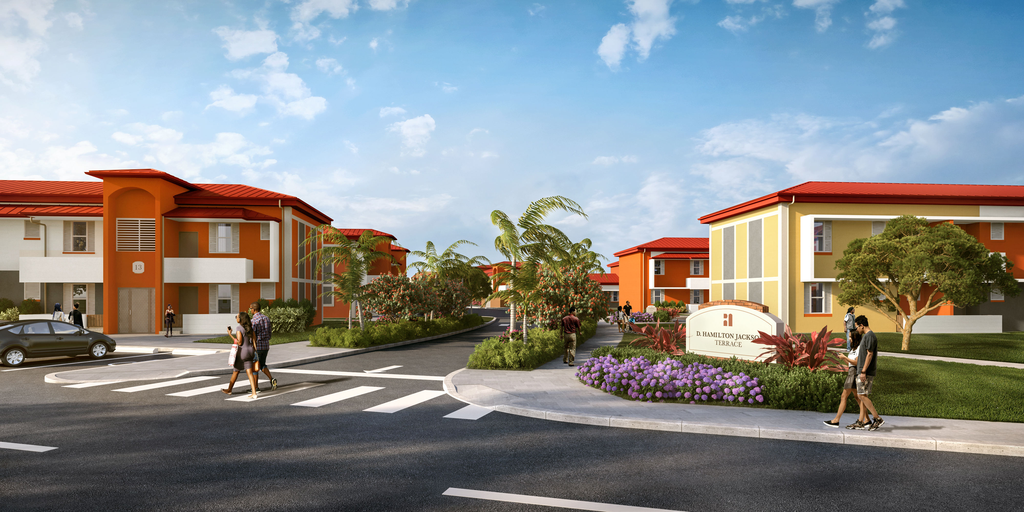
THANK YOU

