Slide 1
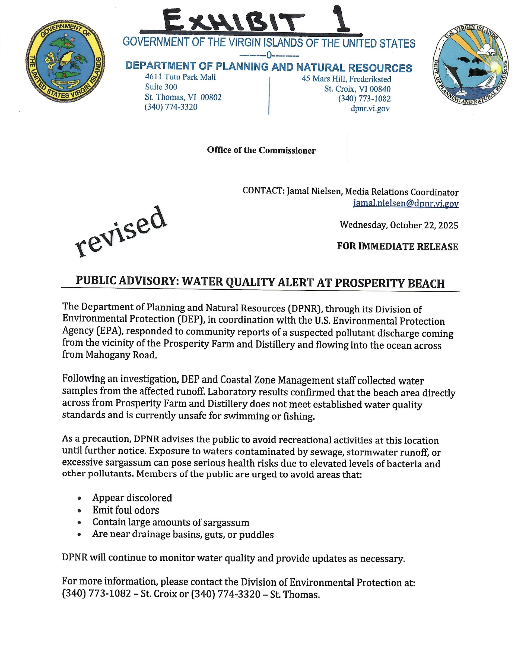

Slide 2
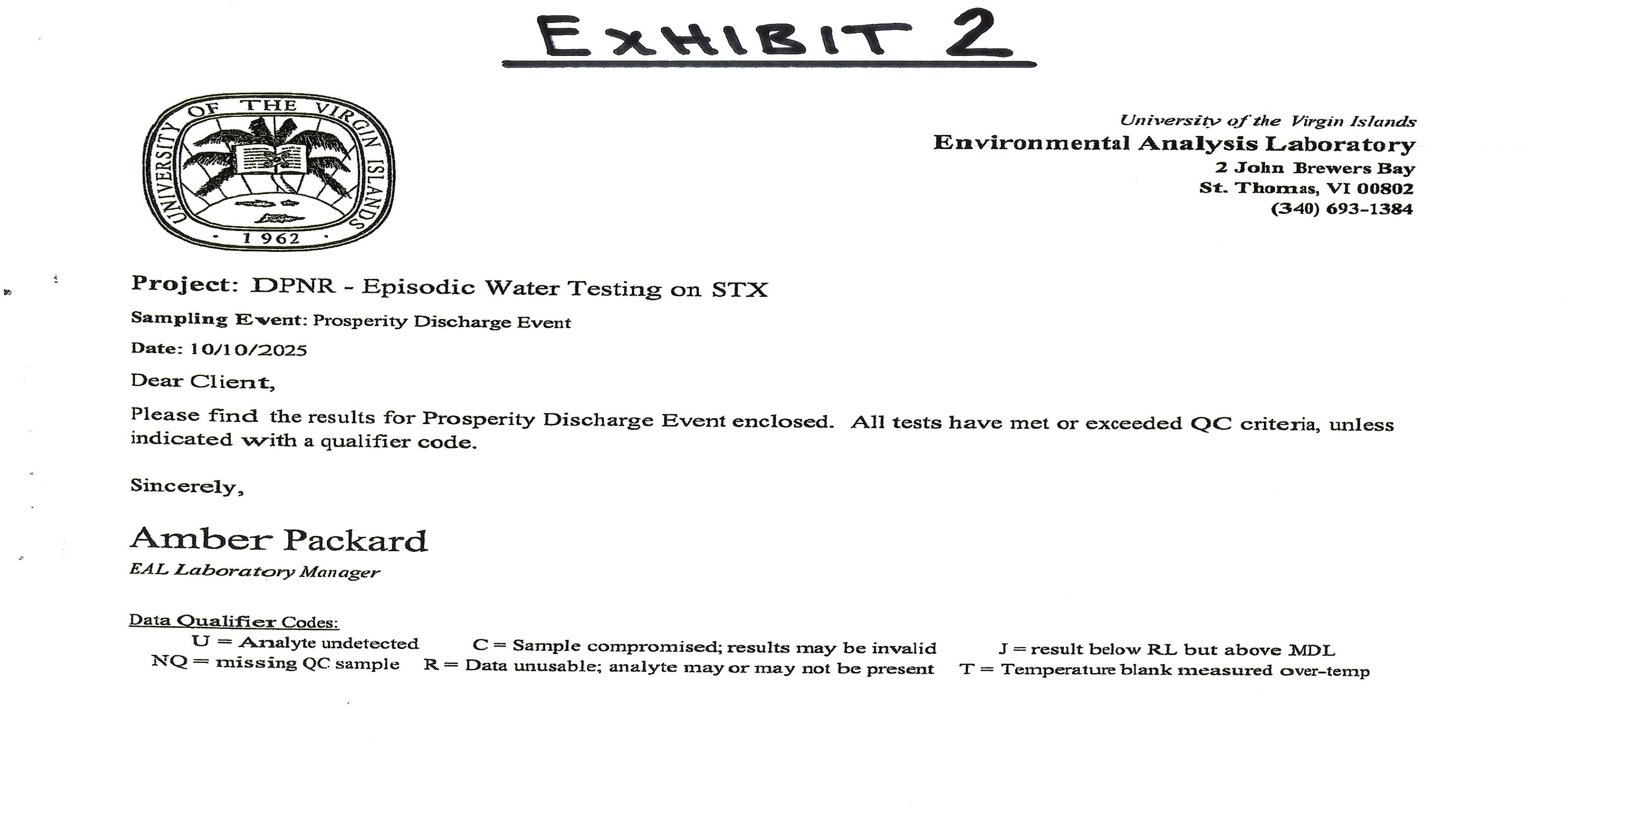

Slide 3
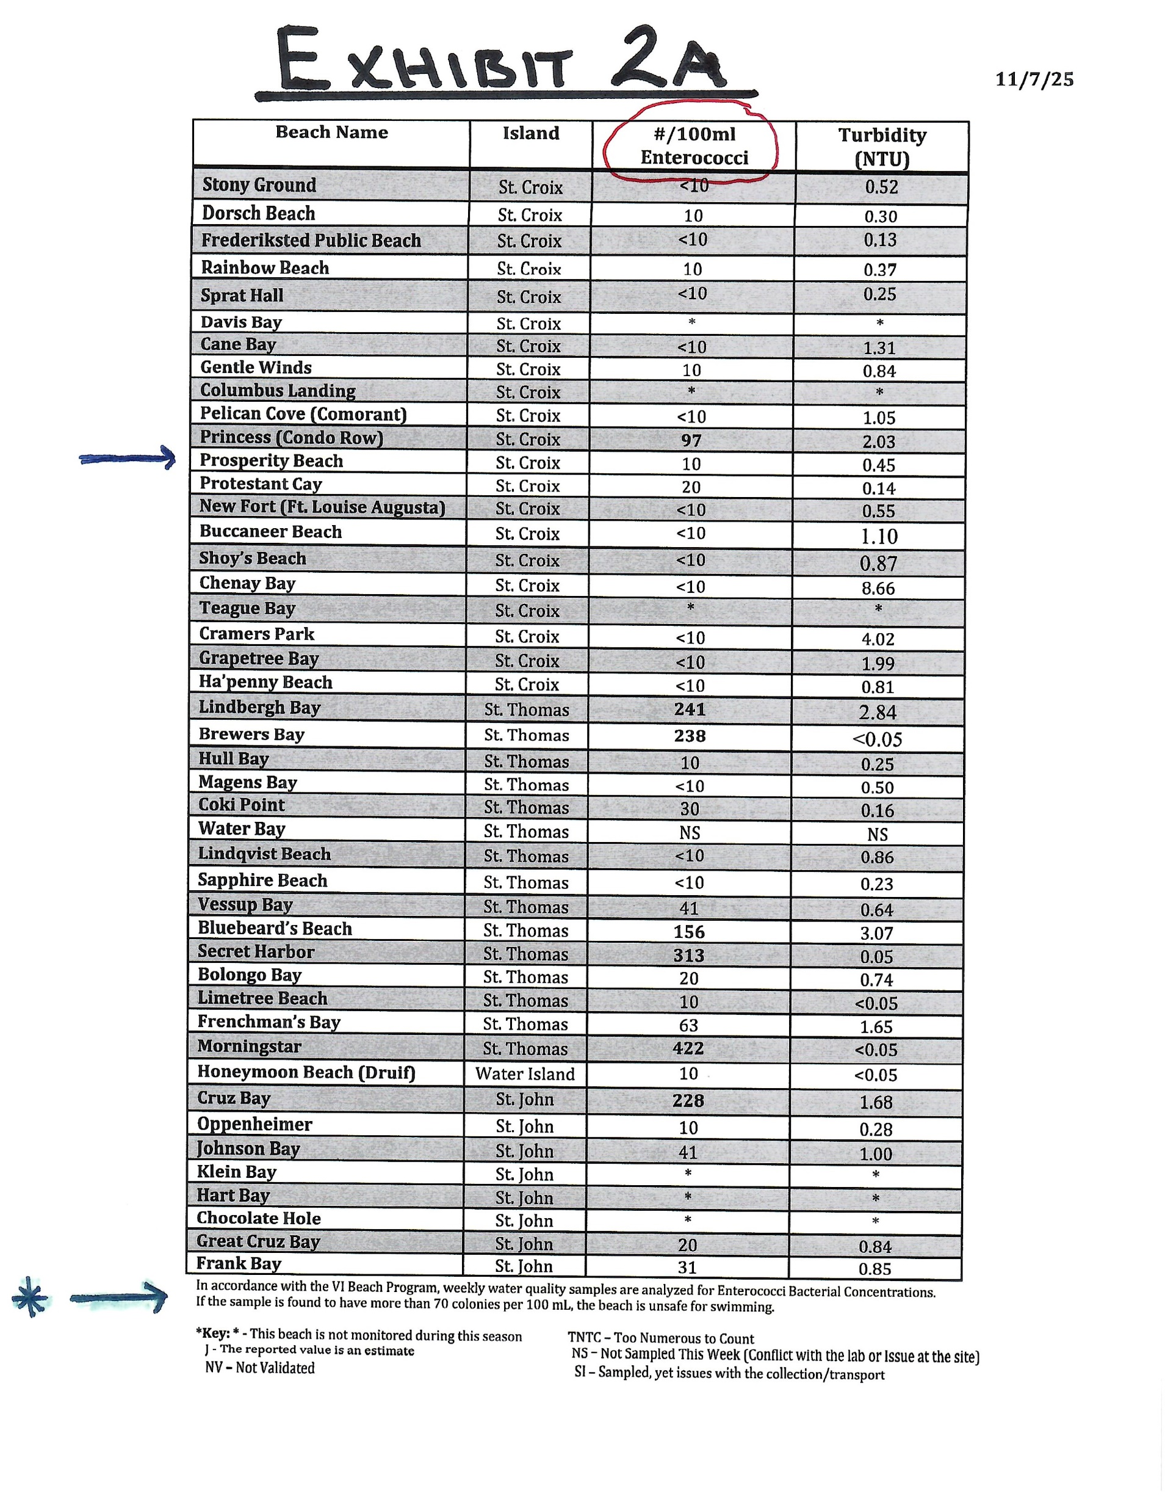

Slide 4
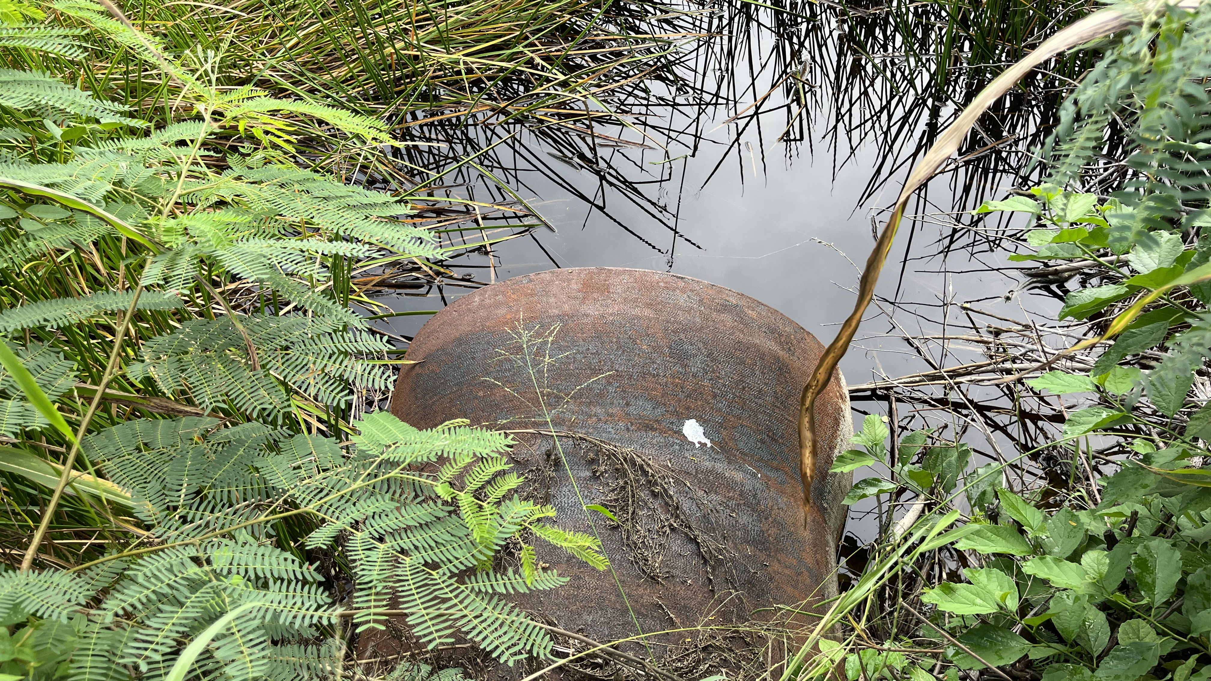
EXHIBIT 3 Inlet on Farm Feb 3

Slide 5
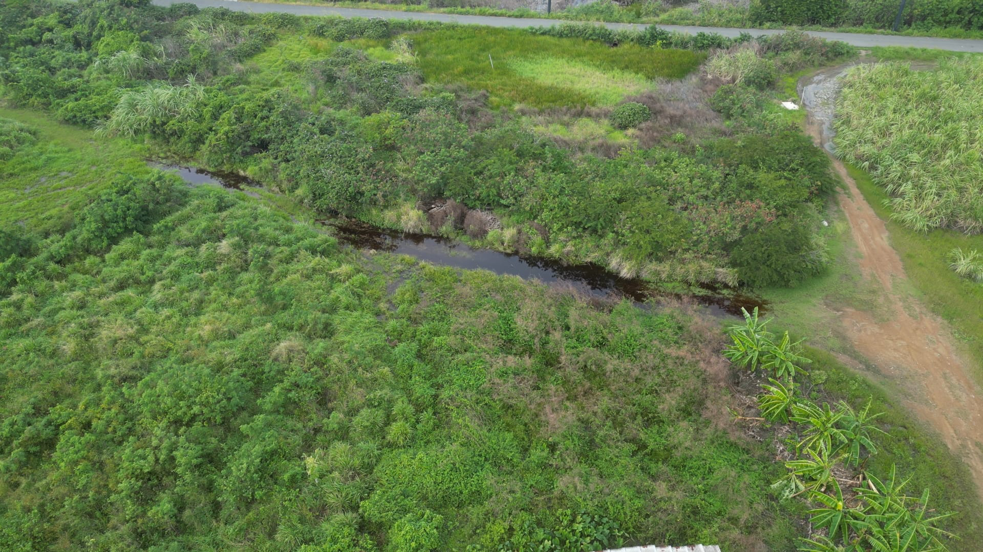
EXHIBIT 3-A Main Discharge Point

Slide 6
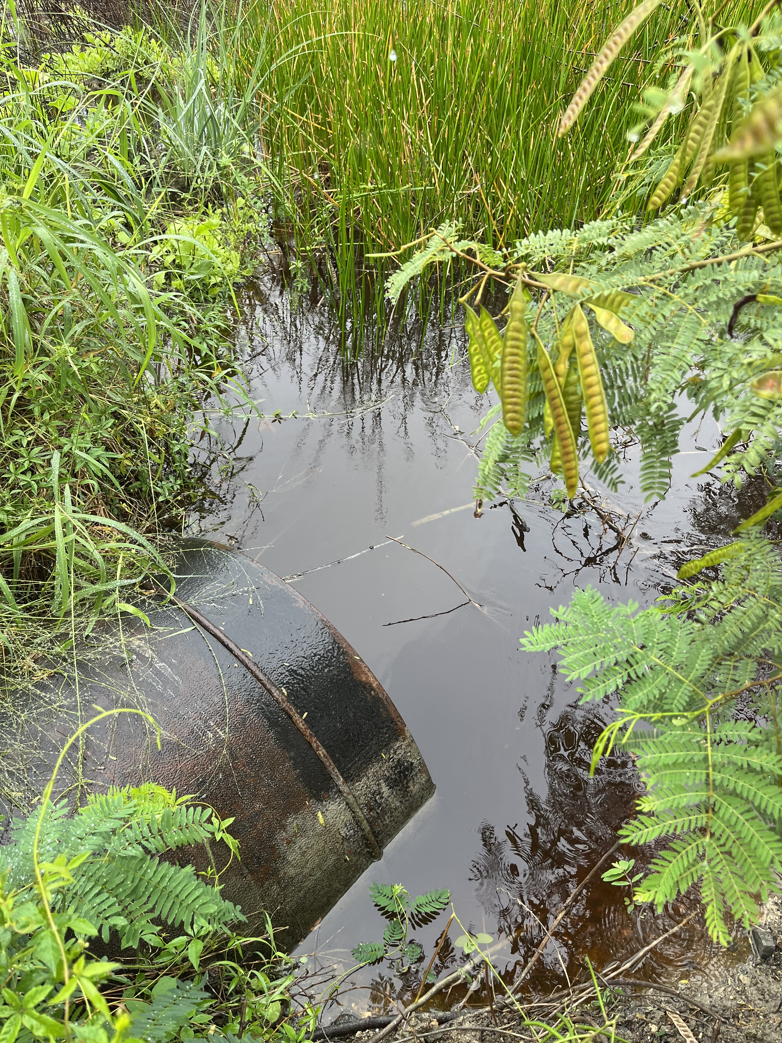
EXHIBIT 4 Outlet on Farm Feb 3 (2)

Slide 7
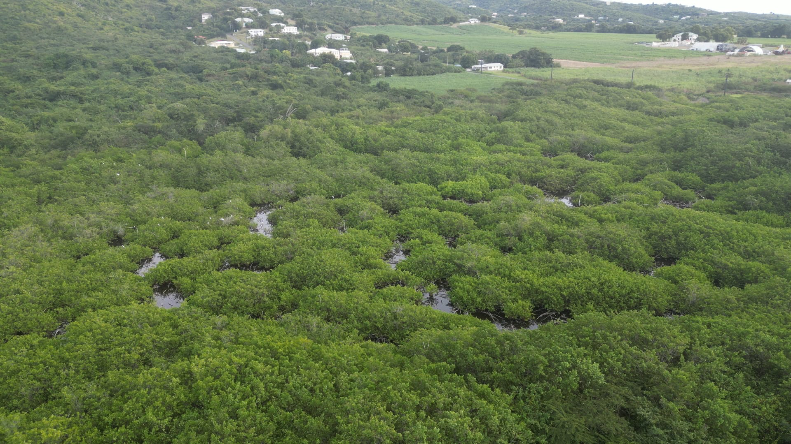
EXHIBIT 5 Adjacent Property Discharge

Slide 8
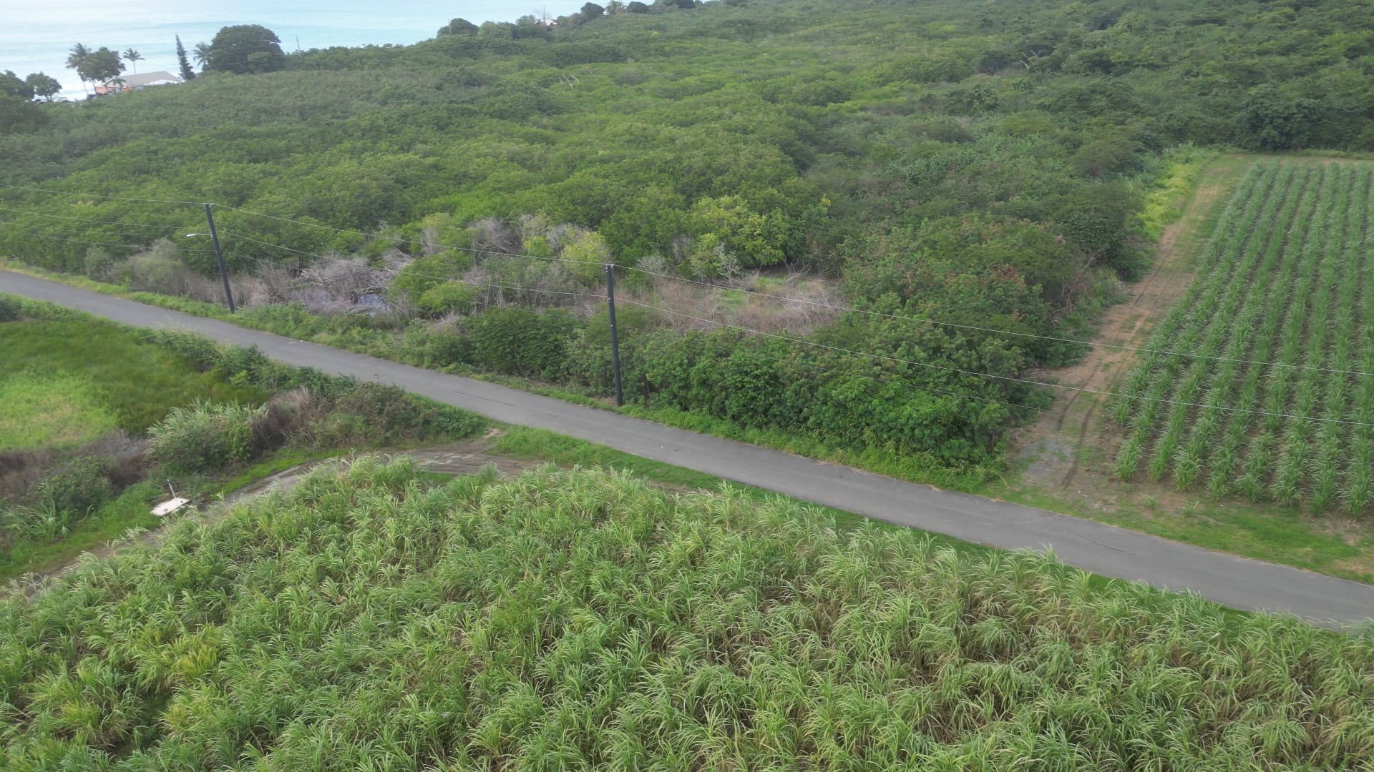
EXHIBIT 6 Discharge Under Road

Slide 9
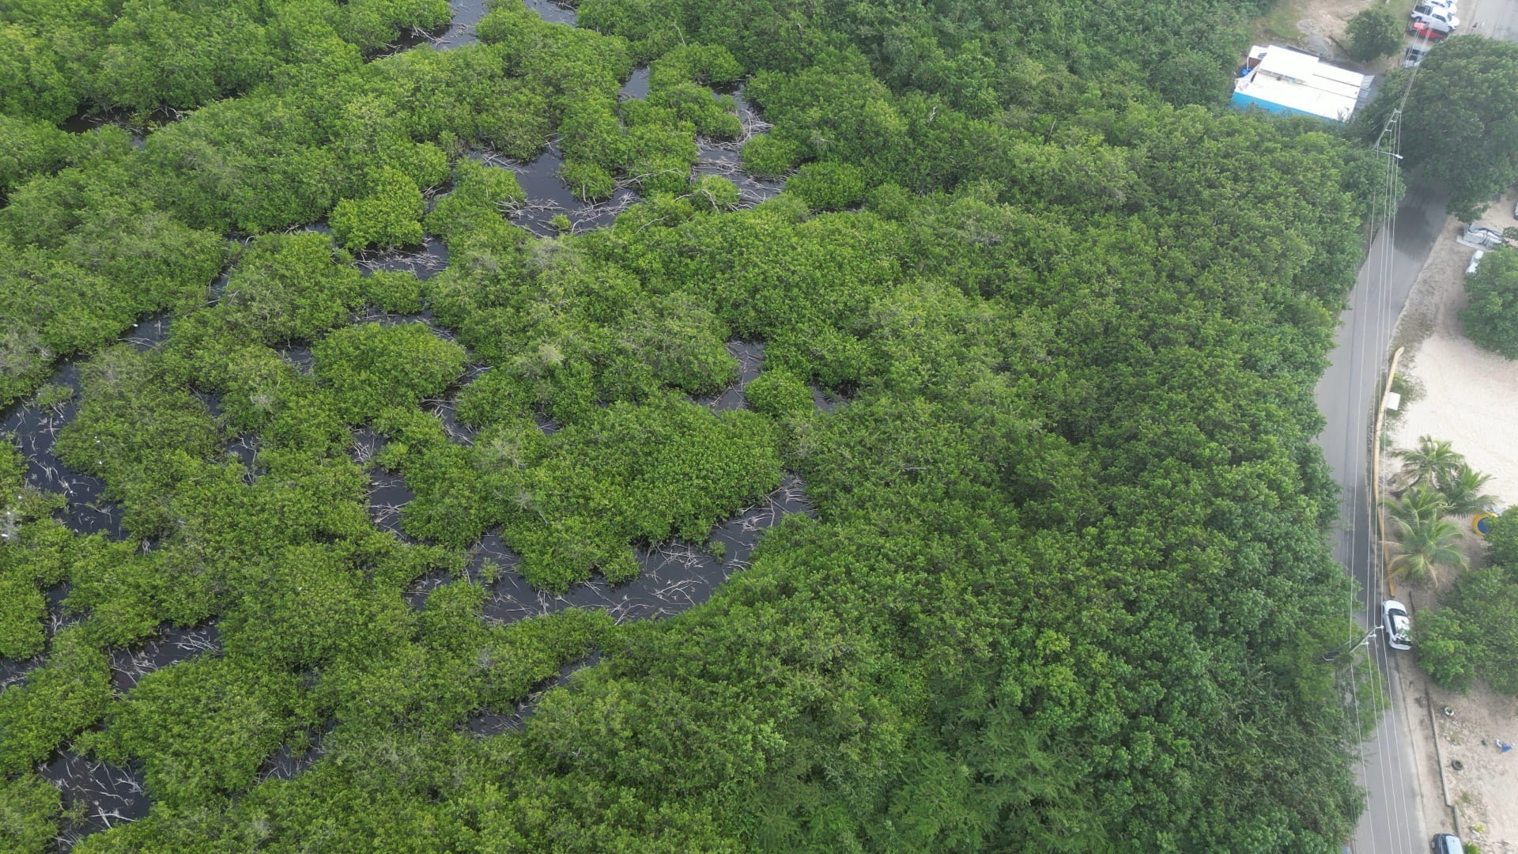
EXHIBIT 6-A Rainbow Beach

Slide 10
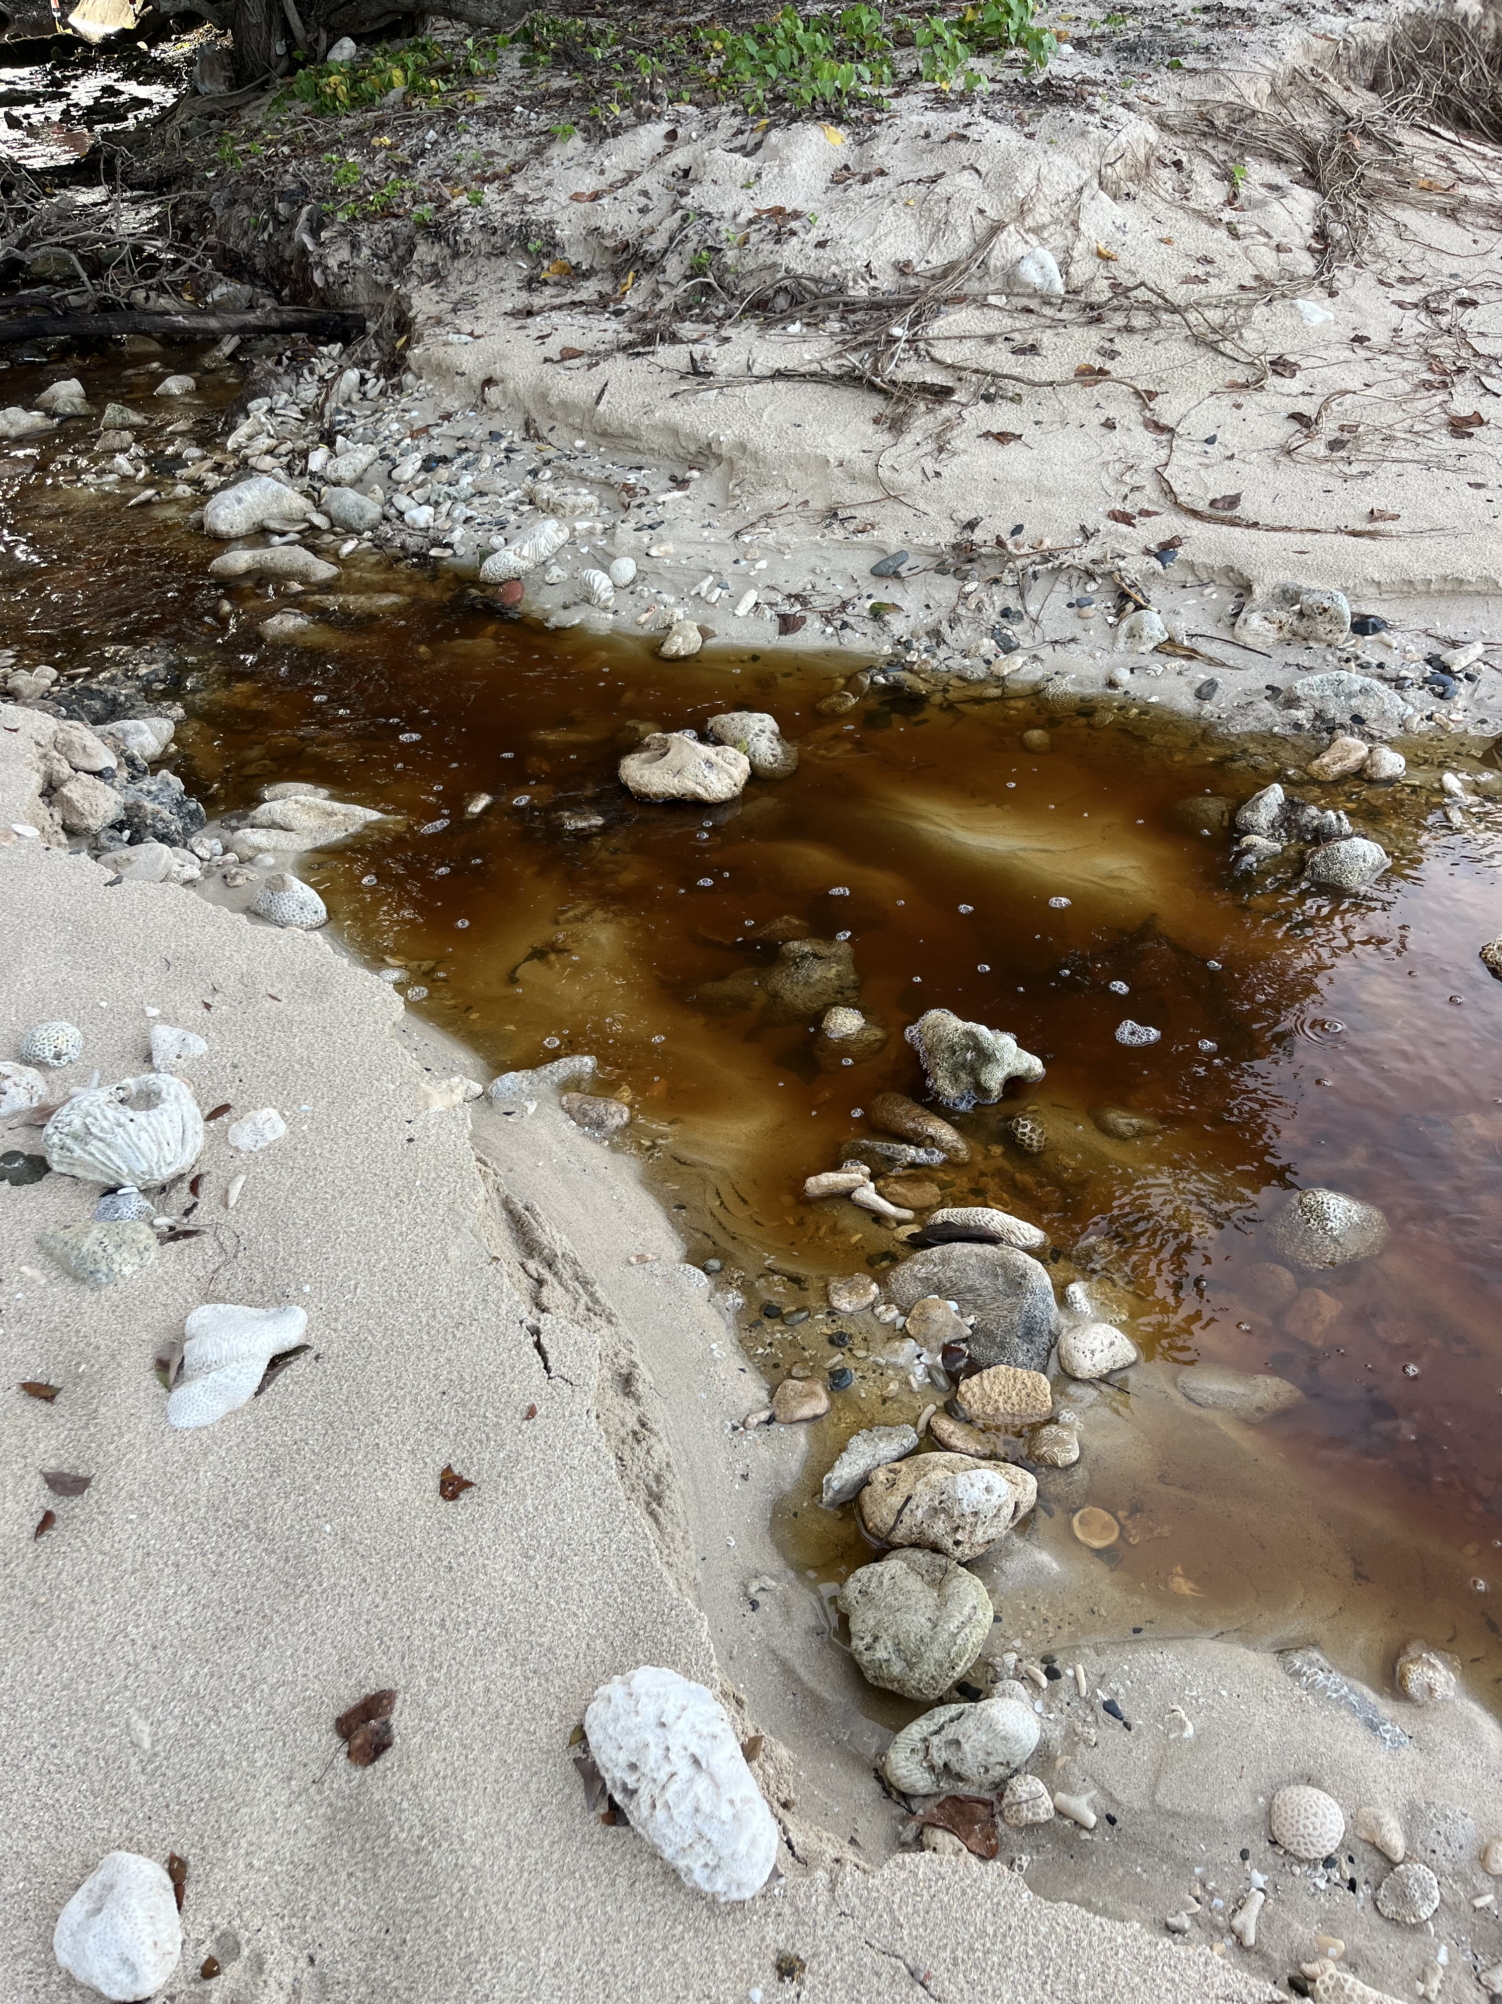
EXHIBIT 7-A Oct 10-2 (1)

Slide 11
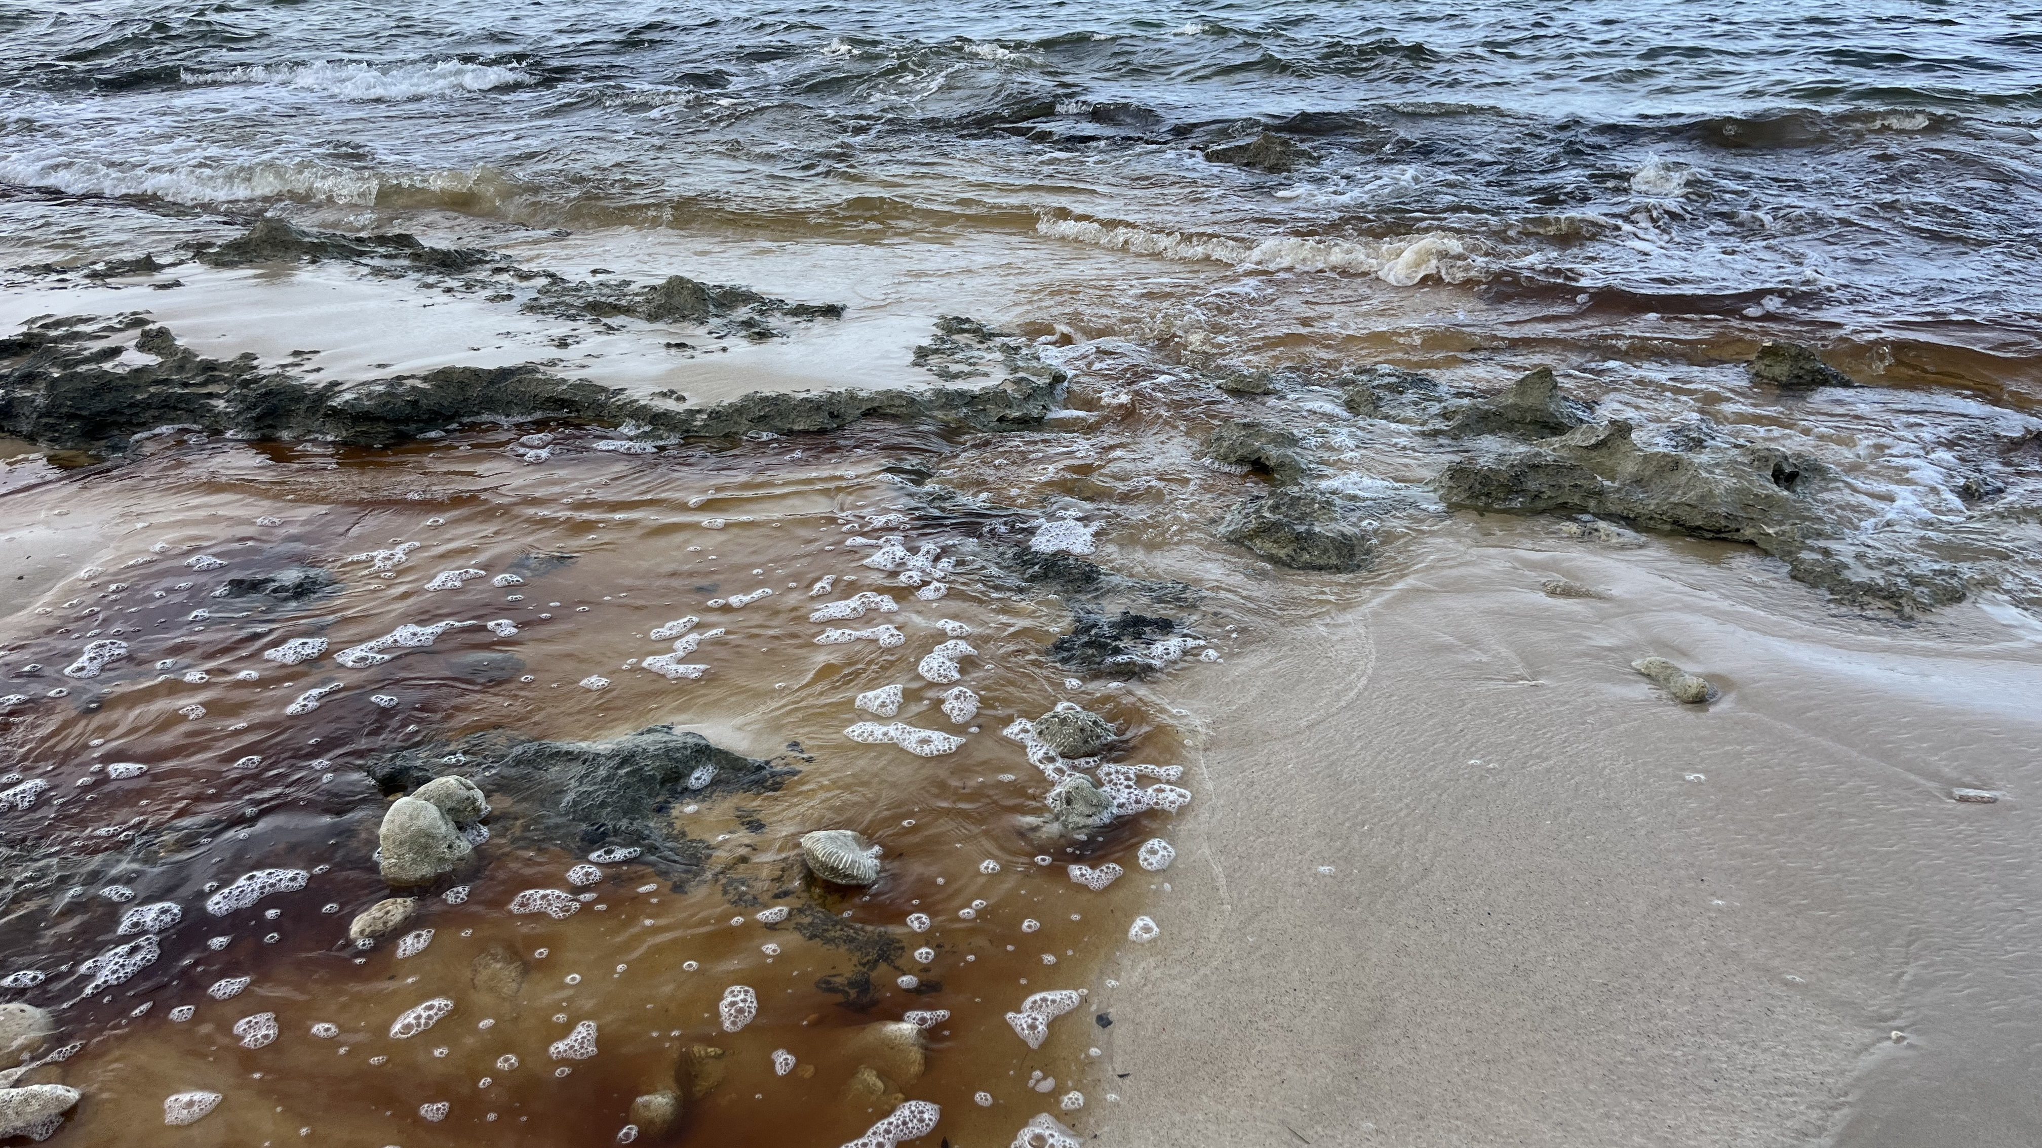
EXHIBIT 7-B Oct 10-2 (2)

Slide 12
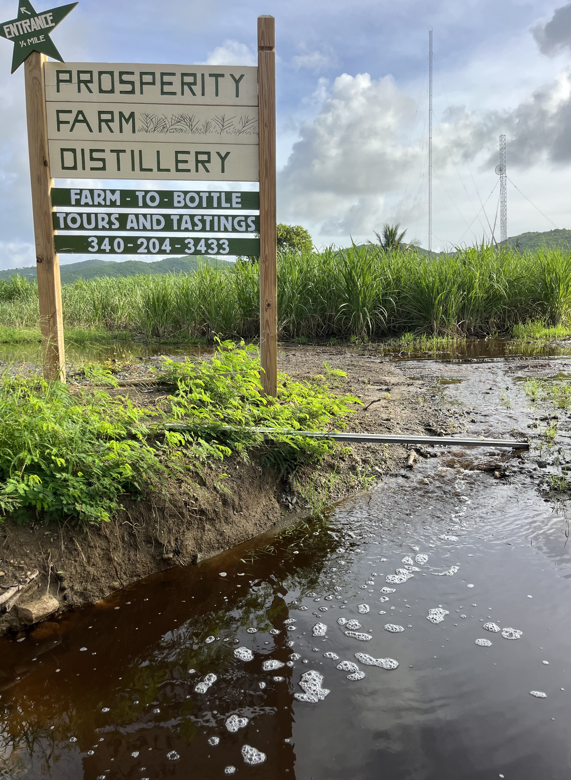
EXHIBIT 7-C Oct 10-2 (3)

Slide 13
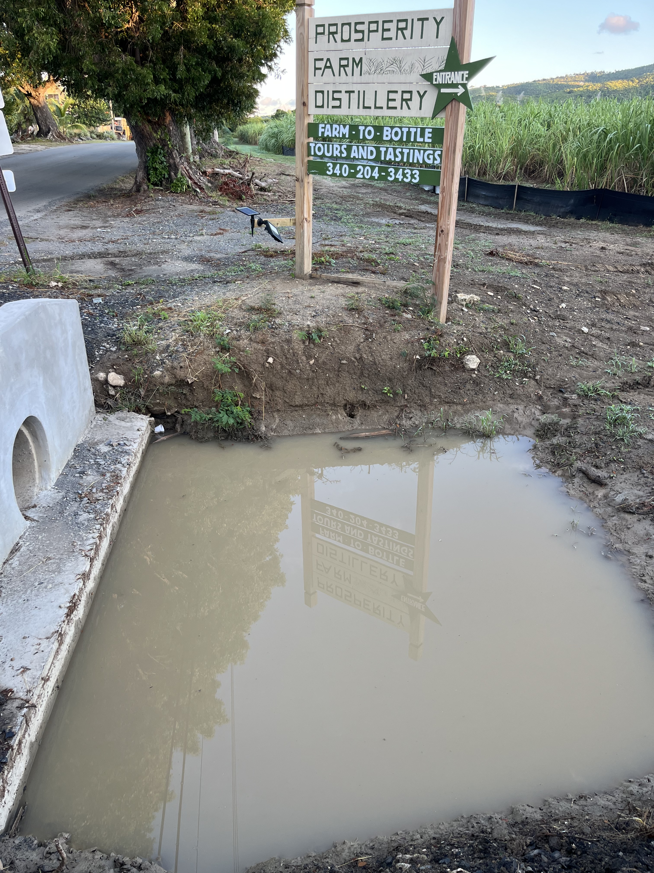
EXHIBIT 8 Regular Runoff

Slide 14
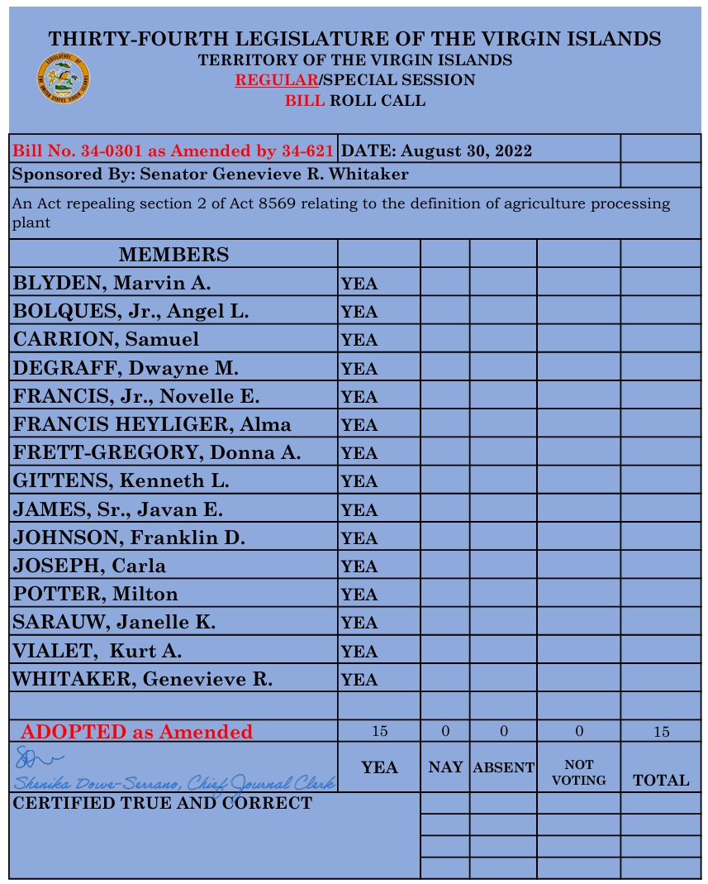
EXHIBIT 9 Repeal Roll Call

Slide 15
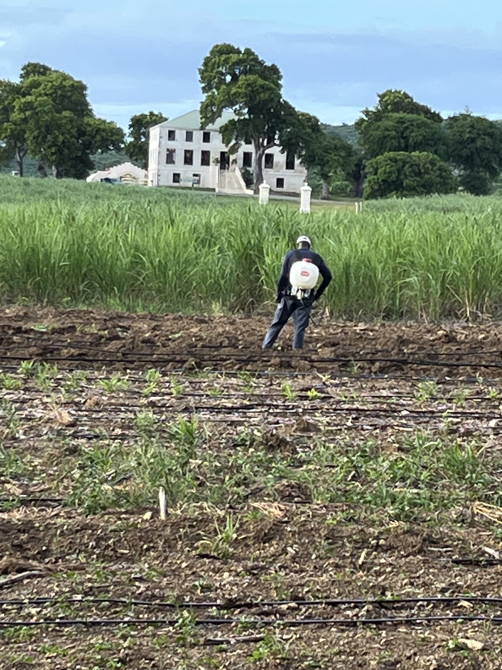
EXHIBIT 9-A Spray small

Slide 16
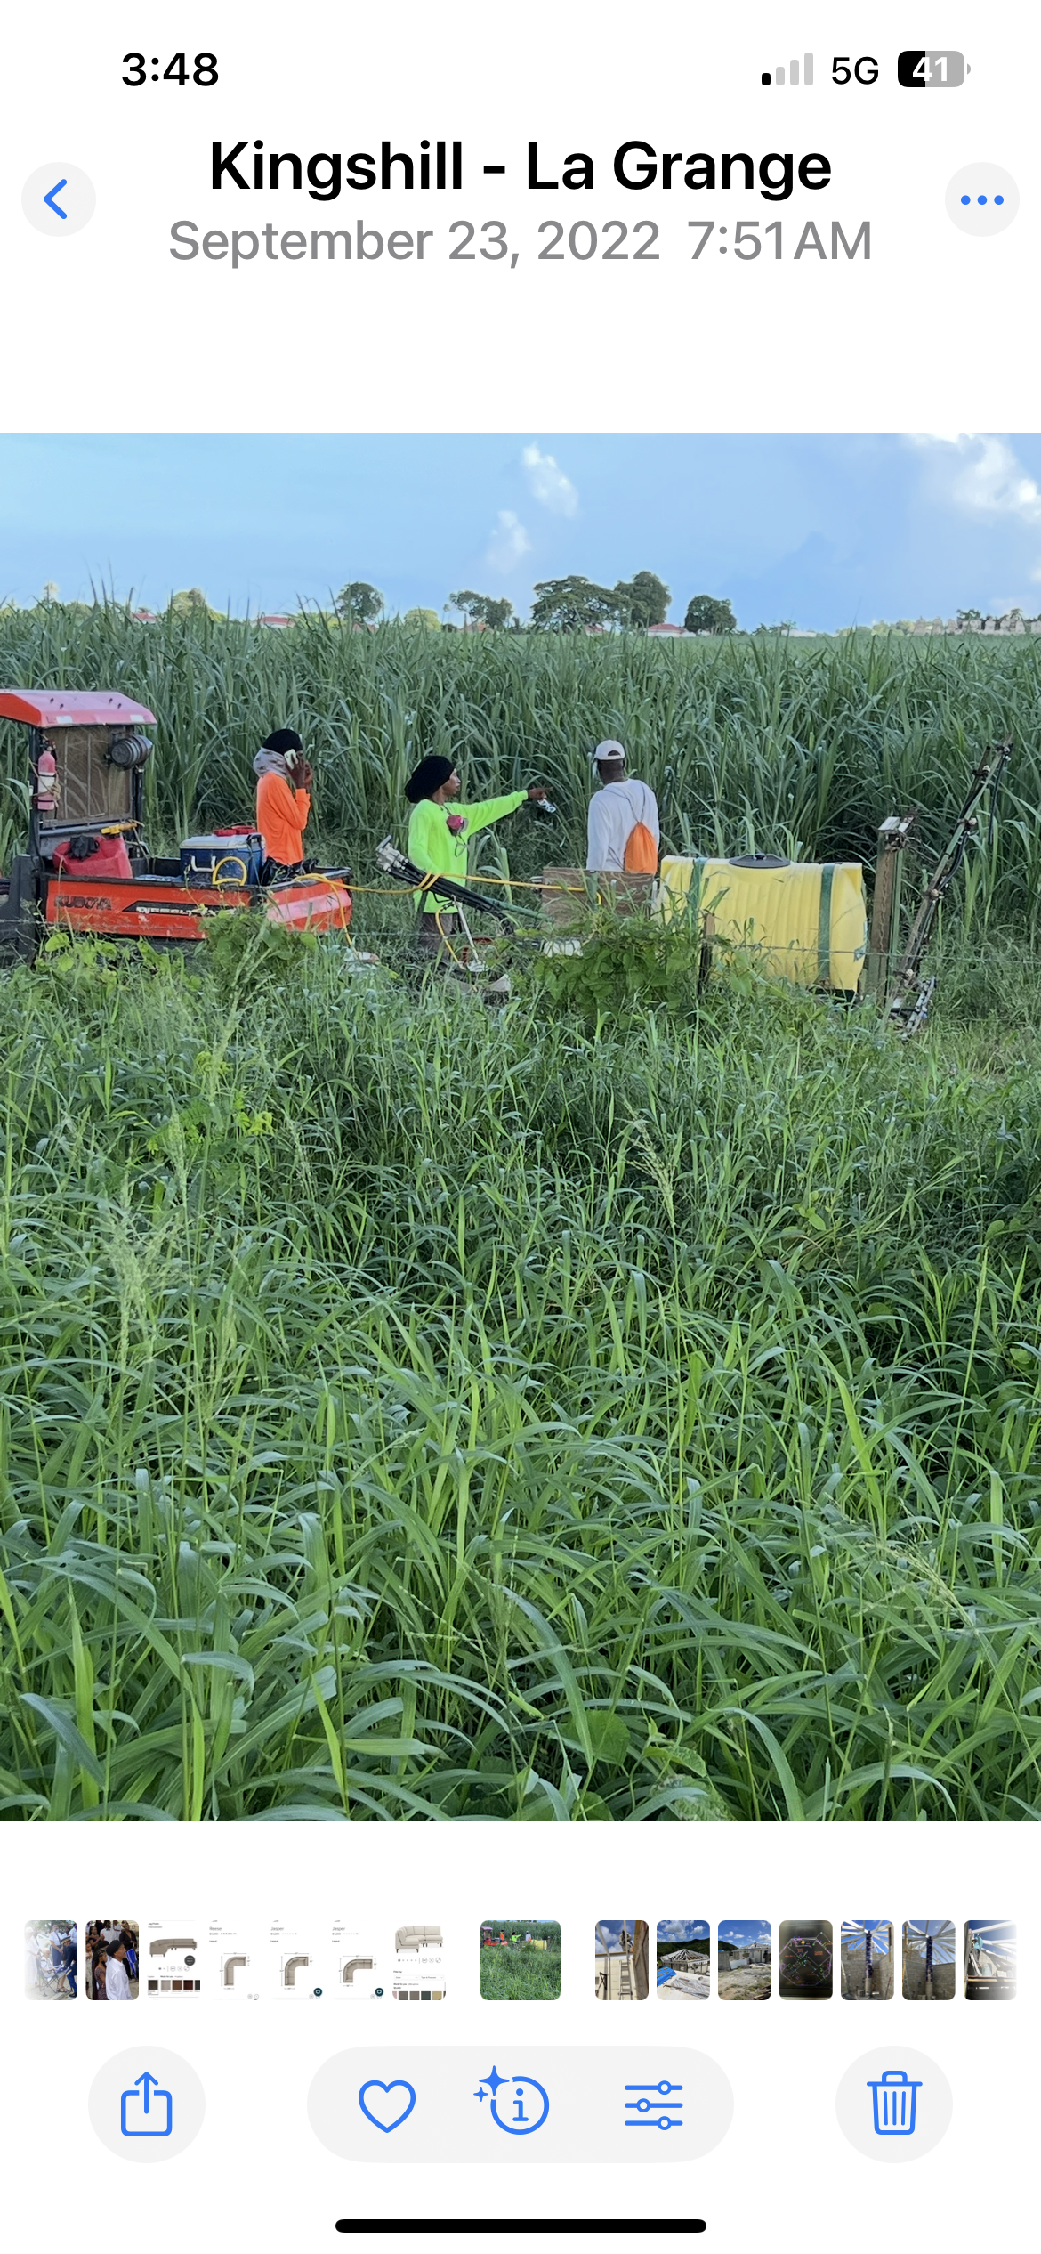
EXHIBIT 9-B Spray large

Slide 17
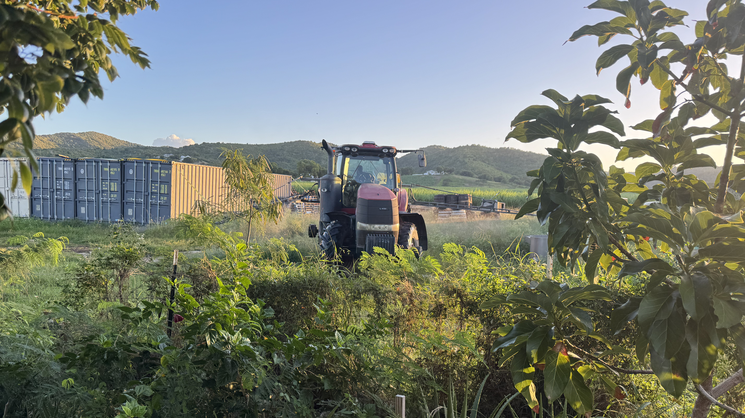
EXHIBIT 9-C

Slide 18
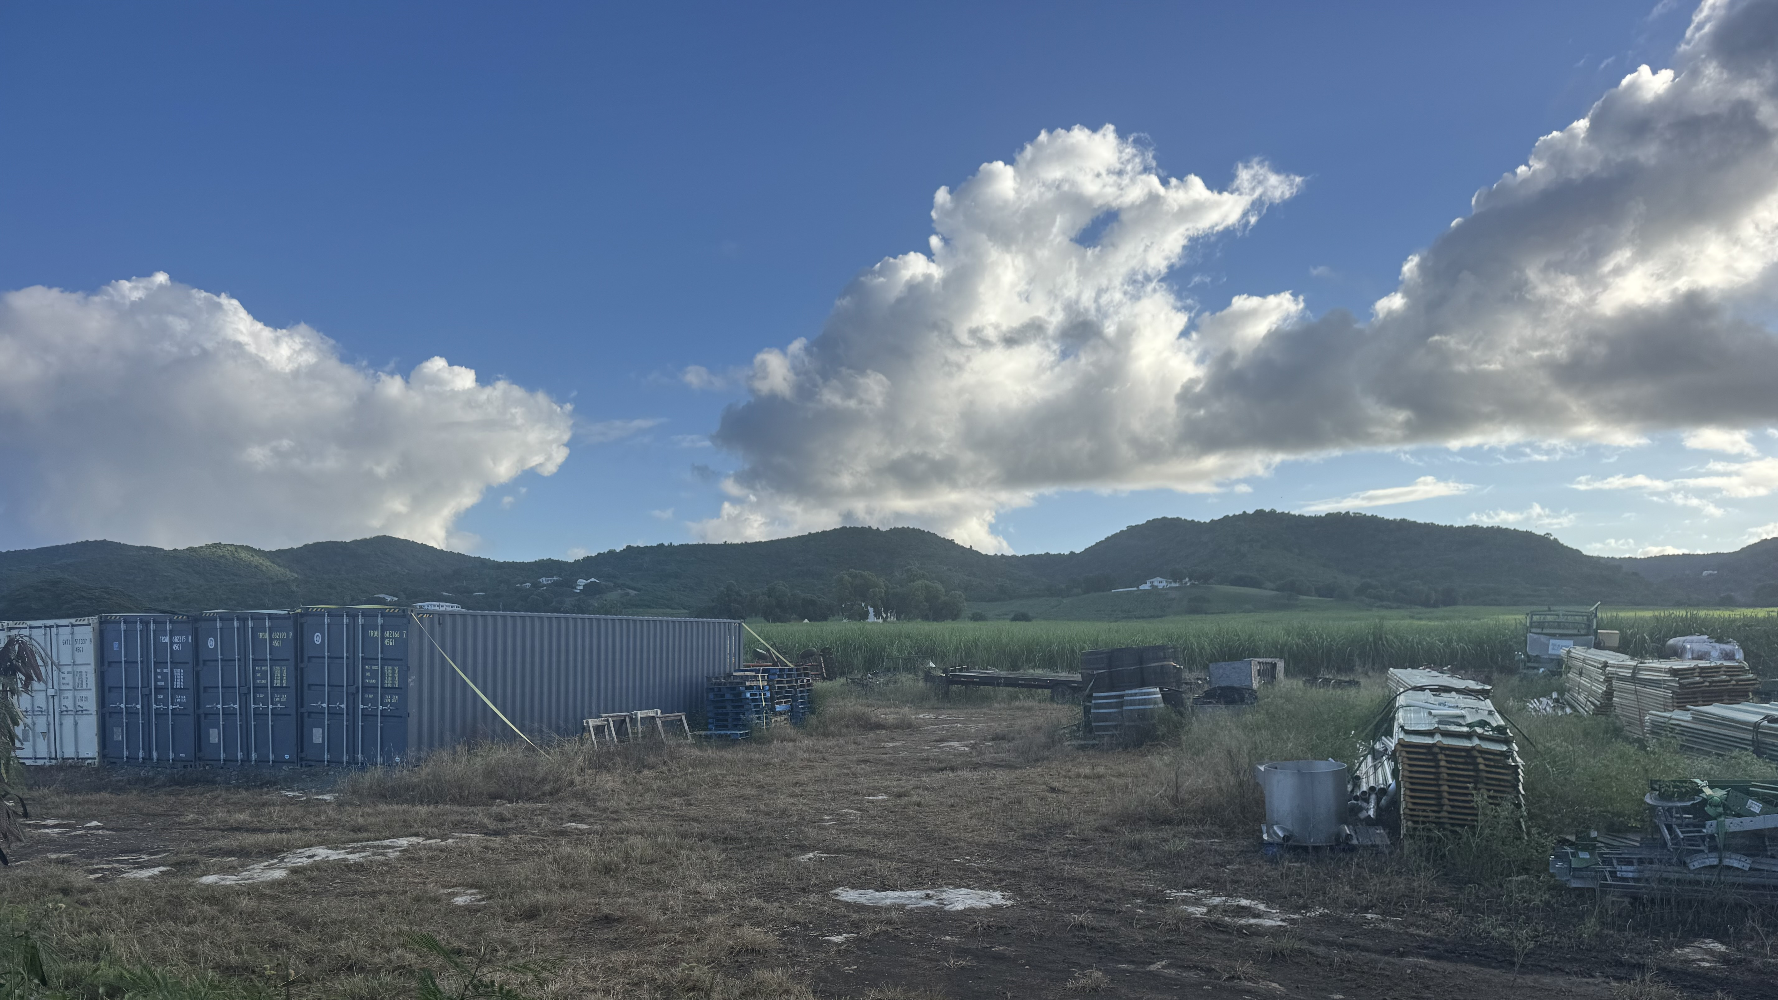
EXHIBIT 9-D

