Slide 1
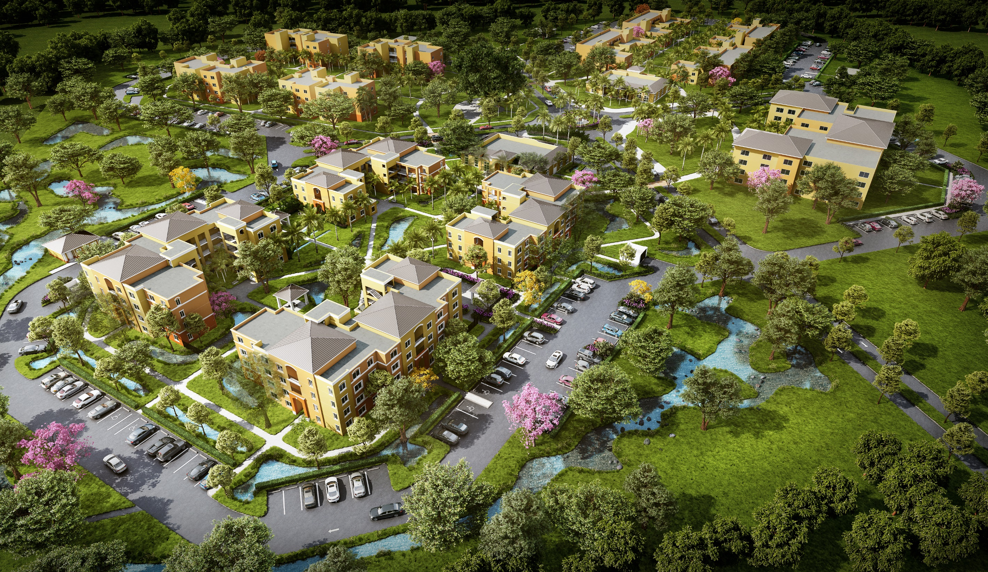




VIHA REDEVELOPMENT PLAN
2023-2024 Update
"Partners in Progress"

Slide 2
PARTNERSHIP GOALS
Vision
• Establish a Multi-Year Portfolio Repositioning Strategy that calls for the Rehabilitation and/or New Construction of 3,000 +/- Residential Units at a Cost of Approximately $2 Billion
Implement
• In coordination with the Government of the Virgin Islands, Implement the Identified Priority Projects for 2023 and 2024
Utilize
• Utilize 4% Credits with Tax Exempt Bonds and 9% Equity Derived from the Syndication of Low-Income Housing Tax Credits (LIHTC) as a Key Component of our Financing Strategy
Create
• Creating Opportunities to Improve the Quality of Life for our Residence Through our BrightPath Initiative
• Creating improved Mixed-Income, Mixed-Use Communities at Oswald Harris and Marley/Harrigan

Slide 3
Table of Contents
Active Projects Update
Walter I.M. Hodge Revitalization
Estate Donoe Redevelopment (“Tutu Phase I”)
Tutu North Phase I Redevelopment (“Senior”)
2023 - 2024 Replacement Housing
D. Hamilton Jackson and Alphonso Gerard Place Revitalization
Tutu North Phase I and Phase II Redevelopment (Family)
Stony Ground Phase I “Wilford Pedro” Development
Oswald Harris Court Senior Redevelopment (Lucinda Millin)
Special Initiatives – Mixed-Income, Mixed-Use
Oswald Harris Court Redevelopment
Williams Delight Villas Homeownership
Marley Homes and Additions / Ludvig Harrigan Redevelopment

Slide 4
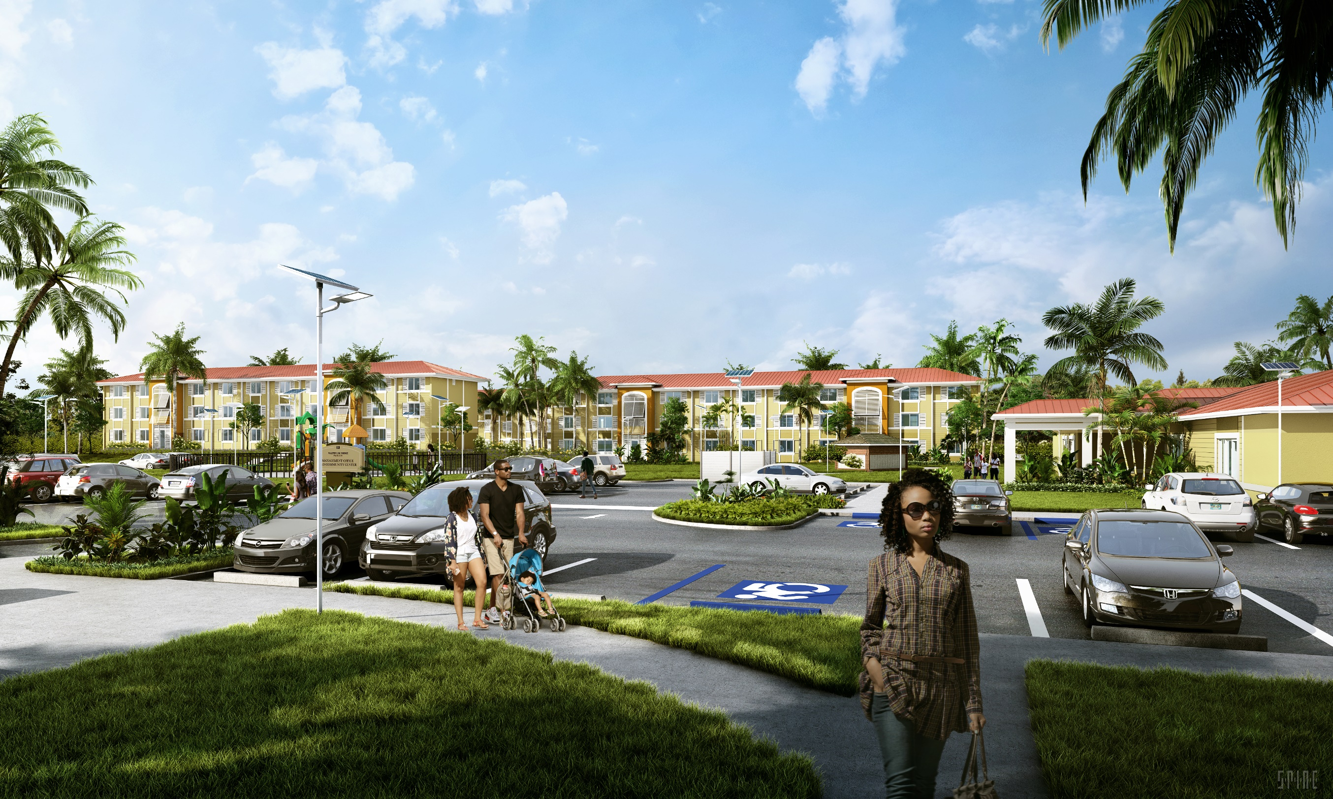
Walter I.M. Hodge
Revitalization | 248 Units | 9% | TDC $116.1M | Equity $44.4M | FEMA $49.1M | CDBG-DR $22.6M | Closed June 2022

Slide 5
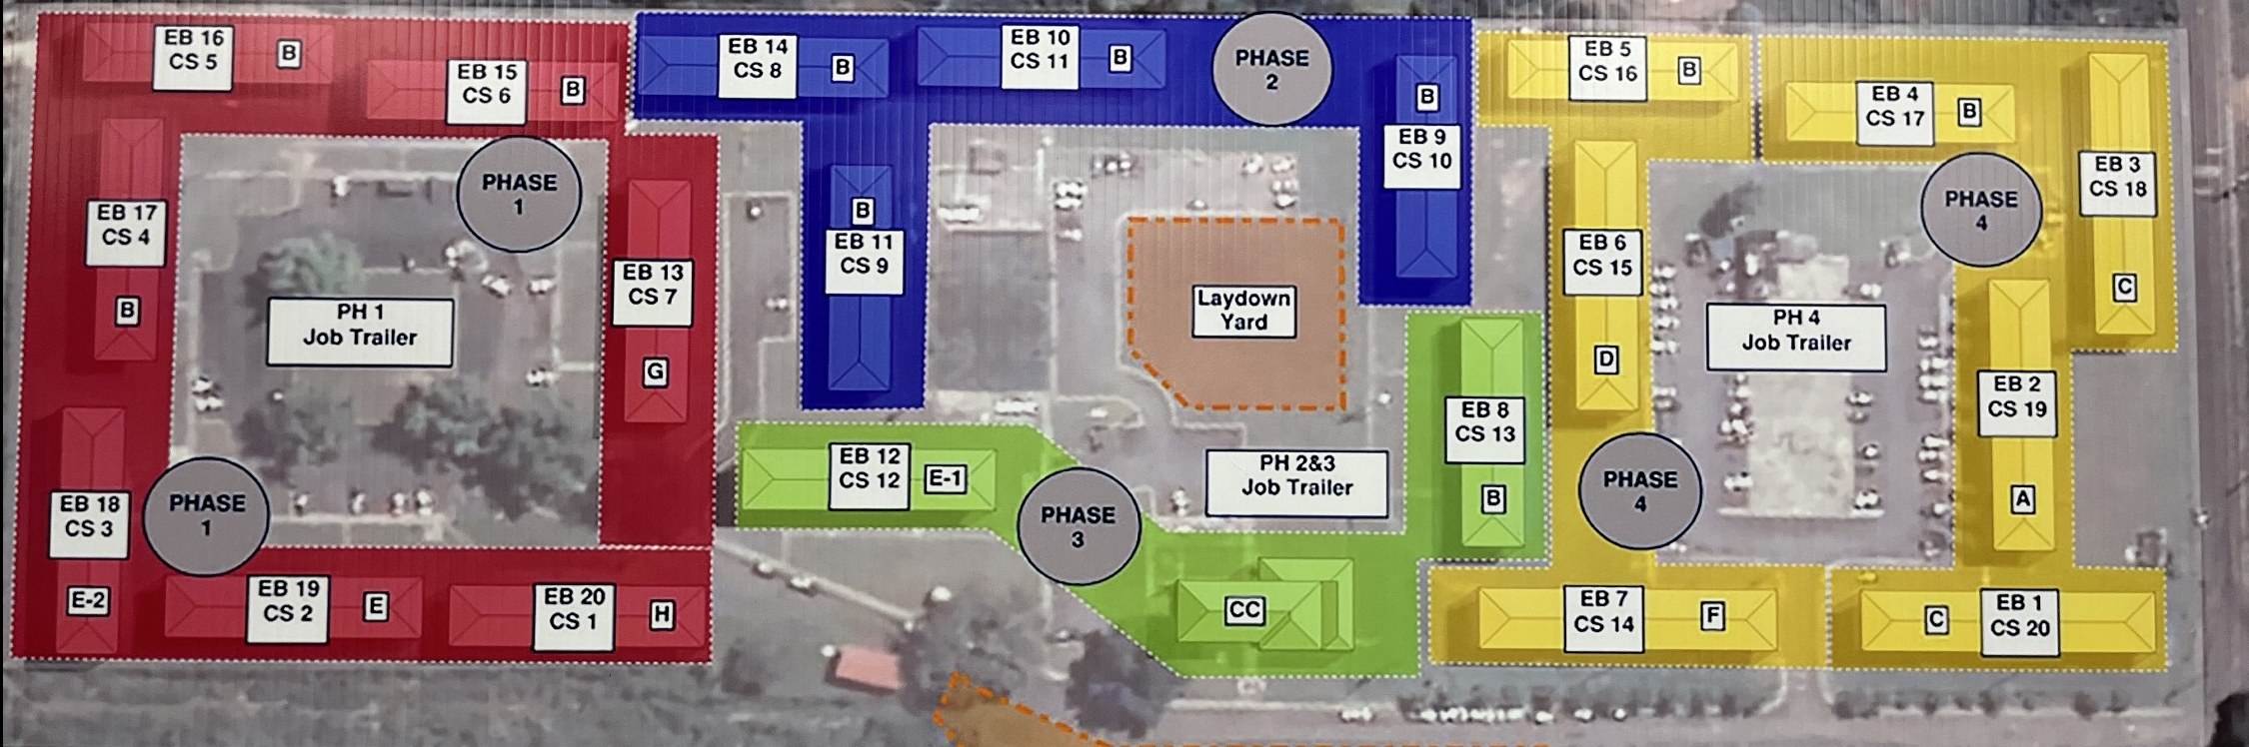
Walter I.M. Hodge Revitalization
Current Status:
Site divided into Four Phases
Completion - July 2024
Phase I Ribbon Cutting – September 2023
Phase I – 82 Units | Phase II – 48 Units | Phase III – 22 Units | Phase IV – 96 Units

Slide 6
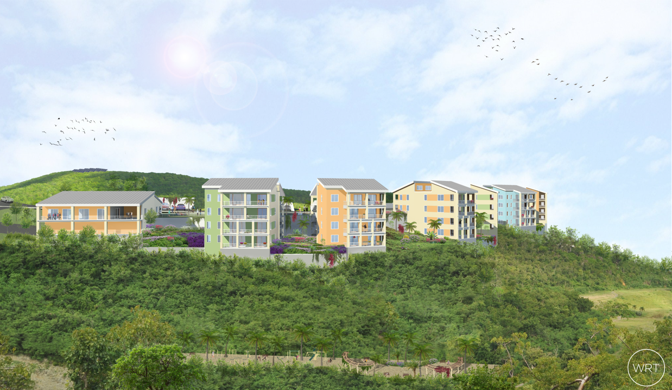
Estate Donoe (“Tutu Phase I”)
Redevelopment | 84 Units | 9% | TDC $102M | Equity $32M | FEMA NA | CDBG-DR $47M (T1) $23M (T2) | Q2 2023

Slide 7
Estate Donoe Redevelopment (“Tutu Phase I”)
Current Status:
Environmental Mitigation In-Progress
General Contractor’s Bid Responses are Due - March 2023
Onsite Construction Projected to Restart Q2 2023
Challenges:
Increased Construction Pricing – Resulting in Potential Increase of $30M
Increased Need for Additional CDBG-DR Funds in the Amount of $23M
Opportunities:
Expedite New Workforce Housing on St. Thomas

Slide 8
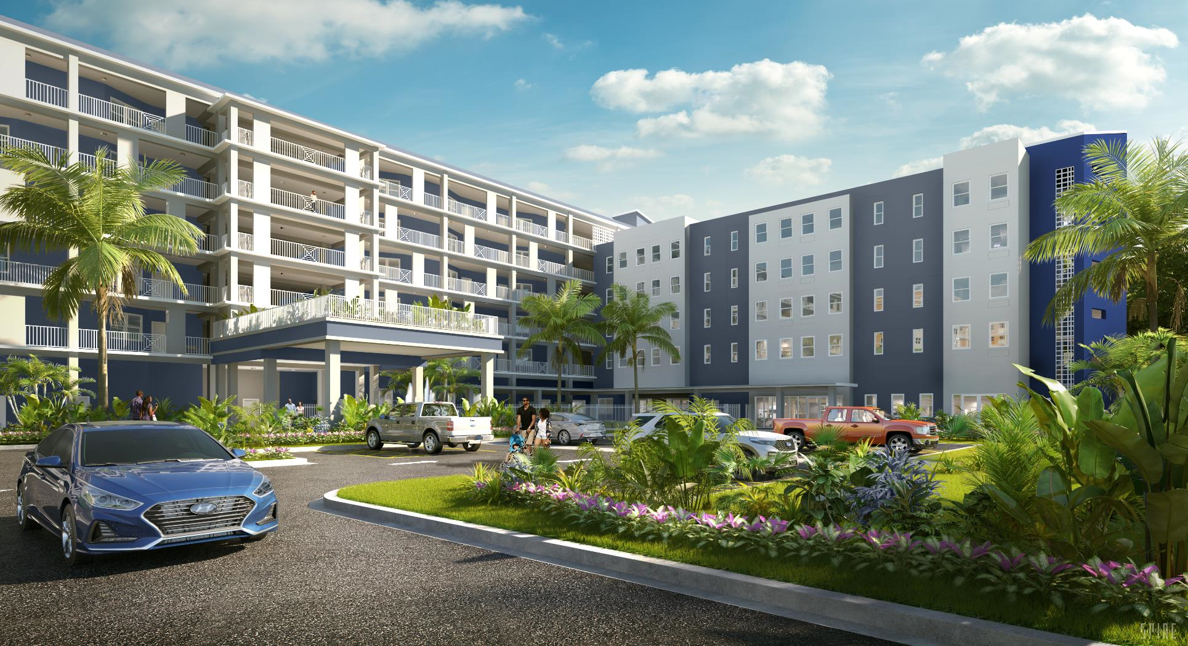
Tutu North Phase I (“Senior”)
Redevelopment | 60 Units | 9% | TDC $88.5M | Equity $29M | FEMA $59.5M | CDBG-DR NA | Closing Dec 2023

Slide 9
Tutu North Phase I Redevelopment (“Senior”)
Current Status:
LIHTC Application Submitted - February 2023
100% Construction Design Documents will be Completed - June 2023
General Contractor Selection - August 2023
Building Permits Approval – September 2023
Financial Closing December 2023
Challenges:
Equity Pricing Below Mainland
Inflation Pressure Impacts Construction Loans
Increase in Construction Costs
Opportunities:
Better Housing Opportunities for Residents at Lucinda Millin

Slide 10
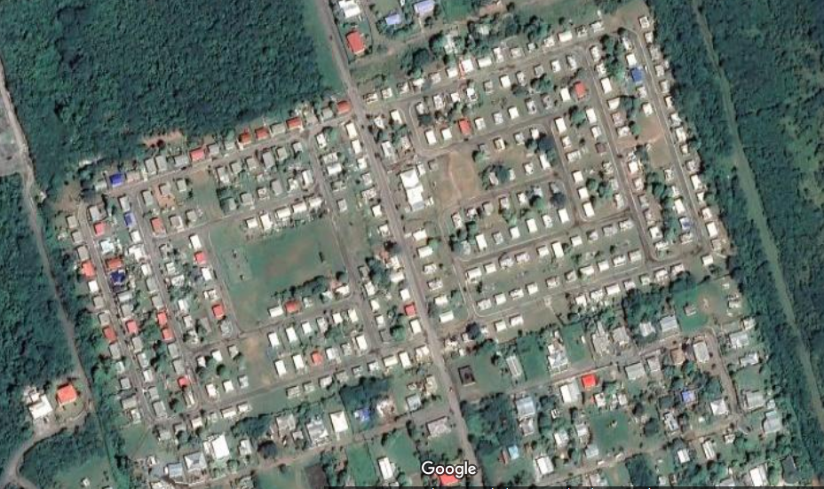
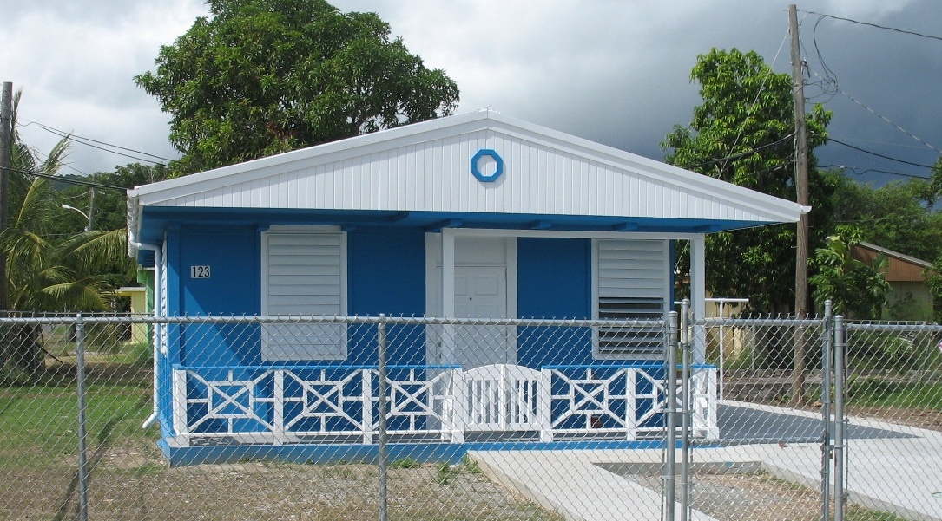
Williams Delight Homeownership
Homeownership | 100 Units | NA | TDC $14M | ARPA $6M | FEMA $8M |  | On-Going

Slide 11
Williams Delight - Homeownership
Current Status:
300 Homes
  34 Homes Sold - as December 31, 2022
  75 Homes To Be Sold
  191 Units To Be Demolished and Lots Resold for Homeownership
Challenges:
Cost of repairs
Ineligible Residents are Transferred to Public Housing
Opportunities:
Helping Families Become Homeowners

Slide 12
2023 – 2024 Replacement Housing
Project | Units | LIHTC | TDC | Private Equity | FEMA | CDBG-DR | Closing
D. Hamilton Jackson I and Alphonso Gerard Place Revitalization | 124 | 4%/9% | $118M | $50.6M | $7M | $48.5M | Sept 2023
Estate Donoe Redevelopment (“Tutu Phase I”) | 84 | 9% | $102.4M | $29M |  | $23M | Q2 2023
Tutu North Phase I and Phase II Redevelopment (Family) | 92 | 4% | $92M | $40M | $16.4M | $35.6M | April 2024
Stony Ground Phase I “Wilford Pedro” Development | 97 | 4% | $87.5M | $32.3M | $13.4M | $41.8M | July 2024
Oswald Harris Court Senior Redevelopment (Lucinda Millin) | 85 | 4% | $80.8M | $32M | $25M | $23.8 | August 2024
 | 482 |  | $480.7M | $183.9M | $61.8M | $172.7M

Slide 13
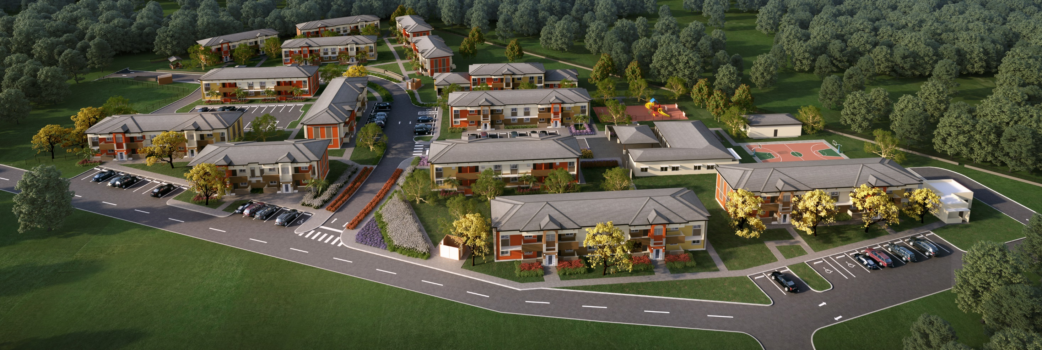
D. Hamilton Jackson / Alphonso Gerard Place
Revitalization | 124 Units | 4%/9% | TDC $118M | Equity $50.6M | FEMA $7M | CBDG-DR $48.5M | Closing Sept 2023

Slide 14
D. Hamilton Jackson I / Alphonso Gerard Place Revitalization
Current Status:
LIHTC Application Submitted - February 2023
General Contractor’s Bids are due - March 2023
Financial Closing - September 2023
Challenges:
Complex Financing Structure
Equity Pricing Below Mainland
Inflation Pressure Impacts Construction Loans
Increase in Construction Costs
Opportunities:
New and Improved Quality of Housing

Slide 15
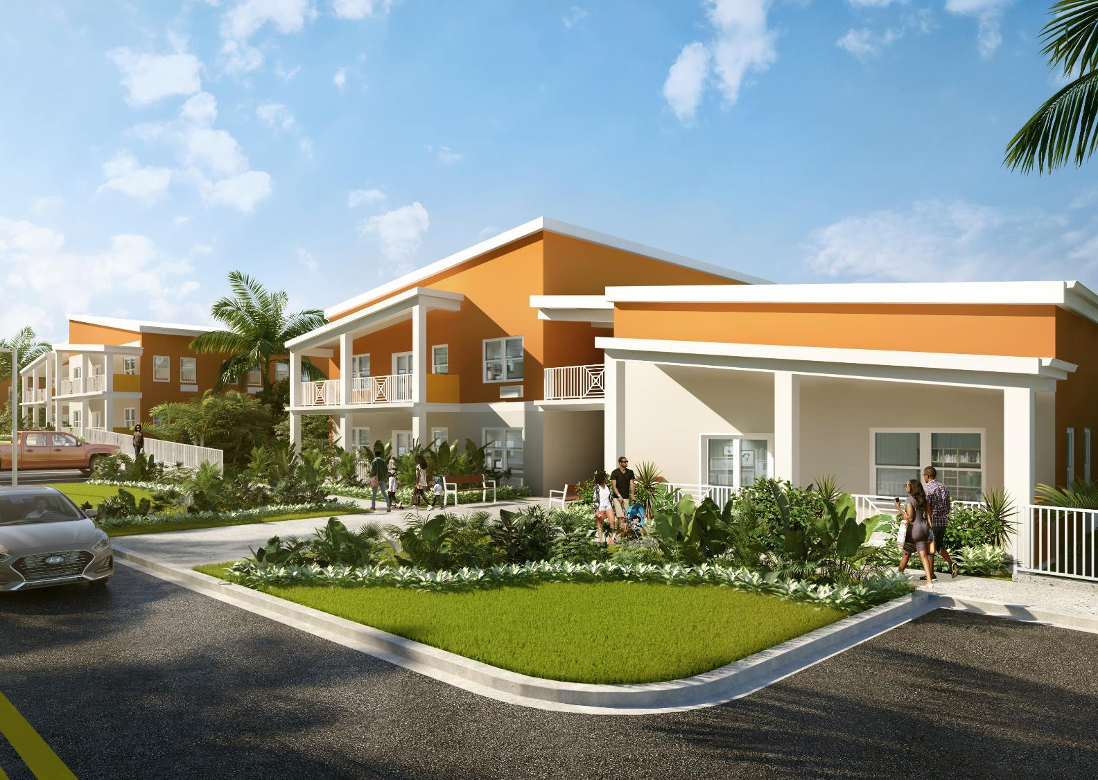
Tutu North Phase I and Phase II (Family)
Redevelopment | 92 Units | 4% | TDC $92M | Equity $40M | FEMA $16.4M | CDBG-DR $35.6M | Closing April 2024

Slide 16
Tutu North Phase I and Phase II Redevelopment (Family)
Current Status:
LIHTC Application will be Submitted - June 2023
Financial Closing - April 2024
Challenges:
Equity Pricing Below Mainland
Inflation Pressure Impacts Construction Loans
Increase in Construction Costs
Opportunities:
New and Improved Quality of Housing
Achieve Lower Density Housing and Increased Parking

Slide 17
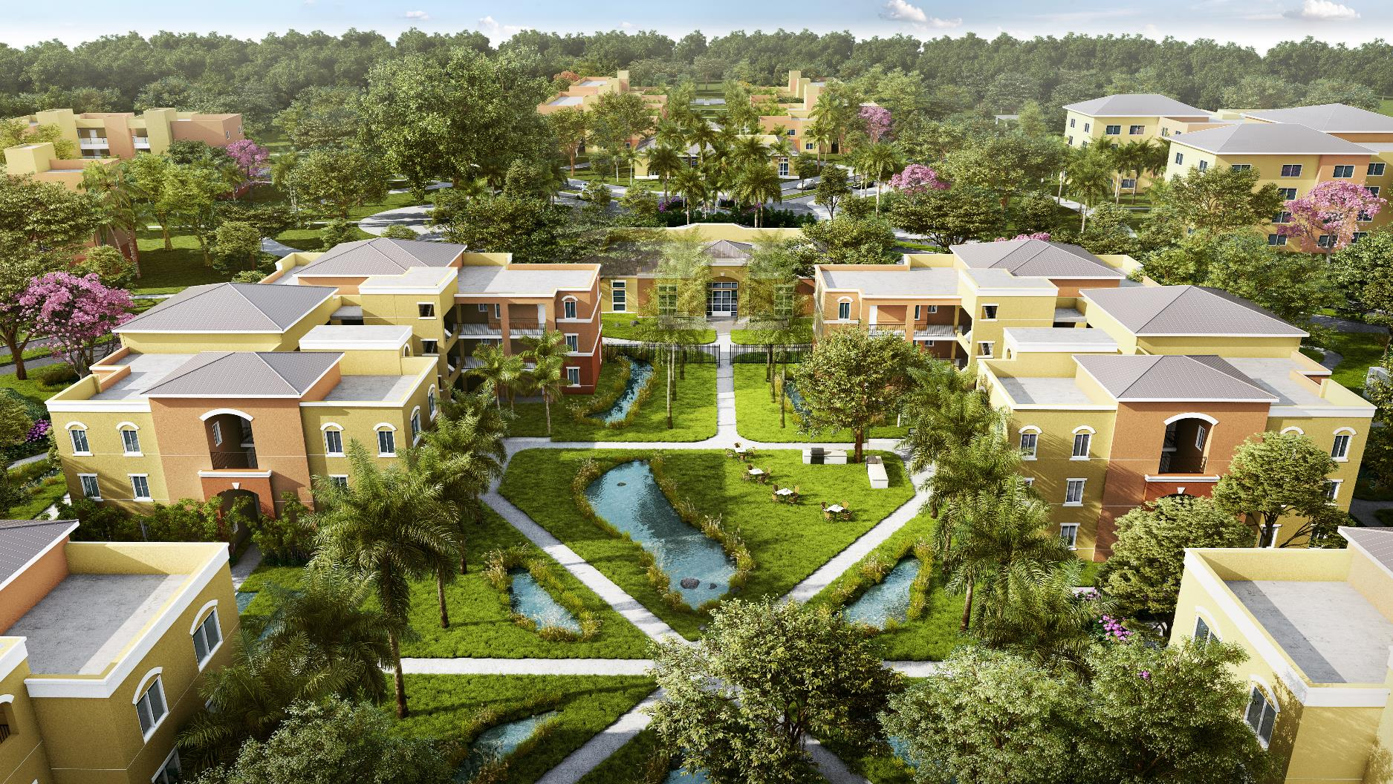
Stony Ground Phase I “Wilford Pedro”
Development | 97 Units | 4% | TDC $87.5M | Equity $32.3M | FEMA $13.4M | CDBG-DR $41.8M | Closing July 2024

Slide 18
Stony Ground Phase I “Wilford Pedro” Development
Current Status:
New Developer Selection is In-Progress
Financial Closing - July 2024
Challenges:
Equity Pricing Below Mainland
Inflation Pressure Impacts Construction Loans
Increase in Construction Costs
Opportunities:
First Phase of a Four Phase Development
Relocation for Occupied Residents at Wilford Pedro
Creating a Continuum of Care Options for Senior

Slide 19
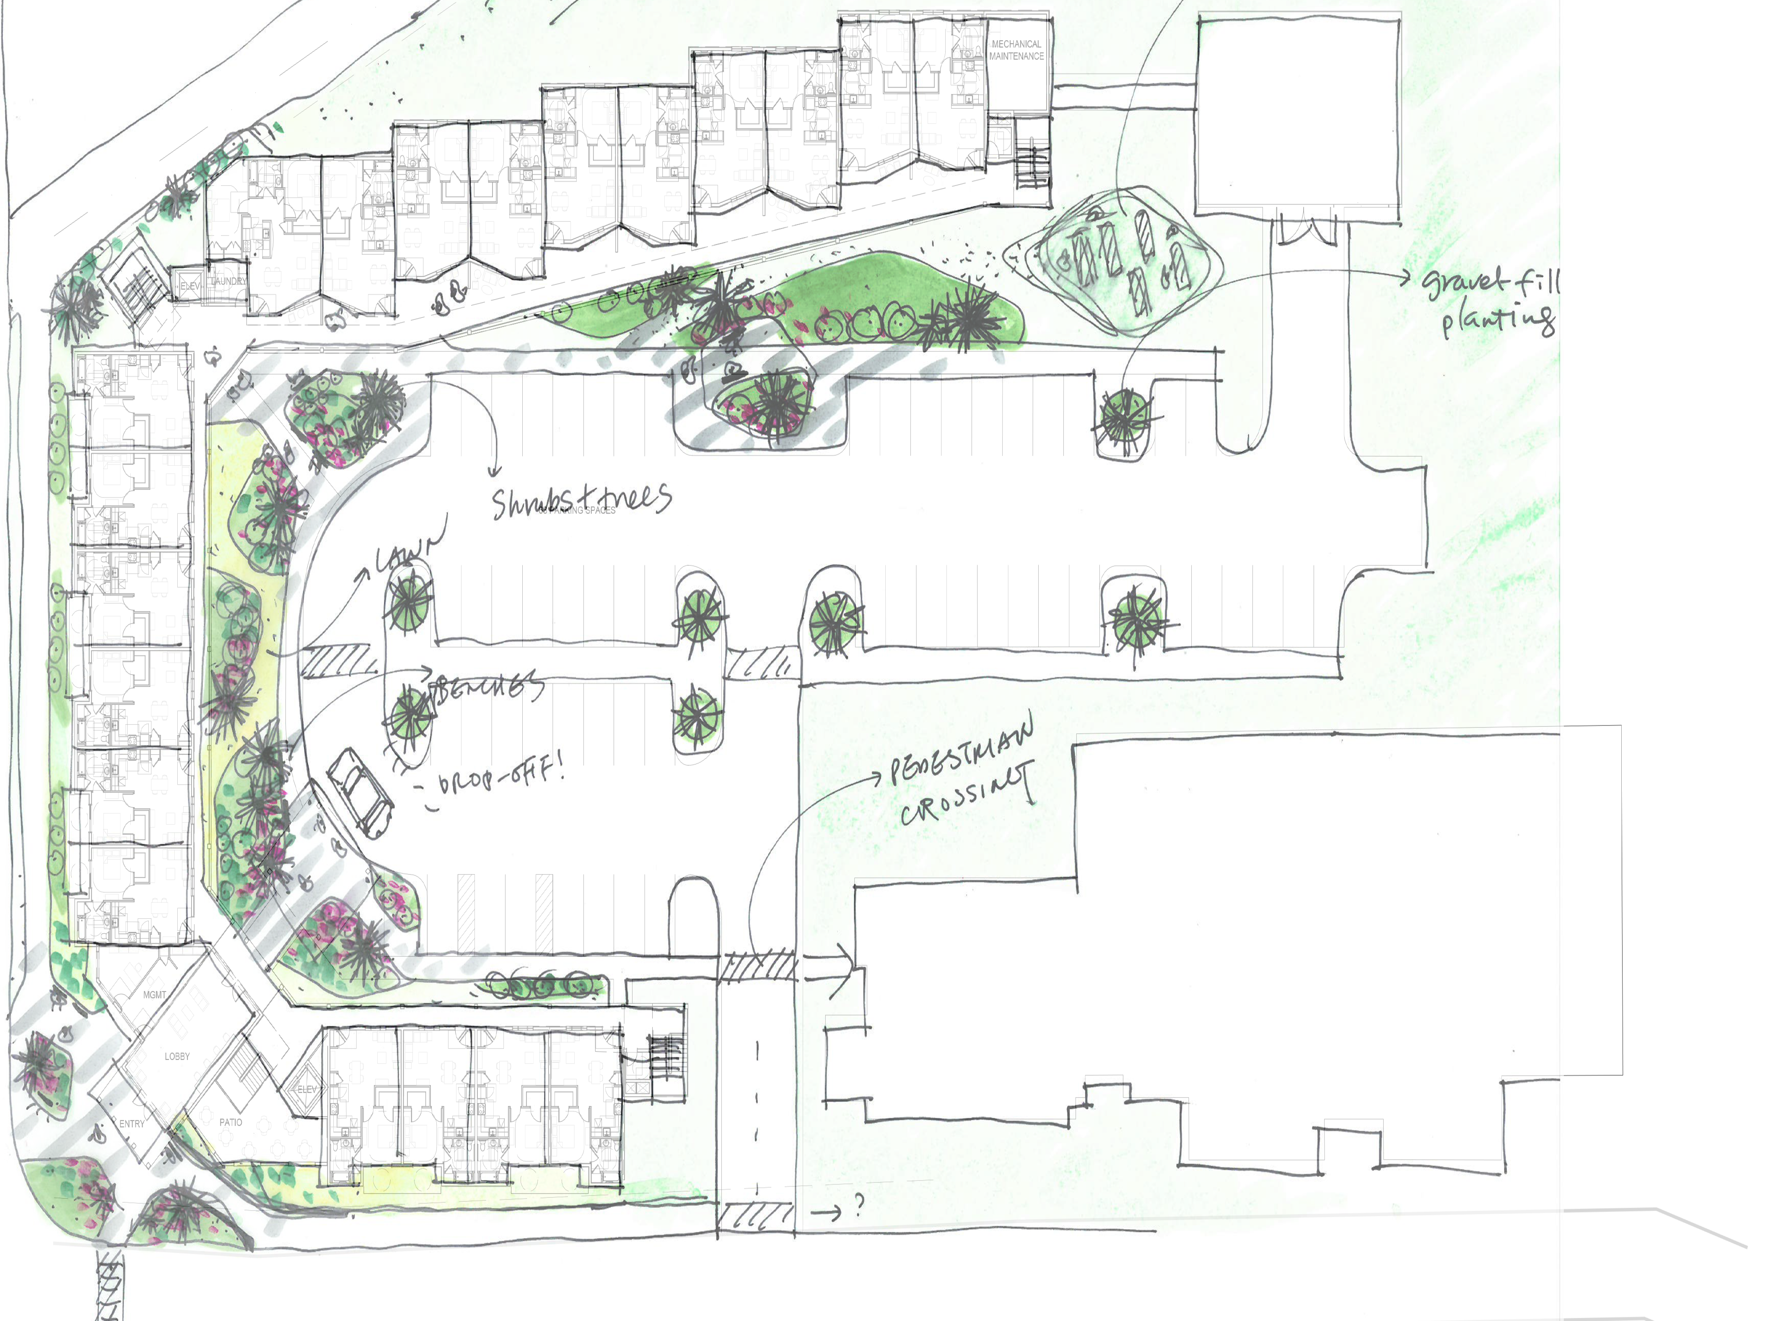
Lucinda Millin - Offsite
New Construction | 85 Units | 4% | TDC $80.8M | Equity $32M | FEMA $25M | CDBG-DR $23.8 | Closing August 2024

Slide 20
Lucinda Millin – Offsite
Current Status:
LIHTC Application Submitted - Jan 2024
Financial Closing - August 2024
Challenges:
Equity Pricing Below Mainland
Inflation Pressure Impacts Construction Loans
Increase in Construction Costs
Opportunities:
Relocation for Occupied Residents at Lucinda Millin
Reduced Density

Slide 21
Oswald Harris Court
MORE INFORMATION COMING SOON
Mixed-Income, Mixed-Use | Unit # TBD | LIHTC TBD | TDC TBD | Equity TBD | FEMA TBD | CDBG-DR TBD | Closing TBD

Slide 22
Marley Homes and Additions / Ludvig Harrigan
MORE INFORMATION COMING SOON
Mixed-Income, Mixed-Use | Unit # TBD | LIHTC TBD | TDC TBD | Equity TBD | FEMA TBD | CDBG-DR TBD | Closing TBD

Slide 23
RECAP
Four In-Progress Projects Totaling– 482 Units
CDBG-DR Needs for In-Progress Projects - $172.7M
Project | Units | CDBG-DR | Closing
D. Hamilton Jackson and Alphonso Gerard Place Revitalization | 124 | $48.5M | Sept 2023
Estate Donoe Redevelopment (“Tutu Phase I”) | 84 | $23M | Q2 2023
Tutu North Phase I and Phase II Redevelopment (Family) | 92 | $35.6M | April 2024
Stony Ground Phase I “Wilford Pedro” Development | 97 | $41.8M | July 2024
Oswald Harris Court Senior Redevelopment (Lucinda Millin) | 85 | $23.8 | August 2024
 | 482 | $172.7M

Slide 24
Q & A

