Slide 1
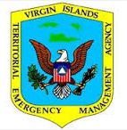
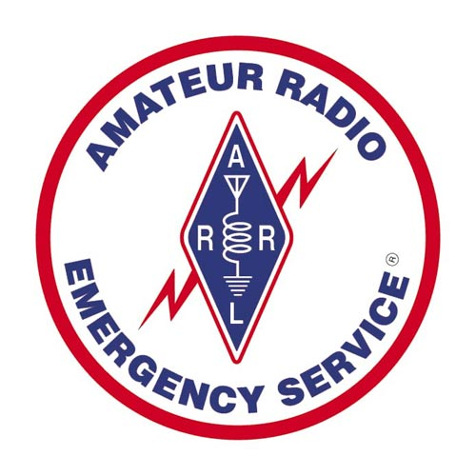
AuxComm, Amateurs and The Territory
Bill 35-0175
Homeland Security, Justice and Public Safety Committee
November 9, 2023
St. John
Fred Kleber
Section Manager
US Virgin Islands
©2023 – F. Kleber

Slide 2
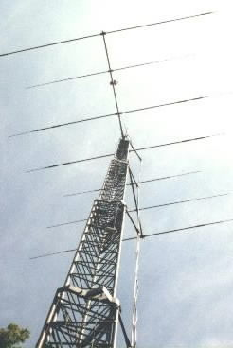
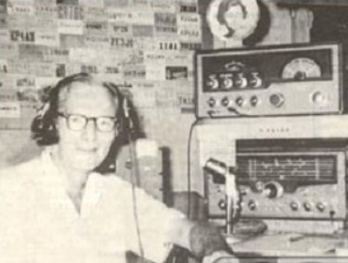


The Early Years…
Dick Spencley, KV4AA

Slide 3
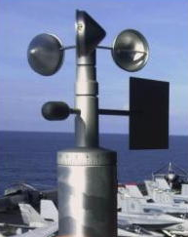
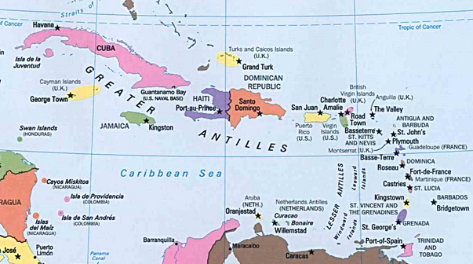
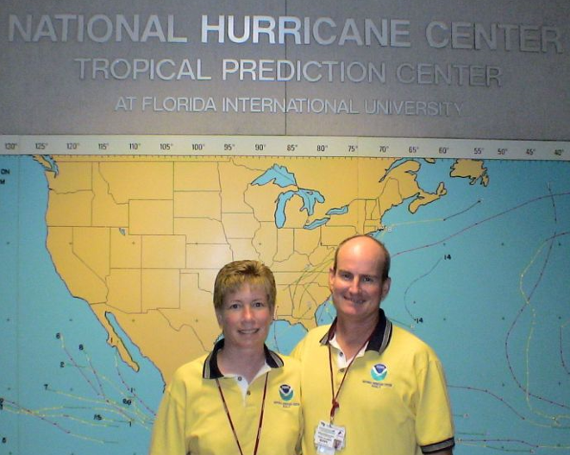

Public Service – My Calling
?

Slide 4
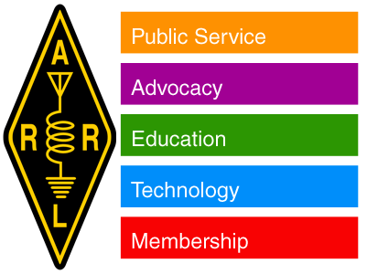
American Radio Relay League
The national organization for ham radio
Over 160,000 members
Elected Section Managers in 71 sections
ARES organized within sections
Section Manager leads ARES locally

Slide 5
VI-ARES Overview
Evolved from Civil Defense
Has decades long relationship with VITEMA
Membership numbers around 35
Four core ICS classes are required
Conducts routine exercises and training

Slide 6
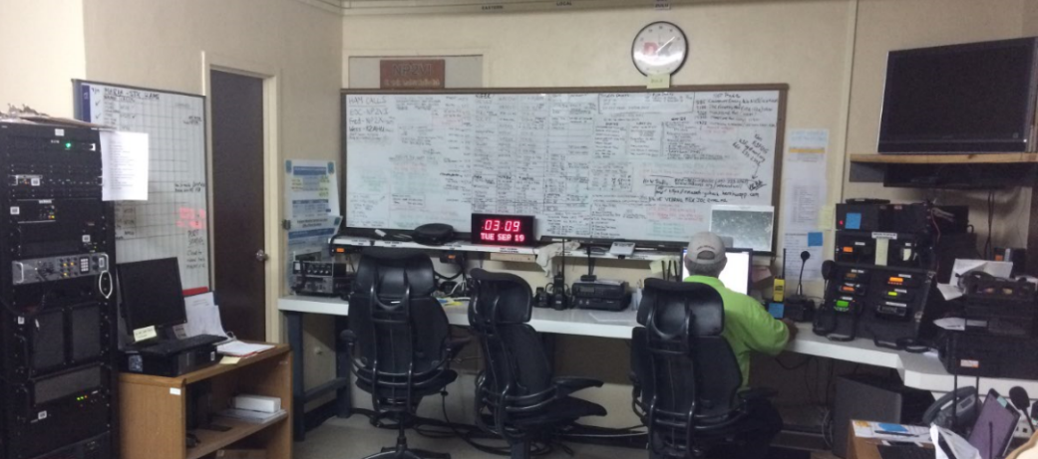
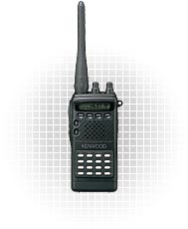
St. Croix EOC Comms Center
Built, maintained & staffed by hams

Slide 7
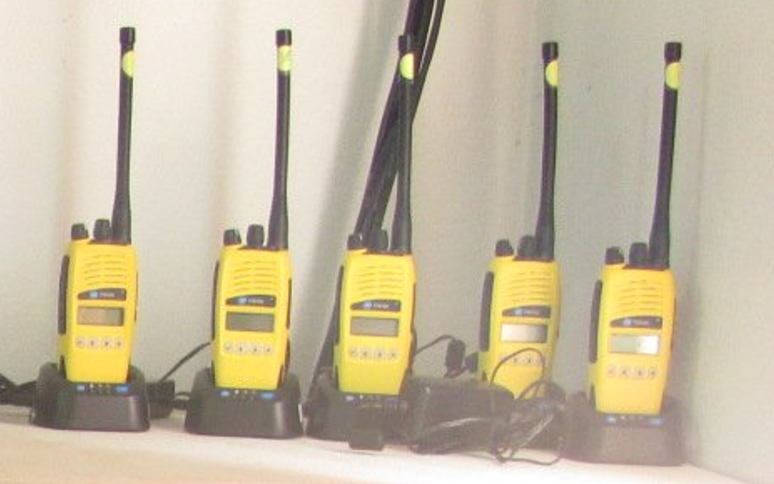
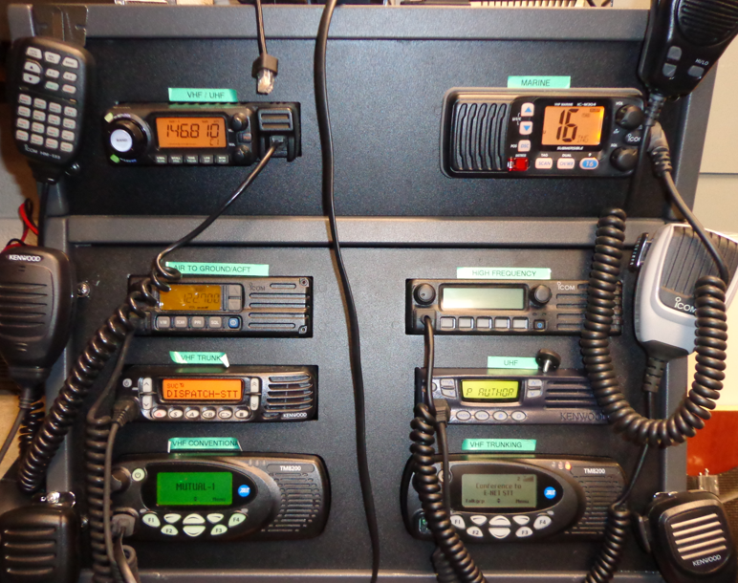
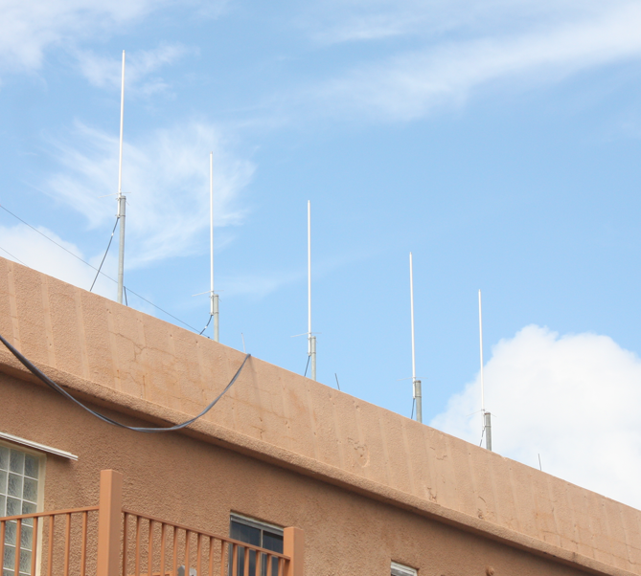
Taking Care of “Business”…
?

Slide 8
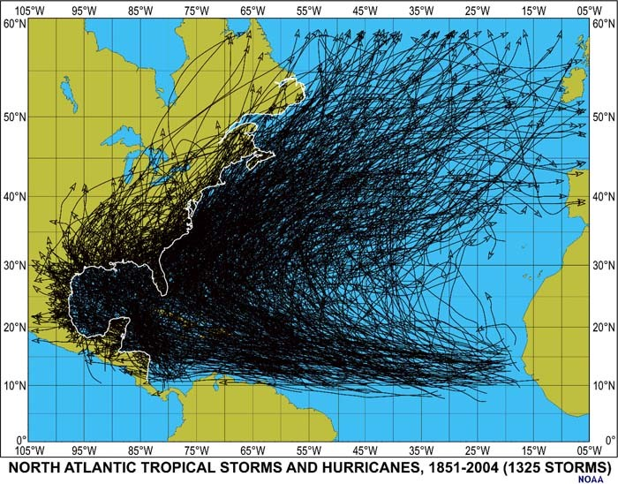
Not IF, but WHEN…

Slide 9
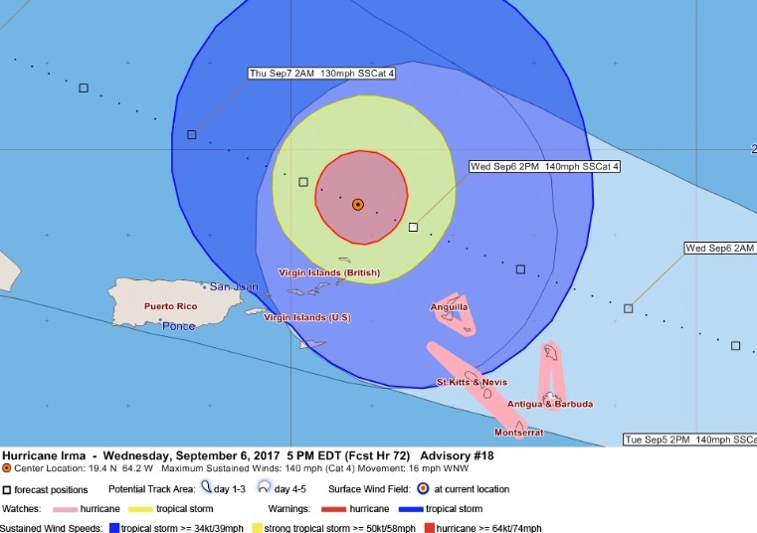
Irma Arrives!

Slide 10
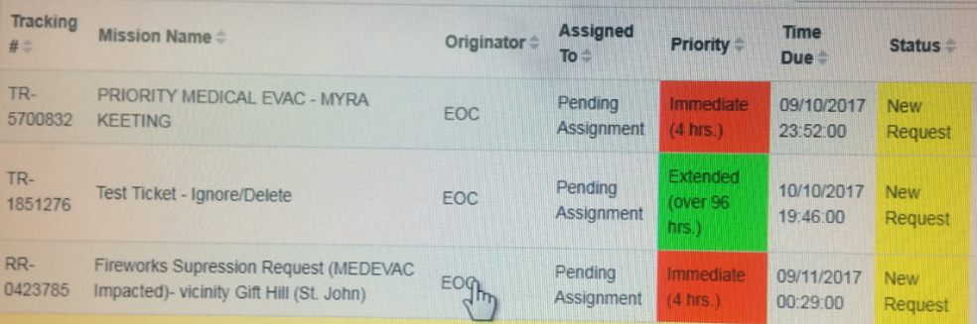
Injects That Never Happen?
Remember those crazy training injects that never happen?
Here we have someone shooting off fireworks near the helicopter landing zone!
No helo pilot will land if fireworks are present!

Slide 11
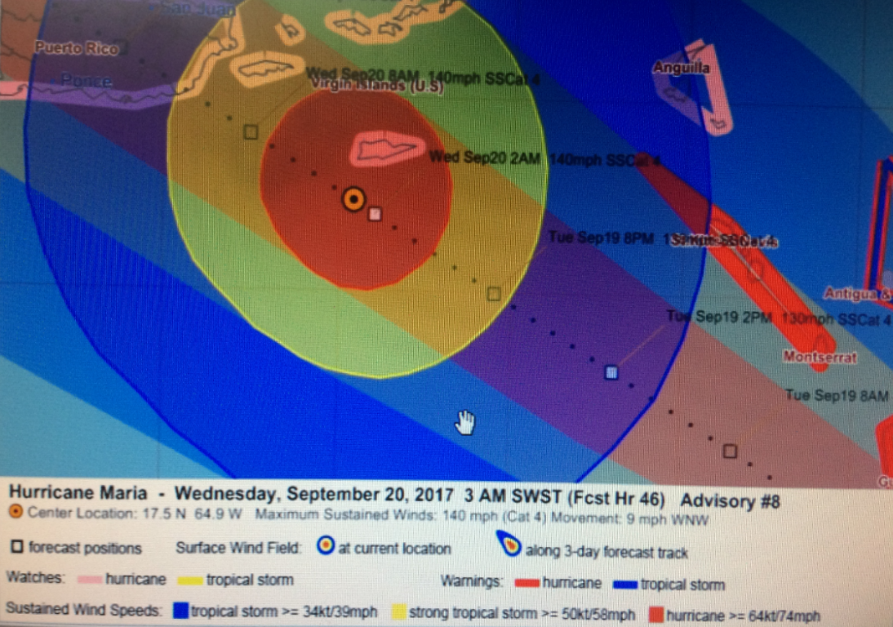
Maria Arrives
?

Slide 12
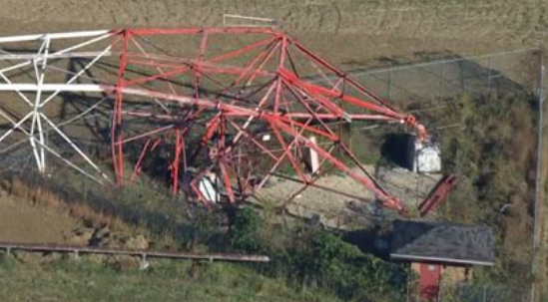
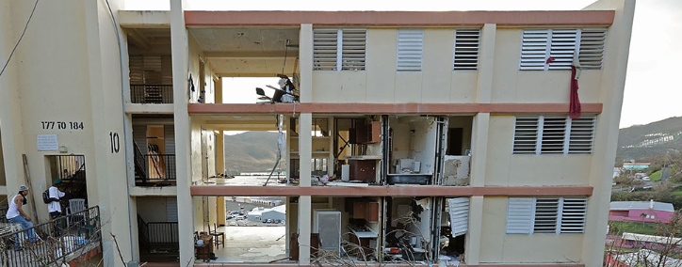
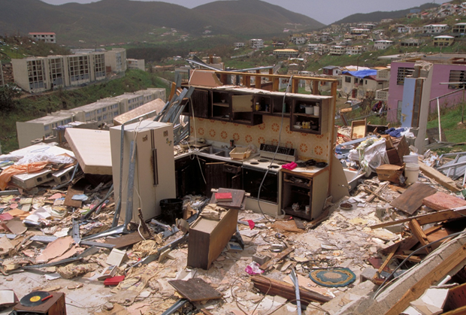
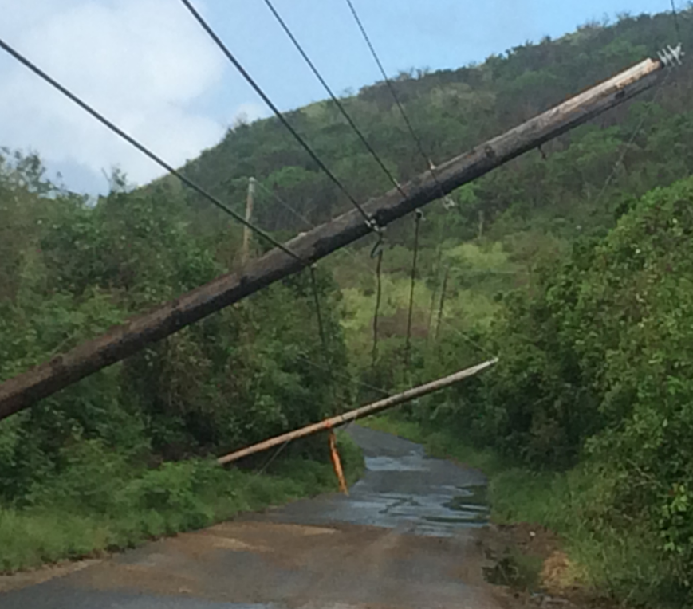
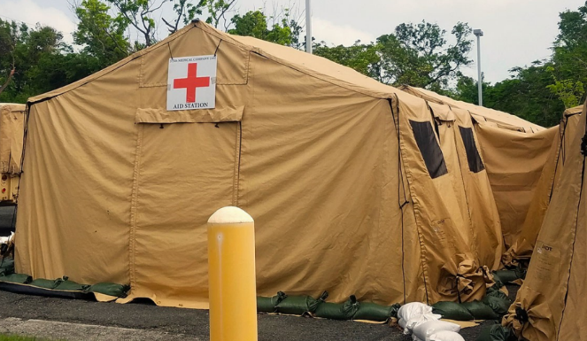
The Aftermath..

Slide 13
Irma-Maria Emcomm Hierarchy
Communications between VITEMA EOCs
Forwarding of 911 emergencies
Intra-agency communications (PD, Fire, etc.)
Comms with Federal partners - FEMA & DoD
Comms with non-governmental organizations

Slide 14
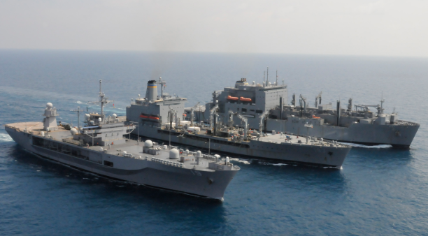
US Navy Support
USS Kearsarge, USS Oak Hill, USS Wasp

Slide 15
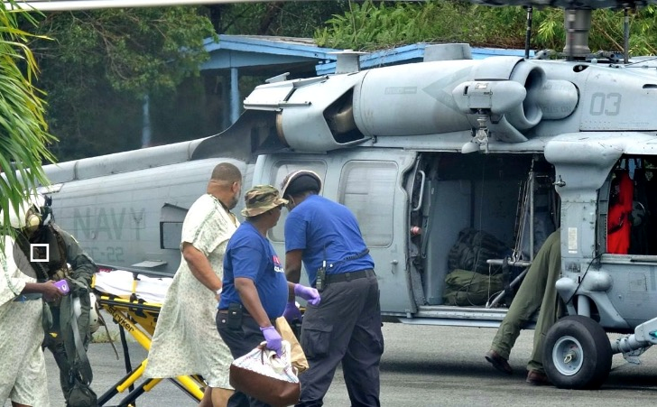
Landing Zone Management - STJ
Single aircraft uncontrolled facility
Congestion – Med-evac, supply and private flights
Off loading of supplies tied up landing pad
Requested additional resources to offload
Offloading resources freed up pad for med-evacs!
Air-to-ground comms on STX 2m repeater!
Surprised DoD helos did not have UNICOM

Slide 16
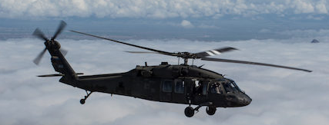
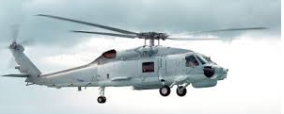

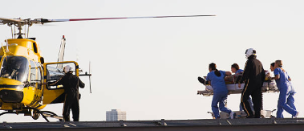
Tick Tock…
Early STJ med-evacs were from PR via helicopter
PR-STJ distance near maximum distance for helo
Hams volunteer to assume landing zone control
Permission granted by STX Incident Commander
Met with DoD and obtained helo STJ schedule
Prioritization plan immediately implemented

Slide 17
Getting It Right – EVERYTIME!
Him: “We have a 24 year old, female DKA who requires immediate med-evac”
Me: “Roger 24 year old female and immediate med- evac. Please confirm that is DKA, delta-kilo-alpha.”
Him: “Yes, that’s right, DKA”
Me: “Negative, please confirm DKA, delta [pause], kilo [pause], alpha”
Him: “Yes, diabetic keto acidosis”
Me: “Negative, please confirm phonetically D-delta, K- kilo, A-Alpha”
Him: “Roger, delta-kilo-alpha.
Me: “Confirming delta-kilo-alpha. Message copied and will relay.”

Slide 18
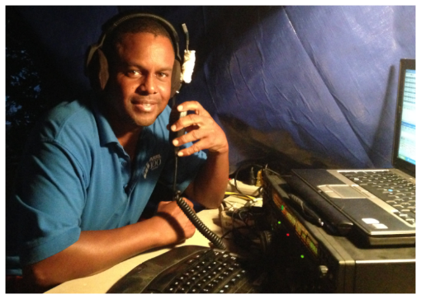
The ARES Response Summary
Hams volunteered 2300+ man-hours
Provided critical communications links
Established and managed daily HF info nets
Pinch hit as air-traffic controllers
Med-evac coordination saved lives
Saved VI government approximately $90,000

Slide 19
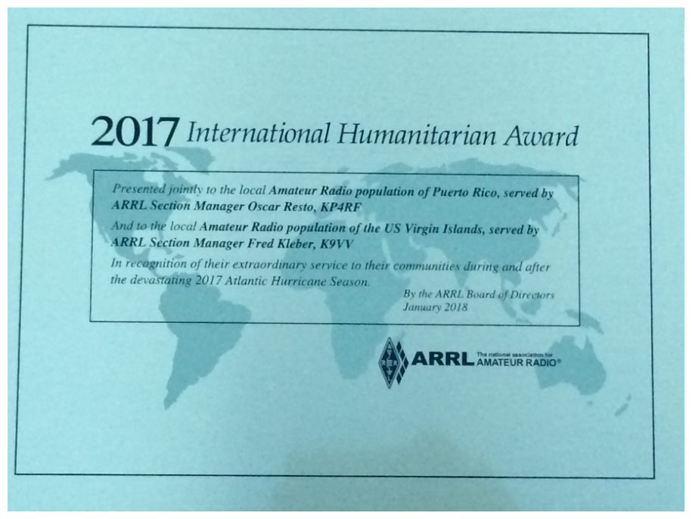
National Recognition

Slide 20


Saving Lives
Gratifying cornerstone of our “hobby”
No better feeling than knowing you saved a life doing something you enjoy doing
Those lives saved will go on to marry, have kids, and be there for their loved ones
Be humble. Not super-heroes. This is what we train and practice for. This is what hams do.
FCC recognizes this public service value through the free license grants & spectrum hams enjoy

Slide 21

The Risks
ARES volunteers are exposed to risk
Med-evac communication is very is risky
We live in a litigious society
Potential risk deters many ARES volunteers
As ARES lead, this exposure is not prudent

Slide 22

AuxComm – What & Why?
AuxComm
35-0175
Framework to ID, train, qualify, and deploy ARES volunteers
Are personally liable for any personal defense
Covered when performing assigned tasks in a non-negligent manner
Potential risk deters many ARES volunteers
No Good Samaritan protection for ARES
Absent travel and meals, no cost to GVI

Slide 23
AuxComm Summary
ARES has an extensive history of serving Territory
Formalizes framework of ARES –VITEMA partnership
Protects qualified AuxComm members when serving
Protection similar to existing Good Samaritan act for volunteer medical responders
Eliminates hesitancy to volunteer due to liability
Absent travel and meals, no cost to VI government
Thank you for your support of AuxComm Bill 35-0175

Slide 25
Tenets of First Response
Above all, do not become a victim yourself
Family first, always. No exceptions.
Hams’ primary emcomm role is that of communicators. May do other things if able.
Can’t help others unless you’re properly trained, qualified to help, and prepared at home
Do not undertake anything you feel uncomfortable doing
Be conscientious of liability!

Slide 26
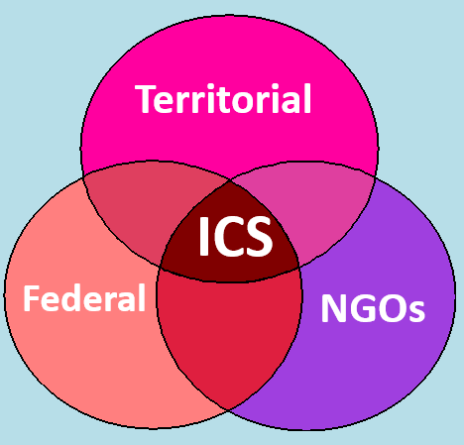
ICS - The Common “Language”
NGO = Non-governmental organization

Slide 27
Emergency Support Functions (ESFs)
Transportation
Communications
Public Works
Firefighting
Emergency Mgt.
Mass Care
Resource Support
Health & Medical
Search & Rescue
Hazmat Response
Agriculture
Energy
Public Safety
Long Term Recovery
External Affairs

Slide 28

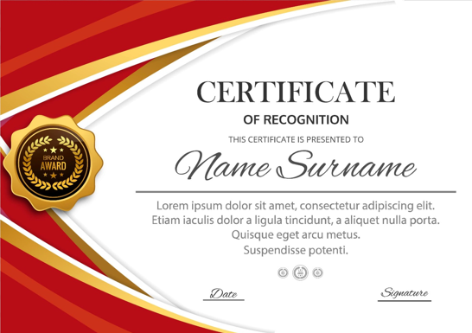
Practice Makes Perfect
If you want to sit at the table, you need to understand the structure and procedures!
Core ICS classes – (Required for ARES)
  ICS-100 – Introduction to ICS
  ICS-200 – Basic Incident Command
  ICS-700 – Nat’l Incident Management System
  ICS-800 – National Response Framework Intro
Advanced courses – Week long tabletop sessions
  ICS-300 – Intermediate ICS for Expanding Incidents
  ICS-400 – Advanced ICS – Command & Gen Staff

Slide 30



Celia Kalousek
Testimony for the Aux Comm bill
from a nonprofit and small business perspective
Independent Contractor Consultant

Slide 31



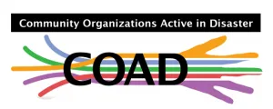


In 2012, STJ started joining the VOAD Meetings with STT-STX...but we quickly realized we needed our own plan...The plan for St. Thomas would NOT work for St. John …
WE are unique and need to plan that way...This led to eventual formation of COADs!
Now we have Community Organizations Active in Disaster (COADs) for each island to coordinate all valuable community resources to help fill the gaps in service during times of emergency and disaster.

Slide 32

National VOAD was established in 1970
National Voluntary Organizations Active in Disaster (VOAD) was founded over 50 years ago in response to unnecessary duplication of service and as a forum for sharing knowledge and coordinating resources -- money, materials and manpower – throughout the disaster cycle
preparation, response and recovery.
A commitment to shared Values; the “4C’s” — communication, coordination, collaboration, cooperation —
as guiding principles.
Agreement to adhere to such standards of conduct and service delivery.
As similar expectations for Federal interagency cooperation during national level disasters emerged, FEMA was formed at the end of the 70’s...

Slide 33


All sectors of society must work together...
to foster more resilient, self-reliant communities nationwide
VOAD facilitates partnerships...
with federal, state and local emergency
management and other governmental
agencies, as well as for-profit corporations,
foundations, and educational and research institutions.
National VOAD is the primary point of contact...
for voluntary organization in the National Response Coordination Center (at FEMA headquarters), a signatory to the National Response Plan, and an Emergency Support Function partner of many other federal agencies as delineated in the National Disaster Recovery Framework.

Slide 34

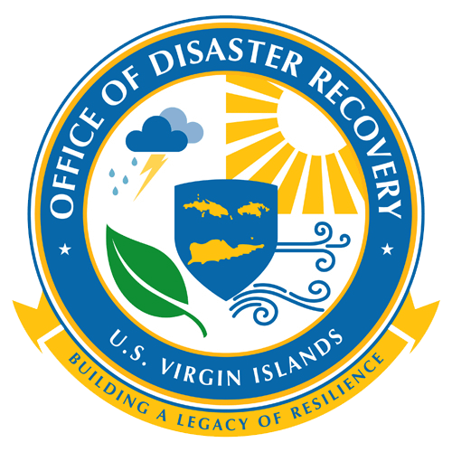












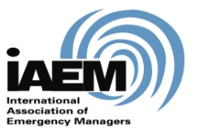

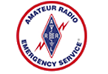









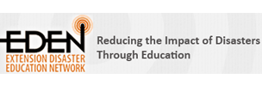


Today, National VOAD is a coalition of over 75
of the nation’s most reputable national organizations
(faith-based, community-based and other non-profit organizations) corporate partners, and 55 State/Territory VOADs
Non-Profit Supportive Partners
Government Partners
Corporate Partners
Academic, Educational & Training Partners

Slide 35

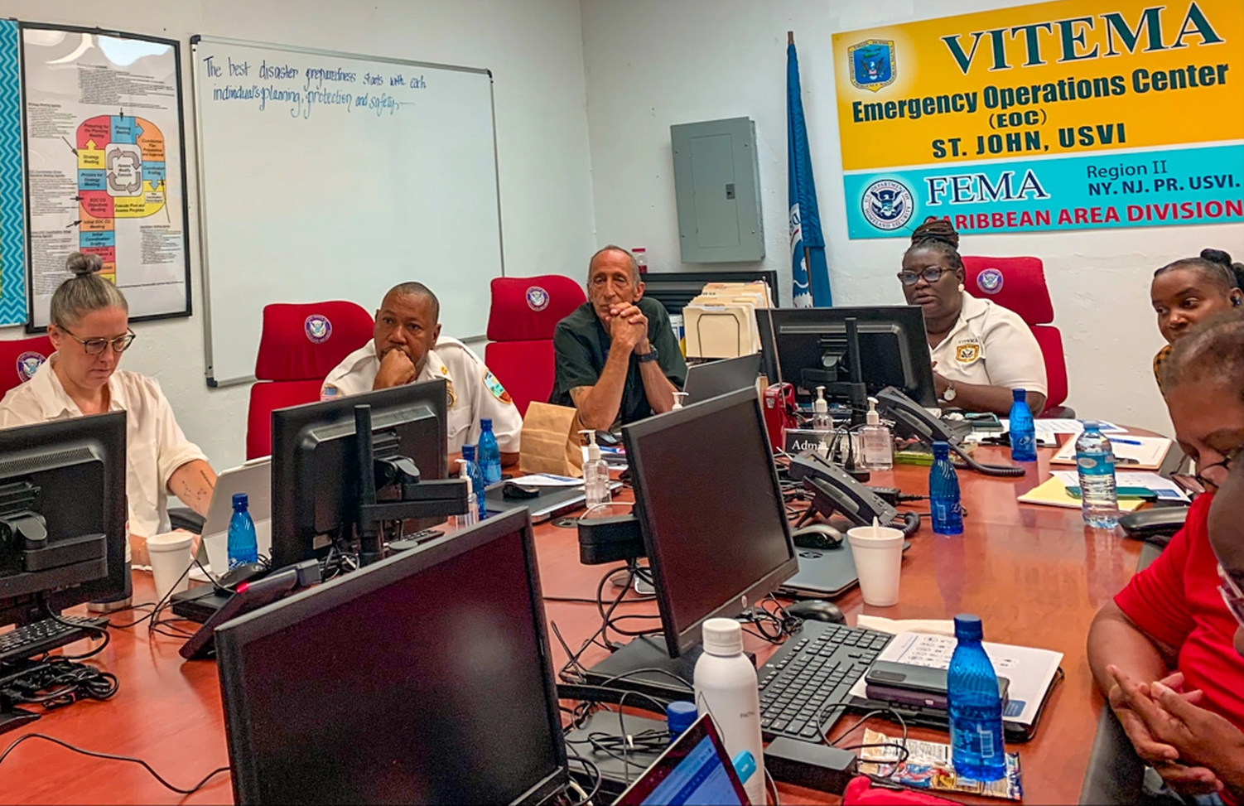
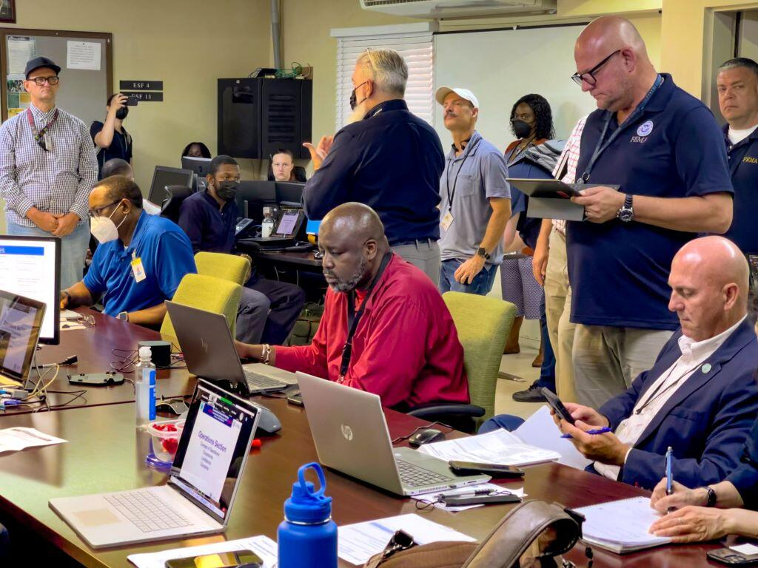
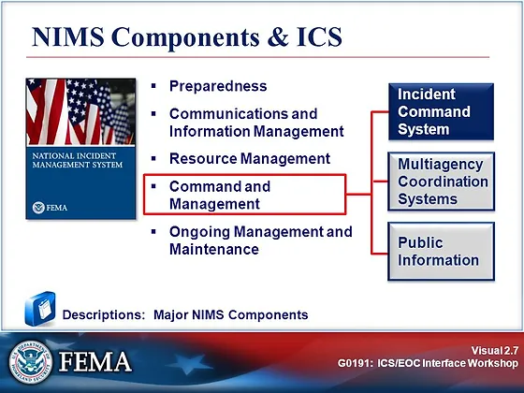
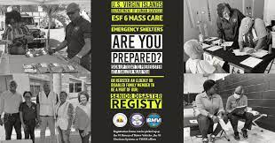
The EOC & ICS ….

Slide 36
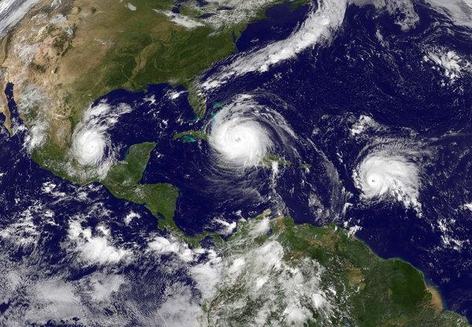
Then there was Irmaria…

Slide 37
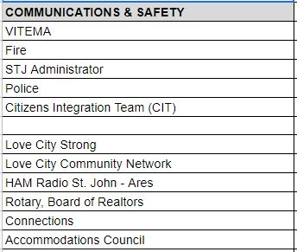
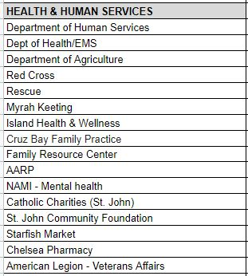
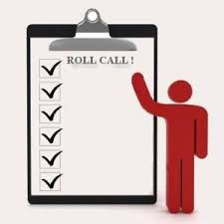
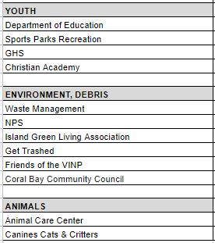
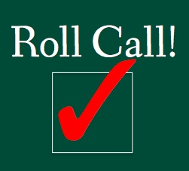
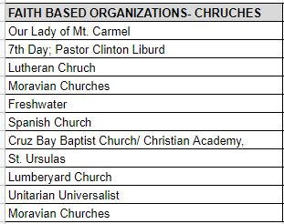
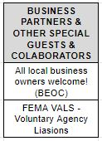
Community Value…..

Slide 38
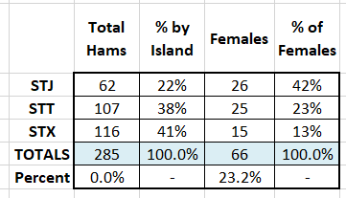
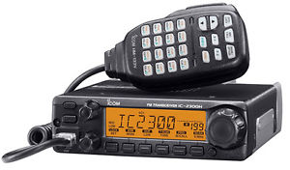
Strength In Numbers…
  The two primary drivers for entry into this hobby are public service and self-preservation.
  As of the last count, there are 285 licensed Ham radio operators in the US Virgin Islands situated in every area of the Territory, from Frederiksted (STX) to Fortuna (STT) and Fortsberg (STJ).
  Another benefit of collaborating with Hams is that there is no cost for the VI to supply Hams with equipment. Most Hams have their personal equipment at home, many have it in their vehicles - connected by territory-wide linked repeater system.

Slide 39
The collaborative efforts between Ham operators and various agencies, nonprofits, small businesses,and government authorities have been instrumental in creating a resilient and well-coordinated disaster response network.
Together, we can continue to build a stronger, more resilient Virgin Islands, better prepared to face the uncertainties of the future.

Slide 41

TSA and Ham Radio
Employed by TSA at St. Croix airport
Lead all St. Croix TSA emergency communications
TSA uses ham radio as secondary communications medium
Hams assisted with TSA comms after Irma and Maria
President of St. Croix Amateur Radio Club
Club partners with local government

Slide 42



Training & Community Outreach
Teaching a licensing class at STX Red Cross
Class teaches modulation, propagation, technology, equipment and regulatory
Outreach to elementary level schools and Youth Stepping Up
Ham radio club exists at Antilles School
Hams as young as 8 have passed entry test
Youth is the future of the hobby!!

Slide 43


Owned
Equipment
Benefits
Most hams have personal equipment at their homes and in vehicles
Some hams have stations that are superior to GVI systems
Have territory-wide linked repeater system & also internet linking
Entire system is owned and maintained by hams. No cost to VI government.

Slide 44





Net Operation
Net Control Station

Slide 45





Field Day Exercise

Slide 47

Thank You
AuxComm Bill of 2023
(35-0175)
Questions?
Testifiers
(in order of appearance)
Fred Kleber
Reynold St. Louis
Celia Kalousek
Reynaldo Bess
Steve DeBlasio

