Slide 1



Operational Status of JFL
Presented By:
Douglas E. Koch, FACHE
Chief Executive Officer
Gov. Juan F. Luis Hospital & Medical Center

Slide 2

Exhibit 1
Vacancy Listing

Slide 3
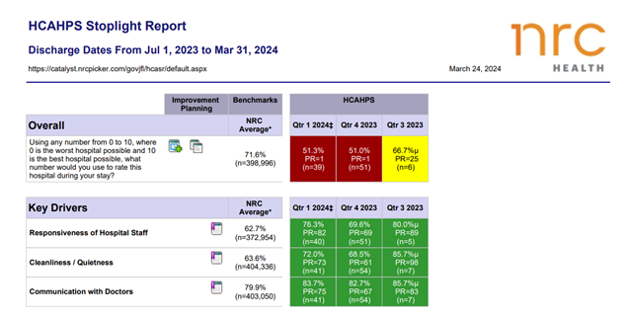
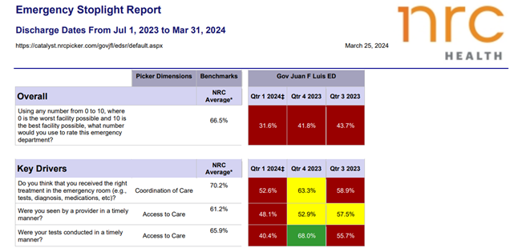
Exhibit 2-3
NRC Reports

Slide 4
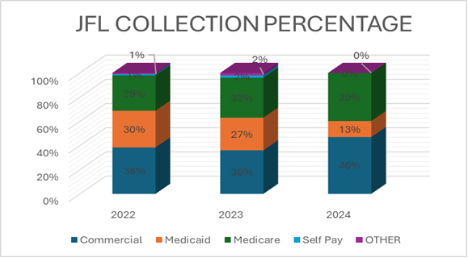
Exhibit 4

Slide 5
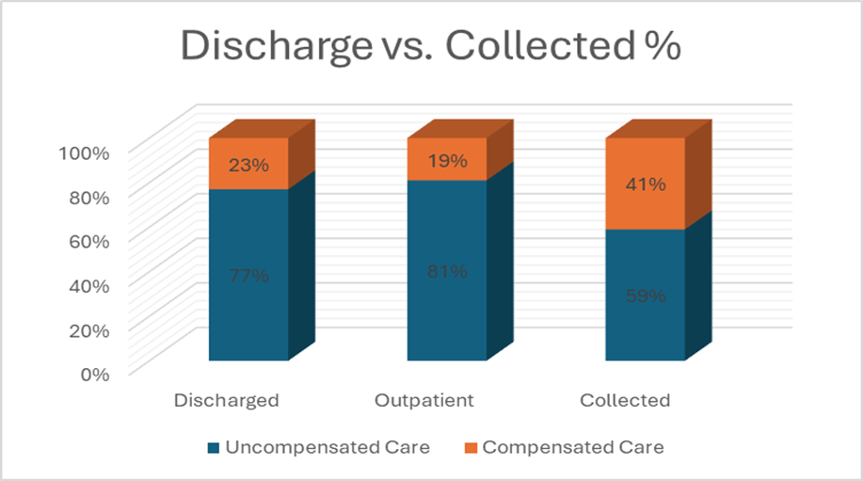
Exhibit 5

Slide 6
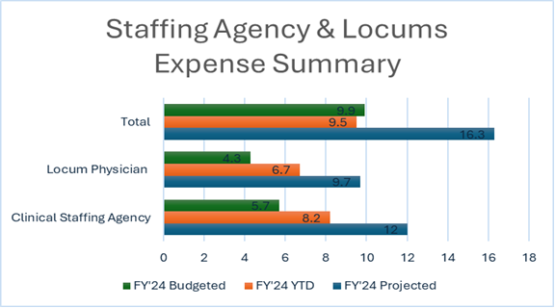
Exhibit 6

Slide 7
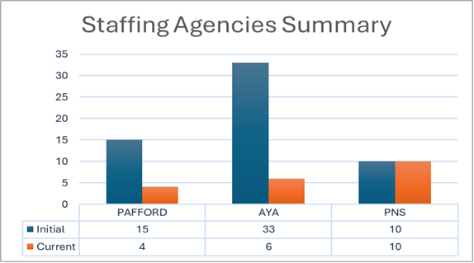
Exhibit 7

Slide 8
THANK YOU

