Slide 1
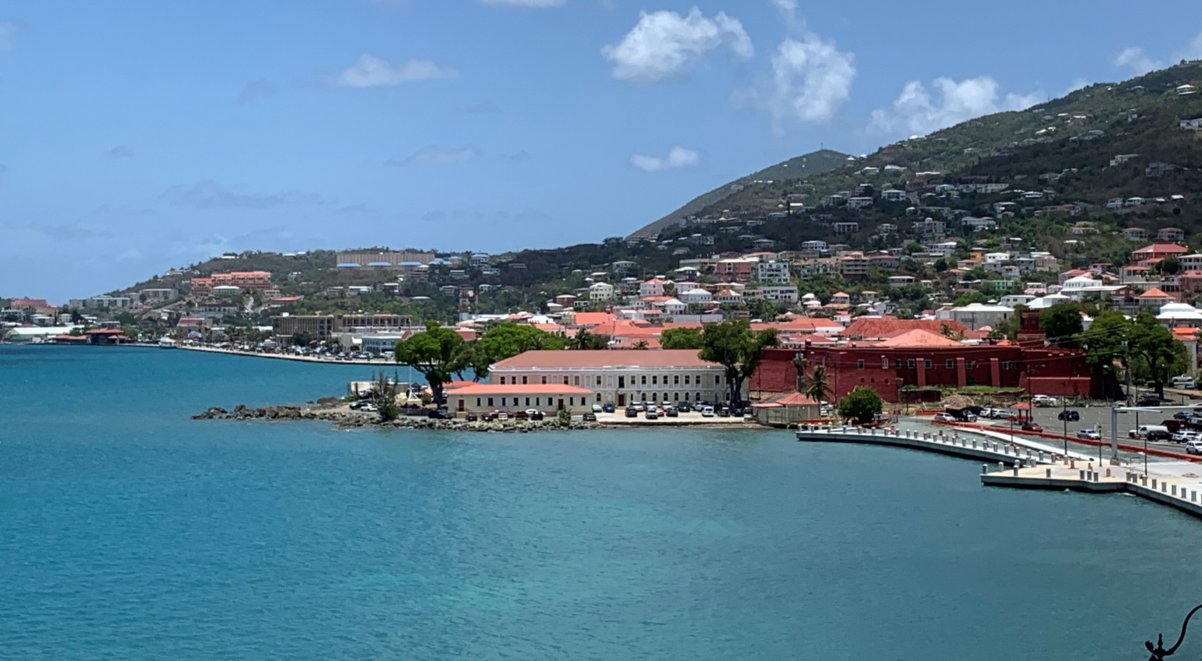
USVI Drought Impacts and Water Resources
USVI Drought Impacts
Presented by: Commissioner Positive Nelson
Prepared by: Christina Chanes-Bryan, Research Specialist
Fernando Silva, Lead Field Technician, Environmental Monitoring
University of the Virgin Islands
Prepared by:
Christina Chanes Bryan University of the Virgin Islands & Commissioner Positive Nelson, VIDA
Notes:
The goal of this PP is to discuss and explain drought to increase water security for farmers by augmenting the capacity of the water distribution network, and to create additional storage to help mitigate the impact of drought on water access. It is also to help you understand the implications of drought and how it impacts farmers in the USVI.

Slide 2
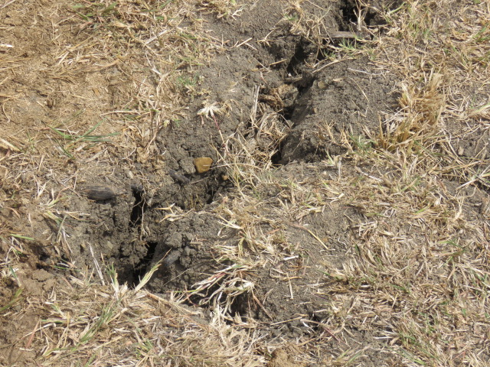
The U.S. Drought Monitor (USDM) is a map that is updated each Thursday to show the location and intensity of drought across the country.
The USDM uses a five-category system:
Labeled Abnormally Dry or D0, (a precursor to drought, not actually drought), Moderate (D1), Severe (D2), Extreme (D3) and Exceptional (D4) Drought.
Drought categories show experts’ assessments of conditions related to dryness and drought including observations of how much water is available in streams, lakes, and soils compared to usual for the same time of year.
The U.S. Drought Monitor began in 2000 and is a collaboration between the NDMC, NOAA and the USDA, who share the weekly author role for the product. The NDMC, based at University of Nebraska, Lincoln, leads the coordination of weekly drought monitor process and provides the maps, data and statistics to the public.
Notes:
This is to go over the DROUGHT levels of INTENSITY:
Abnormally Dry or D0 - Moderate (D1) - Severe (D2) - Extreme (D3) - Exceptional (D4)
The U.S. Drought Monitor began in 2000 and is a collaboration between the NDMC (NEBRASKA) , NOAA and the USDA

Slide 3
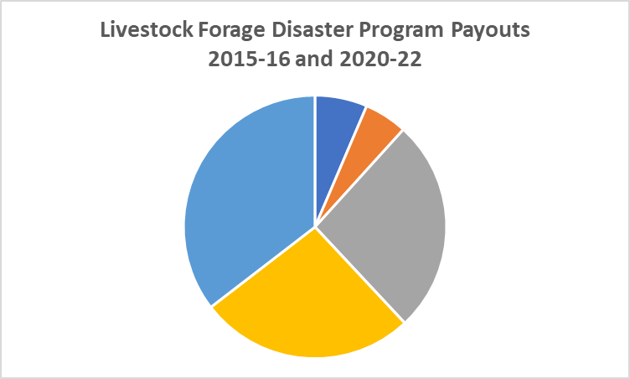
Note: LFP payouts during the drought of 2020-22 exceeded $218,000, based on preliminary data. This is the first time in USDM history that LFP payouts have occurred for islands where drought is depicted using “dot plots”.
Note: Livestock Forage Disaster Program (LFP) payouts in 2015-16—which totaled more than $29,000—were based on a special drought declaration by USDA Secretary Vilsack.
2015
$16K
2016
$13K
2022
$88K
2020
$65K
Note: The U.S. Virgin Islands were added to the U.S. Drought Monitor in 2019. LFP payouts in 2020-22 were based on the USDM depiction.
2021
$66K
LFP total since we began the Drought Monitor for the USVI is $218,568. Total in the history of the LFP program is $247,596.
Notes:
SINCE 2015/2016--Total in the history of the LFP program is $247,596.
Payouts in 2015-16—which totaled more than $29,000
Big number is that from 2020-2022 we had three years of payout $218,568.

Slide 4
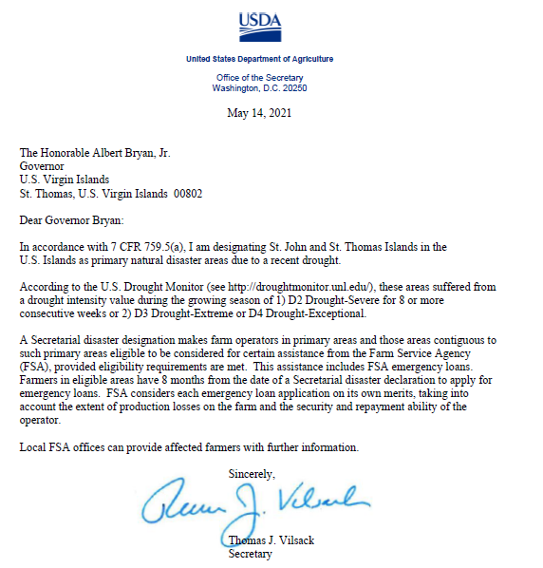
Notes:
This is drafted by Christina who is the volunteer drought coordinator as assigned by NWS and must be requested by Commish of Ag and written and sent by GOV. to SEC of AG (USDA); this info comes from a variety of agencies and is verified before being drafted by USDM’s.
Last year did not need one as this never went out of drought so it was a continuous drought declaration.

Slide 5
Notes:
This is what we looked like as far as reporting in 2015

Slide 6
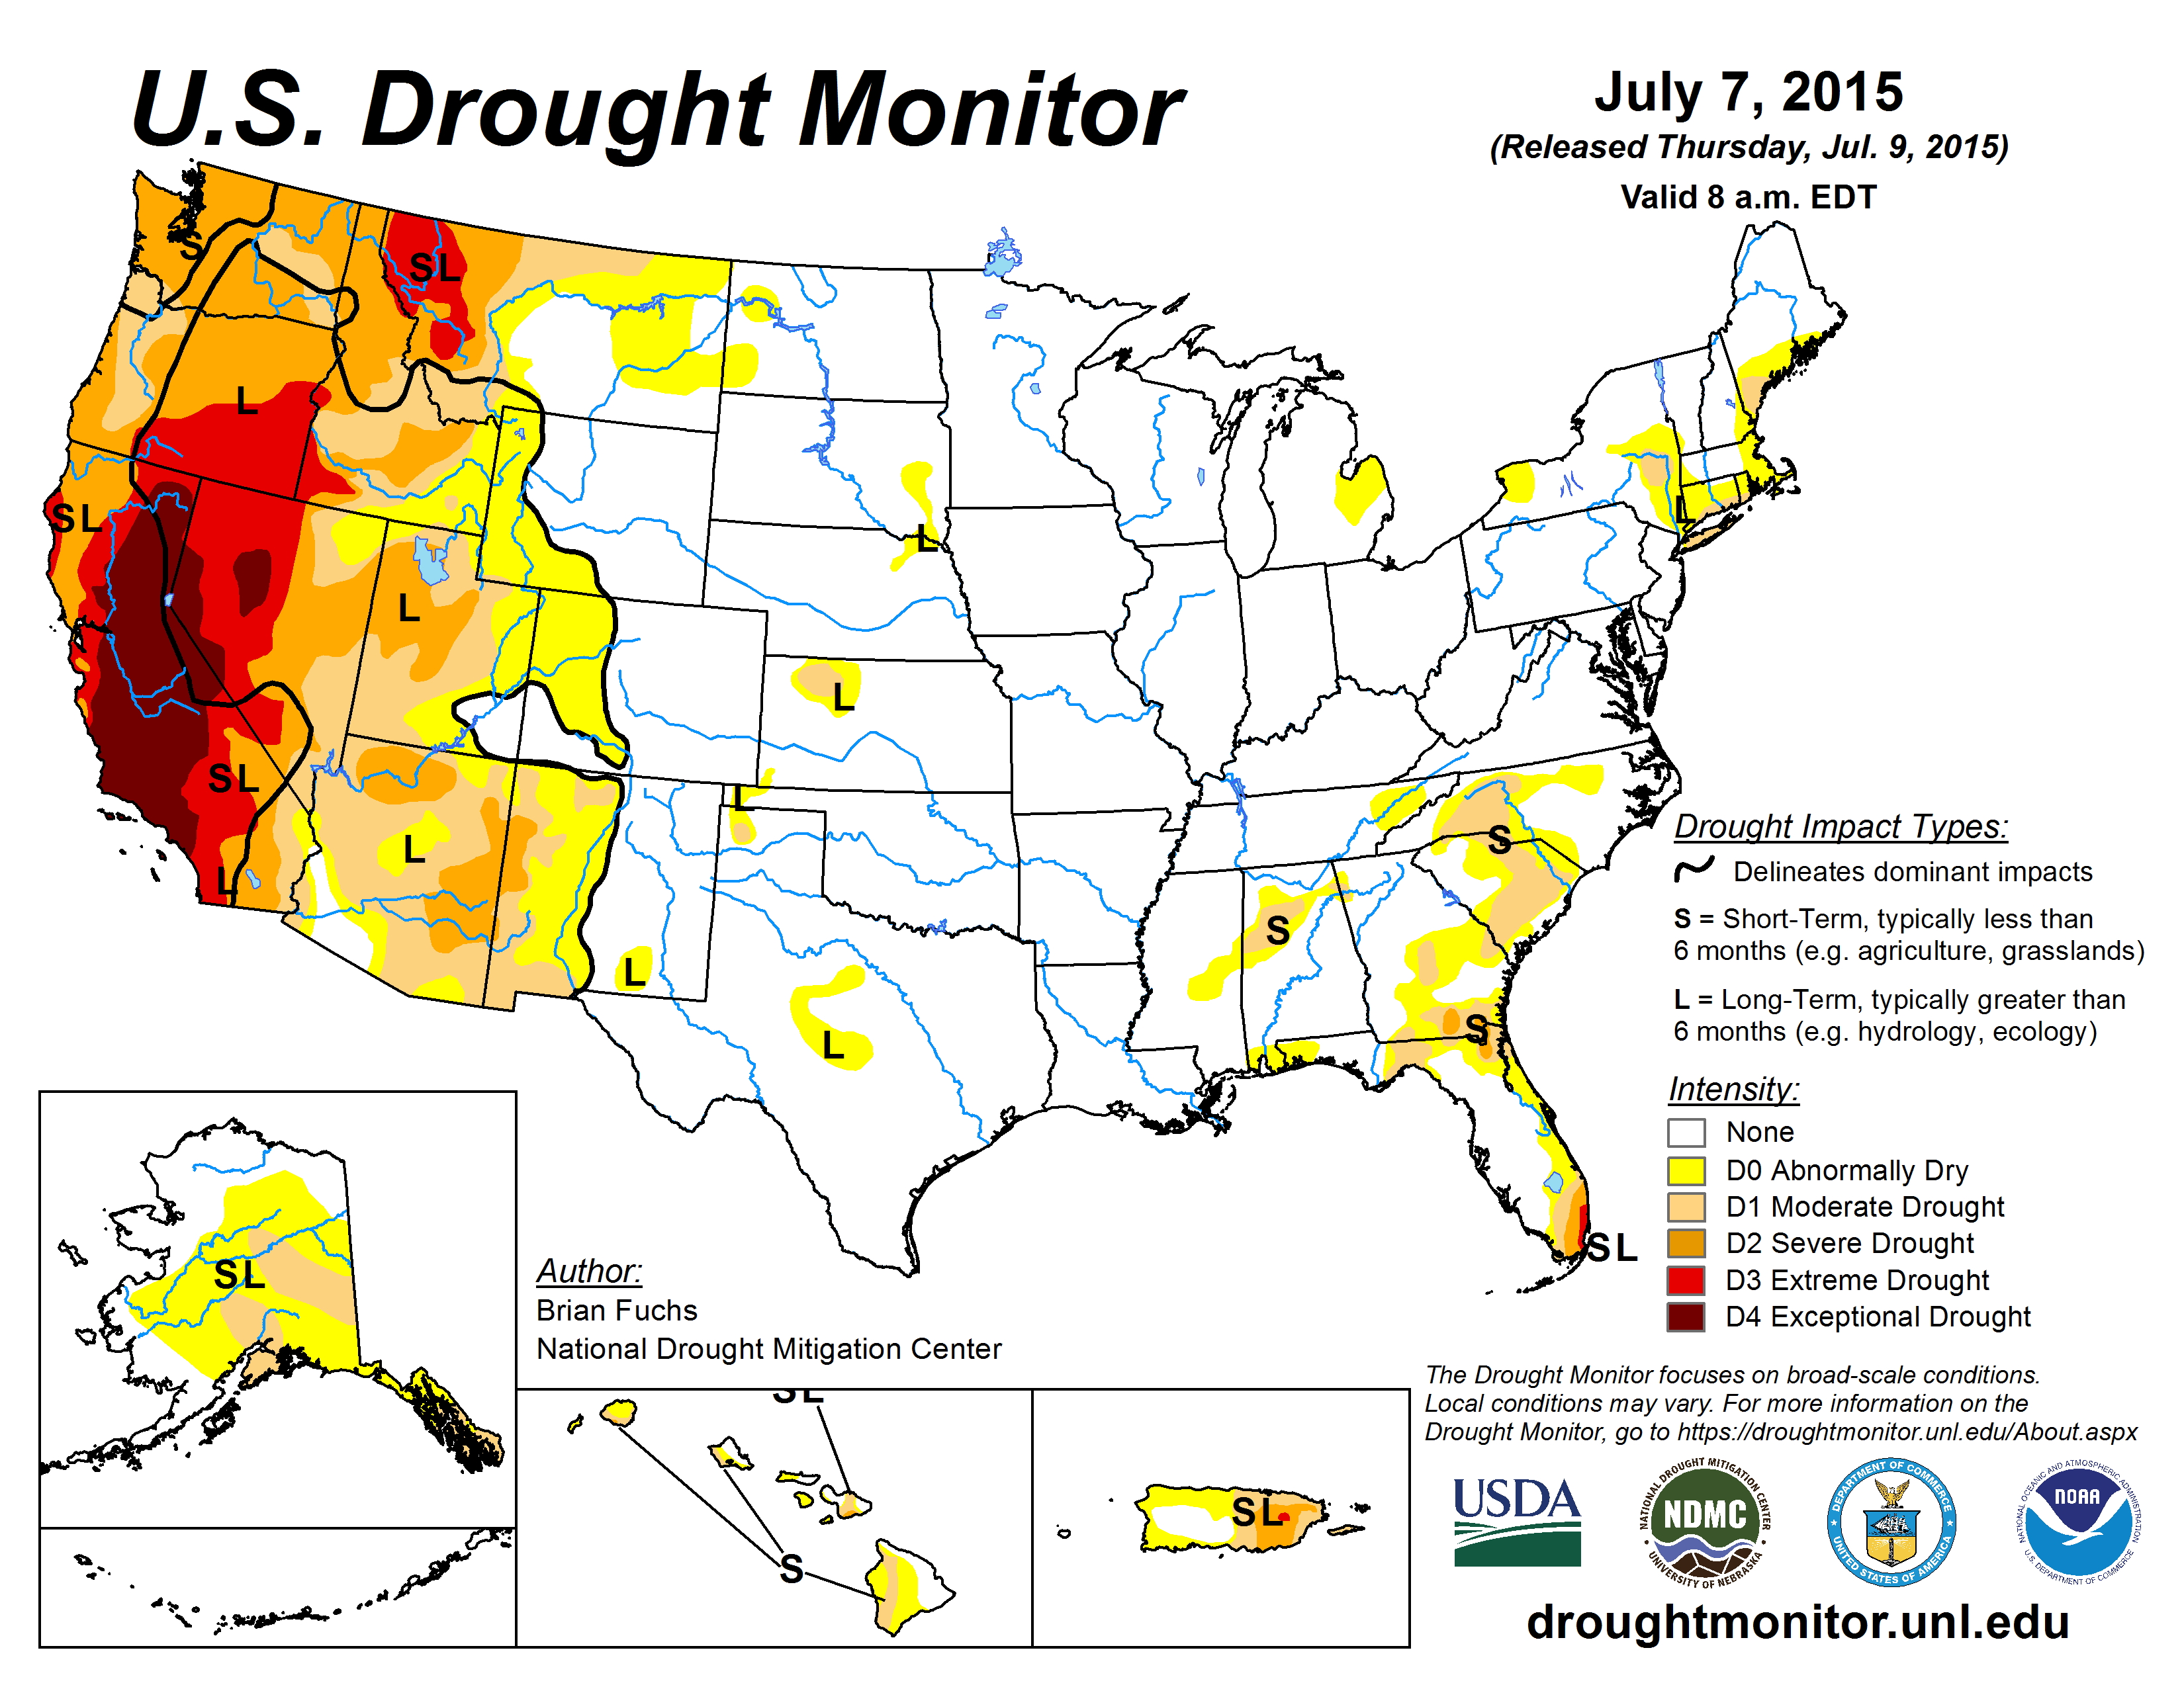
Drought of 2015 was glimpse of what was to come
Notes:
Before data was collected and tabulated for the USVI, our drought declaration was determined using Florida and Puerto Rico as a guide due to our geographic location. BY REGION that the figures were given to provide disaster funds for LFP.
We now currently monitor each island and its own micro climates to give a more distinct and accurate report to the drought monitors

Slide 7
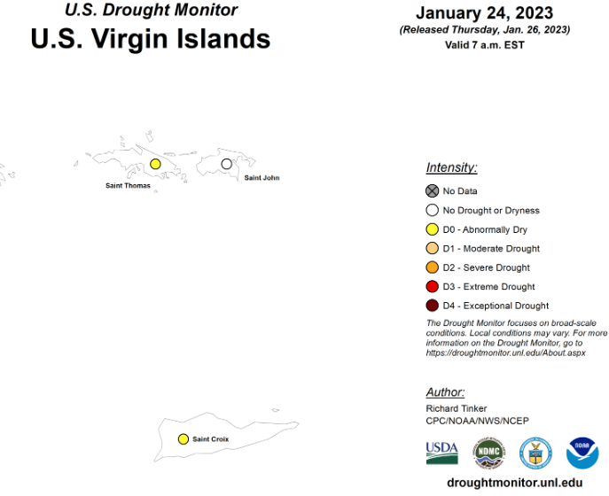
What drought looks like today
Notes:
This depicts the current status of drought in the USVI which in STT and STX is DO (s) short term and STJ is D nada meaning no drought at this time. These are early indicators.

Slide 8
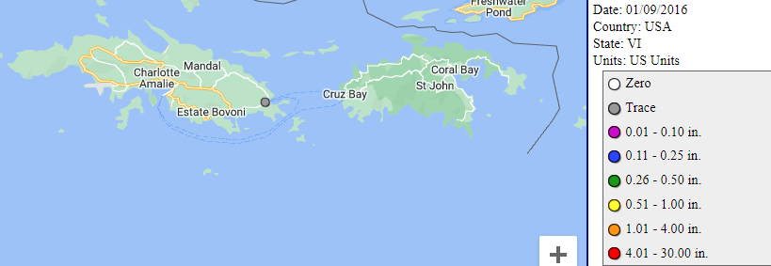
CoCoRaHS – Then 2016
Notes:
First record of CocoRaHs rain gauges was as early in 2016, since then the number of community volunteers has risen to almost 40 in 2023—

Slide 9
CoCoRaHs – Now 2023
Notes:
Currently there are 40 territory wide and more than 15 report fairly regulary. THIS IS VOLUNTEER driven

Slide 10
What does that mean in daily lives of Ag professionals?
2020 Total: 4,357,903 gal 2021 Total: 10,894,197 gal 2022 Total: 11,835,967 gal
Notes:
Gallons of water bought from ag professionals territory wide
April to October shows a spike in water purchasing annually, tends to slow down from November to march
As you can see from the trends, we can expect an increase in total gallons purchased in 2023

Slide 11
Notes:
11 mil gallons and 10 mil gallons = 21 mil over a two-year Drought period

Slide 12
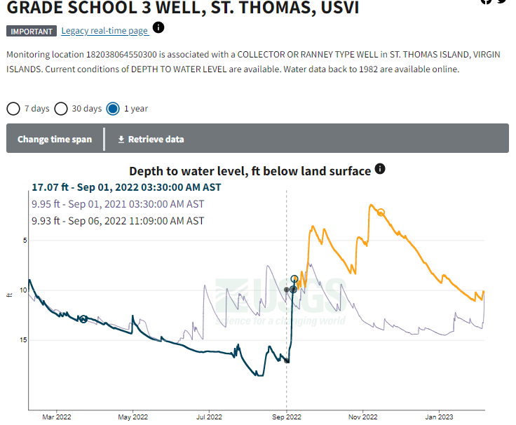
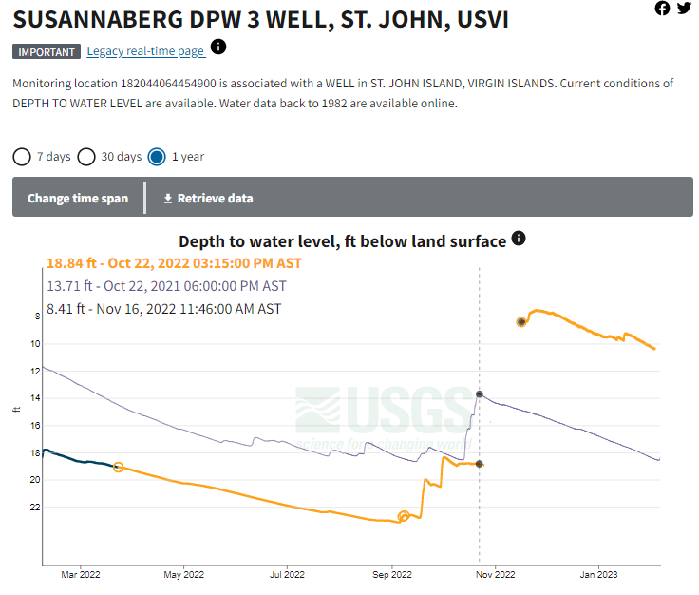
USGS Groundwater
Notes:
The graphs above show the difference in the depth to water level in feet below the surface, and how on both stt and stj, this level has dropped from the 2021 levels

Slide 13
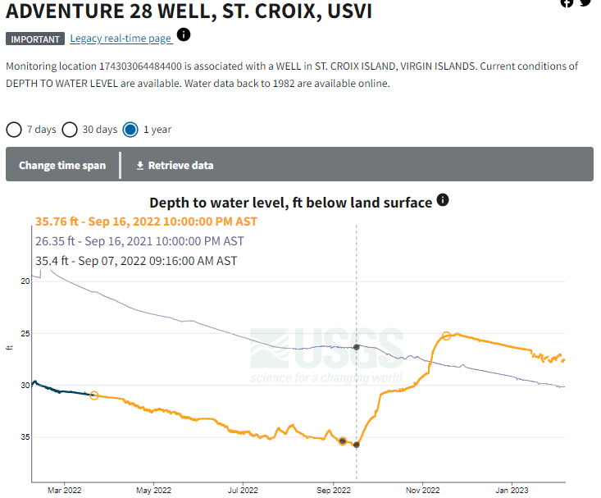

Slide 14
Natural Resources and Conservation District (NRCS) Environmental Quality Incentive program (EQiP) in the USVI for 2020, 21 and 22

Slide 15
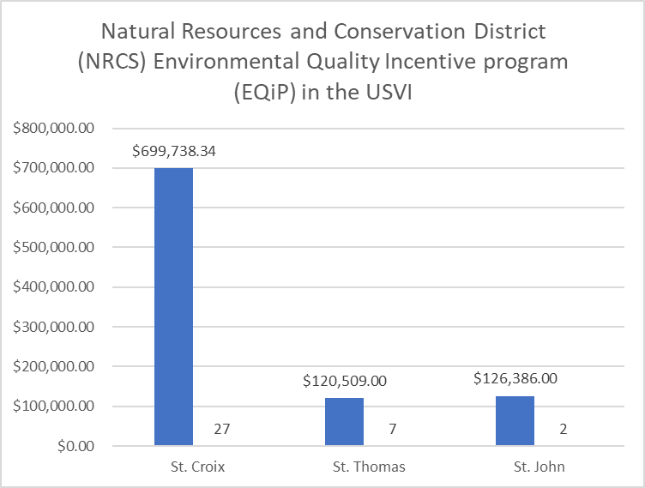
Total Obligation Amount : $946,633.34 for a total of 36 Contracts
Notes:
With our local and federal partners this is what is happening for irrigation and conservation across the USVI with the aid of our collaborators – it take a village and VIDA is leading with the support of the ag plan, researchers and the broader farming and community at large.

Slide 16
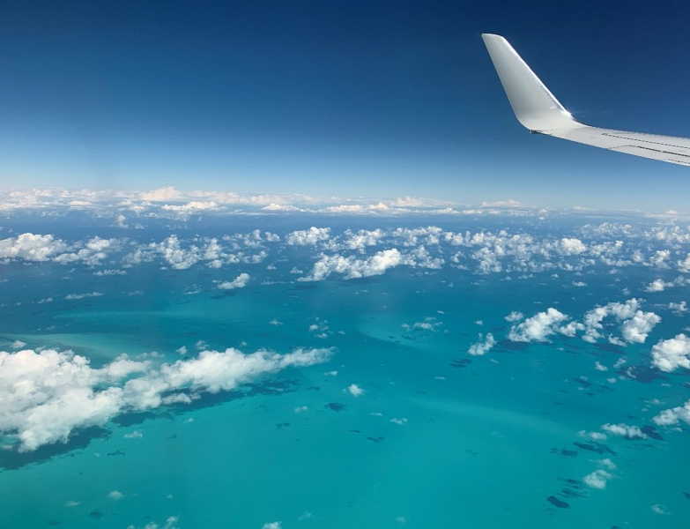
Thank you!! Questions?
Commissioner of Agriculture: Positive T.A. Nelson
positive.nelson@doa.vi.gov
(340) 774-5182
Research Specialist:
Christina Chanes-Bryan
Christina.chanes@uvi.edu
(340) 344-6210

