Slide 1
Notes:
Welcome to Frederiksted Health Care the only Community Health Center on St. Croix!

Slide 2
Frederiksted Health Care
A Healthy,
Vibrant, Resilient
Community
Notes:
A few weeks ago we completed our 3-year strategic plan and rewrote our vision for St. Croix. We chose a vision that targets the health of our community but also acknowledges the spirit of the Caribbean people and the challenges living in our tropical environment.
We will spend the next three years increasing access to services with dental and mental health as our top priorities, creating comprehensive, one-stop-shop health centers with medical, dental and behavioral health services all available at the same location, and integrating services more fully with a particular focus on oral health screening and services provided in medical to expand our capacity among other goals.

Slide 3
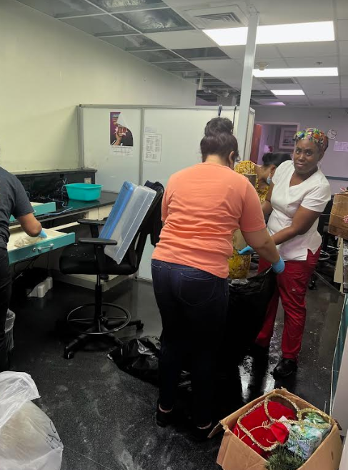
Resilient
Notes:
I am very glad that we included resilient in our vision statement – last Wednesday as we were preparing to shine up our health center here in Frederiksted for this site visit, we were greeted with a water leak that had happened overnight and wreaked havoc on our facility. So instead of last minute preparations for your visit, we spend the remainder of last week cleaning and drying out our flagship health center.

Slide 4
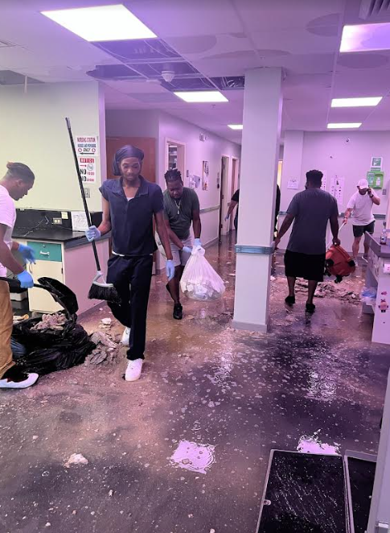
Resilient
Notes:
So, as they say, please forgive our dust!

Slide 5
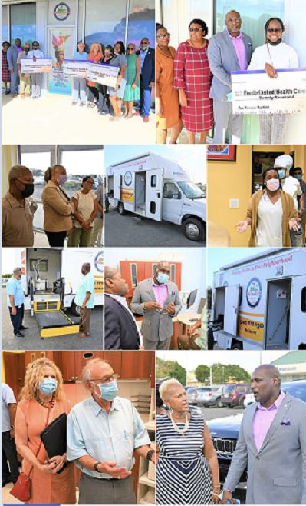
LHSC Dental Opening

Slide 6
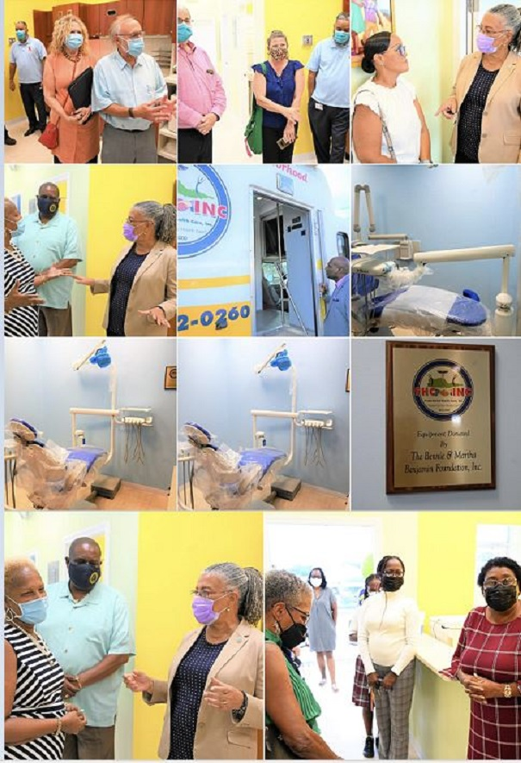
LSHC Dental Opening

Slide 7
Patients
Notes:
Frederiksted Health Care has grown significantly since its creation almost 25 years ago. Our patient population peaked at almost 12,000 patients in 2019. As you can see, our patient population fell dramatically in 2020 due to the COVID-19 public health emergency and although we have increased from the low in 2020, we have lost almost 2,000 patients to care. We will work during 2023 to reengage these patients in care and expect to reach our 2019 level by the end of 2023.

Slide 8
Visits
Notes:
At our 2019 peak, Frederiksted Health Care provider over 42,000 medical, dental, and behavioral health visits. We responded to the COVID-19 public health emergency by rapidly implementing telehealth visits and continue to use that tool to remove access barriers for our patients. We anticipate returning to nearly 42,000 visits again during 2023.

Slide 9
1 in 4 Residents of St Croix Are FHC Patients
Notes:
The population of the Virgin Islands fell significantly from 2010 to 2020 due to many factors including the loss of the key private employer which closed in 2012 and Hurricanes Irma and Maria in 2017. Overall, our community lost 18.1% of its population – leaving many of those with the least resources behind.

Slide 10
Patient Distribution
Notes:
Over the past 10 years, Frederiksted Health Care has added locations across the island to remove transportation barriers to care. These new locations are near population centers extending our reach beyond our original location in Frederiksted at the far west end of the island. Our patients are now evenly distributed across the three major population centers on St. Croix.

Slide 11
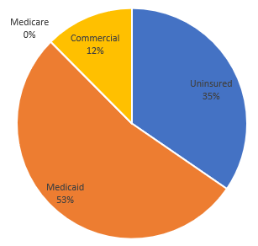
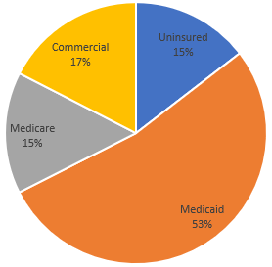
Payer Mix
Medical Dental
Notes:
Frederiksted Health Care is heavily dependent on revenue from Medicaid which accounts for 53% of our patients. Known as the Medical Assistance Program, or MAP, in the Virgin Islands, this program covers approximately 24% of Virgin Islanders. Eligibility for MAP is not as generous as it is in those states that expanded Medicaid under the Affordable Care Act and about 27% of Virgin Islanders remain uninsured.
Our dental payer mix is, of course, significantly worse than our medical payer mix as 15% of our patients are covered by Medicare and not all commercial insurance includes dental coverage. As a result, approximately 35% of our patients are uninsured for dental services.

Slide 12
Current Operations
COMPREHENSIVE SERVICES
Medical Dental Pharmacy
Mental Health Substance Use Disorder Enabling
FIVE LOCATIONS
Ingeborg Nesbitt North Shore Mid Island
Dental East Lena Schulterbrandt
Notes:
Frederiksted Health Care provides comprehensive integrated services including medical, dental, mental health, substance use disorder, pharmacy and enabling services. We are a Ryan White Part C provider and have programming to address the needs of individuals experiencing homelessness. We also receive funding from the CDC to prevent the transmission of HIV and engage individuals in treatment.
Today, we provide services at five locations, however our landlord at our Dental East location has just informed us our lease will not be renewed and will lose that facility which includes 5 dental operatories.

Slide 13
Comprehensive Services
Medical
Dental
Behavioral Health
Psychiatry
Perinatology
Enabling Services
Notes:
Our services are comprehensive in order to meet the needs of our patients. We provide medical care including OB services and provided prenatal services to almost 400 pregnant women in 2022. Our dental services include preventive dental, additional dental and oral surgery services. We provide mental health and substance use disorder counseling services as well as specialty psychiatric services. Due to the high risk associated with ZIKA and other vector-borne disease, we also provide specialty perinatology services including level 2 ultrasounds and amniocentesis. Enabling services include care management for Ryan White patients, individuals experiencing homelessness, and seniors with multiple chronic diseases.

Slide 14
Health Center Program Quality Awards

Slide 15
Only Dental Residency Program in the Virgin Islands

Slide 16
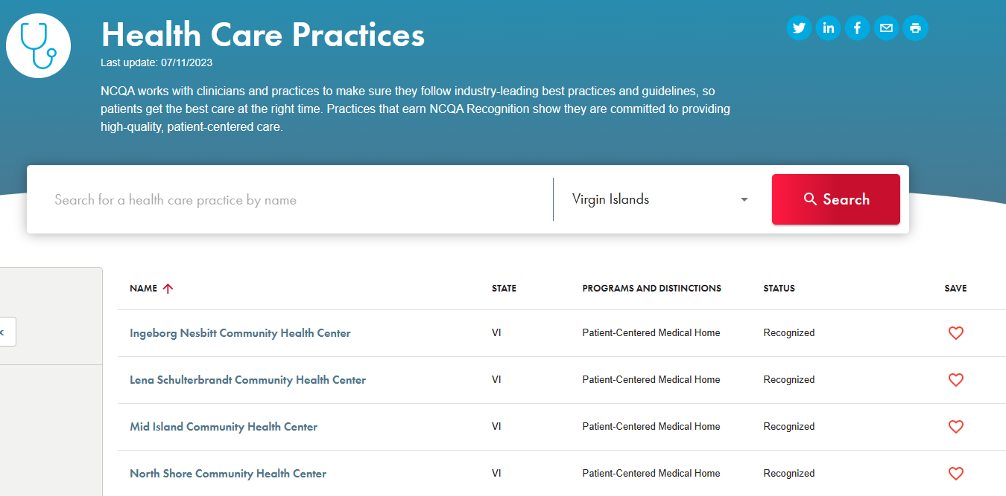
Only Patient Centered Medical Homes in the Virgin Islands
Notes:
In 2020, Frederiksted Health Care worked to receive Patient Centered Medical Home Designation at Ingeborg Nesbitt, Mid Island and North Shore which are the only NCQA PCMH designated locations in the Virgin Islands. Our designations were recently renewed through June 2024. We are finishing our application for PCMH designation for our newest health center, Lena Schulterbrandt, and expect designation by the end of the summer.

Slide 17
Federal Tort Claims Act

Slide 18
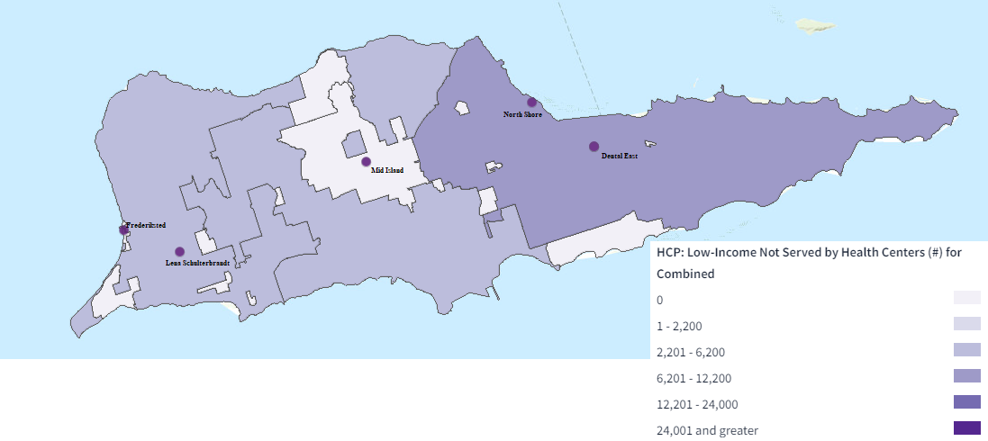
15,000 Low-Income Unserved
Notes:
Despite our growth, the Health Resources and Services Administration estimates there are approximately 15,000 low-income individuals on St. Croix who are without access to care. FHC would have to more than double in size to reach all of these individuals. We clearly have our work cut out for us!

Slide 19
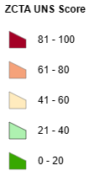
Unmet Needs Score
Notes:
The Health Resources and Services Administration recently developed a numerical measure of unmet needs across the United States and Territories. The vast majority of St. Croix has an UNS Score of more than 81 indicating high unmet needs. UNS includes a variety of factors including poverty level, diabetes prevalence, childhood immunization, health center penetration rate, life expectancy, low birth weight, lack of high school diploma, obesity, smoking, mortality under the age of 5, and lack of health insurance.

Slide 20
Income Declining
2009 Virgin Islands: $44,499
2019 Virgin Islands: $40,408
9.1% Decrease
2019 United States: $67,521
VI: 60% of National Median Household Income
Notes:
The 2020 census found income in the Virgin Islands has actually decreased more than 9% from the 2010 census – and currently is only 60% of the national median household income.

Slide 21
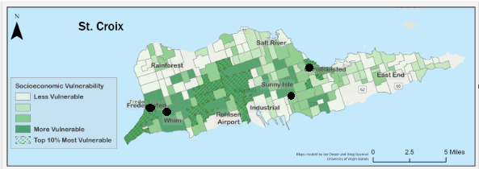
Socio-economic Vulnerability

Slide 22
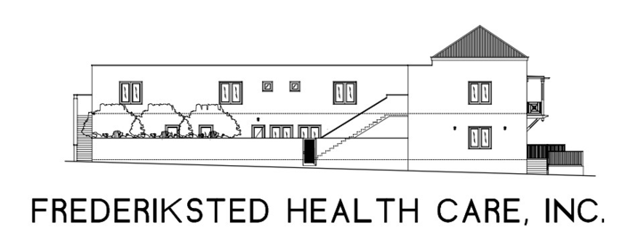
Counseling and Outreach Services
Notes:
Dental is one of the highest unmet need for services on St. Croix. There are 7 dental health professional shortage areas in the Virgin Islands. Frederiksted Health Care has a dental HPSA site designation with a score of 26 – the highest possible HPSA score indicating the most need. The Kaiser Family Foundation estimates only 51% of dental needs in the Virgin Island are met and an additional 26 practitioners are needed to remove the dental HPSA. This would require an additional 52 to 78 dental operatories on the island – most of them here on St. Croix and the poorest and most populous island.

Slide 23
Liberation
Notes:
I mentioned our strategic planning retreat earlier in my presentation. We also considered our values as an organization during our strategic planning retreat which was attended by our Board of Directors and staff.
The knowledge that our island is faced with many health disparities weighs heavy on our organization and we considered the concepts of equality and equity as it applies to health care. The reality is that a few have all of the advantages, some struggle to keep their heads above water, and others are at a clear and measurable disadvantage. While a goal of equality sounds good, you can see that providing equal access and supports to everyone still leaves some struggling and many at a disadvantage. Equity in health care would provide access and supports based on individual needs and results in everyone having equal access – but still facing the same barriers. Liberation removes the fence – the barriers to health care.
Our strategic planning group originally included Equity as one of our core organizational values, however by the end of our retreat, reconsidered and replaced equity with LIBERATION as we strive to remove all barriers to health care on St Croix for everyone

Slide 24
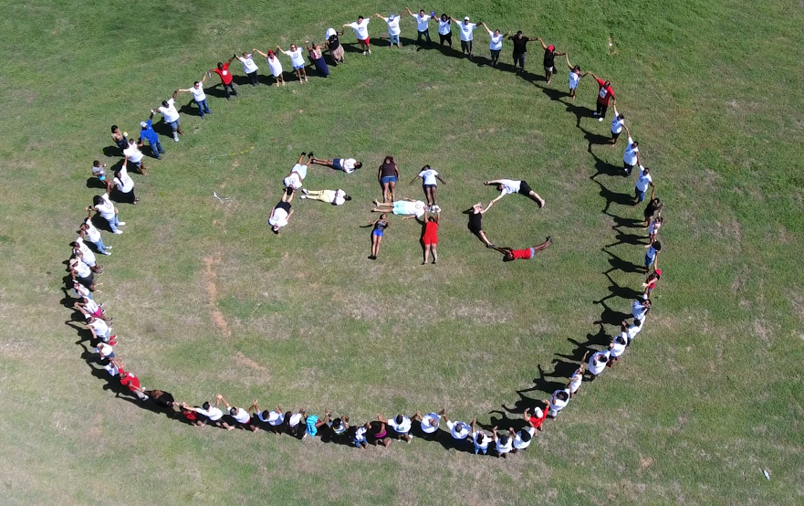
Notes:
Welcome to St. Croix and to Frederiksted Health Care. Our team is happy to have you here!
What questions can I answer for you?

