Slide 1
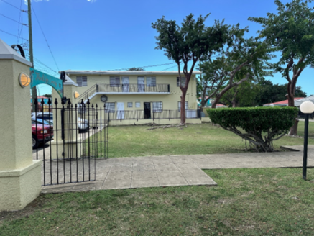
ZAC-24-4: Photo of current site condition- already developed lots

Slide 2
ZAC-24-4: Photo of current site condition- already developed lots

Slide 3
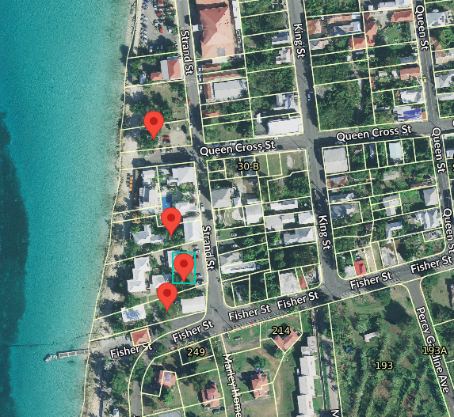
ZAC-24-4: MapGeo aerial view of properties (marked in red)

Slide 4
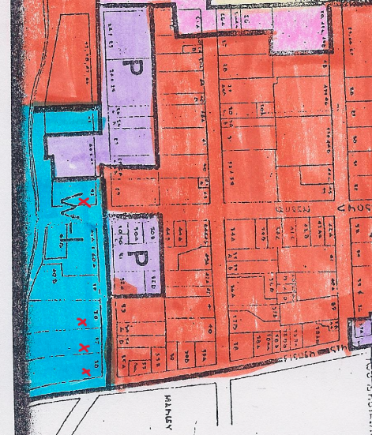
ZAC-24-4: Official Zoning Map No. SCZ-18 (properties’ locations indicated by red Xs)

