Slide 1
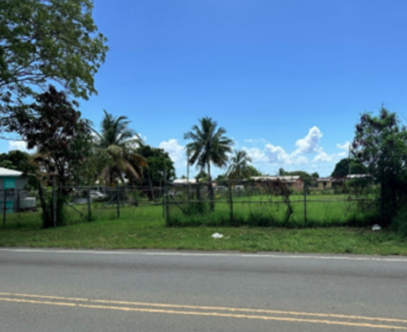
ZAC-24-3: Photo of current site condition- undeveloped land

Slide 2
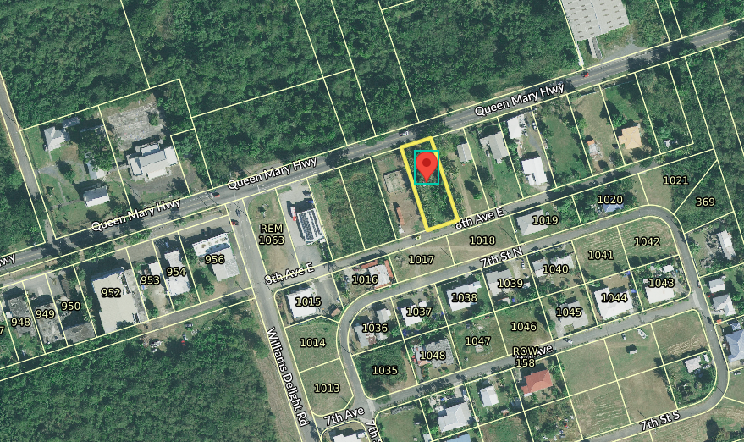
ZAC-24-3: MapGeo aerial view of property (marked in red)

Slide 3
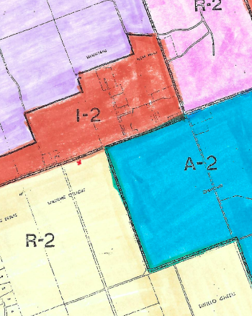
ZAC-24-3: Official Zoning Map No. SCZ-11 (property location indicated by red X)

Slide 4
ZAC-24-3: Conceptual drawing of proposed development

