Slide 1
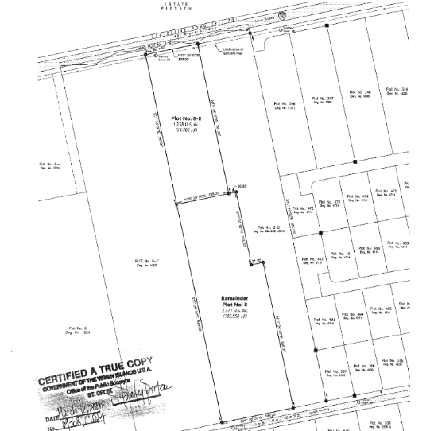
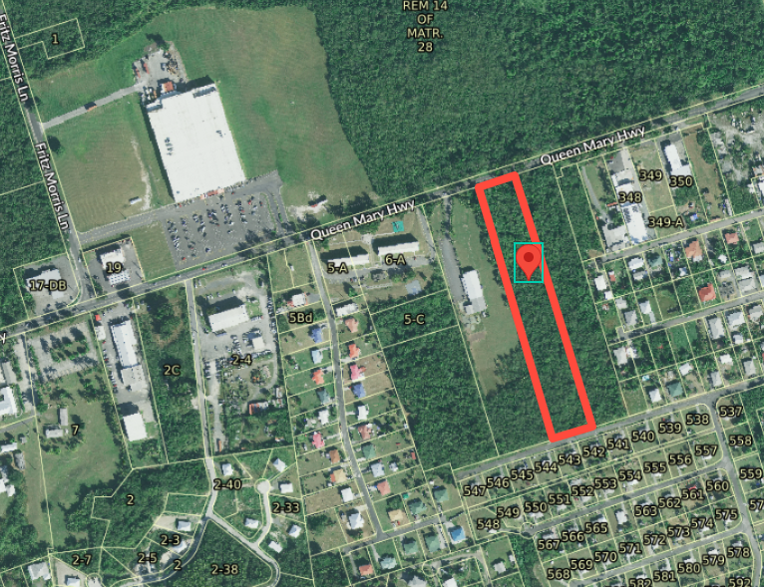
ZAC-24-5: Photo of current site condition- undeveloped land
8-E
B-3
Rem 8
R-3

Slide 2
ZAC-24-5: MapGeo aerial view of properties (marked in red)

Slide 3
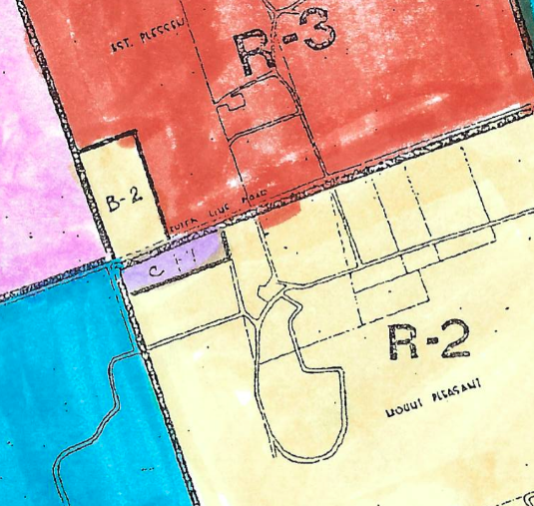
ZAC-24-5: Official Zoning Map No. SCZ-11 (properties location indicated by red X)

Slide 4
ZAC-24-5: Conceptual drawing of proposed development
Phase 3
Phase 2
Phase 1

