Slide 1
ZAC-24-6: Photo of current site condition- undeveloped land

Slide 2
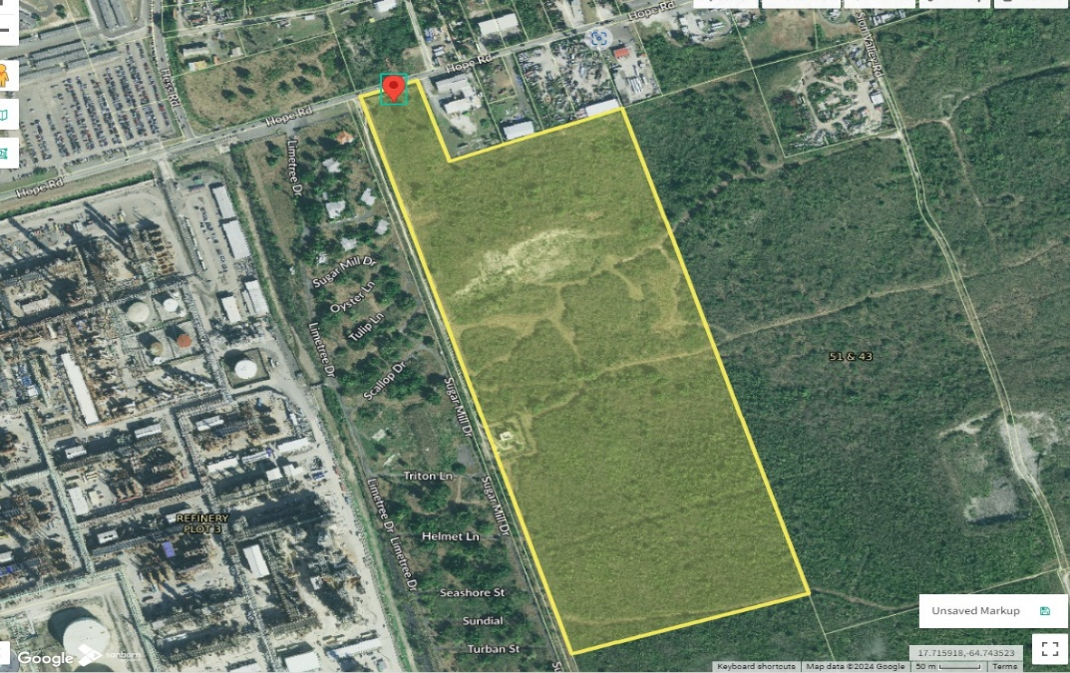
ZAC-24-6: MapGeo aerial view of property (marked in red)

Slide 3
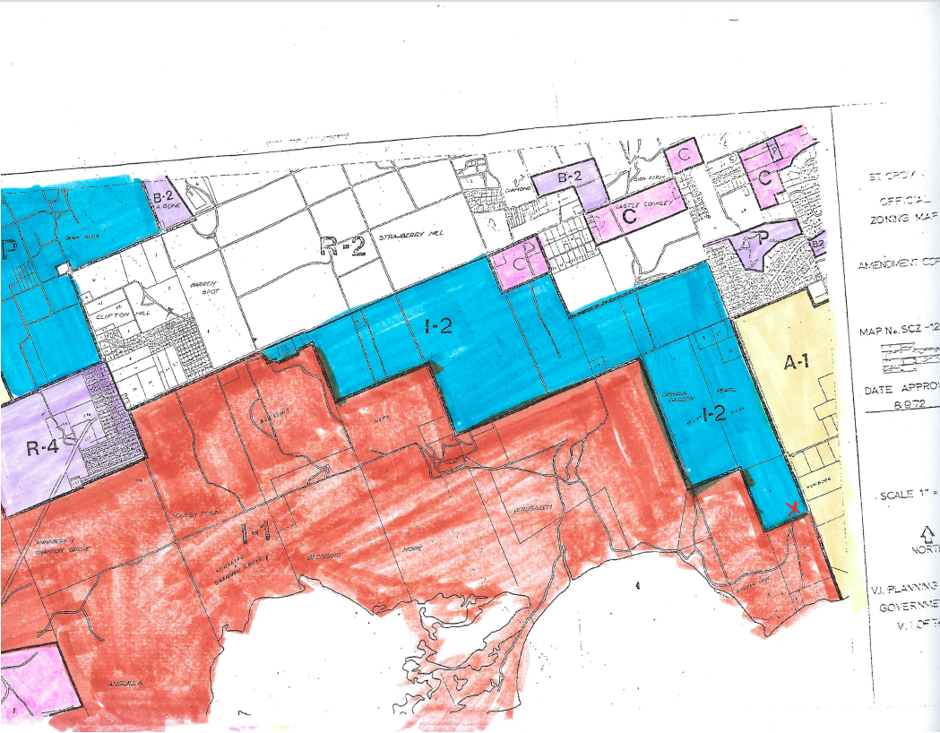
ZAC-24-6: Official Zoning Map No. SCZ-12 (property location indicated by red arrow

Slide 4
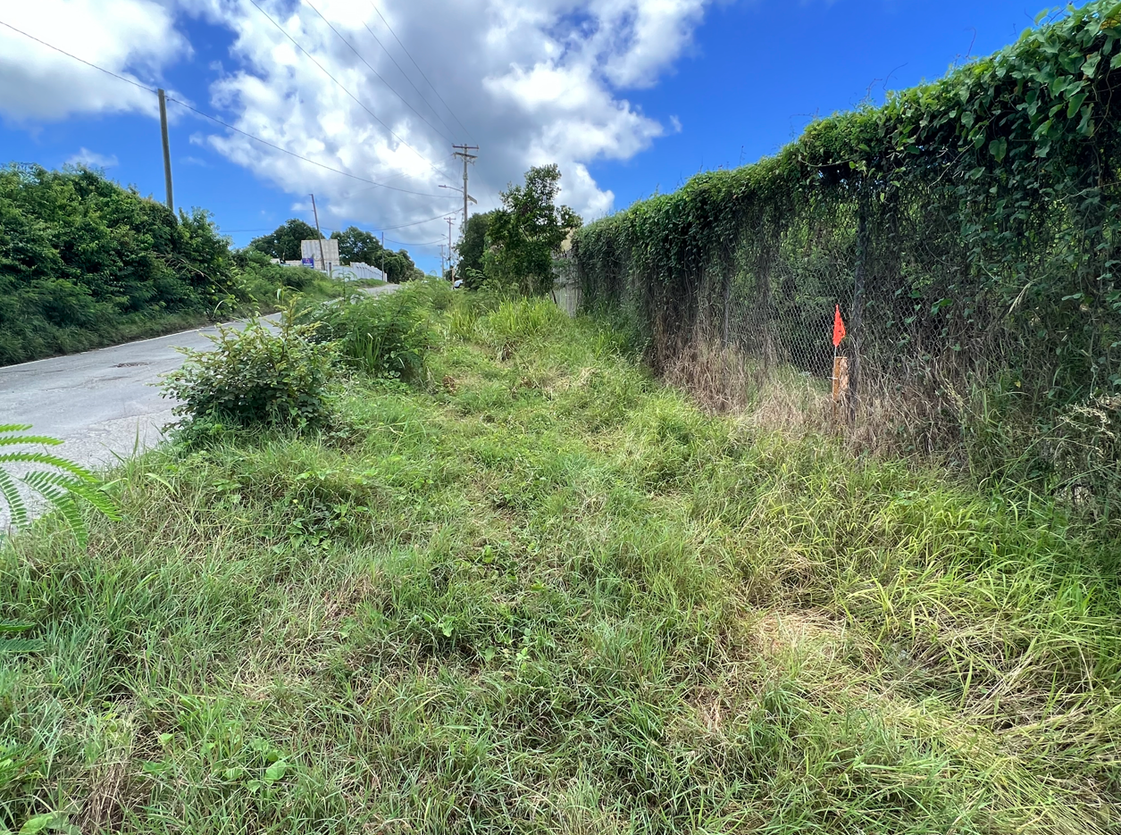
ZAC-24-6: Red arrow shows location of Monitoring Well No. 621/red flag in fence

Slide 5
ZAC-24-6: Conceptual drawing of proposed development

