Slide 1
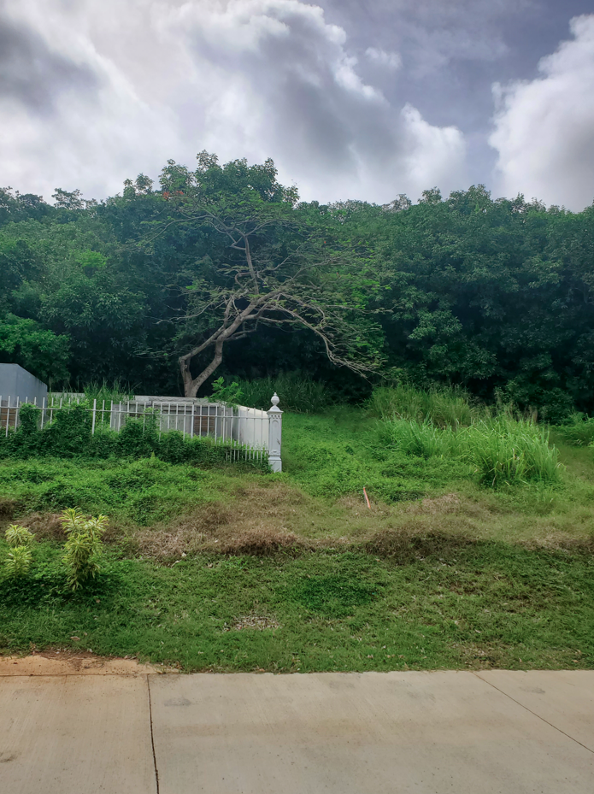
ZAT-24-8: Photo of current site condition- undeveloped lot located behind the Paragon Medical Building and the Lockhart Family cemetery

Slide 2
ZAT-24-8: MapGeo aerial view of property (marked in red)

Slide 3
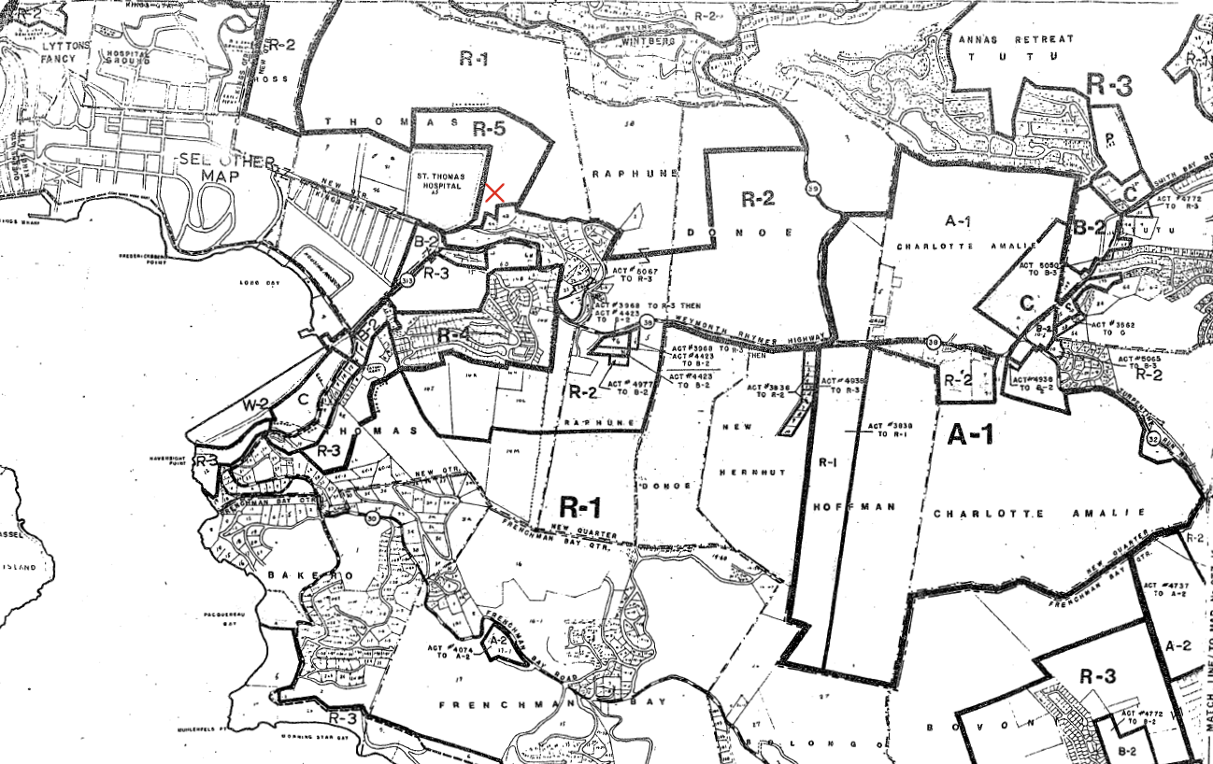
ZAT-24-8: Official Zoning Map No. STZ-7 (property location indicated by red X)

Slide 4
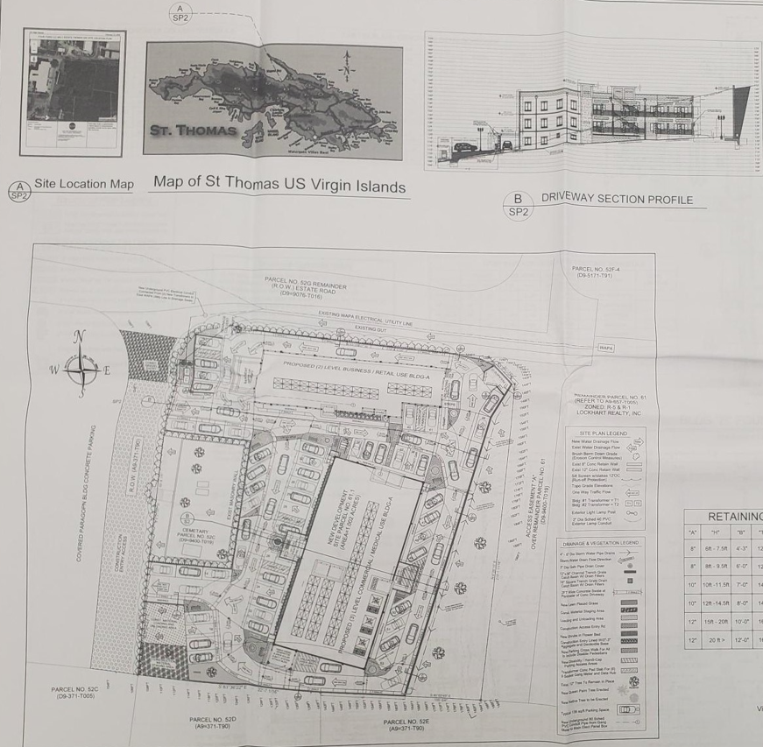
ZAT-24-8: Proposed site plan layout

