Slide 1
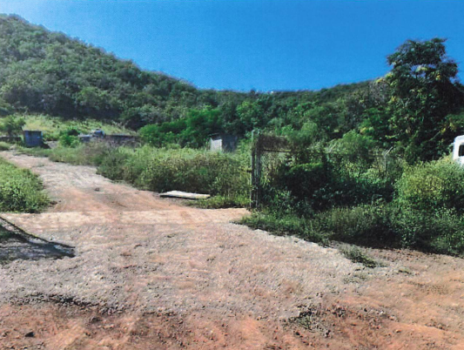
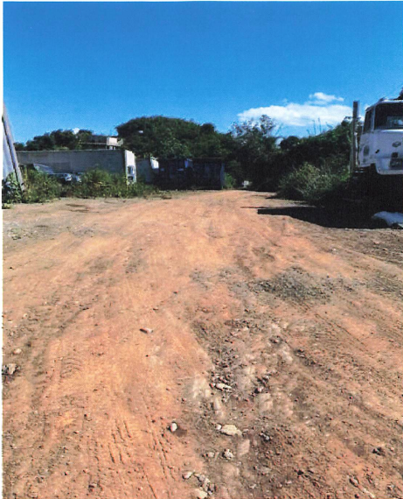
ZAT-24-7: Photos of current site condition

Slide 2
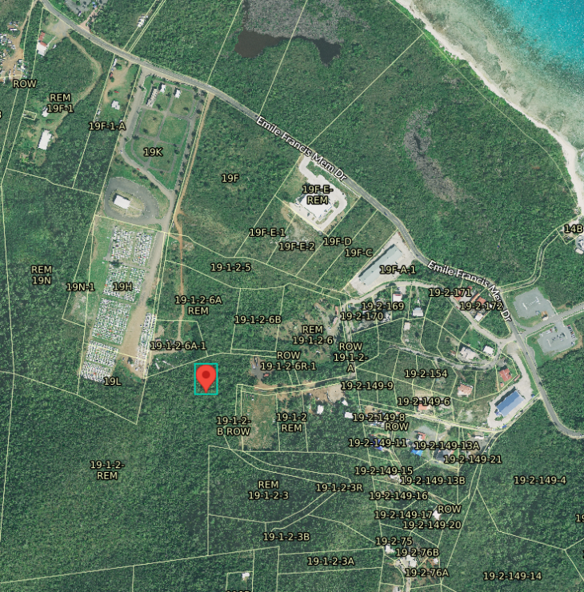
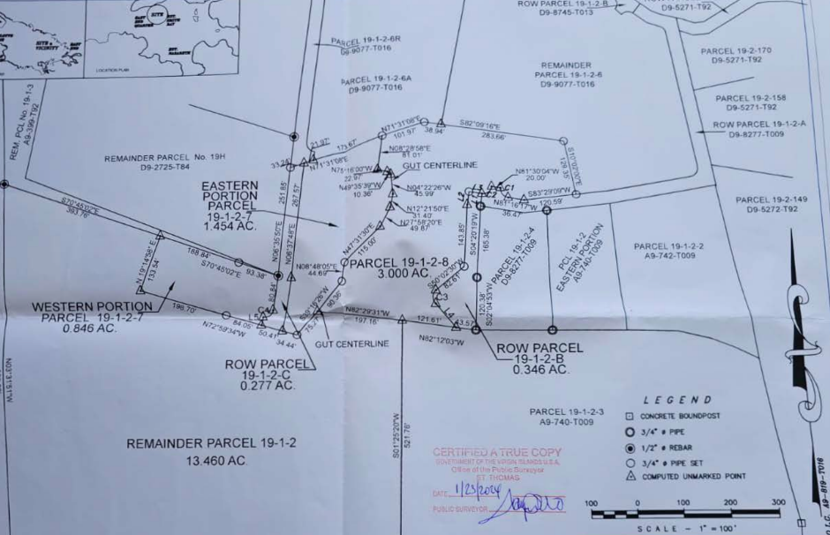
ZAT-24-7: MapGeo aerial view of property (marked in red)

Slide 3
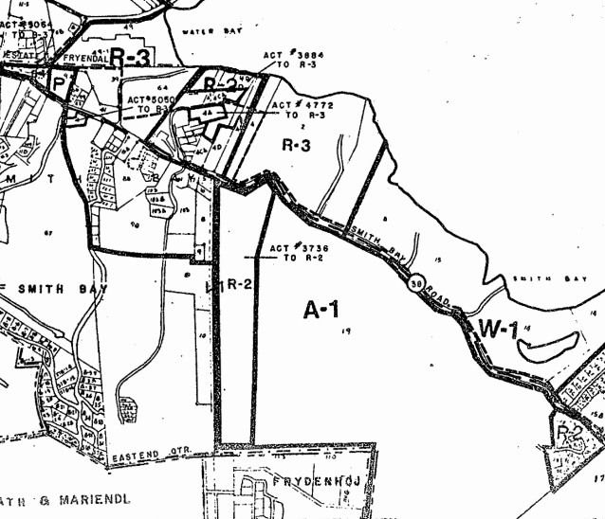
ZAT-24-7: Official Zoning Map No. STZ-9 (property location indicated by red X)

Slide 4
ZAT-24-7: Proposed site plan layout

