Slide 1
Petition for Amendment to Zoning Map No. 19-1-2-8 Estate Smith Bay Legislative Public Hearing September 19, 2024

Slide 2
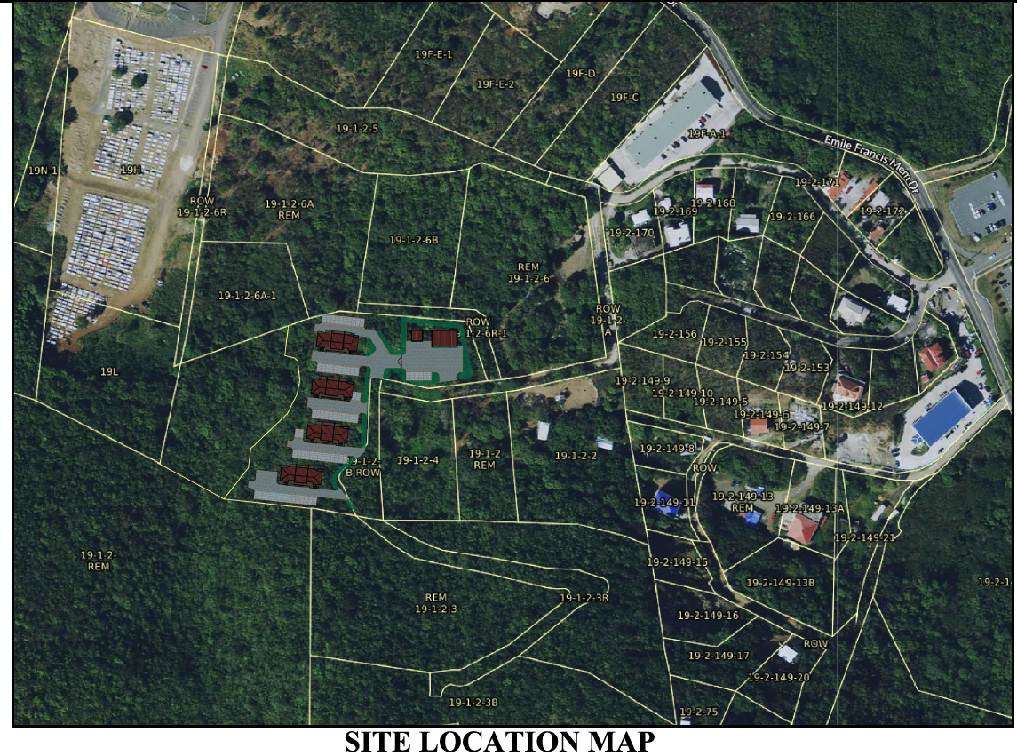
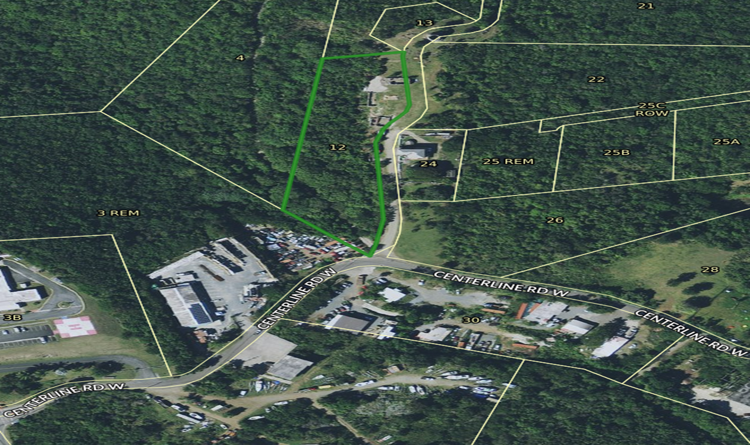
PROPERTY LOCATION
Estate Smith Bay, St. Thomas, U.S. Virgin Islands
East of the Eastern Cemetery near the Emile Francis Memorial Drive.

Slide 3
Access Road

Slide 4
WHAT IS ON THE PROPERTY?
The property consists of bare land with some planted crops.

Slide 5
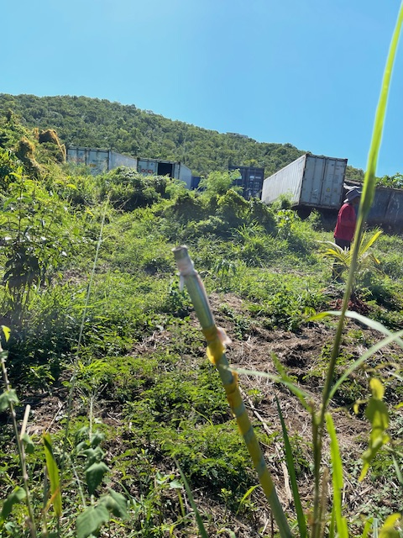
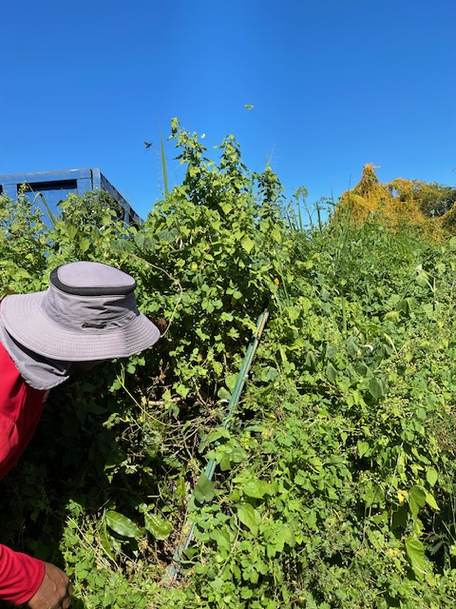
What’s surrounding the property? To the East

Slide 6
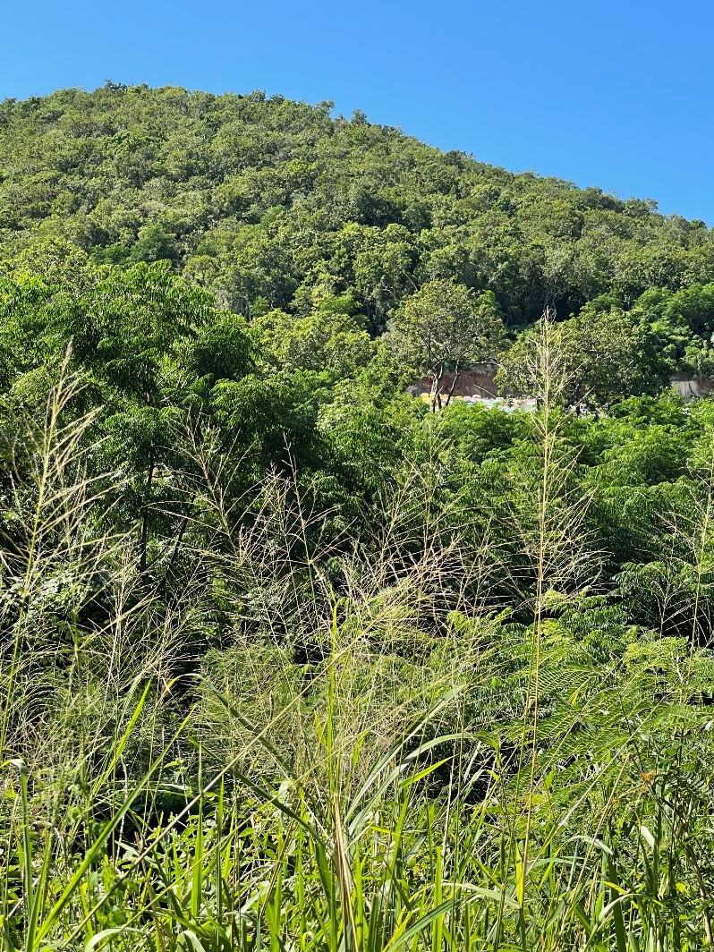
What’s surrounding the property? To the West

Slide 7
What’s surrounding the property? To the North?

Slide 8
AMENDMENT REQUEST PURPOSE
Rezone Parcel No. 19-1-2-8 Estate Smith Bay, St. Thomas, U.S. Virgin Islands from A-Agriculture to B-3 Business—Scattered with a variance for agricultural uses .
Allow for residential development, specifically for the construction and operation of an apartment complex, 36 two-bedroom units.
Incorporates supportive commercial elements, including a convenience store, laundromat, and a management/leasing office.
Variance will allow for light organic farming and retail sales of agricultural products, which continues the historical uses of farming activities on the property.
The use will include commercial equipment rentals and leasing, car rental, small garage, and water delivery and distribution services contributing positively to the local economy and community.

Slide 9
What is the proposed use if the rezoning were to occur?

Slide 10
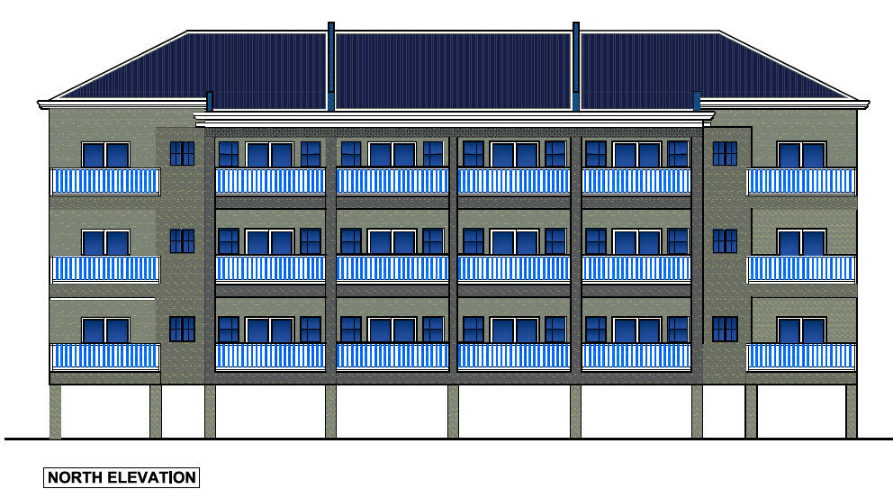
What is the proposed use if the rezoning were to occur?
PROPOSED USES:
4 Buildings containing Residential Apartment Units
Three stories
27 persons per building.
Apartment building size: 4,488.00 S.F.
Lot occupancy: total building coverage: 16% [21,028.00 S.F.]
Residential Buildings total area:: 17,952.00 S.F.
The parking spaces will exceed code requirements.

Slide 11
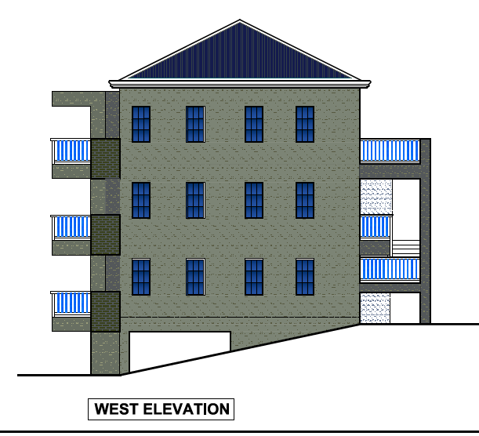

Slide 12
PROPOSED USES (continued): Commercial heavy equipment storage building. Building Size: 2,400.00 S.F. Building Height: One Story

Slide 13
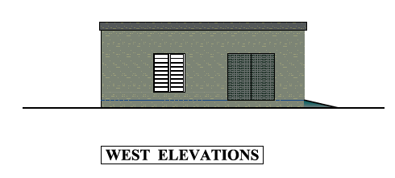
PROPOSED USES (continued): Vehicle parking garage: Building Size: 676.00 S.F. Building Height: One Story
Commercial Buildings total area::
3,076.00 S.F.

Slide 14
COMPATIBILITY OF USES
Use is Compatible with surrounding land uses that include scattered residential and commercial elements.
The US Citizenship and Immigration Services Building is nearby.
A shopping center with a gym and restaurant is located nearby.
The closest residence is more than 300 feet away.
The Property is near to the Red Hook Dock.
The Property is within walking distance of the Lindqvist Beach.
There is a church within walking distance.

Slide 15
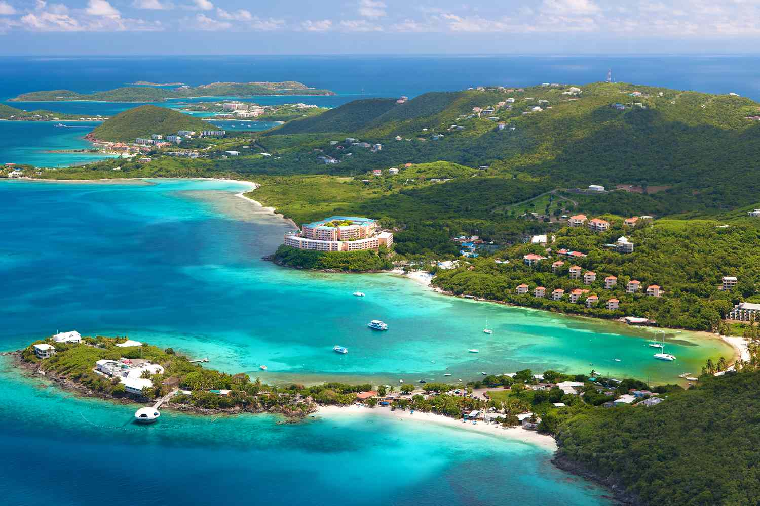
The End

