Slide 1
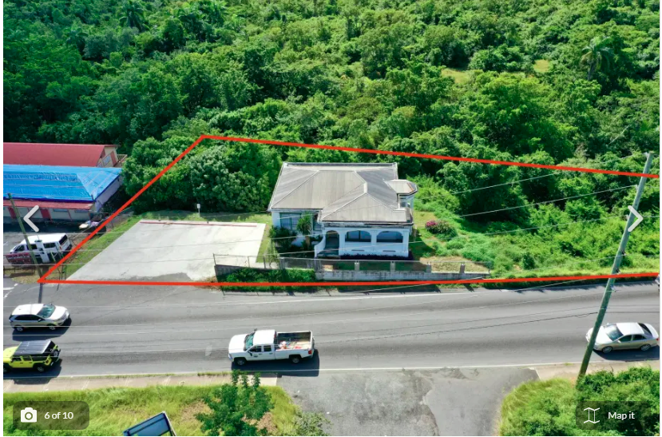
ZAT-24-6: Photo of current site condition

Slide 2
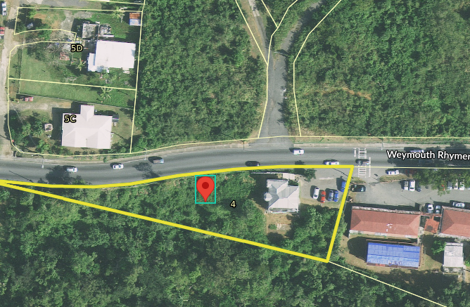
ZAT-24-6: MapGeo aerial view of property (marked in red)

Slide 3
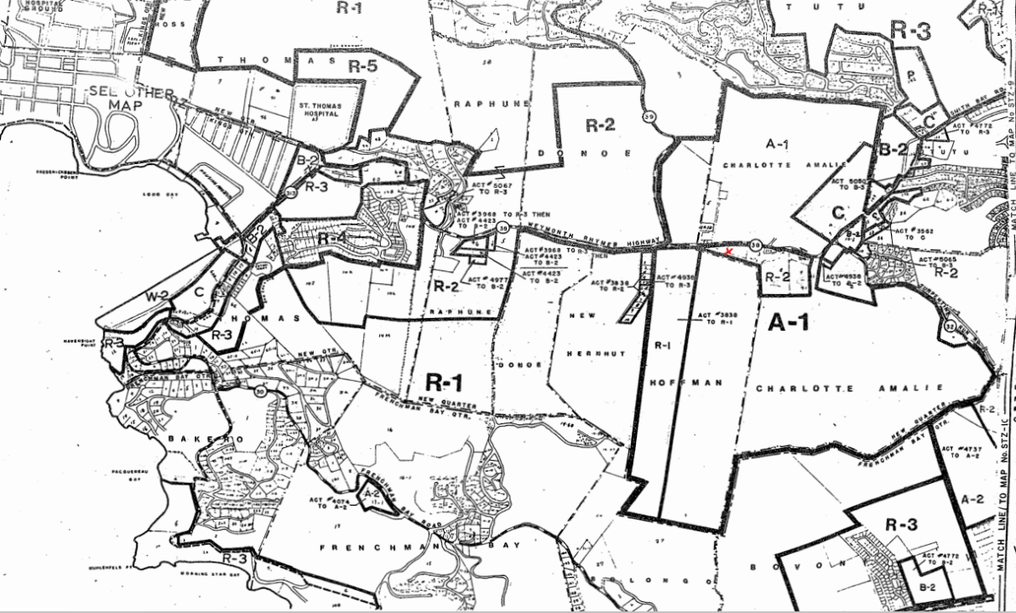
ZAT-24-6: Official Zoning Map No. STZ-7 (property location indicated by red arrow)

