Slide 1
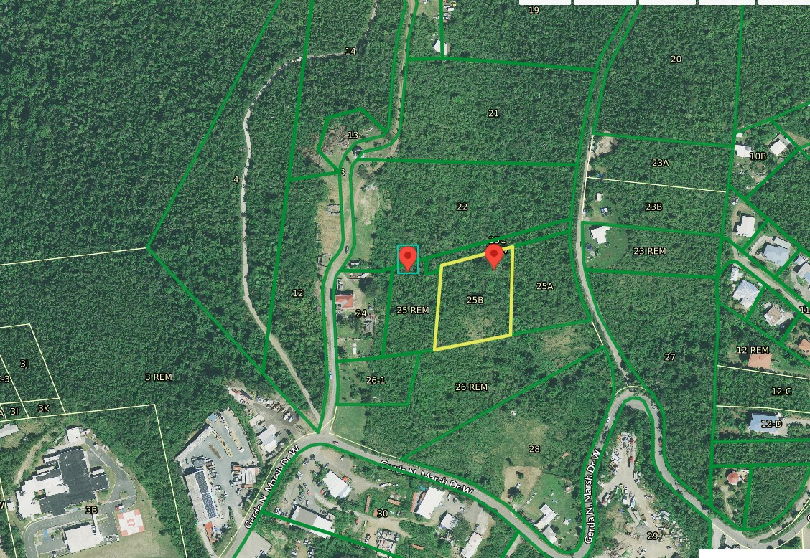
ZAJ-24-4: Photo of current site condition- undeveloped land

Slide 2
ZAJ-24-4: MapGeo aerial view of the subject properties

Slide 3
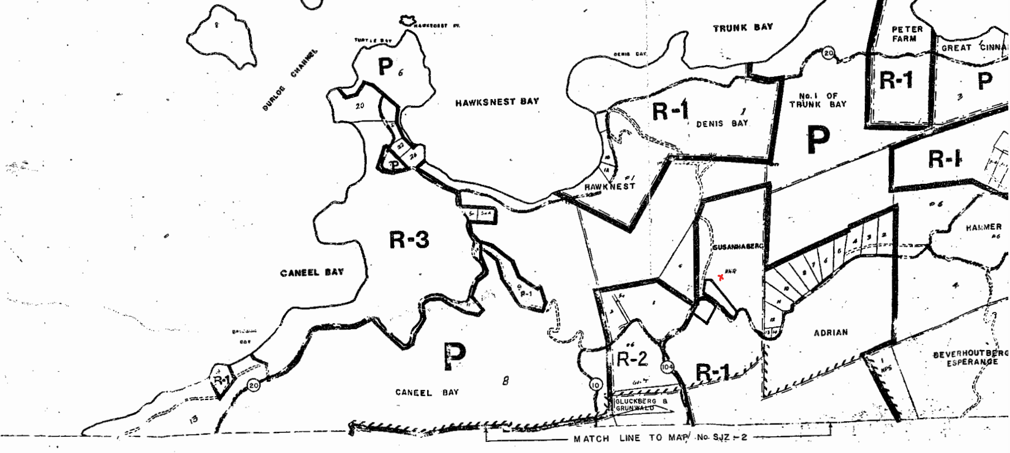
ZAJ-24-4: Official Zoning Map No. SJZ-1 (properties’ location indicated by red X)

Slide 4
ZAJ-24-4: Conceptual drawing of proposed development
Phase 1
Phase 2

