Slide 1
Bill ZAC-22-12 Amending the zoning designation of Plot Nos. 102-A Remainder, 102-B, and102-C Estate Hermon Hill, Company Quarter, St. Croix from R-3 (Residential - Medium Density) to P (Public) for VITEMA’s main office/center of operations on St. Croix to include an Emergency Operations Center, a safe room for emergency responders to shelter in place during storm/disasters, and a 9-1-1 Emergency Center
35th Legislature, Committee of the Whole VITEMA EOC and Safe Room
March 10, 2023
Notes:
MATCH ALL TEXT AND TEXT SIZES

Slide 2
Today’s Agenda
Project Introduction
Proposed Zoning Designation
Existing Conditions Review
Exterior Building Review
Next Steps
35th Legislature, Committee of the Whole VITEMA EOC and Safe Room
March 10, 2023
Notes:
MATCH ALL TEXT AND TEXT SIZES

Slide 3
Daryl Jaschen
Director
VITEMA
2164 King Cross Street
St. Croix, US Virgin Islands 00820
Steve DeBlasio
Deputy Director of Logistics
VITEMA
Graciela Rivera
Territorial Hazard Mitigation Officer
VITEMA
Asante Richards
Construction Program Manager
VITEMA
Gilbert Laban RA
Director
Springline Architects, LLC
6346 Estate Smith Bay
St. Thomas, US Virgin Islands 00802
Mike de Haas AIA
Principal
Springline Architects, LLC
Jerry Traino AIA, REWC
Principal
Springline Architects, LLC
35th Legislature, Committee of the Whole VITEMA EOC and Safe Room
March 10, 2023
Notes:
MATCH ALL TEXT AND TEXT SIZES

Slide 4
Proposed Site
35th Legislature, Committee of the Whole VITEMA EOC and Safe Room
March 10, 2023
Notes:
MATCH ALL TEXT AND TEXT SIZES

Slide 5
PROPOSED USE – SUMMARY
PROPOSED USE
Main offices for VITEMA, Emergency Operations Center (EOC) and 9-1-1 Emergency Call Center (ECC)
New 4-story, 25,000 sf facility on existing footprint
VITEMA Operational Facility, Connecting Corridor, Safe Room, Mechanical Equipment Building
Support facilities – Water collection/connection, stormwater basin, generator
CONSTRUCTION PHASES
No phasing, New Construction
Demolition – 2 months
Construction – 18 months
STAFFING
Office Staff and 911 – 60 occupants
Safe Room – 24 to 48 hour operations – 200 occupants
Training/Pre and Post-Hazard Staffing – 150 occupants
FUNDING
FEMA-4340-DR-VI Hazard Mitigation Grant Program (HMGP) - Project 4340-0010
200
Safe Room
24-hrs to
48-hrs
150
150
Training or 24-hr operations Pre-Storm Staffing
24– hr operations
Post Storm Staffing
100
60
Training or 12-hr operations Post Storm Staffing
60
Office Staff &
9-1-1
Office Staff &
9-1-1
35th Legislature, Committee of the Whole VITEMA EOC and Safe Room
March 10, 2023

Slide 6
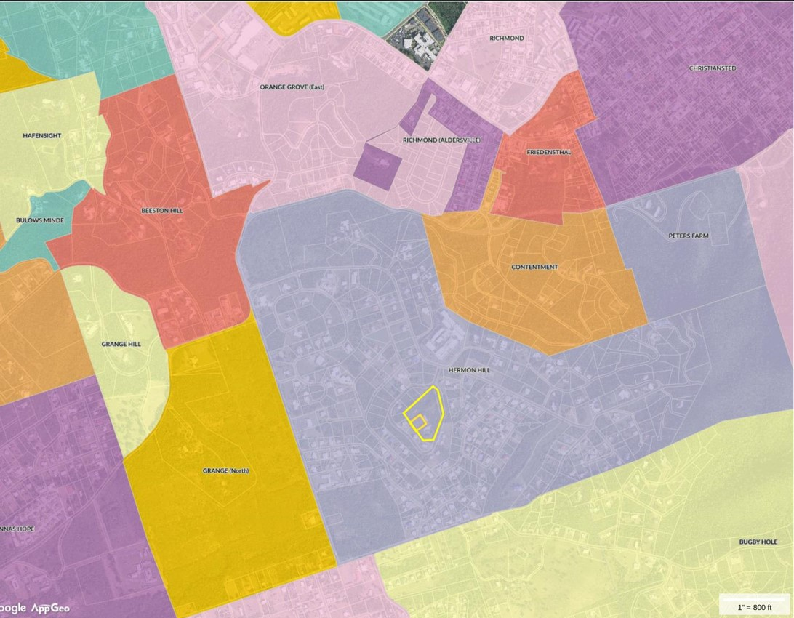
PROPERTY LOCATION/DETAILS
ESTATE
Hermon Hill
PROJECT LAT/LONG
17º43’58.27’’ N /64 º42’51.08” W
PROPERTY DESCRIPTION
Plot 102-A Remainder Plot 102-B Plot 102-C Estate Hermon Hill, Company Quarter
4.579 Acres
ZONING
Current – R-3 (Residential-Medium Density)
Proposed – P (Public) – VITEMA EOC
35th Legislature, Committee of the Whole VITEMA EOC and Safe Room
March 10, 2023
Notes:
MATCH ALL TEXT AND TEXT SIZES

Slide 7
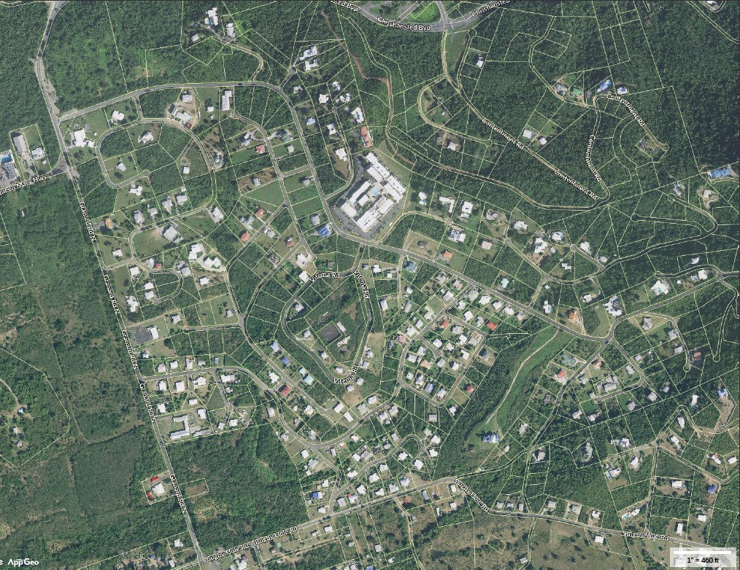
ADJACENT LAND USE
LAND USE WITHIN ¼ MILE OF PROJECT
Multi-Family Residential
Single Family Residential
Religious/Institutional
Open Space
Vacant Land
NEAREST RESIDENTIAL BUILDING TO LOT LINE
~ 25 Feet
NEAREST RESIDENTIAL BUILDING TO EXISTING AND PROPOSED BUILDING
~ 110 Feet
35th Legislature, Committee of the Whole VITEMA EOC and Safe Room
March 10, 2023
Notes:
MATCH ALL TEXT AND TEXT SIZES

Slide 8
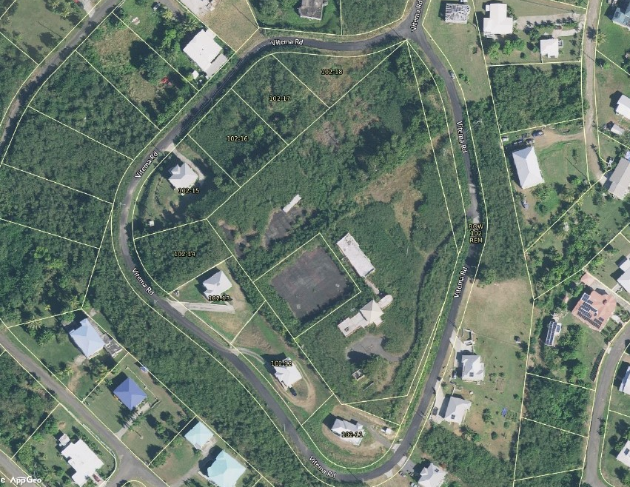
EXISTING CONDITIONS
BUILDINGS
2-Story L Shaped Building
Built circa 1976
North Wing and South Wing
STRUCTURES AND SITE
Tennis Courts
Driveways
Parking
Underground Utilities
USE
Original Use as Tennis Club
VITEMA-occupied to 2011
Currently Vacant
Existing North Wing
Tennis Courts
Existing South Wing
Parking and Driveway
35th Legislature, Committee of the Whole VITEMA EOC and Safe Room
March 10, 2023
Notes:
MATCH ALL TEXT AND TEXT SIZES

Slide 9
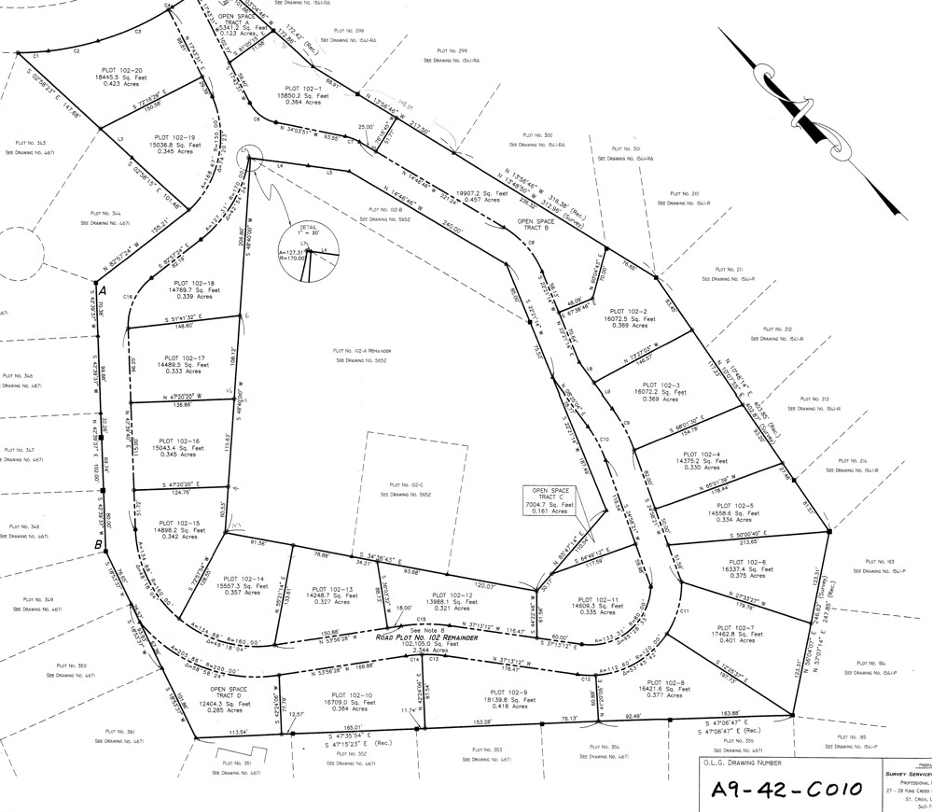
PROPERTY LOCATION/DETAILS
PROPERTY ID
204913023300
102 Hermon Hill
STX
OLG MAP No.
A9-42-C010
35th Legislature, Committee of the Whole VITEMA EOC and Safe Room
March 10, 2023
Notes:
MATCH ALL TEXT AND TEXT SIZES

Slide 10
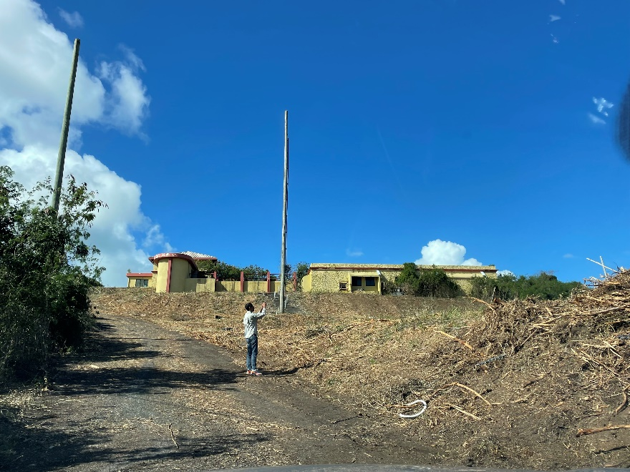
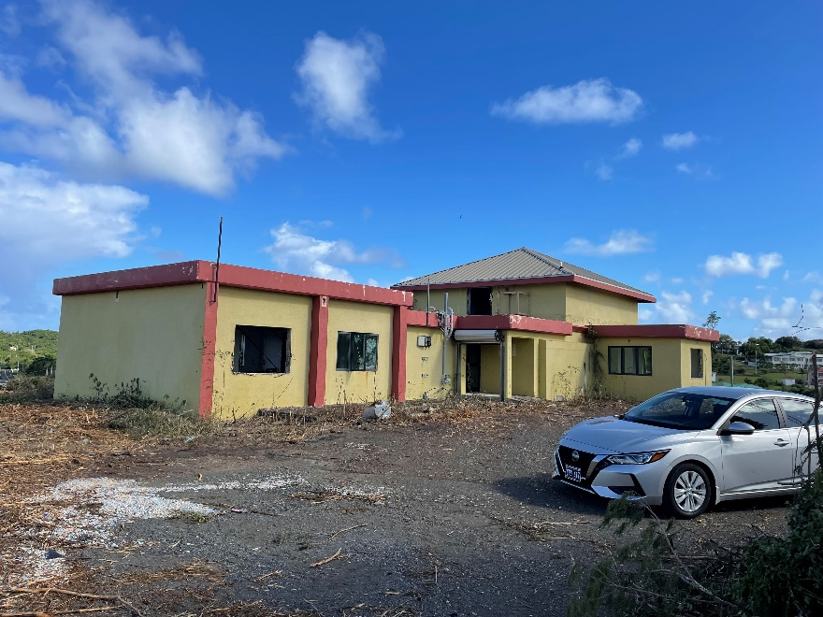
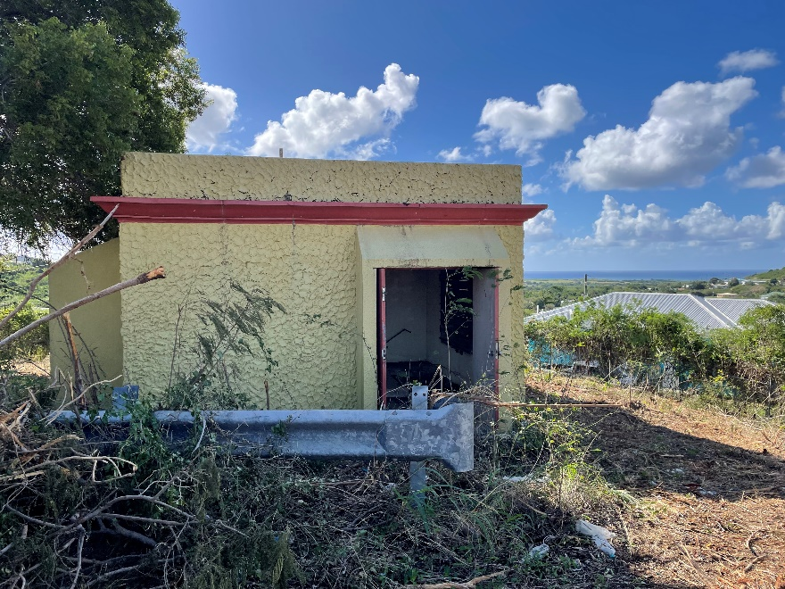
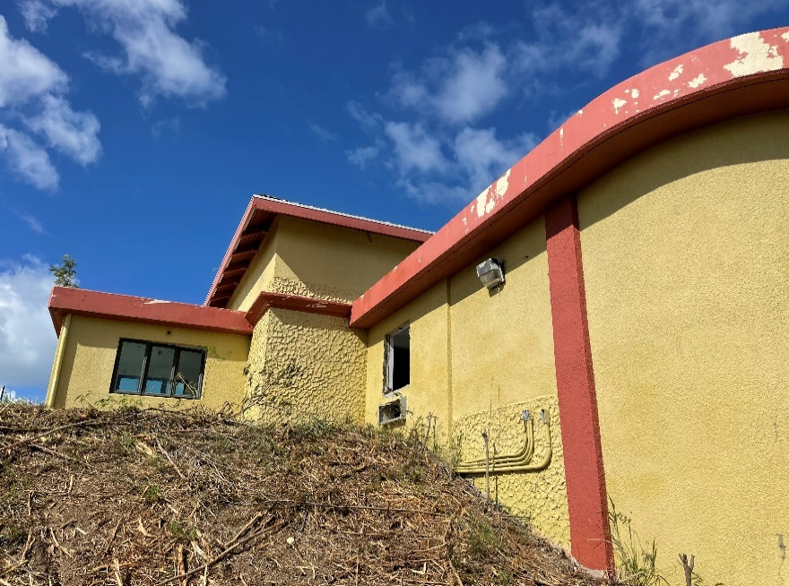
35th Legislature, Committee of the Whole VITEMA EOC and Safe Room
March 10, 2023
Notes:
MATCH ALL TEXT AND TEXT SIZES

Slide 11
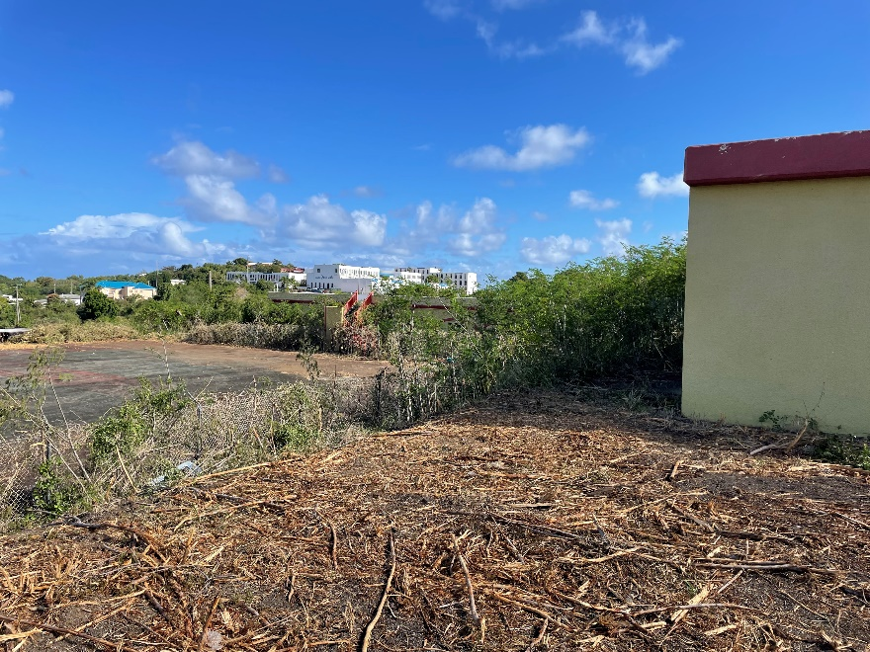
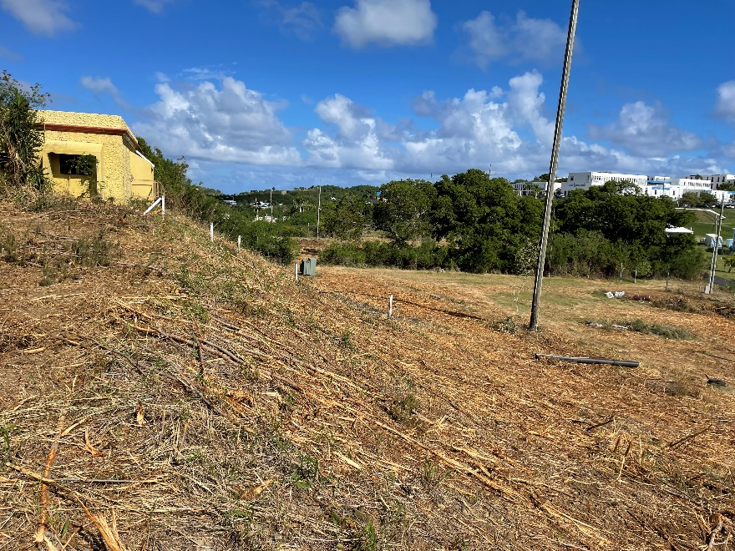
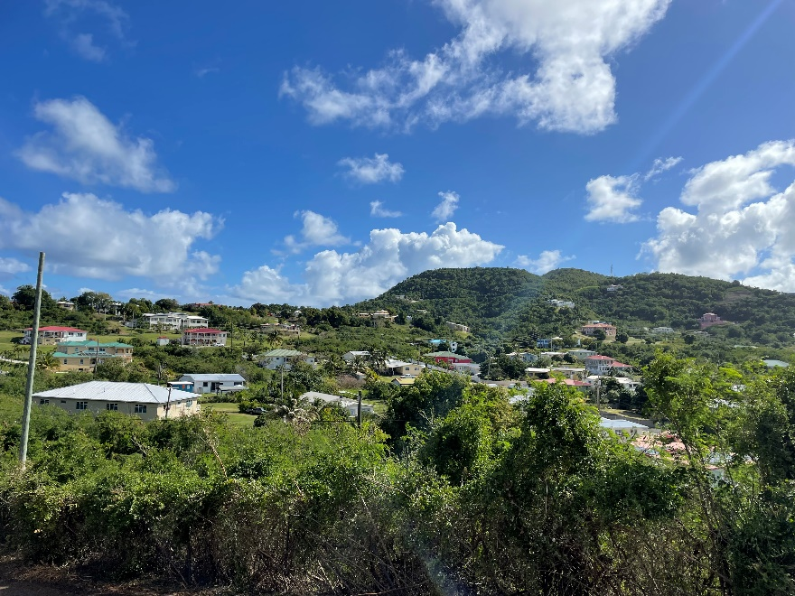
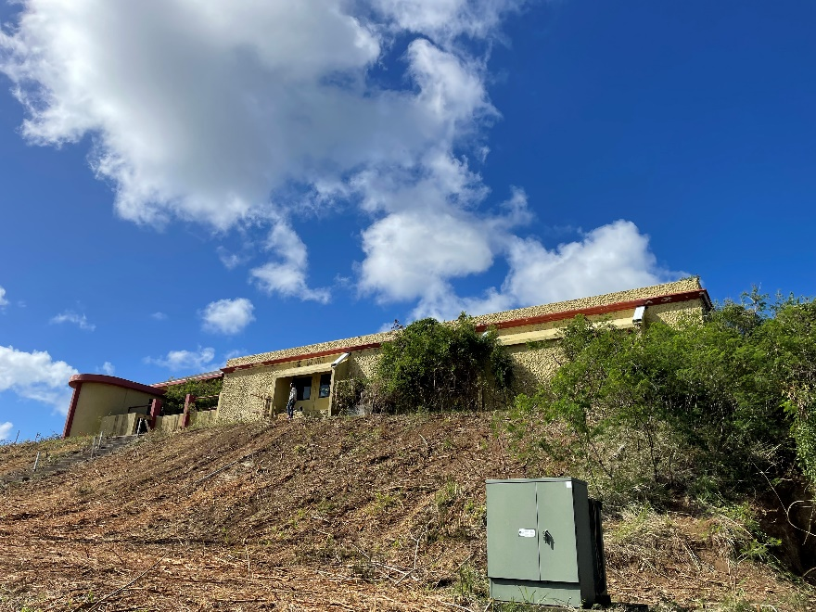
35th Legislature, Committee of the Whole VITEMA EOC and Safe Room
March 10, 2023
Notes:
MATCH ALL TEXT AND TEXT SIZES

Slide 12
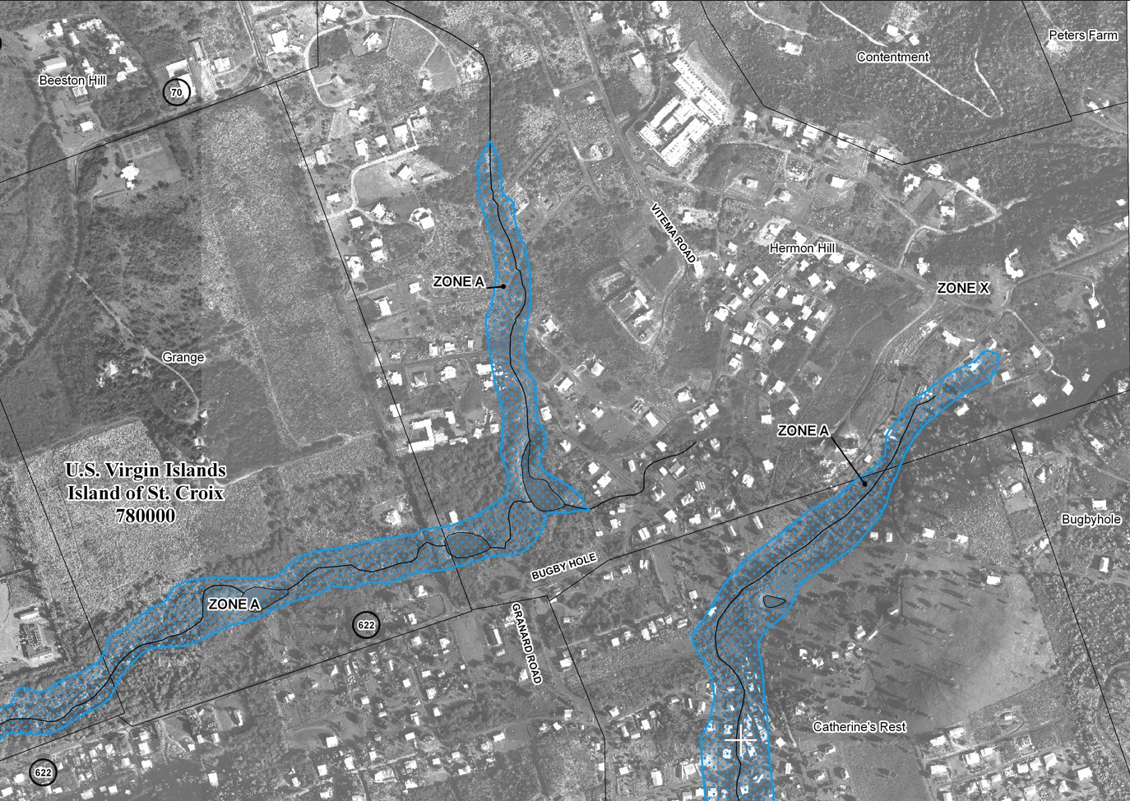
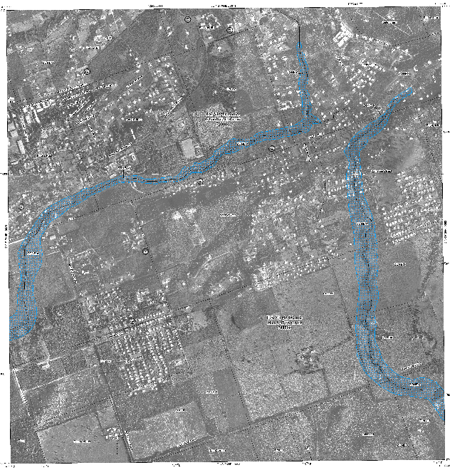
EXISTING CONDITIONS
FLOODING/GUTS
No FEMA flood zones or guts
Pre-existing flood conditions exist
CULTURAL/HISTORICAL RESOURCES
Previously Disturbed Site
No Cultural/Historical Resources
Cease Work and Report Resources
ENDANGERED PLANTS/ANIMALS
No ESAs or Boa Habitat
NO WETLANDS
35th Legislature, Committee of the Whole VITEMA EOC and Safe Room
March 10, 2023
Notes:
MATCH ALL TEXT AND TEXT SIZES

Slide 13
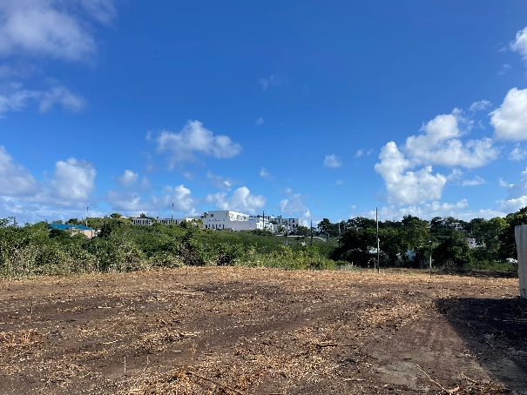
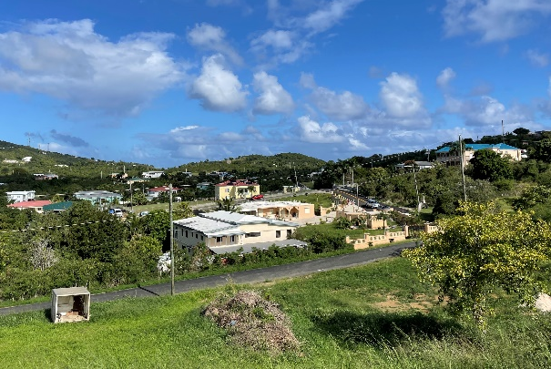
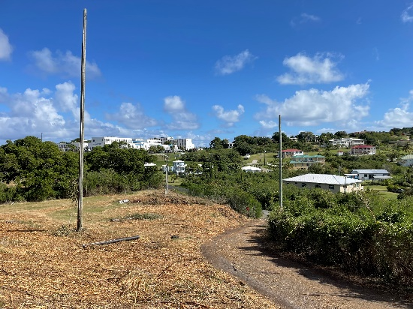
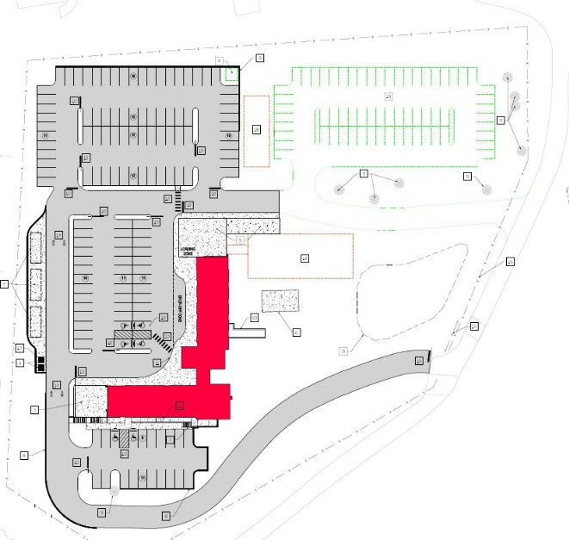
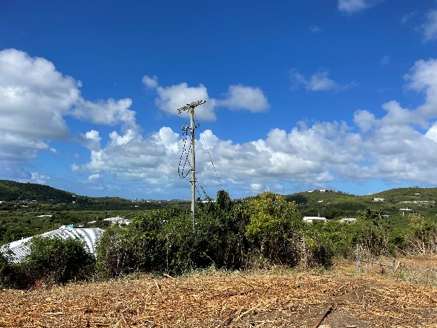
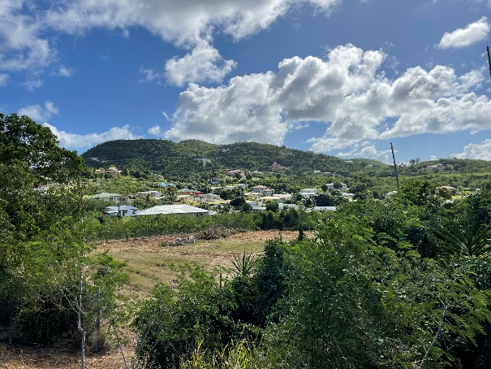
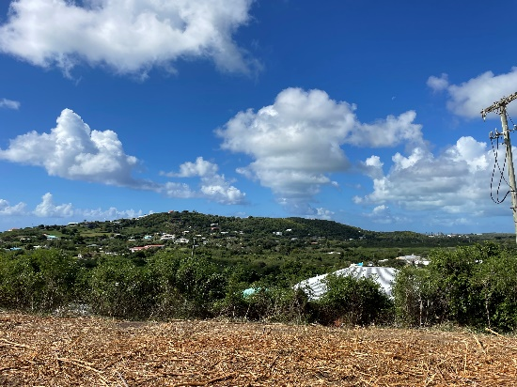
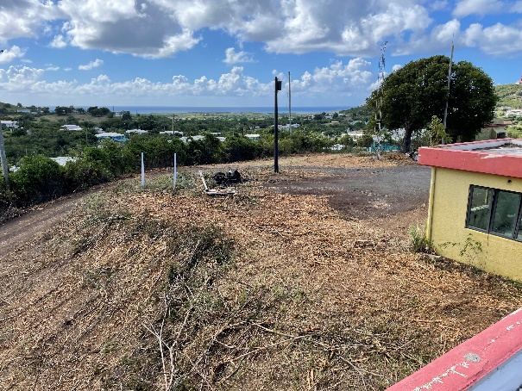
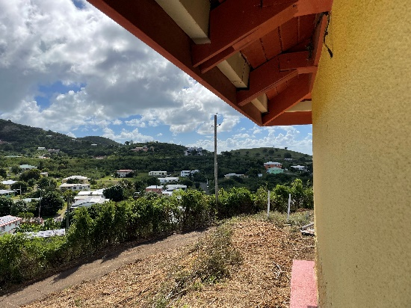
NEW VITEMA EOC FACILITY
Summary of Exterior Building Views
View looking West
Residential neighborhood
Faith facilities
View looking North
Residential & Questa Verde Condos
View looking East
Residential neighborhood
View looking South
Residential neighborhood
2
1
3
4
35th Legislature, Committee of the Whole VITEMA EOC and Safe Room
March 10, 2023
Notes:
MATCH ALL TEXT AND TEXT SIZES

Slide 14
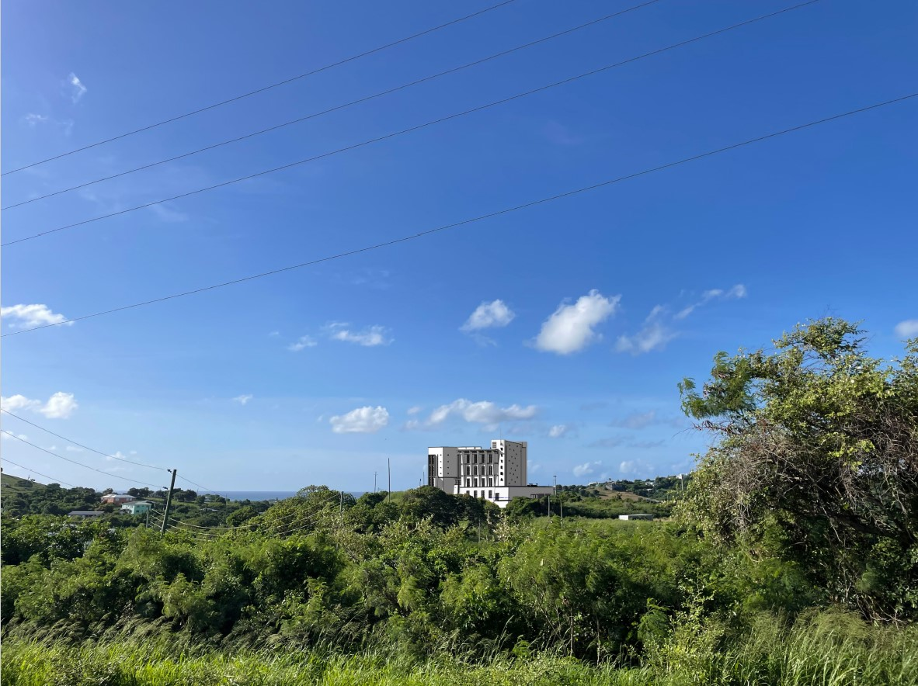
VIEW FROM QUESTA VERDE
TO NEW VITEMA EOC FACILITY
35th Legislature, Committee of the Whole VITEMA EOC and Safe Room
March 10, 2023
Notes:
MATCH ALL TEXT AND TEXT SIZES

Slide 15
Proposed Facility
35th Legislature, Committee of the Whole VITEMA EOC and Safe Room
March 10, 2023
Notes:
MATCH ALL TEXT AND TEXT SIZES

Slide 16
5
PROPOSED SITE PLAN
PARKING - Surface
Regular Stalls - 135 (includes ADA)
RV Stalls – 4
Overflow – 64
Total - 202
SITE IMPROVEMENTS
Stormwater Pond
Mechanical Yard
Sidewalks and Driveways
Entrance Gate
Perimeter Fence
Generator Enclosure & Mechanical Yard
6
5
1
4
3
3
2
3
5
35th Legislature, Committee of the Whole VITEMA EOC and Safe Room
March 10, 2023
Notes:
MATCH ALL TEXT AND TEXT SIZES

Slide 17
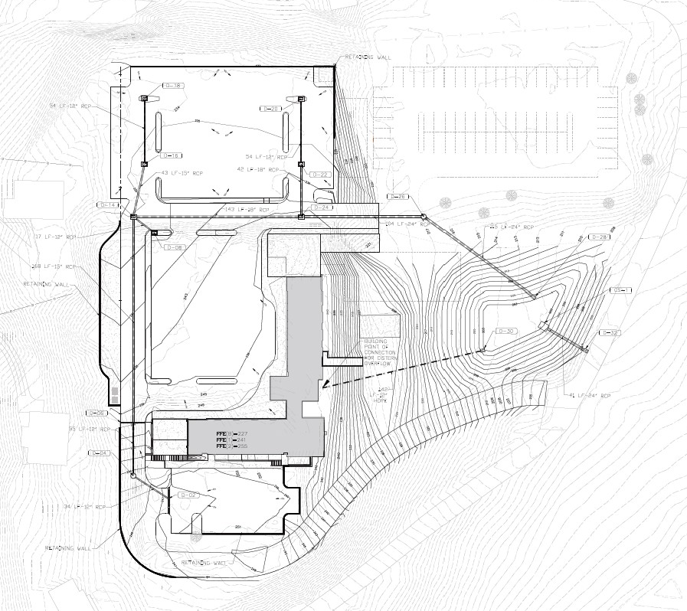
PROPOSED GRADING AND DRAINAGE
STORMWATER POND
Parking Lot Runoff
Cistern Overflow
STORMWATER INLETS
STORMWATER DRAINAGE SYSTEM
35th Legislature, Committee of the Whole VITEMA EOC and Safe Room
March 10, 2023
Notes:
MATCH ALL TEXT AND TEXT SIZES

Slide 18
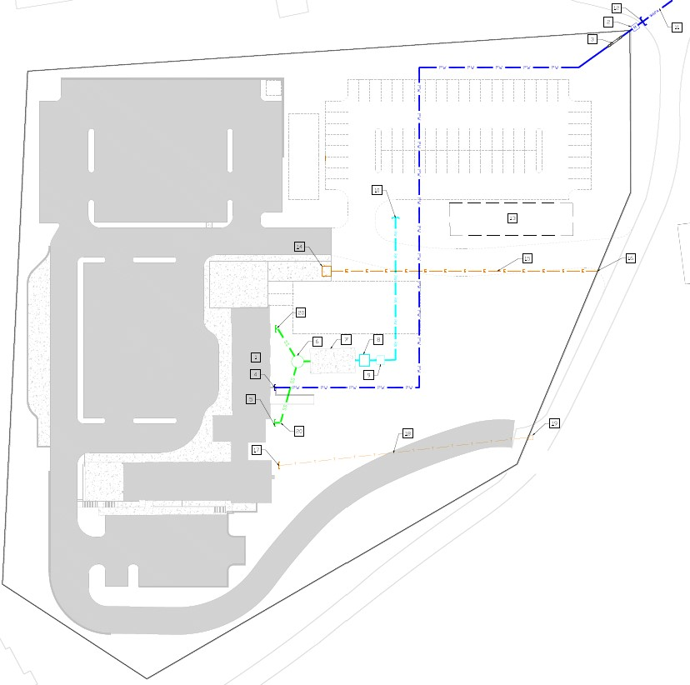
PROPOSED UTILITIES
POTABLE WATER
Cistern and Pump Station (interior, basement level)
Master Meter/Backflow Preventor
Reuse Water Cistern
Reuse Water Pump Station
Reuse Water Drip Irrigation Connection
WAPA 2 inch Potable Water Pipe
SANITARY SEWER
Wastewater Treatment Plant
Buffer Tank
Sanitary Cleanout
Irrigation Area
POWER
Transformer (by WAPA)
Underground Power Conduits (by WAPA)
TELECOMMUNICATIONS
Conduits
Connection to WAPA Provided Telecom Handhole
35th Legislature, Committee of the Whole VITEMA EOC and Safe Room
March 10, 2023
Notes:
MATCH ALL TEXT AND TEXT SIZES

Slide 19
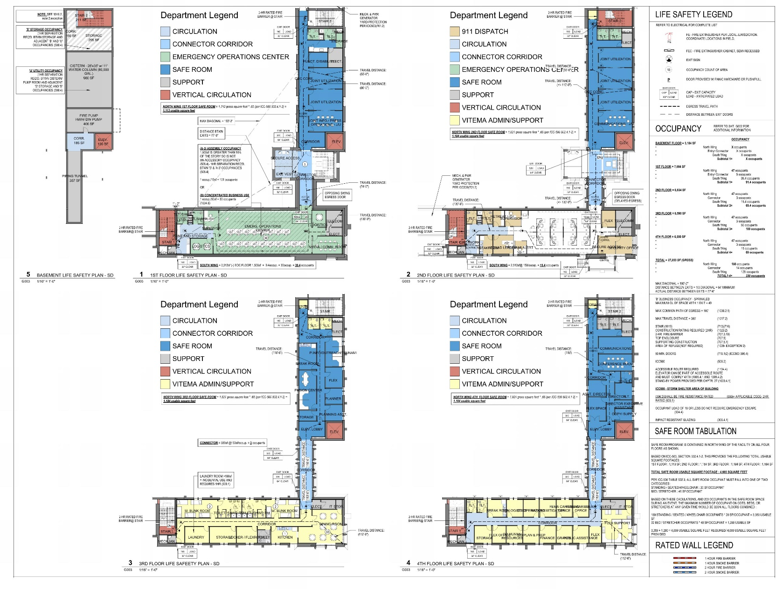
NEW VITEMA EOC FACILITY
Summary of Building Program
Ground Floor
Cistern
Utility and Storage space
1st Floor
Secure EOC Entry
Emergency Operations Center (EOC)
Meeting Space
2nd Floor
Secure ECC Entry
911 Call Center (ECC)
Office space & Meeting Rooms
3rd Floor
Staff Bunk and Multi-purpose space
4th Floor
EOC Office space
35th Legislature, Committee of the Whole VITEMA EOC and Safe Room
March 10, 2023
Notes:
MATCH ALL TEXT AND TEXT SIZES

Slide 20
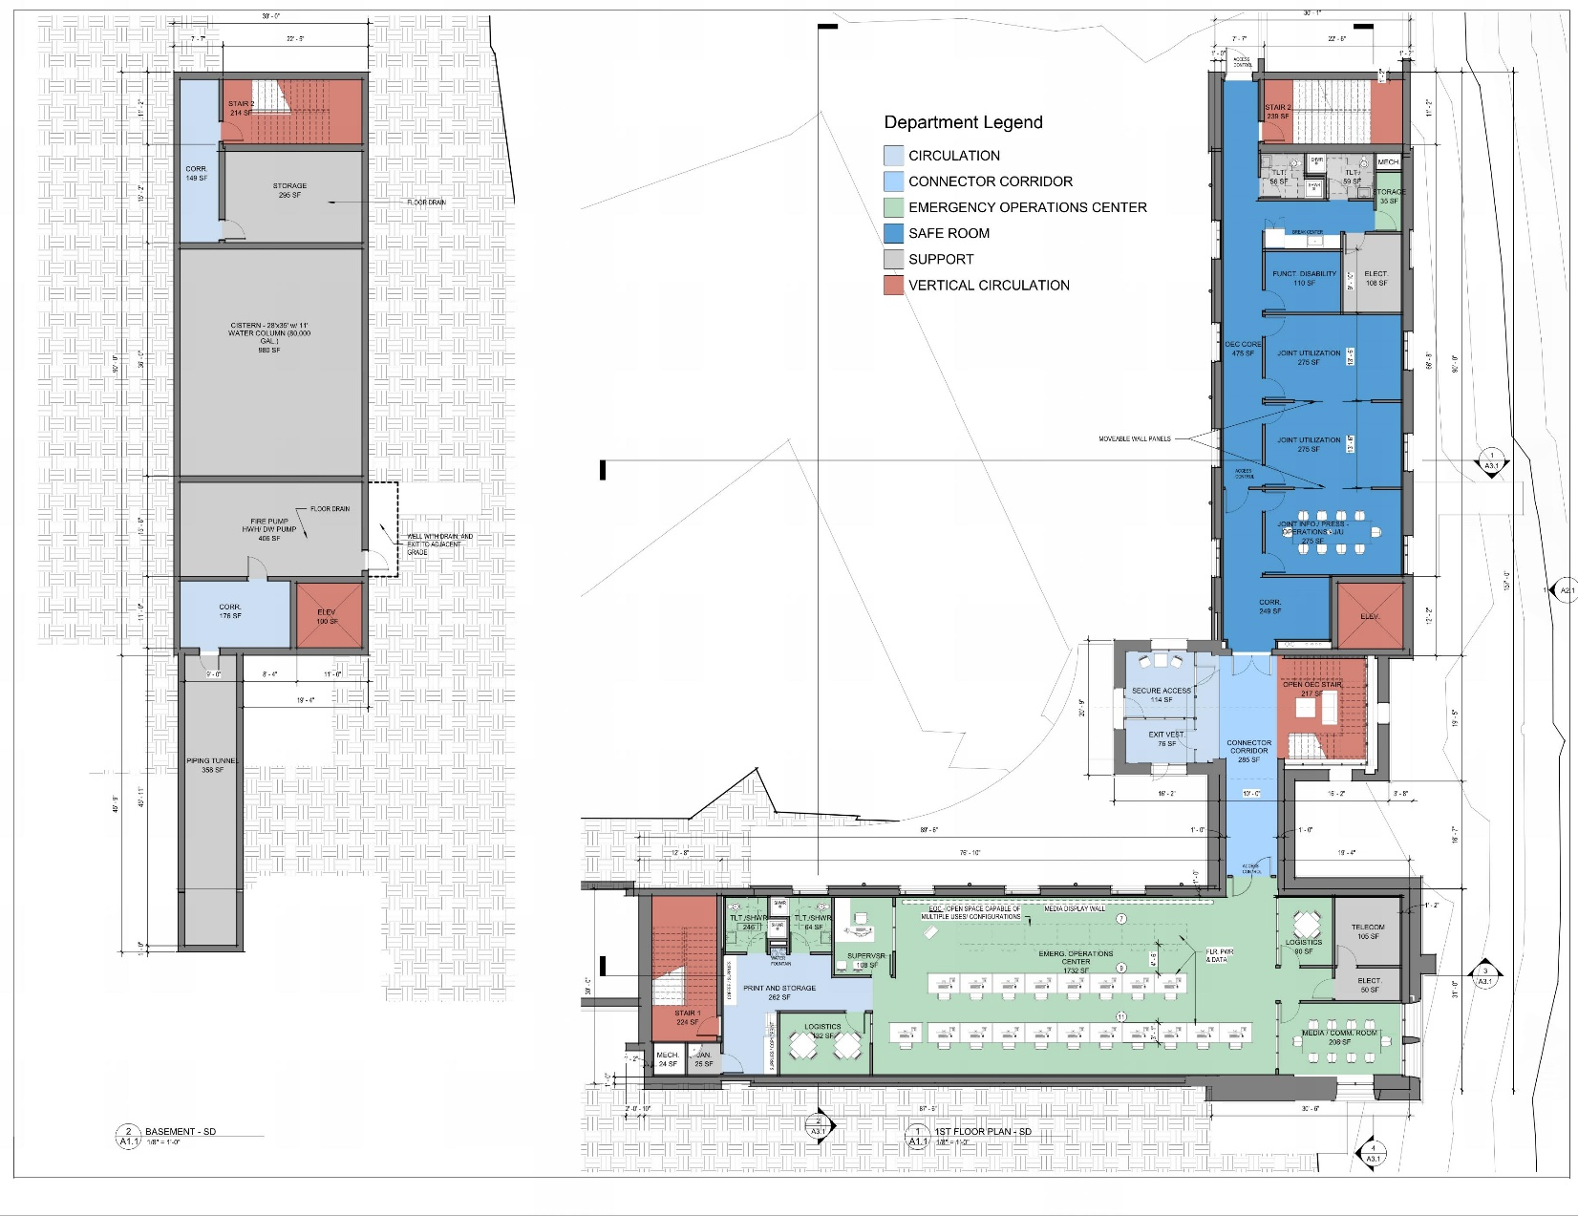
NEW VITEMA EOC FACILITY
Ground Floor
Cistern
Utility and Storage space
1st Floor
Secure EOC Entry
Emergency Operations Center (EOC)
Meeting Space
35th Legislature, Committee of the Whole VITEMA EOC and Safe Room
March 10, 2023
Notes:
MATCH ALL TEXT AND TEXT SIZES

Slide 21
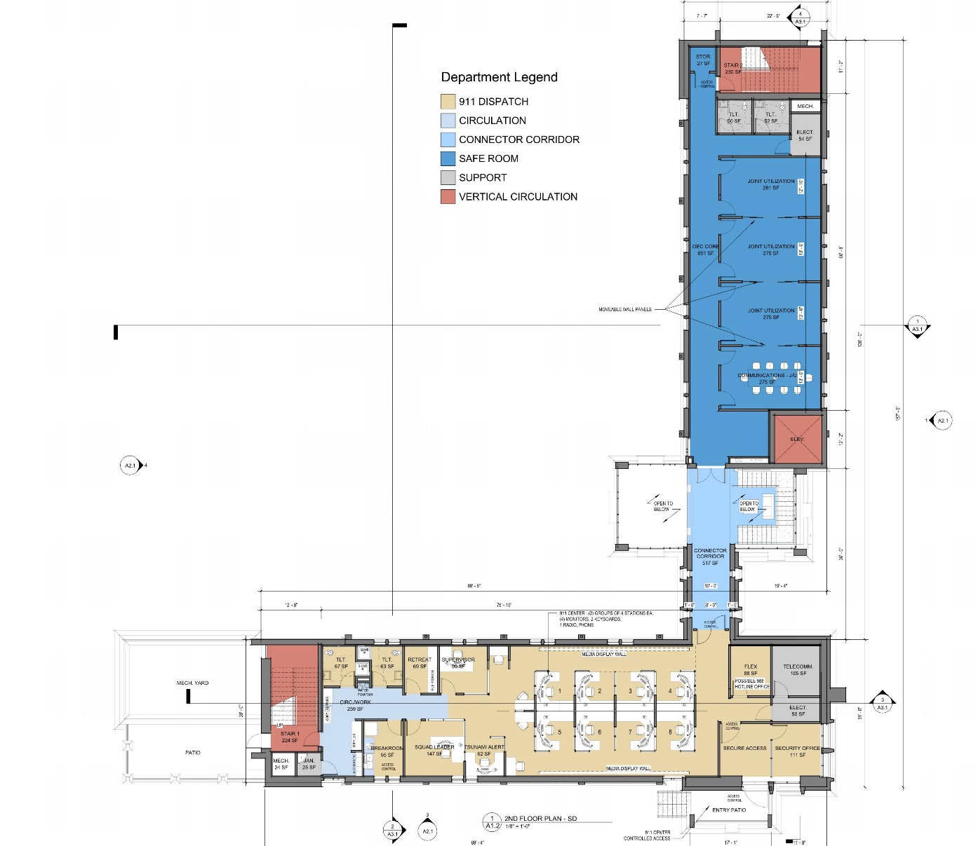
NEW VITEMA EOC FACILITY
2nd Floor
Secure ECC Entry
911 Call Center (ECC)
Office space & Meeting Rooms
35th Legislature, Committee of the Whole VITEMA EOC and Safe Room
March 10, 2023
Notes:
MATCH ALL TEXT AND TEXT SIZES

Slide 22
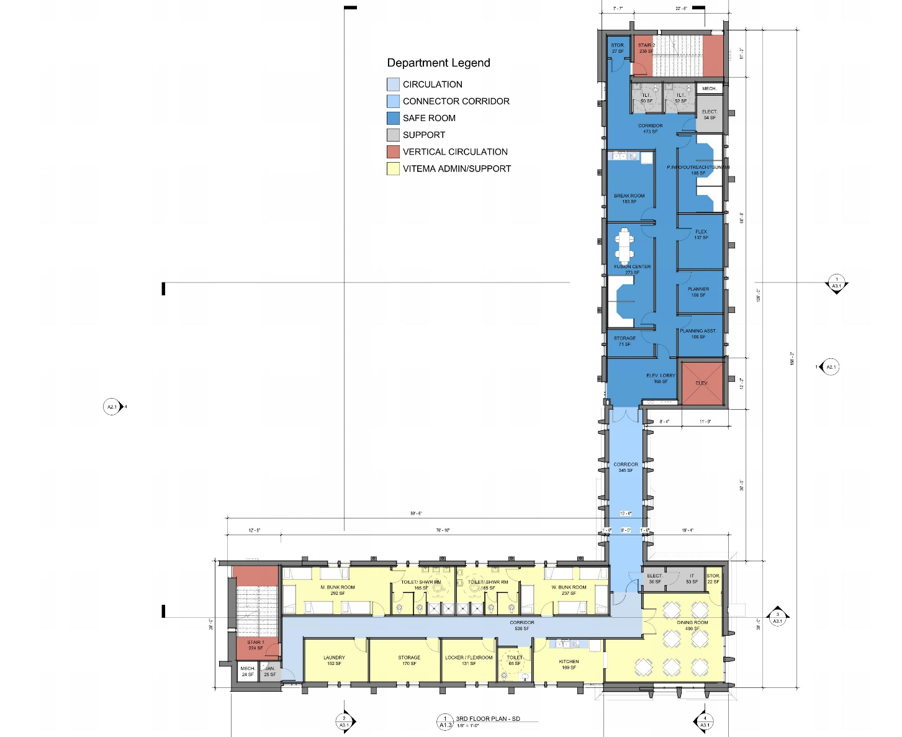
NEW VITEMA EOC FACILITY
3rd Floor
Staff Bunk and Multi-purpose space
35th Legislature, Committee of the Whole VITEMA EOC and Safe Room
March 10, 2023
Notes:
MATCH ALL TEXT AND TEXT SIZES

Slide 23
NEW VITEMA EOC FACILITY
4th Floor
EOC Office space
35th Legislature, Committee of the Whole VITEMA EOC and Safe Room
March 10, 2023
Notes:
MATCH ALL TEXT AND TEXT SIZES

Slide 24
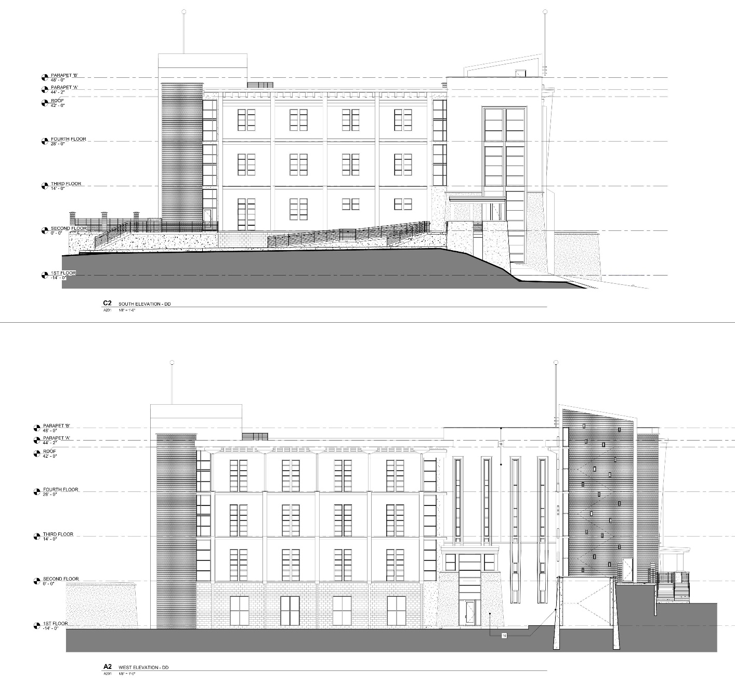
NEW VITEMA EOC FACILITY
Exterior Building
SOUTH Exterior Building Elevation
WEST Exterior Building Elevation
1
35th Legislature, Committee of the Whole VITEMA EOC and Safe Room
March 10, 2023
2
Notes:
MATCH ALL TEXT AND TEXT SIZES

Slide 25
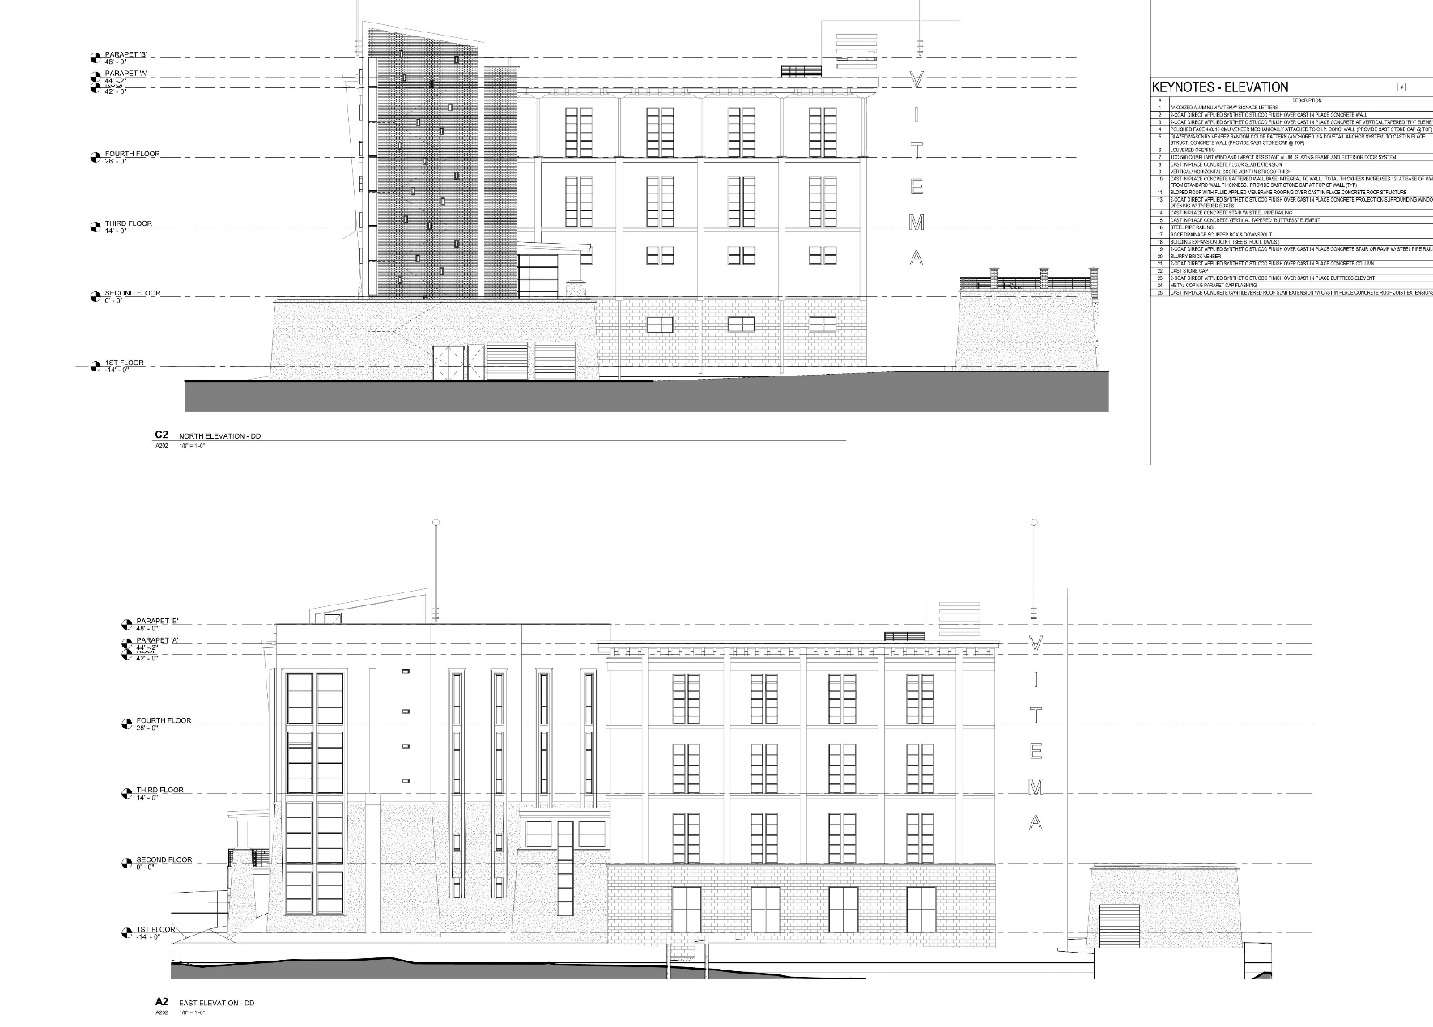
NEW VITEMA EOC FACILITY
Exterior Building
NORTH Exterior Building Elevation
EAST Exterior Building Elevation
3
35th Legislature, Committee of the Whole VITEMA EOC and Safe Room
March 10, 2023
2
Notes:
MATCH ALL TEXT AND TEXT SIZES

Slide 26
35th Legislature, Committee of the Whole VITEMA EOC and Safe Room
March 10, 2023
Notes:
MATCH ALL TEXT AND TEXT SIZES

Slide 27
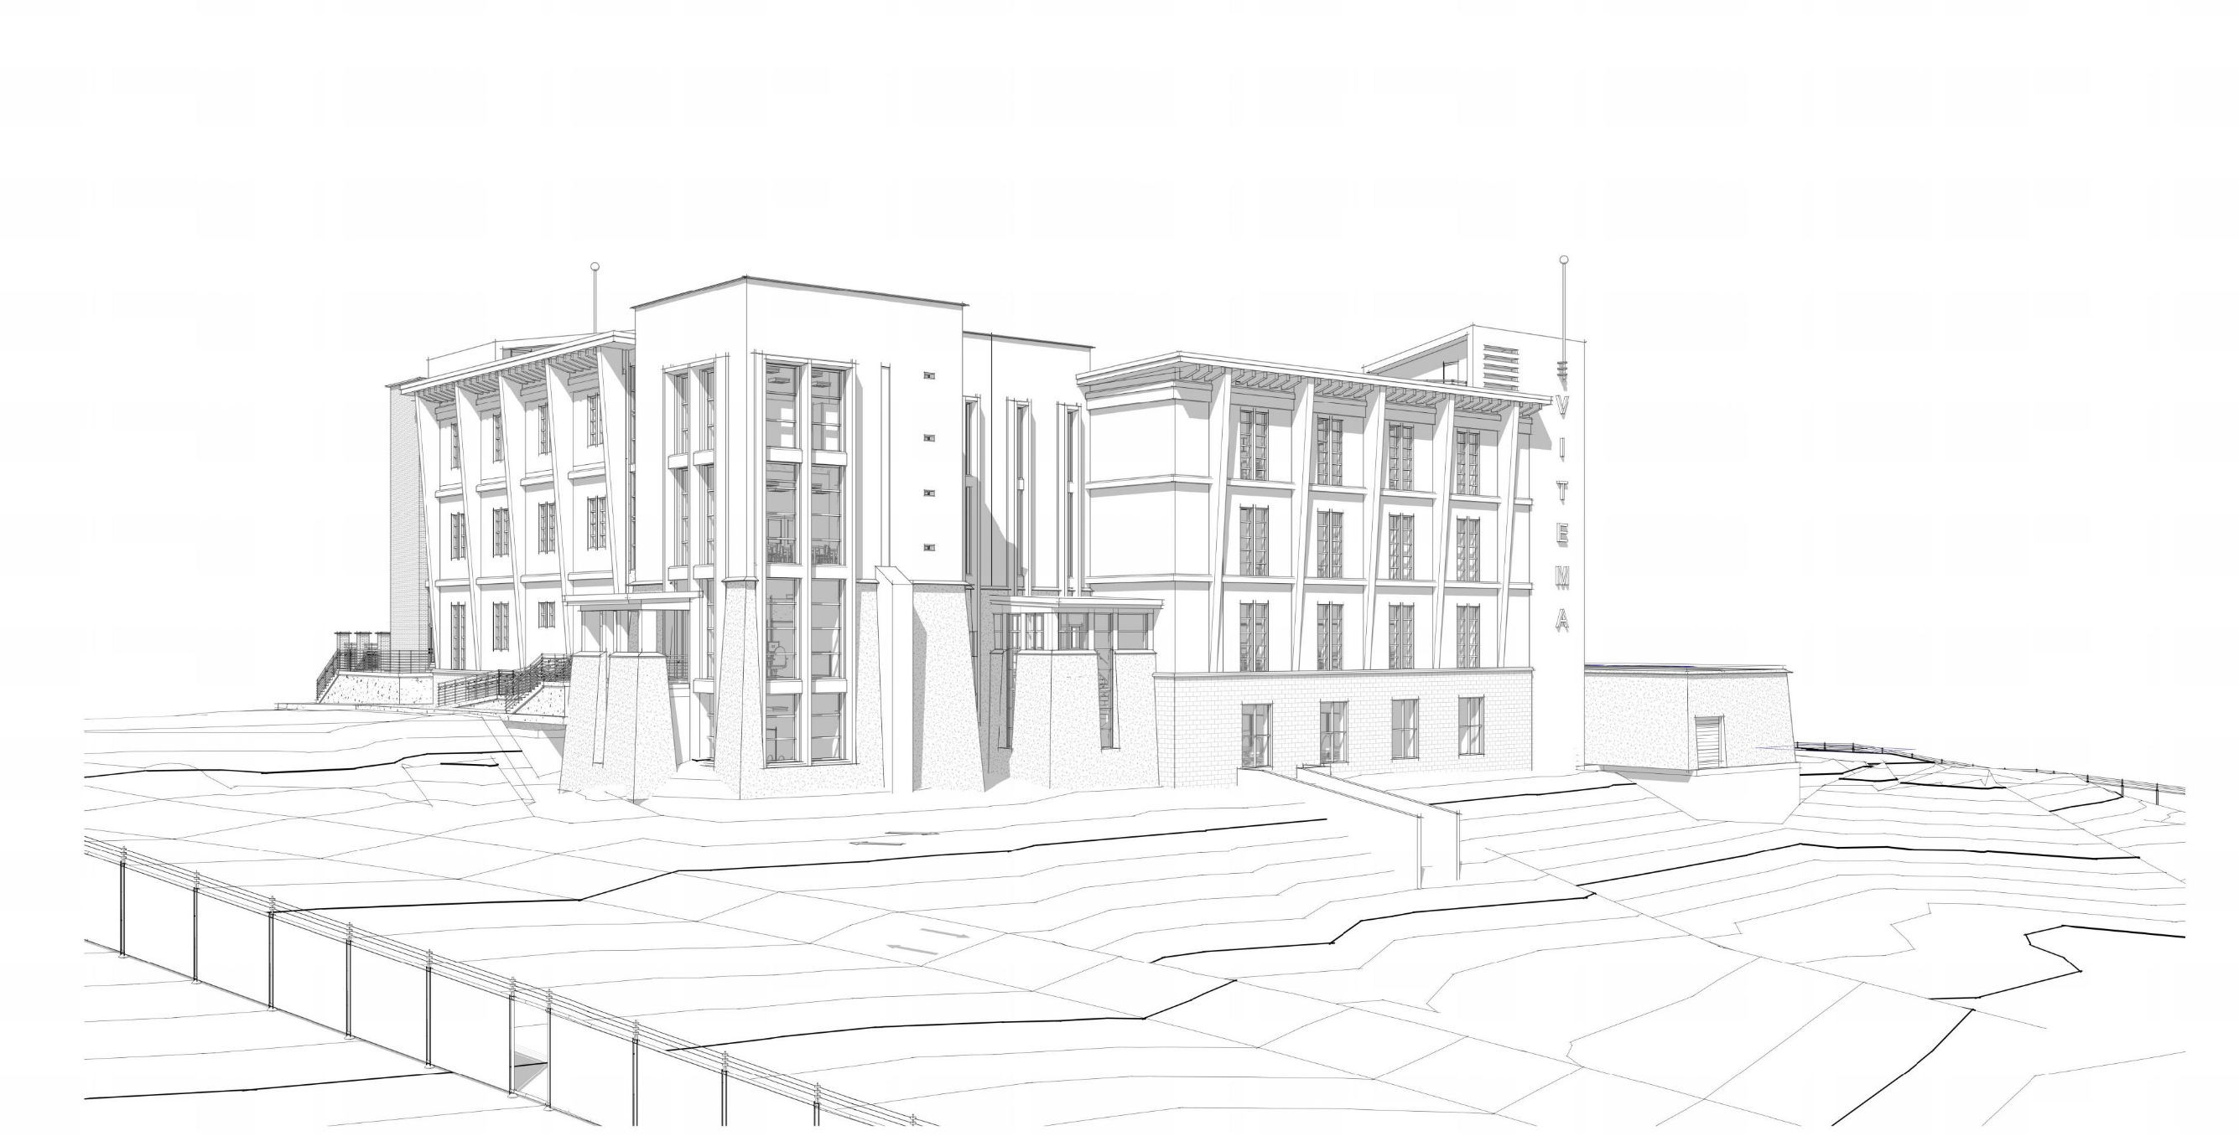
35th Legislature, Committee of the Whole VITEMA EOC and Safe Room
March 10, 2023
Notes:
MATCH ALL TEXT AND TEXT SIZES

Slide 28
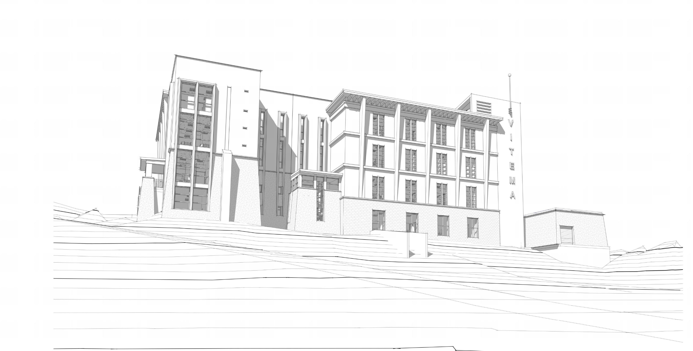
35th Legislature, Committee of the Whole VITEMA EOC and Safe Room
March 10, 2023
Notes:
MATCH ALL TEXT AND TEXT SIZES

Slide 29
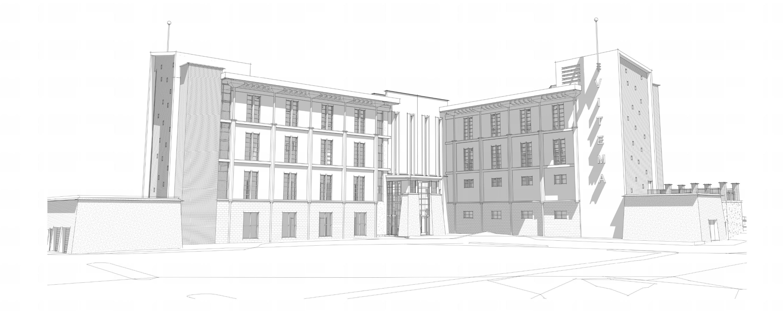
35th Legislature, Committee of the Whole VITEMA EOC and Safe Room
March 10, 2023
Notes:
MATCH ALL TEXT AND TEXT SIZES

Slide 30
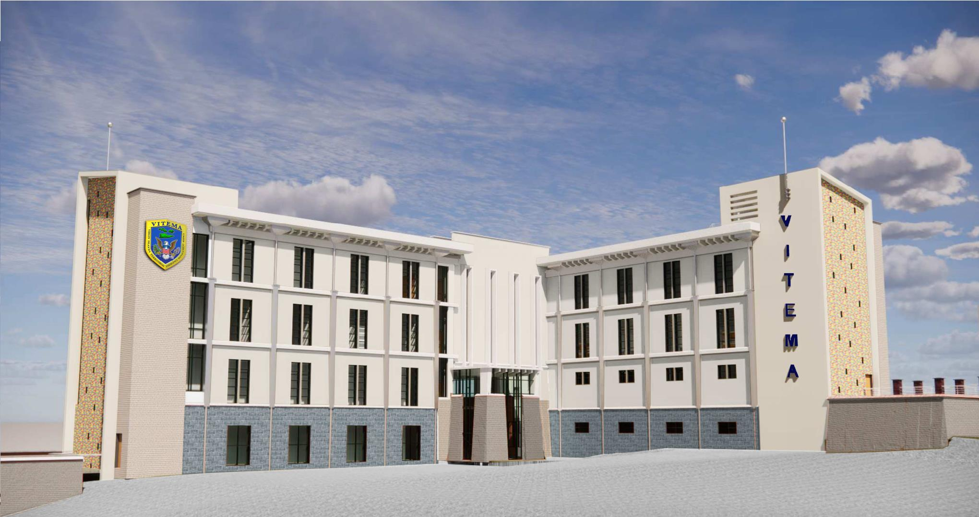
NEW VITEMA EOC FACILITY
Summary of Exterior Building Materials
1st Floor Blue-Grey base
Polished- face masonry veneer
End- walls at Stairs
Multi-colored glazed masonry veneer
Slurry brick veneer
North & South wing end walls
Stucco finished concrete structure
Synthetic Stucco finish over concrete at 2nd, 3rd, and 4th floors of North and South wings
Synthetic Stucco finish over concrete at smaller scaled battered wall elements
Secure Entry elements with Battered walls
Synthetic Stucco finish over concrete
3
4
2
2
5
1
5
1
5
35th Legislature, Committee of the Whole VITEMA EOC and Safe Room
March 10, 2023
Notes:
MATCH ALL TEXT AND TEXT SIZES

Slide 31
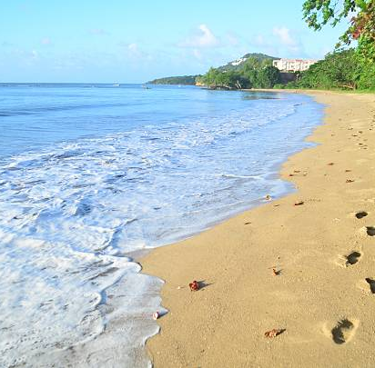
NEXT STEPS
Federal Consistency Determination
Finalize Site Improvements and Building Design
Complete Construction and Permit Documents
Complete All DPNR-Required Permitting
Major Land Disturbance Application and Public Hearing
Building Permits
Construction
35th Legislature, Committee of the Whole VITEMA EOC and Safe Room
March 10, 2023
Notes:
MATCH ALL TEXT AND TEXT SIZES

Slide 32
BENEFITS VS NO ACTION
Public Service that Benefits St. Croix AND US Virgin Islands
Caribbean Territorial Collaboration and Data Sharing
Better Comprehensive All-Hazards Planning and Prediction
Primary Employment Center for Emergency Response Employees Currently in Christiansted (EOC) & La Reine (9-1-1 ECC)
New Building Facilitates Collaboration between FEMA/HLS, VITEMA, US VI 9-1-1
Direct Line of Site to All Four Radio Towers for USVI 9-1-1 / Emergency Communications Center
New Facility will Support Programs Badly Needed for Federal and Local Emergency Personnel to Respond to Contemporary Disasters
Improve Post-Disaster Response
New Development on Existing EOC Property
New Development on Previously Disturbed Land
Opportunity to Improve Site Conditions
Eliminate On-going Annual Rental and Utility Costs of Separate Office Leases for VITEMA and 9-1-1 ECC
35th Legislature, Committee of the Whole VITEMA EOC and Safe Room
March 10, 2023
Notes:
MATCH ALL TEXT AND TEXT SIZES

Slide 33
Benefits to the Territory
World Class Facility
World Class Technology
World Class Workforce
35th Legislature, Committee of the Whole VITEMA EOC and Safe Room
March 10, 2023

Slide 34
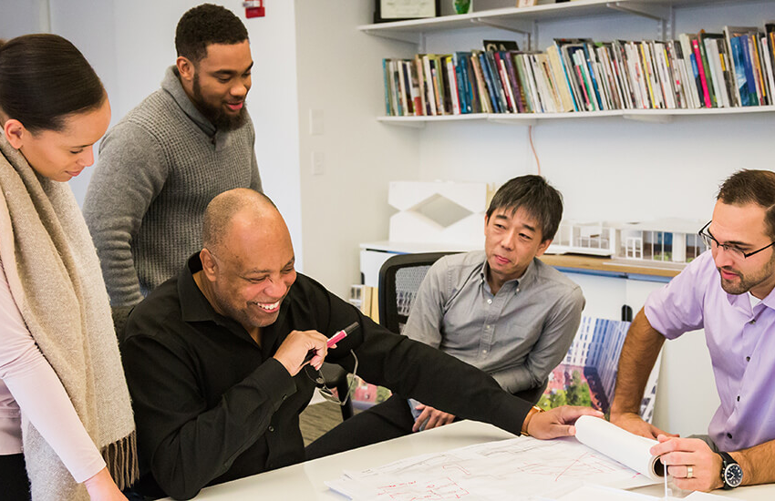
Thank you!
35th Legislature, Committee of the Whole VITEMA EOC and Safe Room
March 10, 2023
Notes:
MATCH ALL TEXT AND TEXT SIZES

