Slide 1
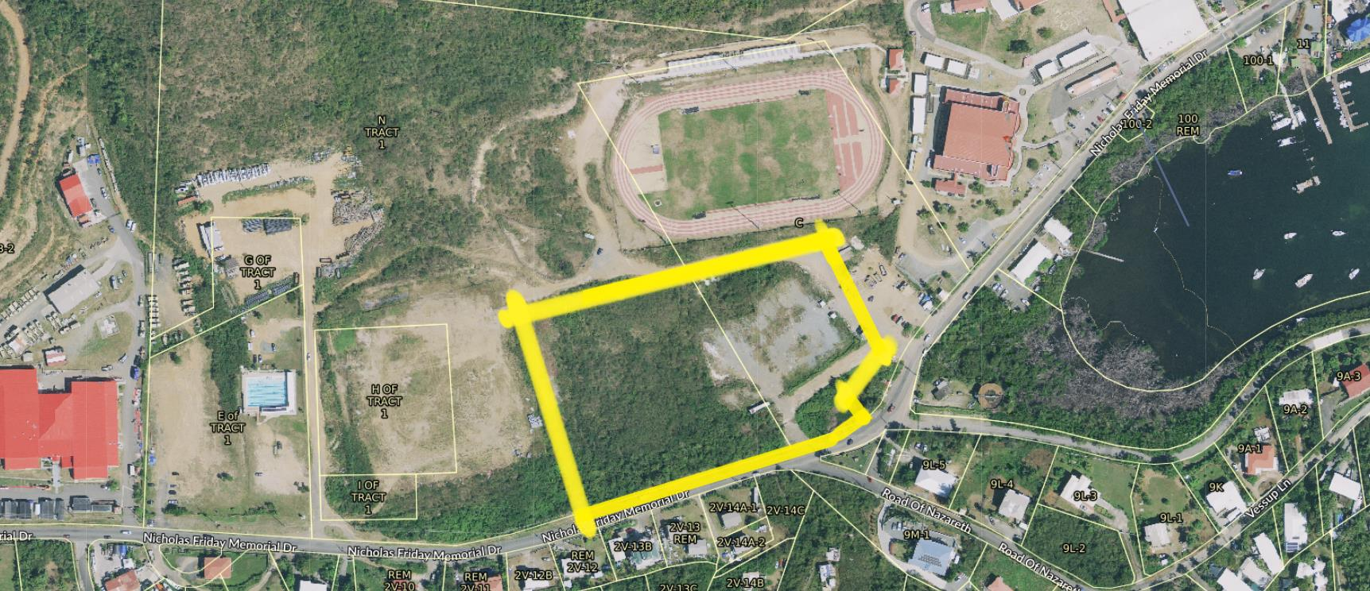
ZAT-24-9: Photo of current site condition

Slide 2
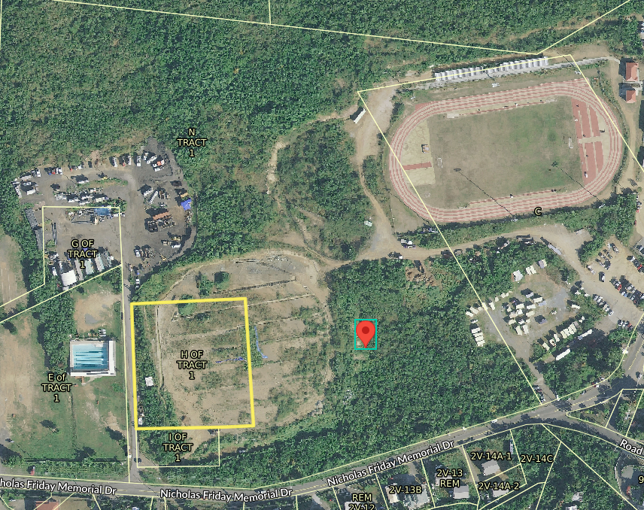
ZAT-24-9: MapGeo aerial view of property (marked in red)

Slide 3
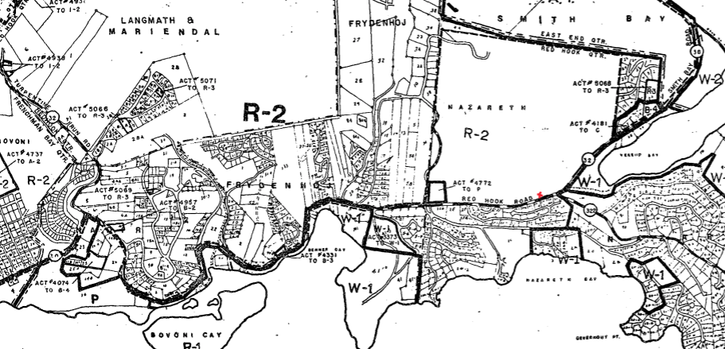
ZAT-24-9: Official Zoning Map No. STZ-10 (property location indicated by red X)

Slide 4
ZAT-24-9: Conceptual
50 FT. SETBACK LINES

