Slide 1
ZAT-24-10: Photo of current site condition- abandoned residence

Slide 2
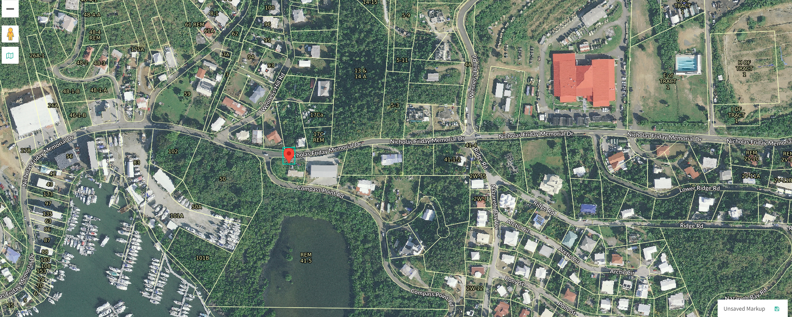
ZAT-24-10: MapGeo aerial view of property (marked in red)

Slide 3
ZAT-24-10: Official Zoning Map No. STZ-10 (property location indicated by red X)

