Slide 1
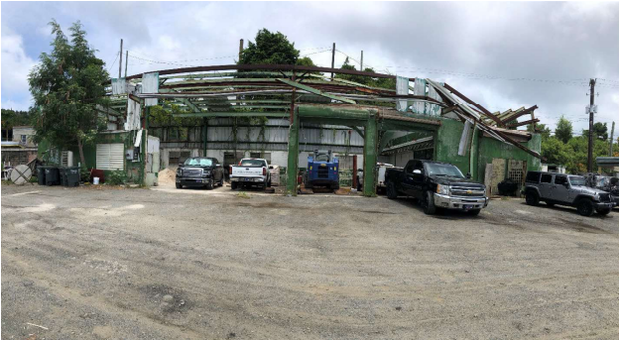
ZAJ-24-1: Photo of current site condition- hurricane damaged maintenance building

Slide 2
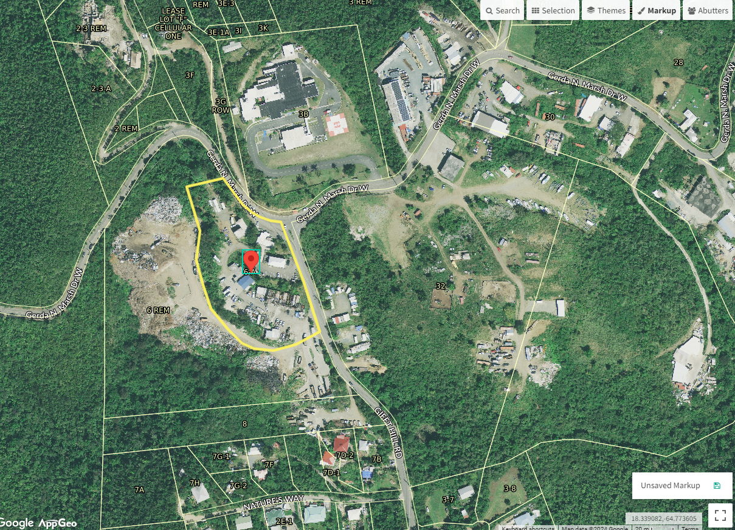
ZAJ-24-1: MapGeo aerial view of property (marked in red)

Slide 3
ZAJ-24-1: Official Zoning Map No. SJZ-1 (property location indicated by red X)

Slide 4
ZAJ-24-1: Conceptual drawing of proposed maintenance building redevelopment

