Slide 1
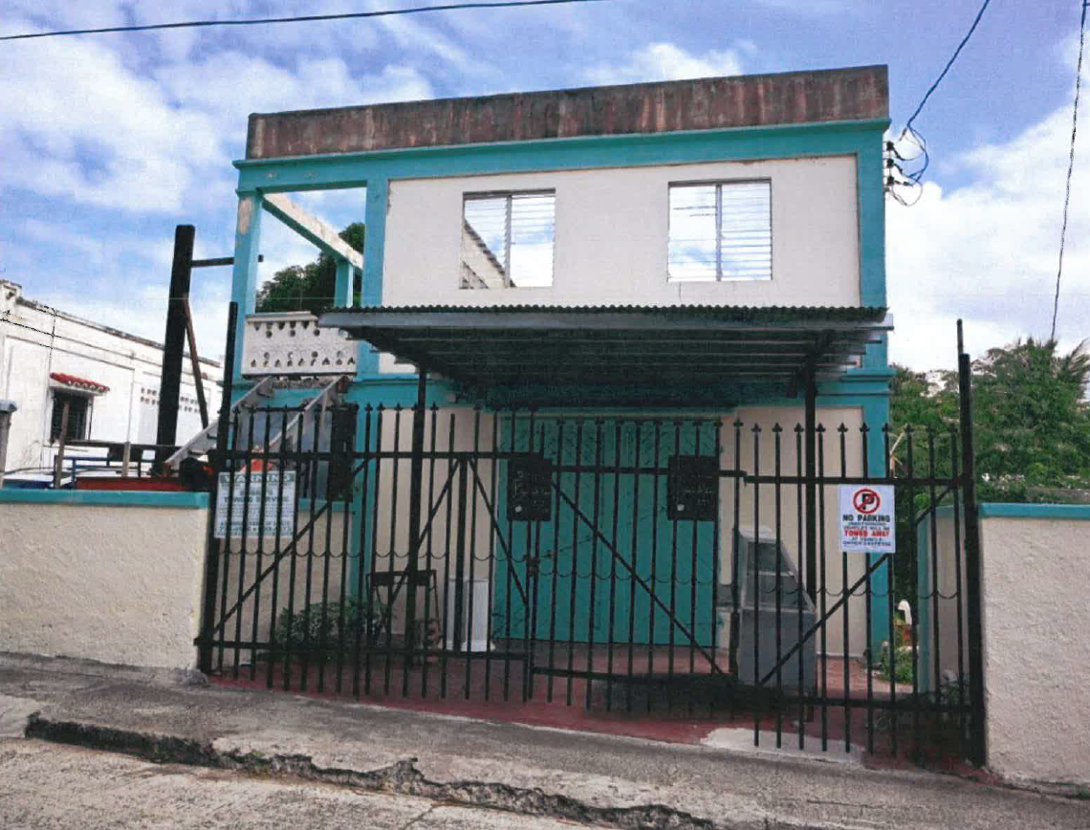
ZAT-24-4: Photo of current site condition

Slide 2
ZAT-24-4: MapGeo aerial view of property (marked in red)

Slide 3
ZAT-24-4: Official Zoning Map No. STZ-11 (property location indicated by red X)

