Slide 1
ZAJ-23-1: Photo of current site condition

Slide 2
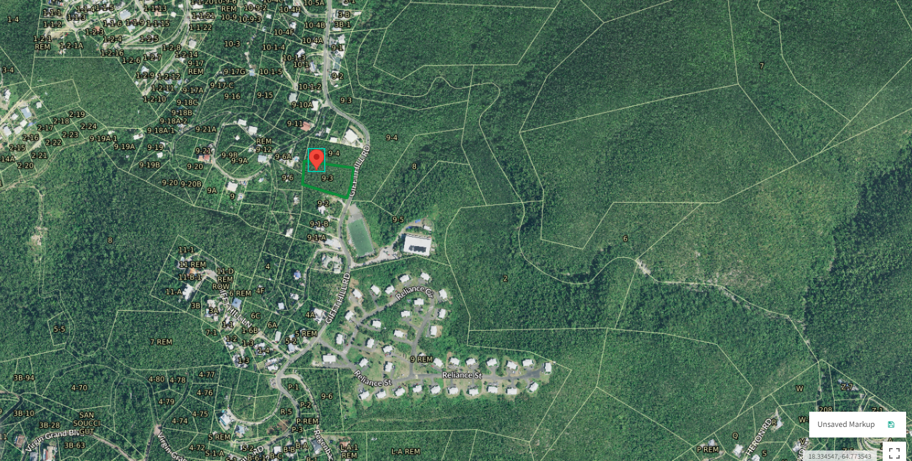
ZAJ-23-1: MapGeo aerial view of property (marked in red)

Slide 3
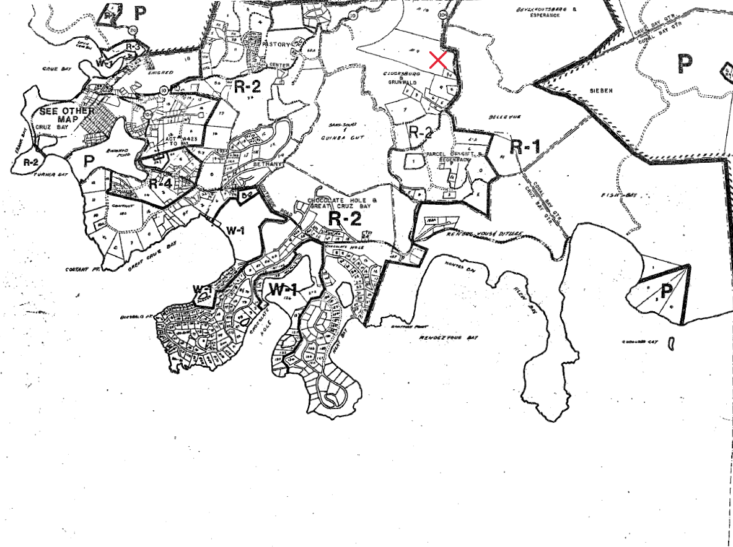
ZAJ-23-1: Official Zoning Map No. SJZ-2 (property location indicated by red X)

Slide 4
ZAJ-23-1: Conceptual drawing of proposed development

