Slide 1
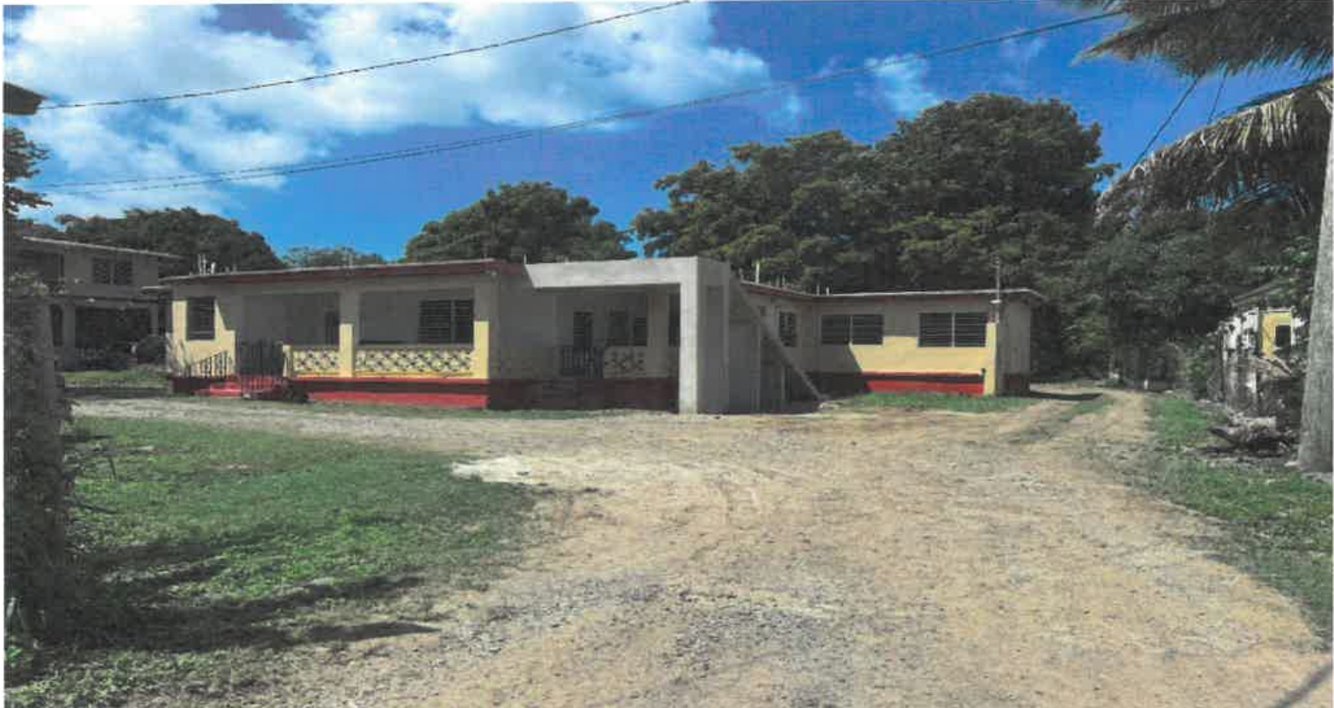
CCZP0031-26: Site photo- Occupied residential building

Slide 2
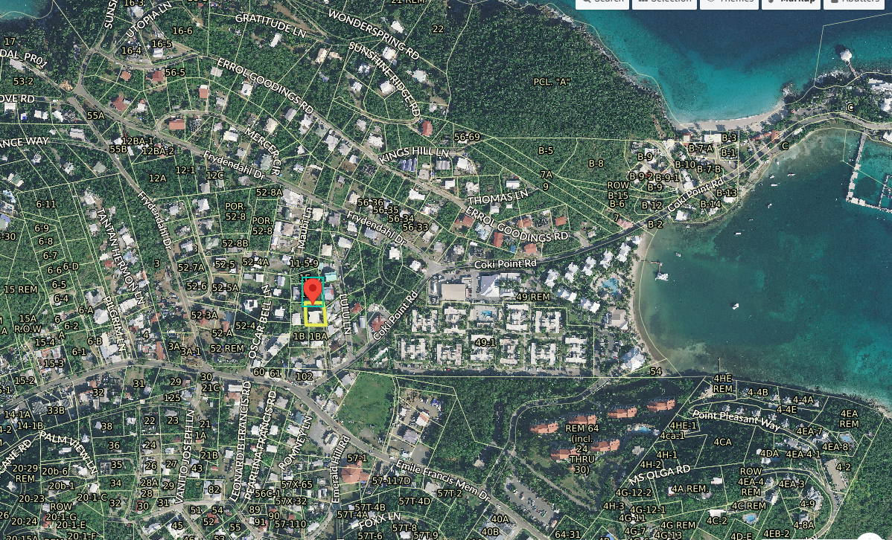
CCZP0031-26: MapGeo aerial view of property (marked with red)

Slide 3
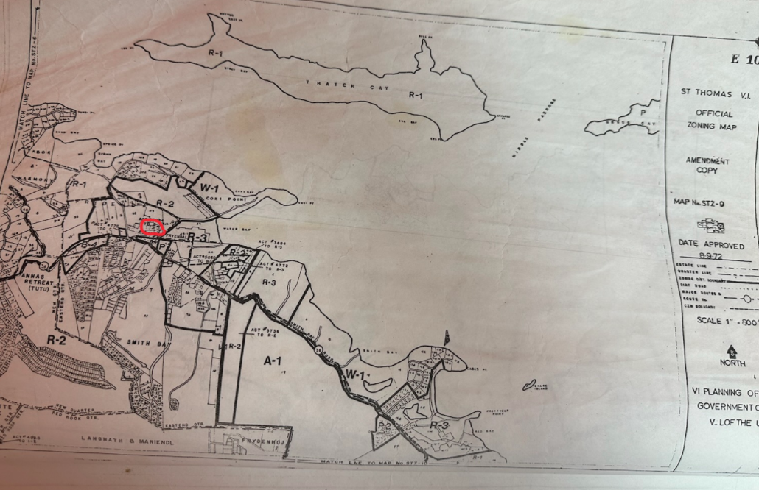
CCZP0031-26: Official Zoning Map No. STZ-9 (property’s location indicated by red circle)

