Slide 1
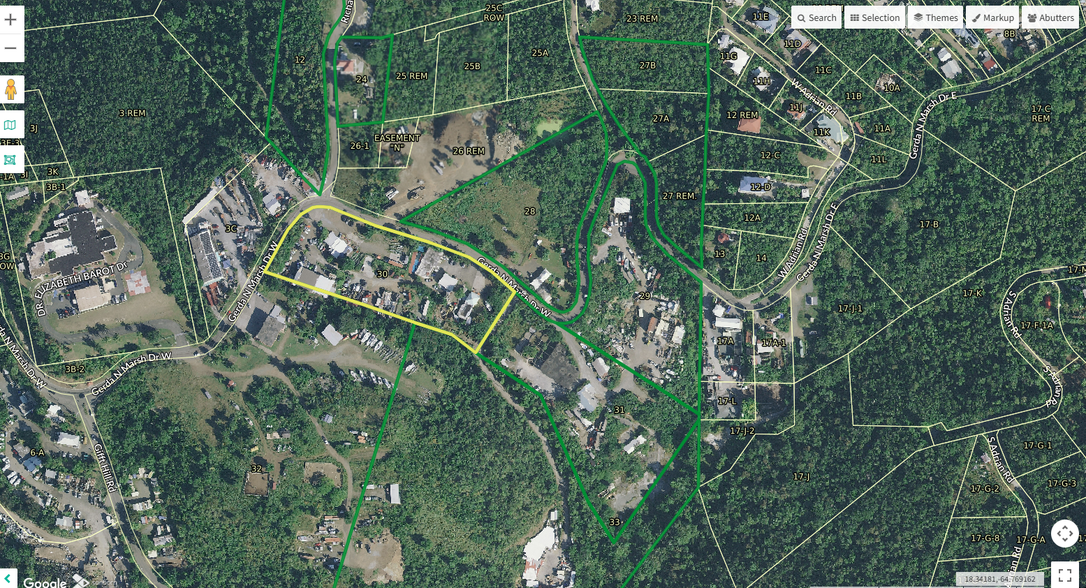
CCZP0036-26: Mapgeo aerial view of property (outlined in yellow)

Slide 2
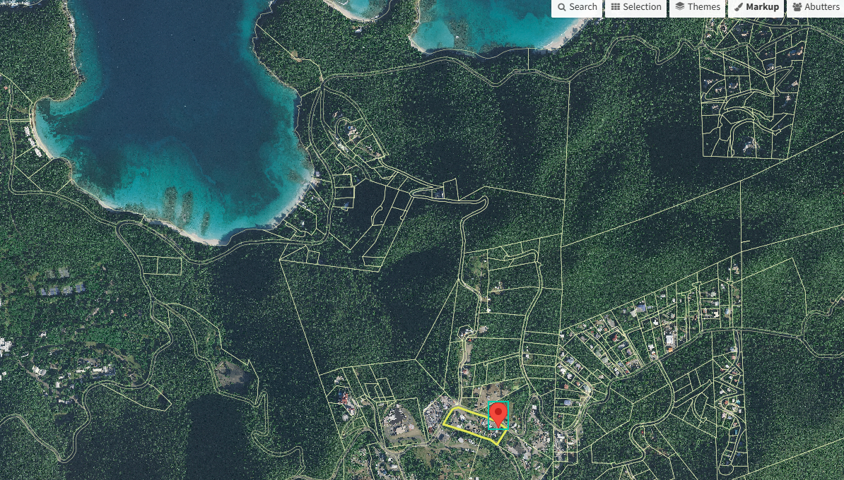
CCZP0036-26: MapGeo aerial view of property (marked with red)

Slide 3
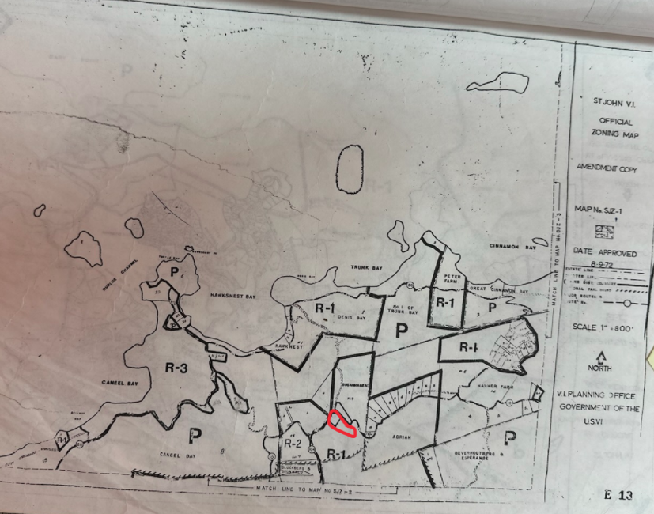
CCZP0036-26: Official Zoning Map No. SJZ-1 (property’s location indicated by red circle)

Slide 4
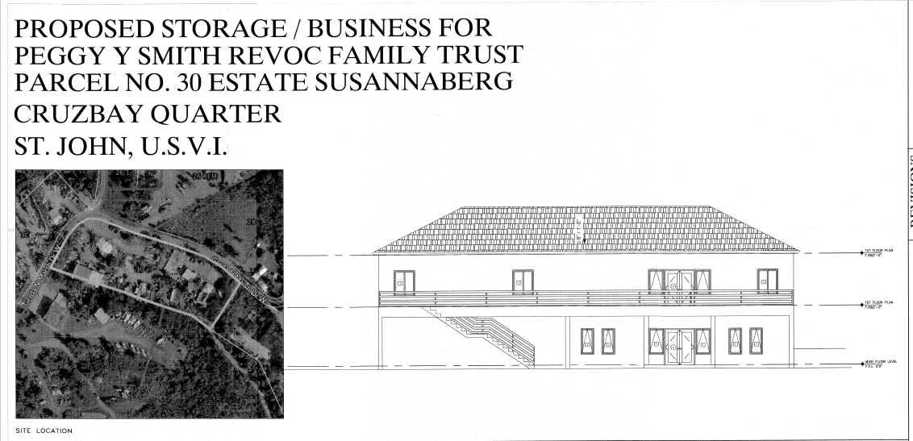
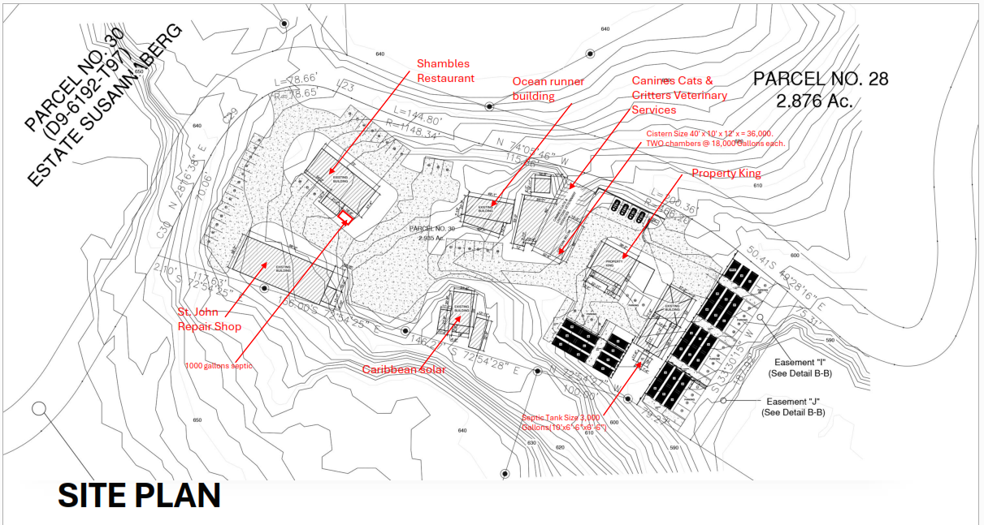
CCZP0036-26: Conceptual Site Plan Layout

