Slide 1
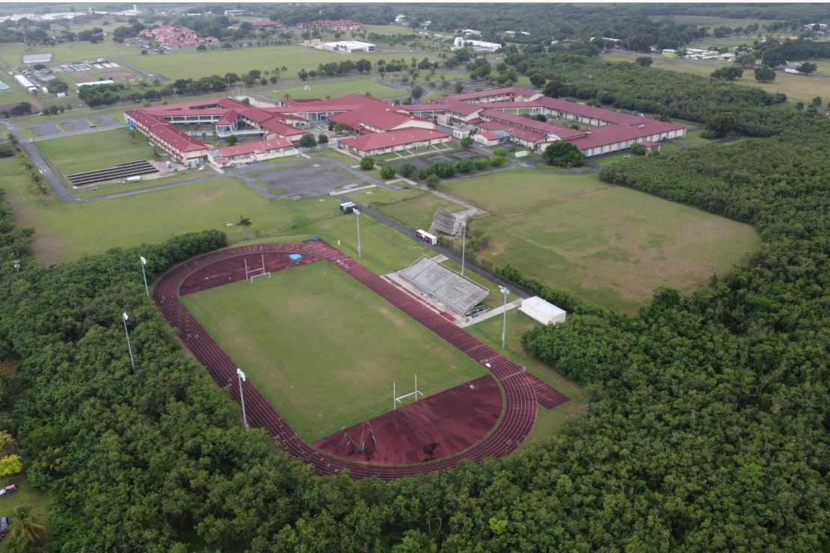
CCZP0055-26: Site photo- existing conditions

Slide 2
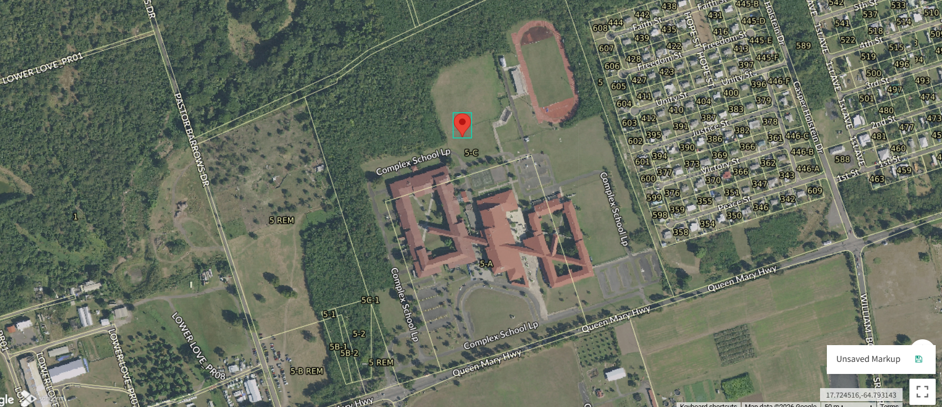
CCZP0055-26: MapGeo aerial view of properties (marked with red)

Slide 3
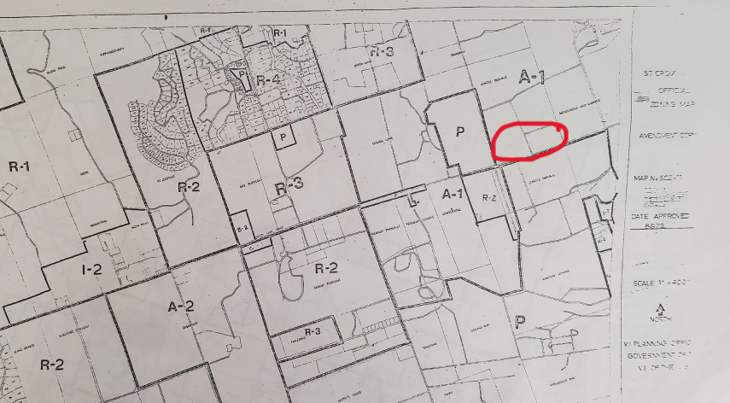
CCZP0055-26: Official Zoning Map No. SCZ-11 (properties’ location indicated by red circle)

