Slide 1
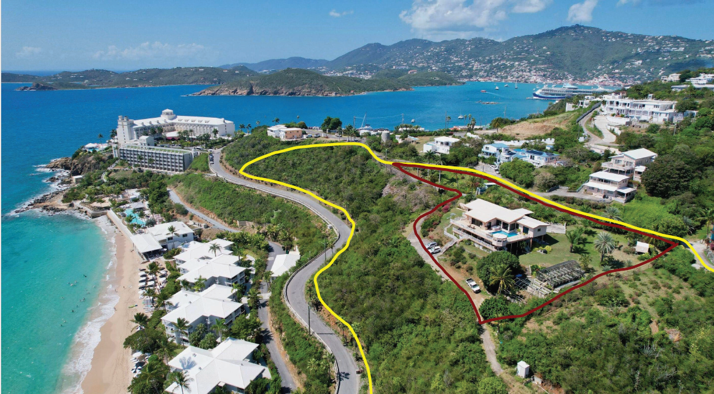
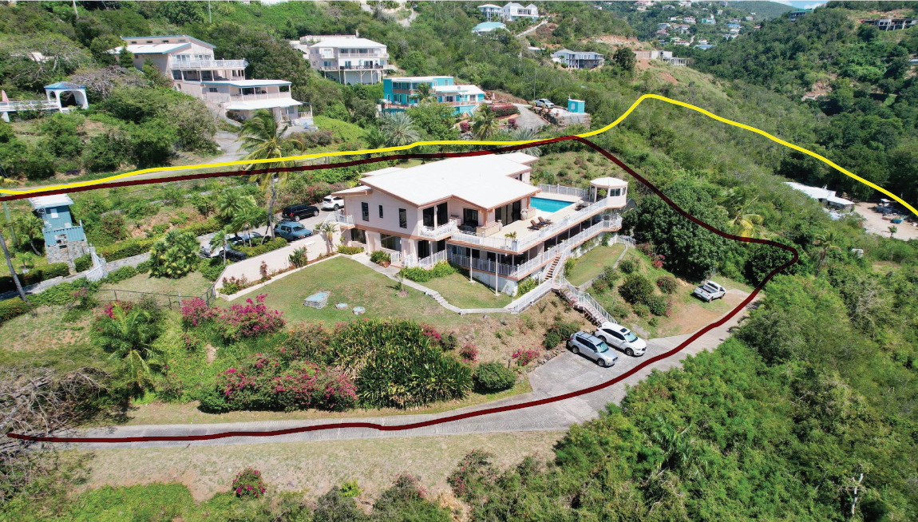
CCZP0043-26: Site photo- subject properties outlined in red. Adjacent owned properties outlined in yellow

Slide 2
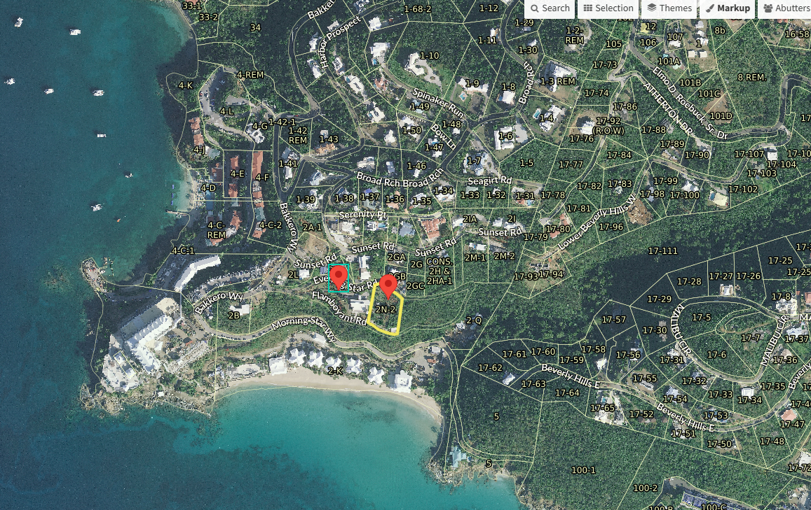
CCZP0043-26: MapGeo aerial view of properties (marked with red)

Slide 3
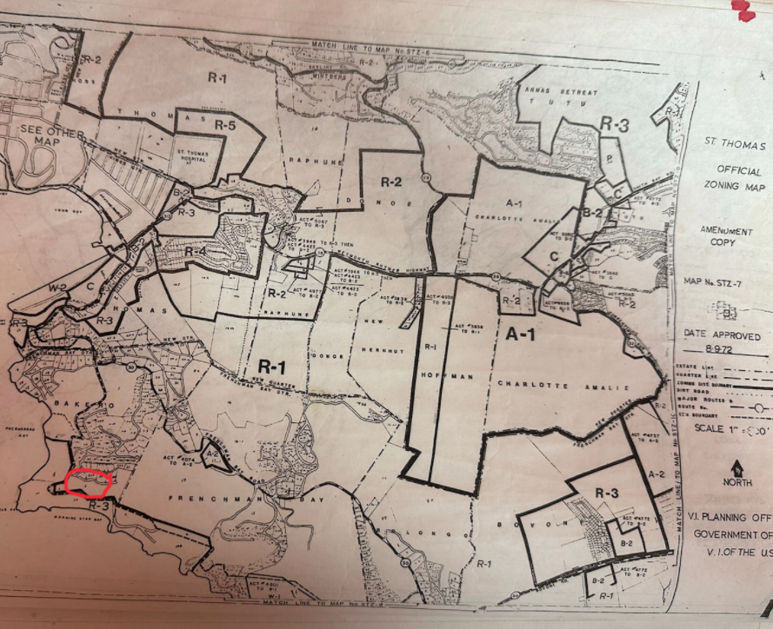
CCZP0043-26: Official Zoning Map No. STZ-7 (properties’ location indicated by red circle)

Slide 4
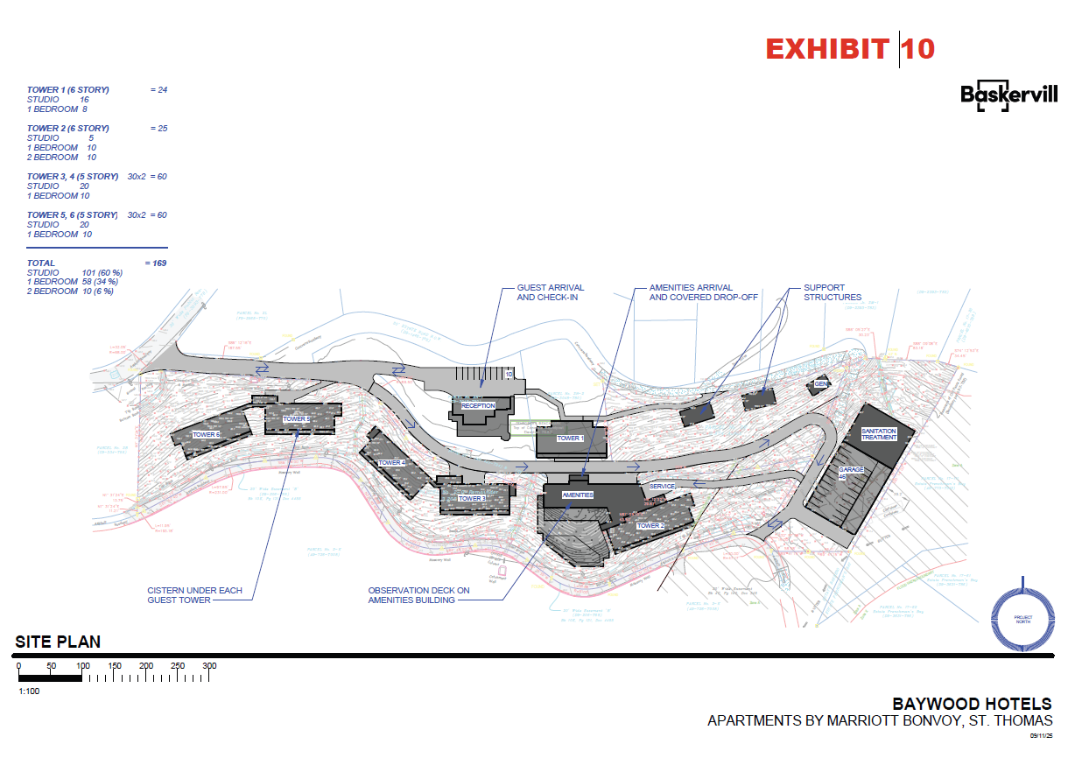
CCZP0043-26: Conceptual Site Plan Layout

