Slide 1
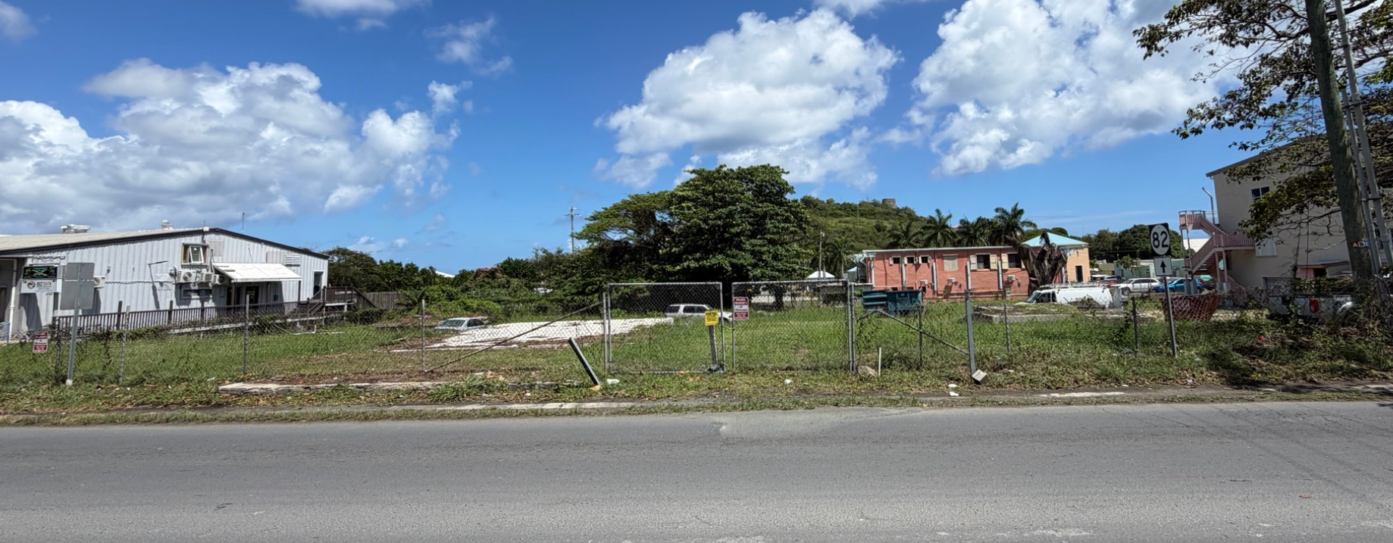
CCZP0022-26: Site photo- undeveloped lot

Slide 2
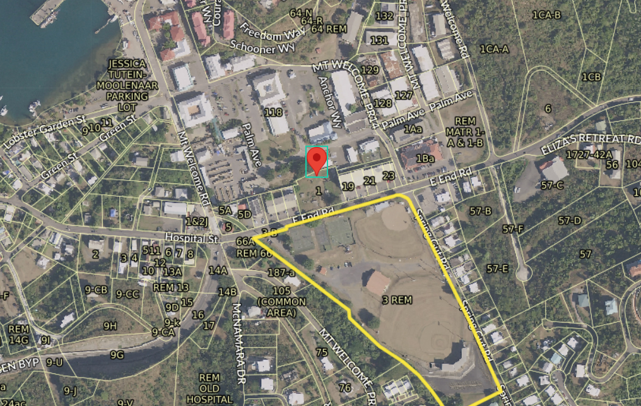
CCZP0022-26: MapGeo aerial view of property (marked with red)

Slide 3
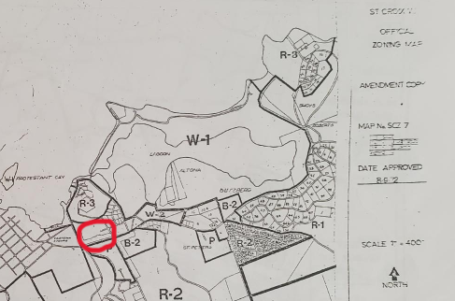
CCZP0022-26: Official Zoning Map No. SCZ-7 (property location indicated by red circle)

Slide 4
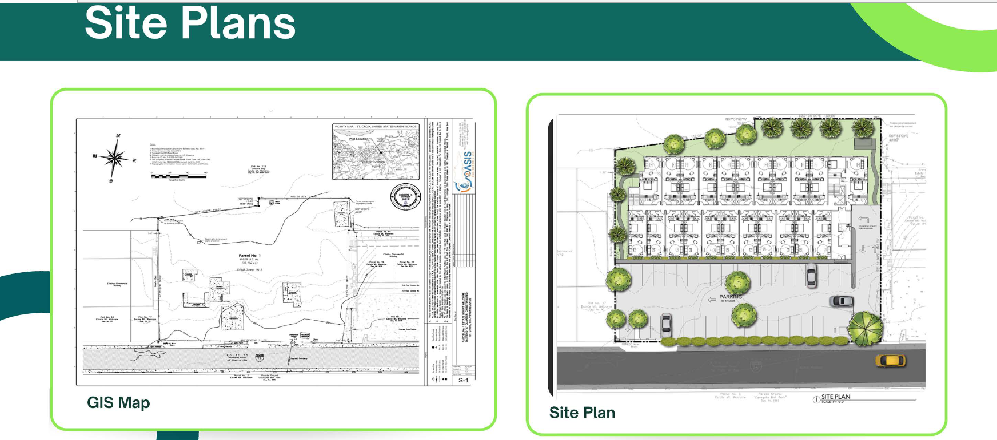
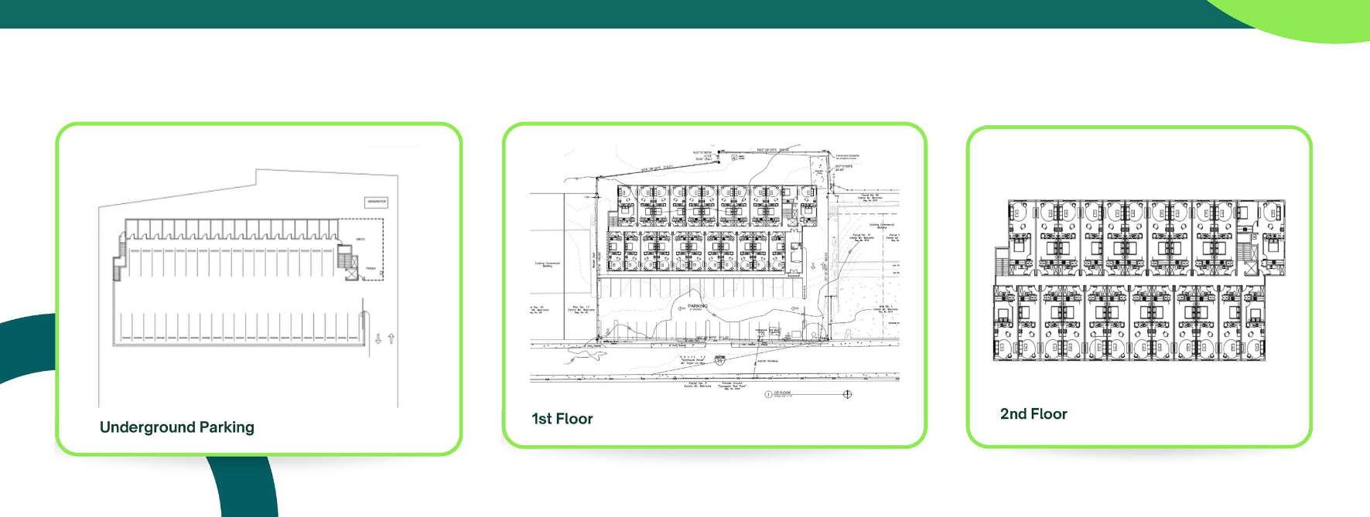
CCZP0022-26: Conceptual Site Plan Layout

