Slide 1
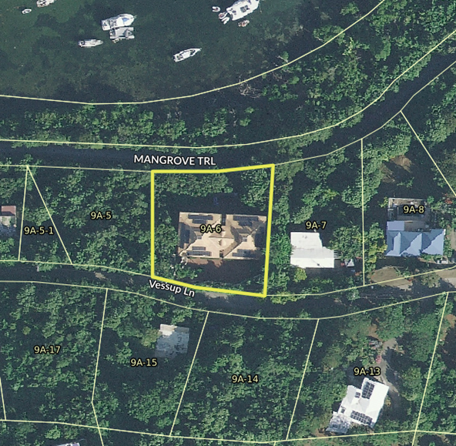
CCZP0014-26: MapGeo aerial photo of site (outlined in yellow)

Slide 2
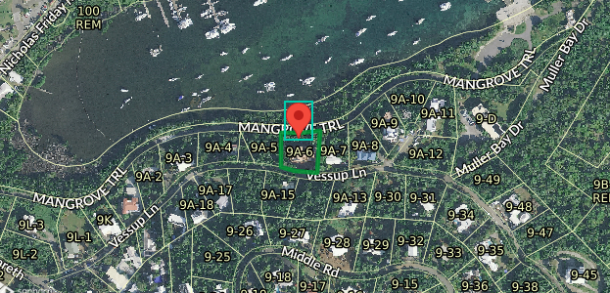
CCZP0014-26: MapGeo aerial view of property (with red marker)

Slide 3
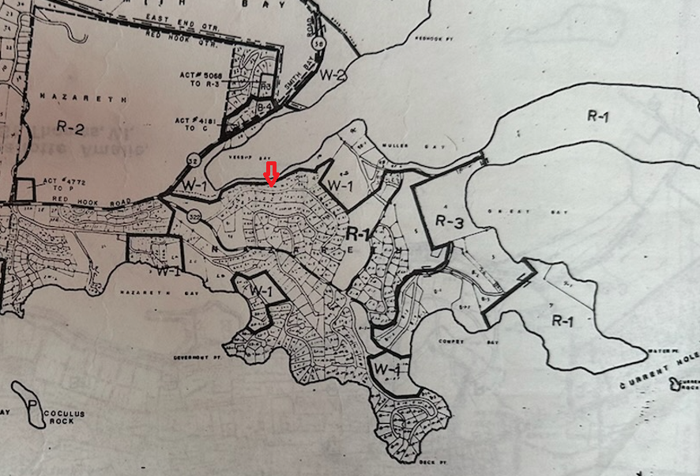
CCZP0014-26: Official Zoning Map No. STZ-10 (property’s location indicated by red arrow)

