Slide 1
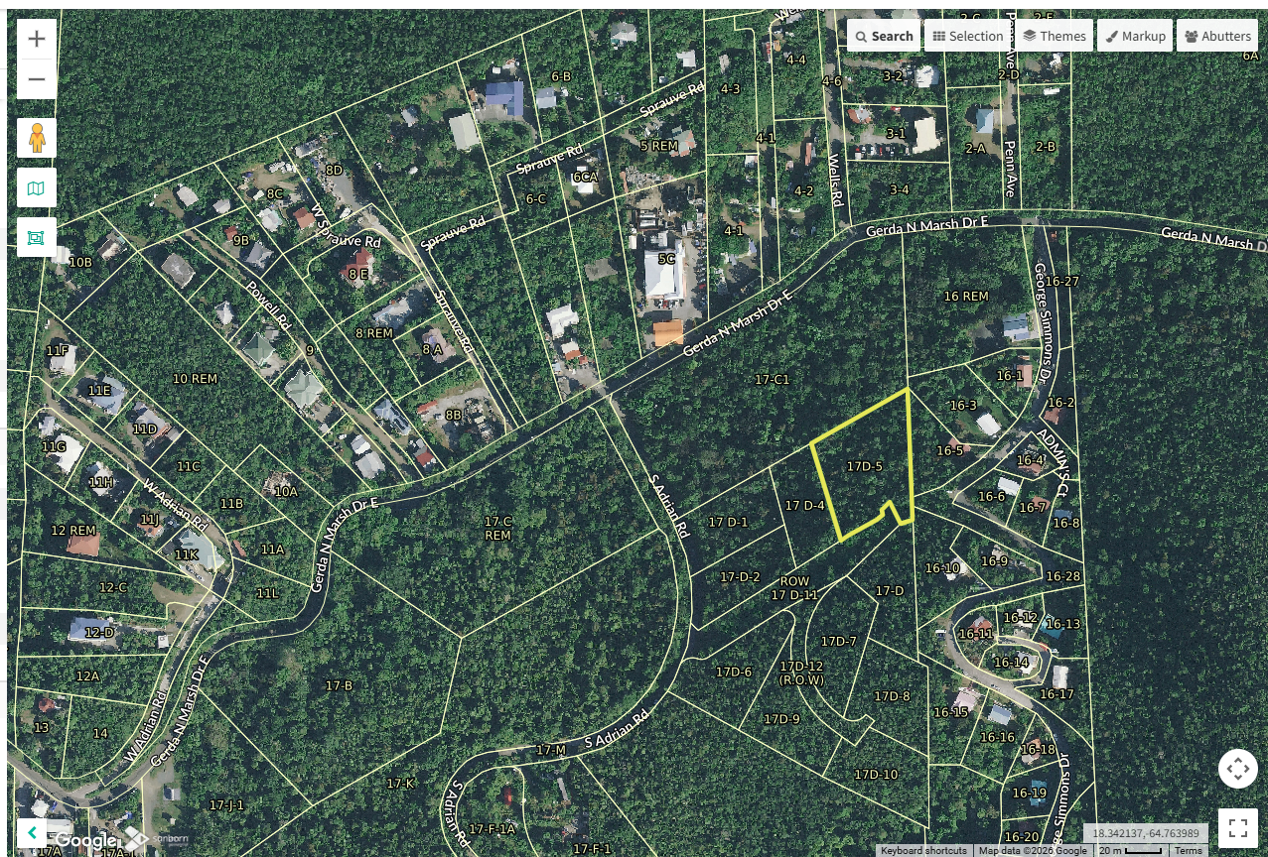
CCZP0011-26: Mapgeo aerial photo of site location- vacant land highlighted in yellow

Slide 2
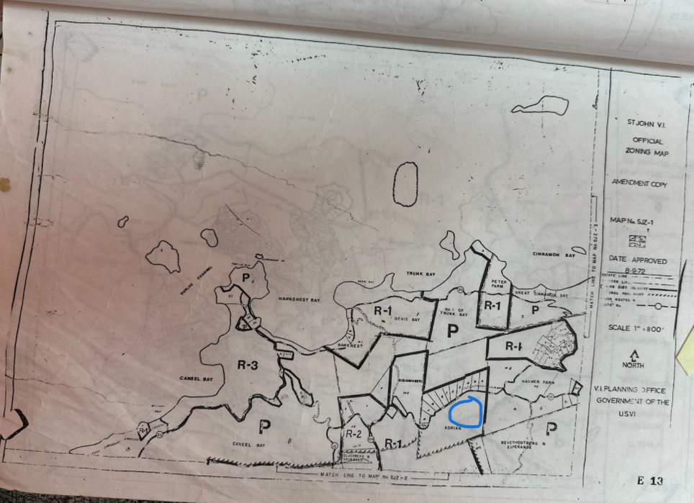
CCZP0011-26: Official Zoning Map No. SJZ-1 (property location indicated by blue circle)

Slide 3
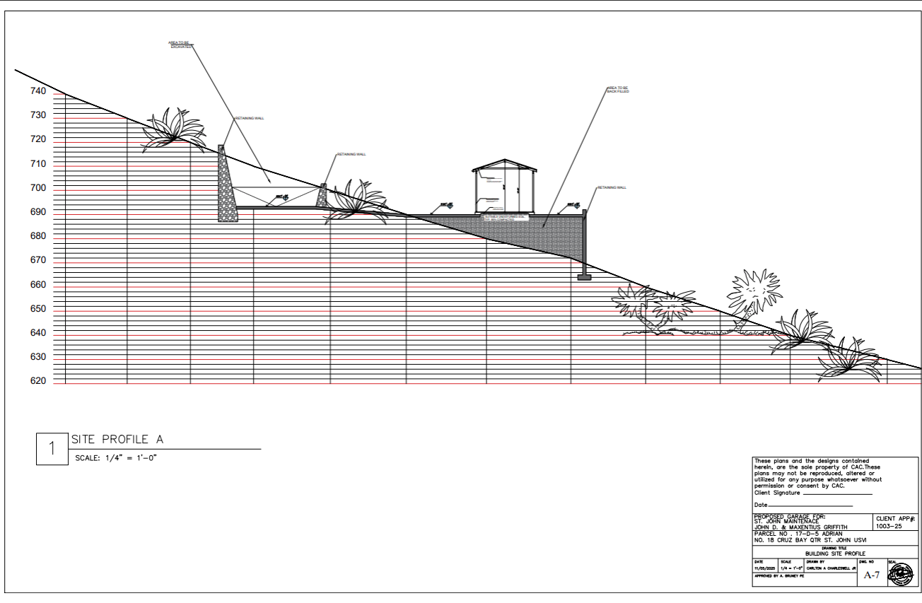
CCZP0011-26: Conceptual Site Plan Layout

