Slide 1
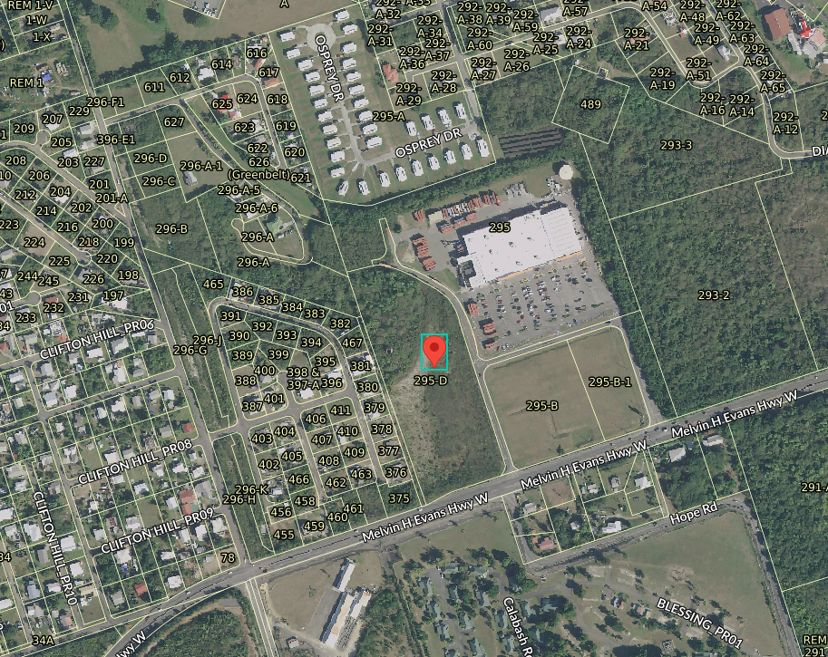
CCZP0118-25: MapGeo aerial view of property’s location (marked in red)

Slide 2
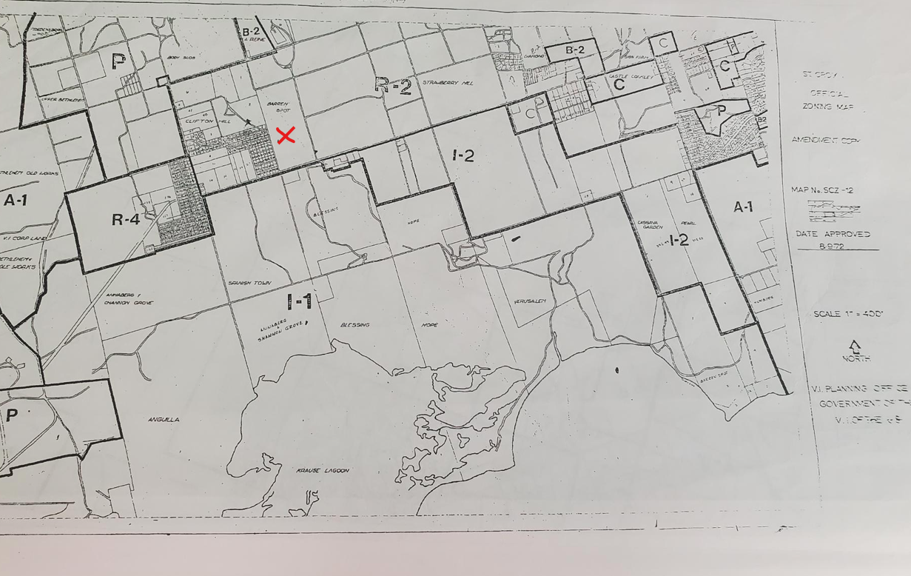
CCZP0118-25: Official Zoning Map No. SCZ-12 (property marked with red X)

