Slide 1
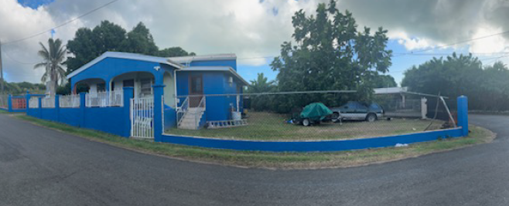
CCZP0109-25: Photo of current site condition- Two houses; one occupied and another vacant

Slide 2
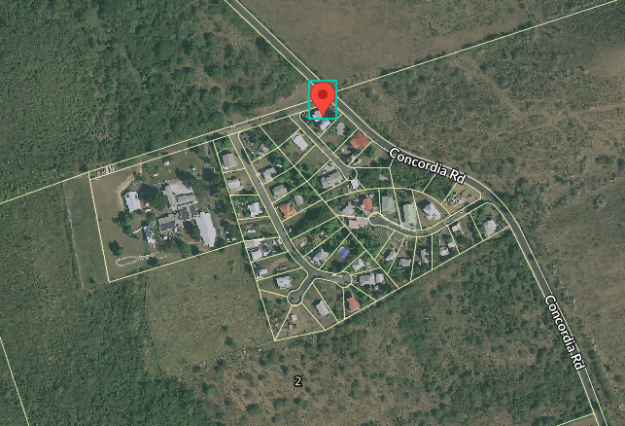
CCZP0109-25: MapGeo aerial view of property (marked in red)

Slide 3
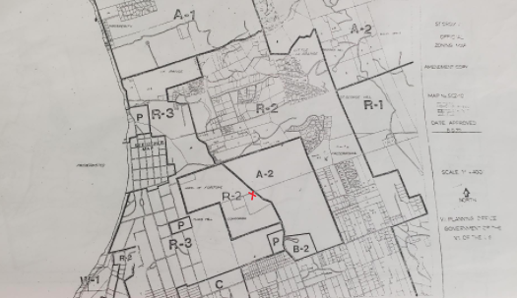

CCZP0109-25: Official Zoning Map No. SCZ-10 (property marked with red X)

Slide 4
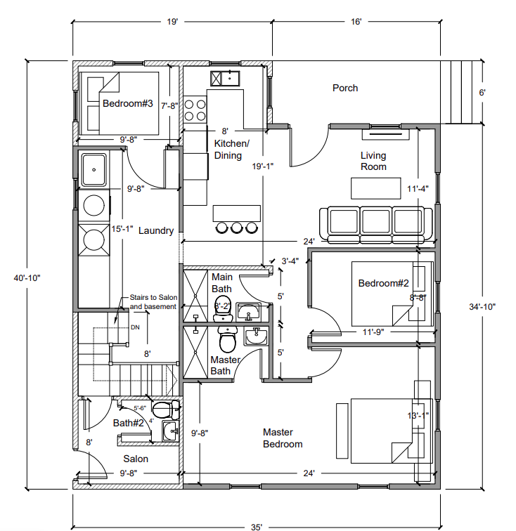

CCZP0109-25: Conceptual Site Plan Layout- Addition of Salon to existing bathroom

