Slide 1
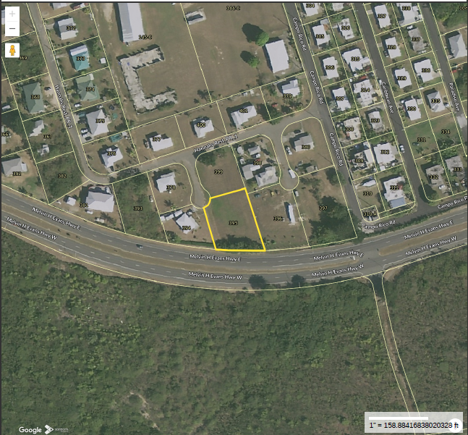
CCZP0108-25: MapGeo aerial of current site condition- vacant land

Slide 2
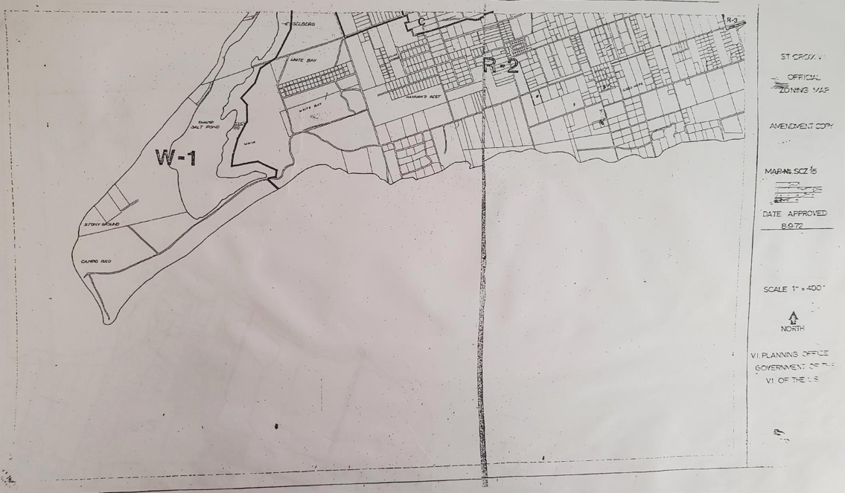
CCZP0108-25: Official Zoning Map No. SCZ-15 (property marked with red X)

