Slide 1
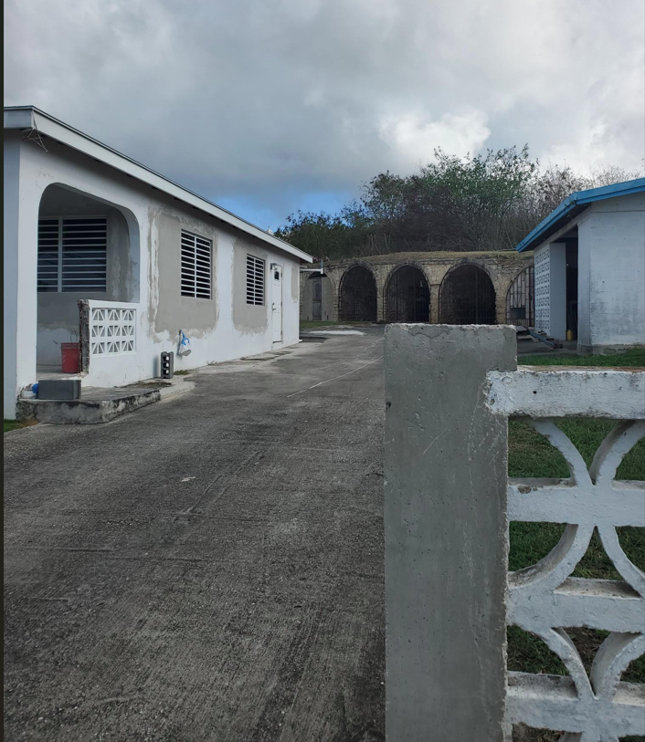
CCZP0107-25: Site photo- from left to right: single-family dwelling, historical ruins, & storage building

Slide 2
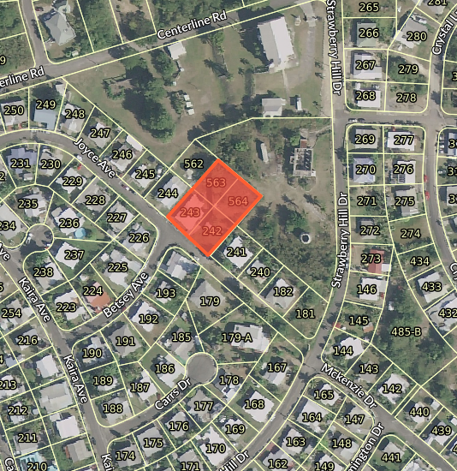
CCZP0107-25: MapGeo aerial view of property (marked in red)

Slide 3
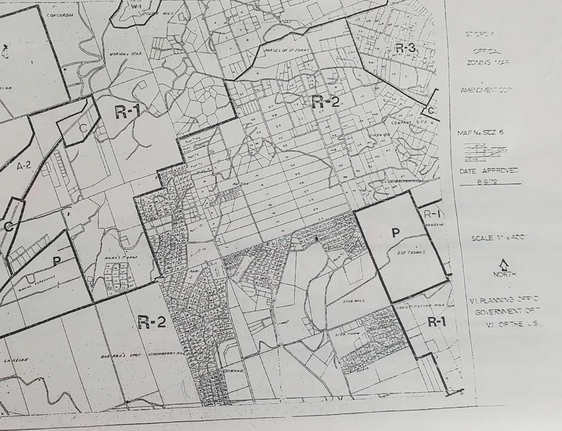

CCZP0107-25: Official Zoning Map No. SCZ-6 (property marked with red X)

Slide 4
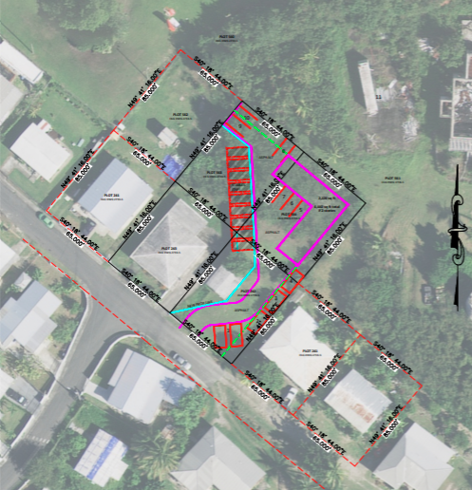
CCZP0107-25: Conceptual Site Plan Layout

