Slide 1
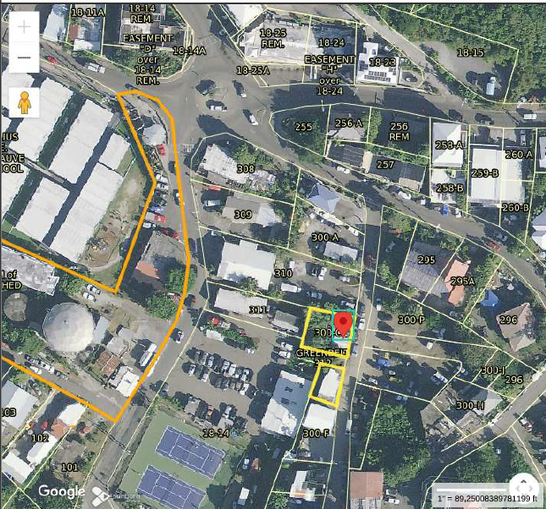
CCZP0104-25: MapGeo aerial view of property (marked in red)

Slide 2
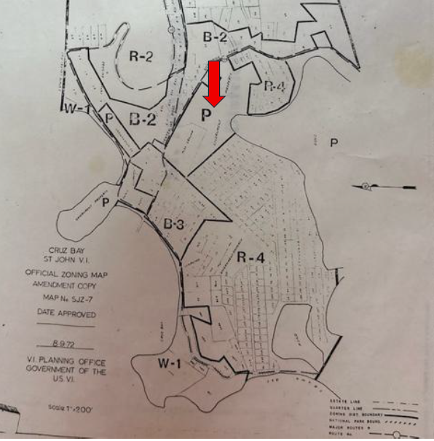
CCZP0104-25: Official Zoning Map No. SJZ-7 (property marked with red arrow)

Slide 3
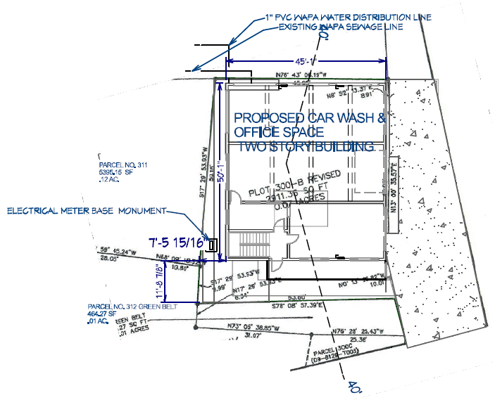
CCZP0104-25: Conceptual Site Plan Layout

