Slide 1
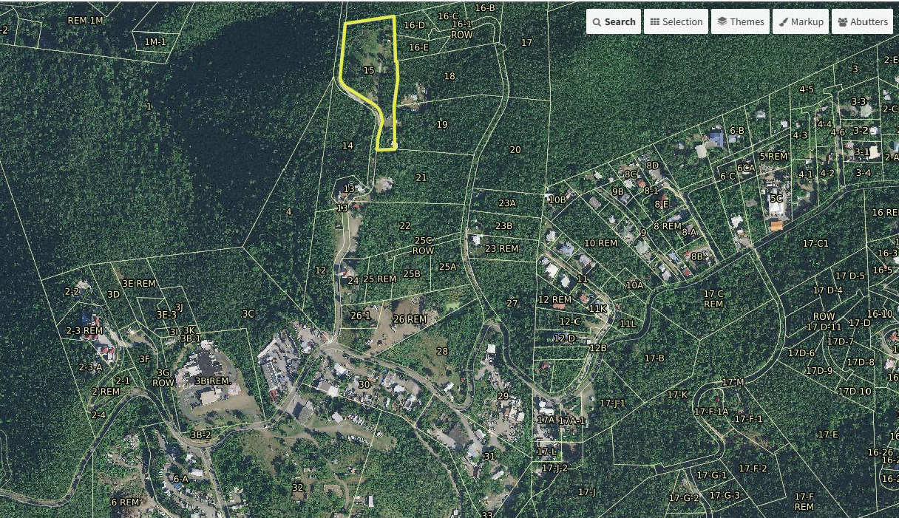
CCZP0085-25: MapGeo aerial view of property (marked in yellow)

Slide 2
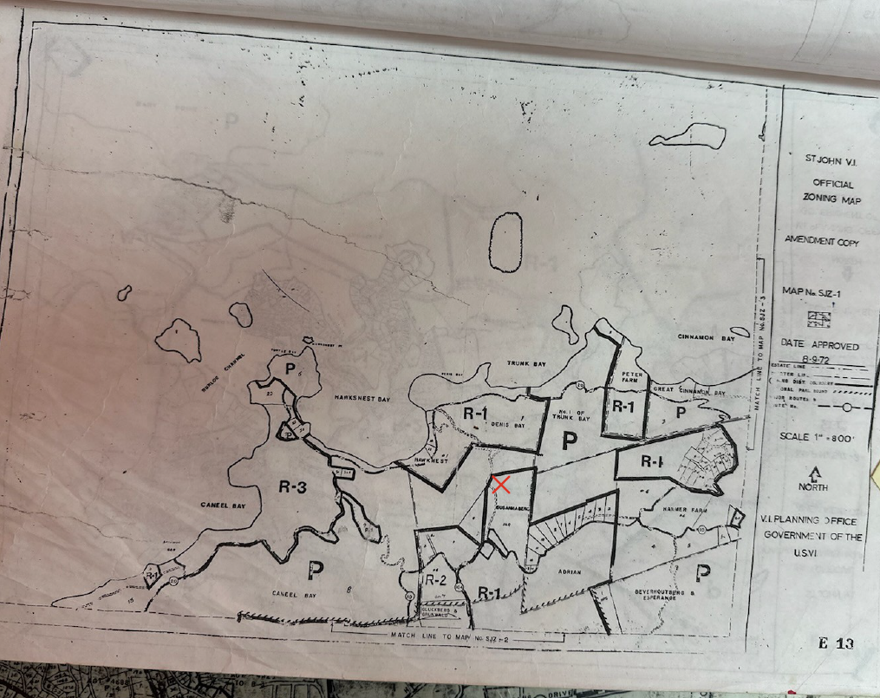
CCZP0085-25: Official Zoning Map No. SJZ-1 (property marked with red X)

Slide 3
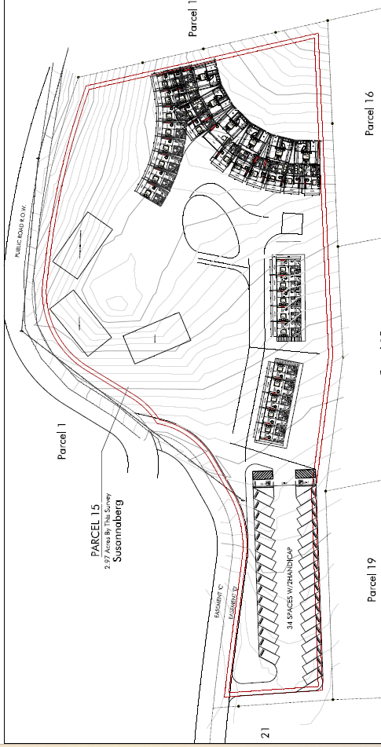
CCZP0085-25: Conceptual Site Plan Layout

