Slide 1
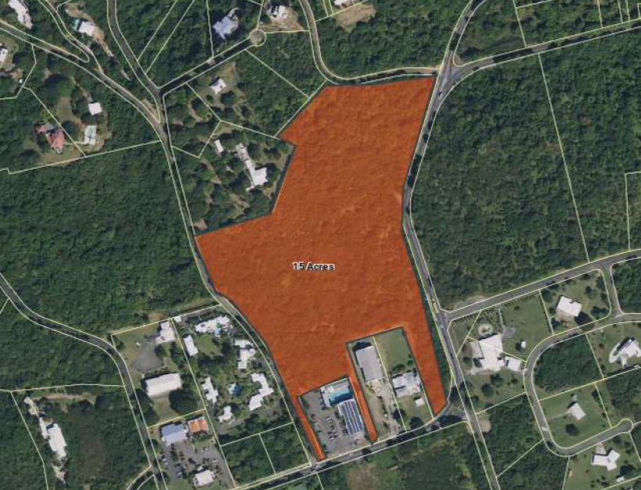
CCZP0069-25: Aerial photo of site’s location

Slide 2
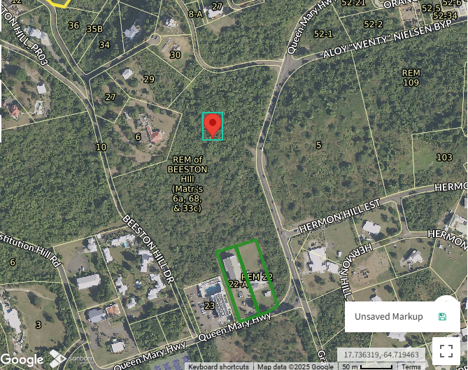
CCZP0069-25: MapGeo aerial view of property (marked in red)

Slide 3
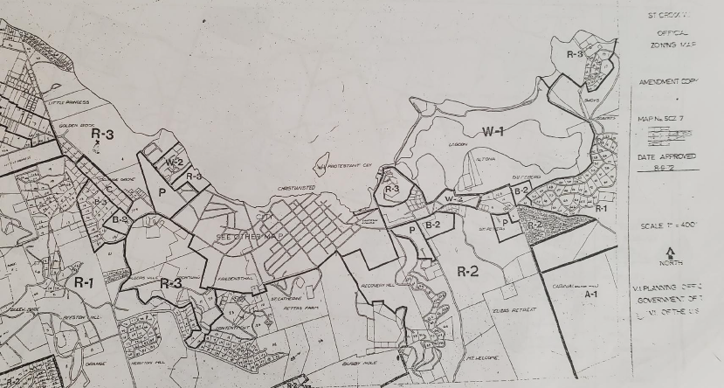

CCZP0069-25: Official Zoning Map No. SCZ-7 (property location indicated by red X)

Slide 4
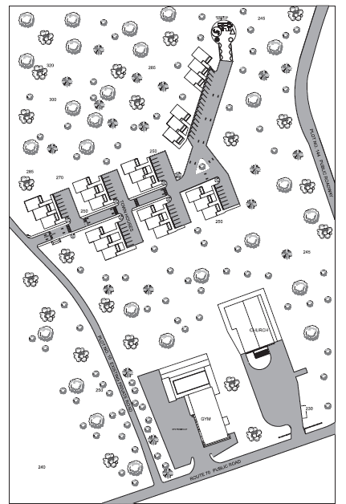
CCZP0069-25: Conceptual Site Plan Layout

