Slide 1
Lindbergh Bay , St. Thomas Lime Out 2 LLC Floating Restaurant and Support Moorings
Committee of the Whole
September 17th, 2025
Permit Number: CZT –08-21(W)
Applicant: Lime Out 2 LLC

Slide 2
Project Overview
Goal of project: To install moorings to tie up floating restaurant (Taco Bar) and support mooring for vessels visiting the restaurant. Lime Out.
Lime Out 1 operates in Coral Bay St John Grey Water and Black Water Tanks- pumpout at 50%. Active service contract proof No Swim up , Kayak or Paddle board. | Hurricane and Emergency Plan. Decibel Level conditions Daytime operations Monitoring of benthos and marine life for 3 years after operations commence.

Slide 3
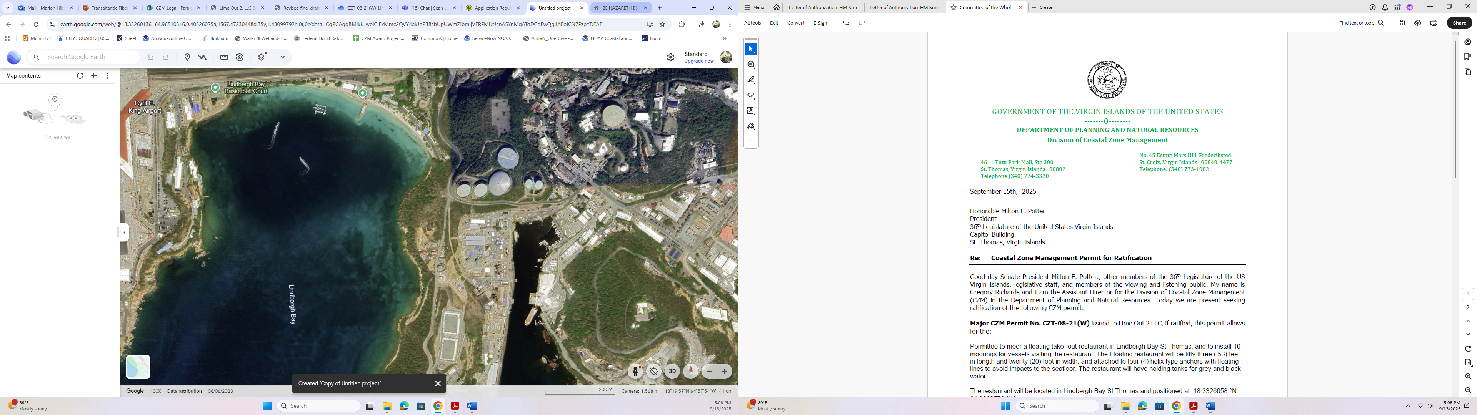
Google Earth Image of Lindbergh Bay
Notes:
Left: Image of the overview of the entire proposed cable network from Trans America Fiber, U.S.
Right: Zoom in to the proposed branches in Puerto Rico and St. Croix, image from Telegraphy Transport Networks Research Service and the online submarine cable map

Slide 4
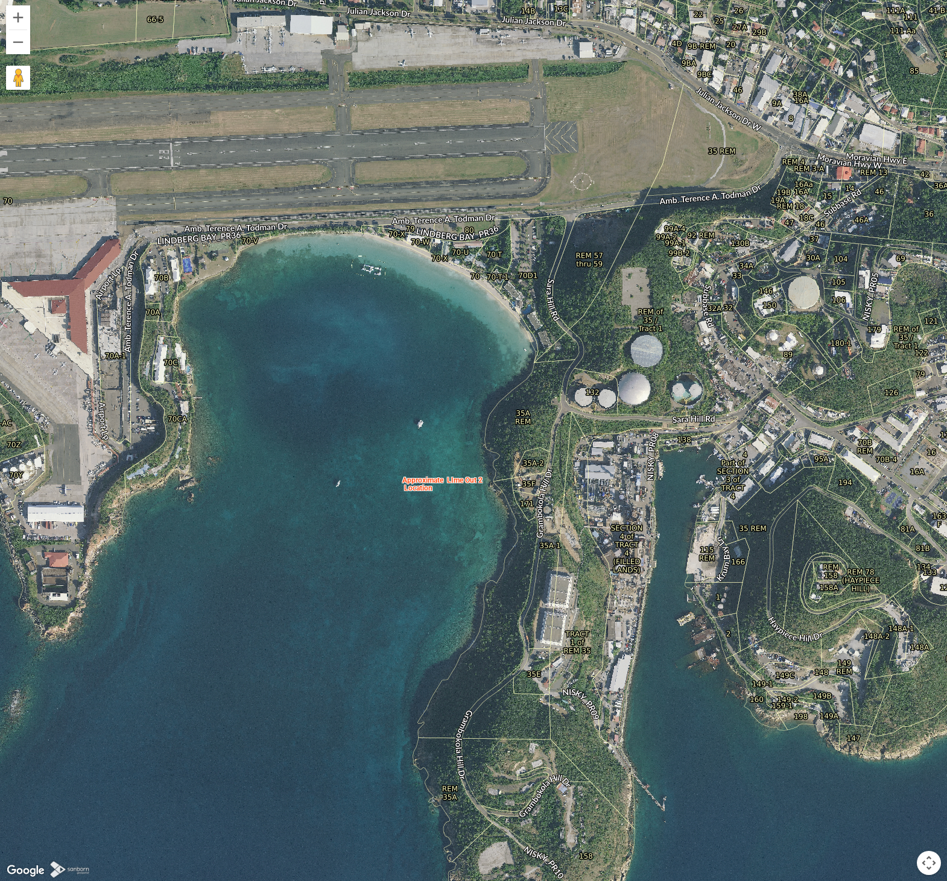
Approximate Location of Lime Out 2

Slide 5
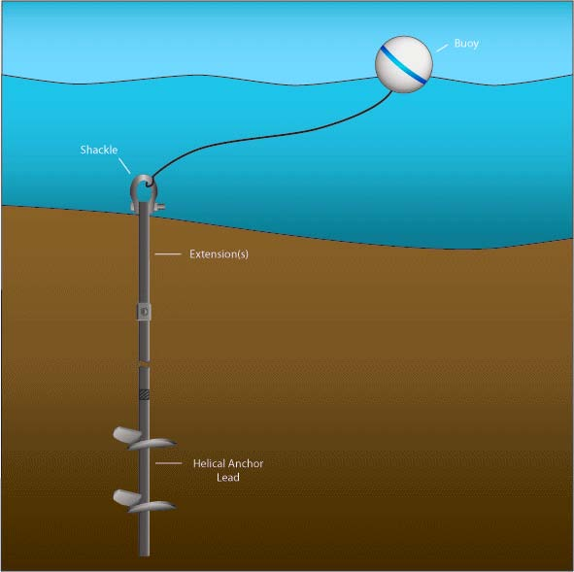
Simplified Image of Helix Anchor with floating lines

Slide 6
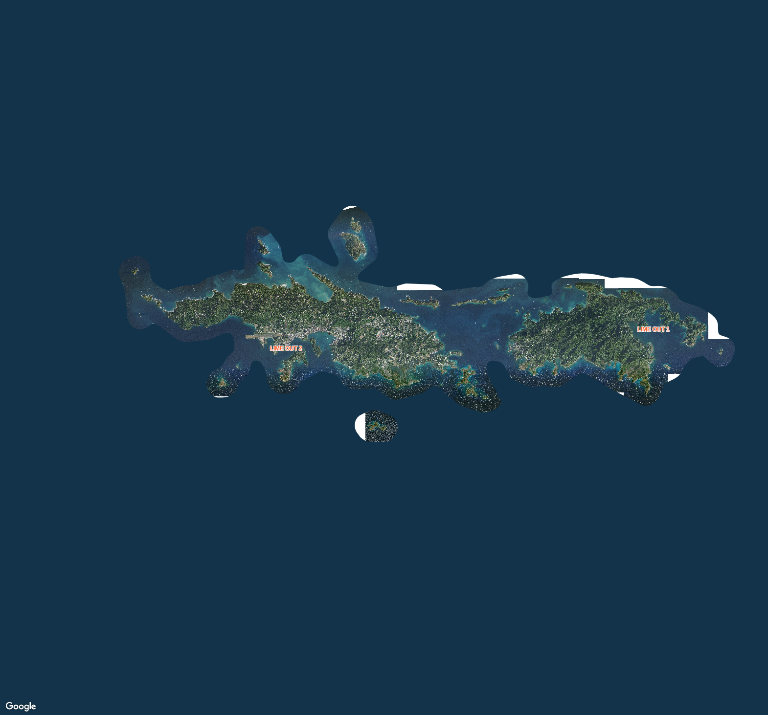
Lime Out Locations
Notes:
Top Left: Full view image of St. Croix showing northern location of the site in reference to the island (Google Maps Image using Map Geo)
Bottom Left: North side of the island showing with the site highlighted (Google Maps image using MapGeo)
Right: Static hi-res imagery of the site from MapGeo. Location is Parcel 4A, Butler Bay, STX. Building is currently owned by AT&T

Slide 7
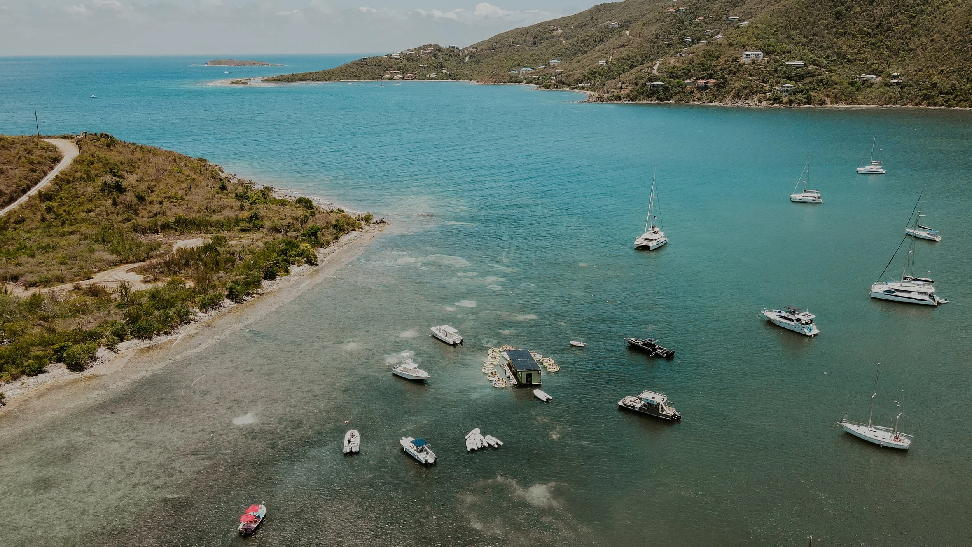
Image of Lime Out 1- photograph courtesy of Limeoutvi.com
Notes:
-Squiggly Lines: Existing submarine cables in the area
-Solid red line perpendicular to St. Croix is the proposed cable installation.
-Numbers are depths in Fathoms
Image taken directly from the environmental assessment report (pg 12)

