Slide 1
FY 2026 Executive Budget
May 30, 2025

Slide 2
Operating Revenues

Slide 3
FY 2026 Revenue Estimates
Individual Income Tax (IIT)
Corporation Income Tax (CIT)
Gross Receipts Tax (GRT)
Excise Tax (ET)
Other Revenues (Taxes & Fees)

Slide 4
Individual Income
Approximately 2% reduction
With Capital Projects (Mitigation/Disaster Recovery) of $78.5M - potential increase of 12.7%
Weights Used:FY2023 (30%), FY2024 (70%)
Result Implication: Indicates mild contraction and base flattening.
Why This Model: Emphasizes recent income trends while down weighting earlier, inflated post-COVID years for a more accurate reflection of the current economic base.
FY 2024 Actuals | FY 2025 Forecast | FY 2026 Forecast
$421,083,750 | $423,429,742 | $414,156,631

Slide 5
Corporate Income Tax
Approximately 5% reduction
Weights Used: FY2022 (15%), FY2023 (35%), FY2024 (50%)
Result Implication: One-time peak followed by moderate contraction aligned with corporate stress.
Why This Model: Reflects the post-COVID transition by emphasizing recent trends and down weighting inflated years impacted by one-time supports, anticipating a return to normal amid economic softening and reduced business activity.
FY 2024 Actuals | FY 2025 Forecast | FY 2026 Forecast
$65,430,415 | $78,806,965 | $74,866,616

Slide 6
Gross Receipts Tax
Approximately 3% increase
With Capital Projects (Mitigation/Disaster Recovery) of $48.9M - potential increase of 14%
Weights Used: FY2022 (10%),FY2023 (30%), FY2024 (60%)
Result Implication: Stable base with modest inflation-driven growth
Why This Model: GRT’s broad, consistent performance supports a modest 3% FY2026 growth, with the model emphasizing recent data and factoring in inflation and stable tourism.
FY 2024 Actuals | FY 2025 Forecast | FY 2026 Forecast
$209,342,833 | $213,819,225 | $220,233,802

Slide 7
Excise Tax
Approximately 1.5% increase
With Capital Projects (Mitigation/Disaster Recovery) of $11.7M - potential increase of 33.7%
Weights Used: FY2022 (20%),FY2023 (30%), FY2024 (50%)
Result Implication: Continuity of stability with minor growth assumptions
Why This Model: Excise tax receipts are highly predictable due to stable import dependency. This model provides low-variance outputs that align with long-term historical performance.
FY 2024 Actuals | FY 2025 Forecast | FY 2026 Forecast
$36,150,443 | $36,456,367 | $37,003,213

Slide 8
Other Revenues Taxes & Fees
All remaining tax and fee categories have been modesty adjusted to reflect recent annual trends and their fiscal performance throughout the current year.
Corporate Franchise Tax: FY2025 is projected at $5,421,176 and increase by 2.5% to $5,556,705 in FY2026. This growth aligns with long-term stability in collections and steady registration activity among corporate filers assumption.
Stamp Tax: FY2026 is projected to increase by 2%, from $15,960,662 in FY2025 to $16,279,875. The increase reflects ongoing growth in real estate transaction values and a corresponding uptick in property-related tax collections.
Hotel Occupancy Tax and Related Revenues: All occupancy-related revenue categories are increased by 3% to account for inflationary pressure on room rates and steady performance in the tourism sector.
Time Share Revenues: In a recent analysis, since FY 2022 Time share revenue has stabilized at $5.3M per fiscal year, which is approximately 200K annual rentals per fiscal year, which is based on the $25.00 daily tax rate.

Slide 9
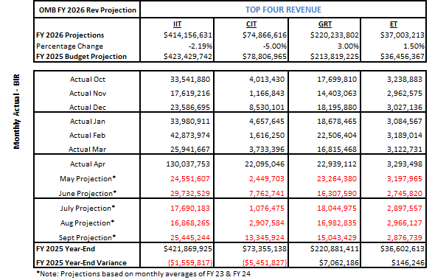
FY 2025 Projected Year-End Top Four Revenues, Excluding Real Property Tax
FY 2025 Year-End Projections:
IIT: $421,869,925 or ($1,559,817) under original forecast
CIT: $73,355,138 or ($5,451,827) under original forecast
GRT: $220,881,411 or $7,062,186 over original forecast
ET: $36,602,613 or $146,246 over original forecast

Slide 10
Revenue Outlook
FY 2026 revenue estimate, assumes additional revenues from PROJECTS.
Tracking all mandated transfer outs including the debt service, the total general fund revenue after transfer outs is tracking at $936,426,140.

Slide 11
General Fund Operating Budget

Slide 12
FY26 Department /Agency Budgets
The proposed budget for FY 26 has been established at $ 936,426,140.00 for the general fund. The proposed General Fund Budget includes investments aimed at strengthening core agencies. We have adopted a highly conservative budgeting approach considering significant uncertainties within the current U.S. government landscape. One key observation is personnel expenses continue to increase the financial burden on the General Fund. The increase is driven by a combination of vacancies being filled, incentive and union-based raises as well as overtime cost.

Slide 13
FY 26 Recommended Budget
Department / Agency | FY 26 Recommended Budget
Legislature | $ 24,713,000.00
Department of Justice | $ 18,755,216.00
Supreme Court | $ 40,258,400.00
Judicial Court | $ 130,620.00
Bureau of Corrections | $ 37,702,232.00
Office of the Governor | $ 14,087,494.00
Office of Management & Budget | $ 6,374,287.00
Division of Personnel | $ 62,758,866.00
Office of Collective Bargaining | $ 1,263,391.00
VITEMA | $ 5,911,126.00
Virgin Islands Fire Emergency Medical Service | $ 35,224,463.00
Territorial Public Defender | $ 6,132,220.00
Bureau of Information Technology | $ 12,329,386.00
Virgin Islands Energy Office | $ 1,554,499.00
Office of the Adjutant General | $ 3,243,939.00
Office of Veteran's Affairs | $ 1,219,369.00
Lt Governor's Office | $ 7,743,246.00
Office of the Supervisor of Elections | $ 2,500,000.00
Board of Elections | $ 250,000.00
Bureau of School Construction and Maintenance | $ 5,746,152.00
Board of Education | $ 2,137,697.00
Bureau of Internal Revenue | $ 14,060,535.00
Office of the Inspector General | $ 2,898,392.00
Bureau of Motor Vehicles | $ 3,596,365.00
Subtotal | $ 310,590,895.00

Slide 14
FY 26 Recommended Budget
Department / Agency | FY 26 Recommended Budget
Department of Labor | $ 12,984,698.00
Department of Licensing and Cons. Affairs | $ 7,582,741.00
Department of Finance | $ 13,809,602.00
Department of Education | $ 179,316,999.00
Career & Tech. Education Board | $ 689,681.00
Virgin Islands Police Department | $ 73,339,967.00
Law Enforcement Planning Commission | $ 734,766.00
Department of Property & Procurement | $ 14,616,564.00
Department of Public Works | $ 23,958,321.00
Virgin Islands Waste Management Authority | $ 32,500,000.00
Department of Health | $ 29,754,129.00
East End Medical Center | $ 2,700,000.00
Schneider Regional Medical Center | $ 31,750,000.00
Frederiksted Health Care | $ 3,000,000.00
Juan Luis Hospital & Medical Center | $ 30,250,000.00
Department of Human Services | $ 69,153,007.00
Department of Planning and Natural Resources | $ 7,009,487.00
Department of Agriculture | $ 5,268,235.00
Department of Sports Parks & Recreation | $ 9,272,040.00
University of the Virgin Islands | $ 34,980,932.00
Labor Management | $ 200,000.00
Public Employees Relation Board | $ 1,686,910.00
Nurse Licensure Board | $ 856,373.00
Subtotal: | $ 585,414,452.00

Slide 15
FY 26 Recommended Budget
Department / Agency | FY 26 Recommended Budget
Virgin Islands Housing Finance Authority | $ 2,000,000.00
Virgin Islands Public Broadcasting Station | $ 4,431,902.00
Casino Control Commission | $ 1,723,800.00
Office of Disaster Recovery | $ 2,500,000.00
Virgin Islands Economic Development Authority | $ 6,613,000.00
Virgin Islands Public Finance Authority | $ 4,200,000.00
Scholarships | $ 1,555,566.00
Miscellaneous | $ 17,396,525.00
Subtotal: | $ 40,420,793.00
Grand Total | $ 936,426,140.00

Slide 16
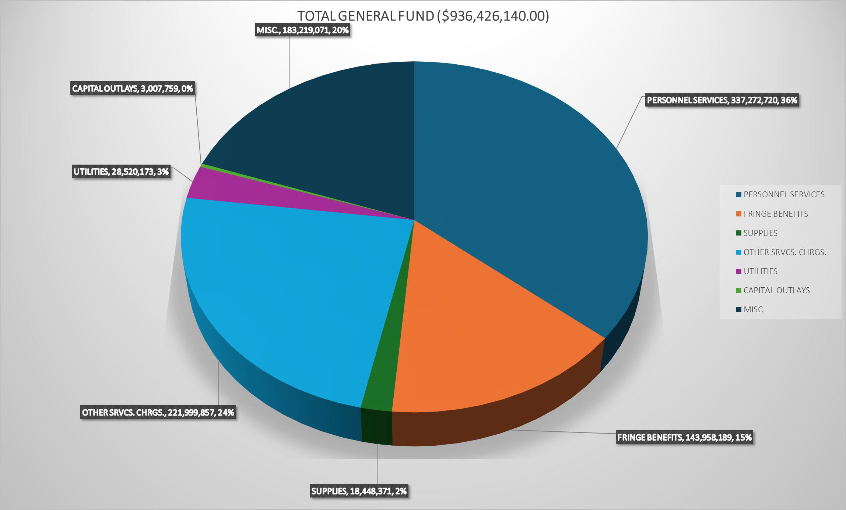
FY 26 Recommended Budget By Expense Category

Slide 18
Key Observation
The Federal grant environment continues to be unpredictable as US Executive Orders have imposed new requirements, such as required justifications as part of the drawdown process and delayed issuance of yearly funding opportunities. The language in the applications is being updated by the granting agencies based on the Executive Orders. These orders have created challenges for grant administrators in complying with changing regulations as well as the constant personnel changes within their grantor agencies. As many of these orders are being contested in judicial courts, the FY2026 Federal grant budget predictions remain mostly consistent with those of the previous year, due to the majority of the grants being formula-driven. As these legal battles unfold, the USVI must remain vigilant and adaptable to potential changes in funding and eligibility criteria, prioritizing federal spending on the most critical needs while the Federal grant environment stabilizes.
In turn, spending on one-time grants such as the American Rescue Plan Act (ARPA) and COVID-19 grants decreased the FY2026 overall Federal budget availability due to continued utilization of the specialty grants as well as expirations and extension request denials. The GVI, however, continues to submit requests for reconsiderations for the extensions by providing justifications by project and vendor as the grantors have directed.
The changing landscape of Federal grants may allow for more state-level decision-making autonomy regarding grant spending if funding is awarded directly to states. GVI would be able to leverage its knowledge of local needs and environments to make more informed and effective spending choices. This independence would allow for a more customized approach to addressing issues and projects that are most pertinent to our communities. We must remain adaptable to both the challenges and opportunities in the Federal grant environment with an aggressive approach to expending all funds in a compliant and timely manner.

Slide 19
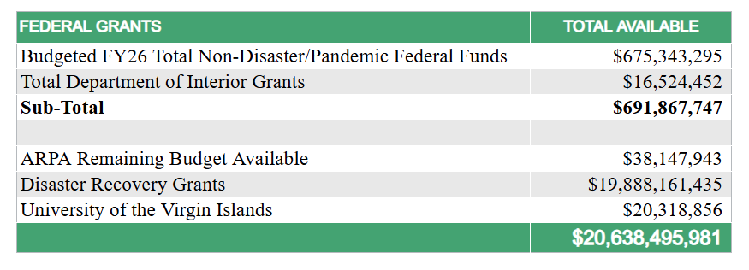

Slide 20
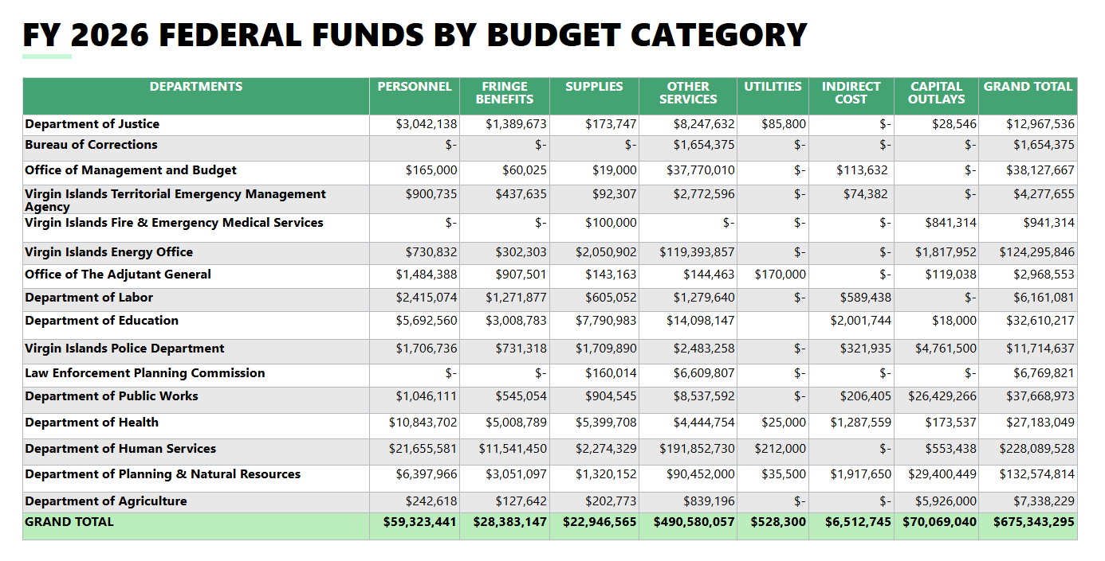

Slide 21
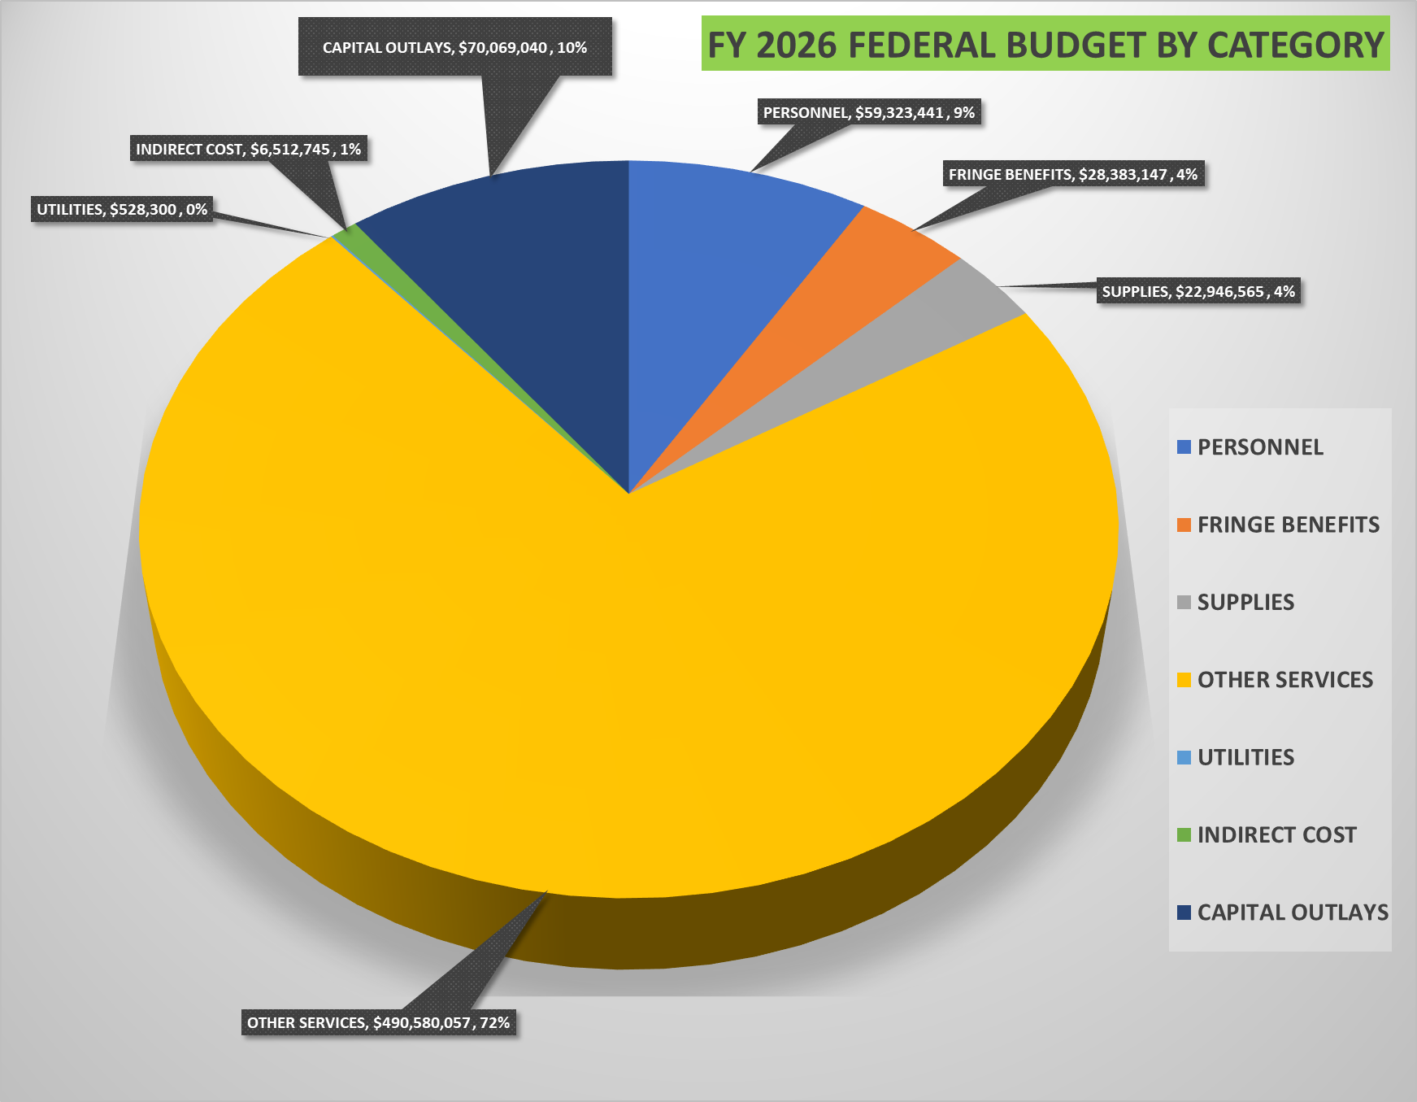
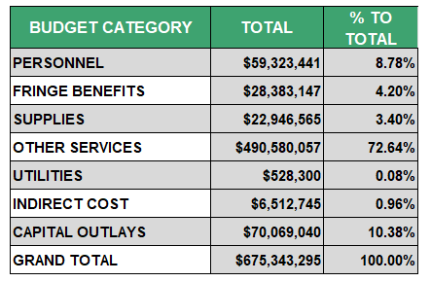

Slide 22
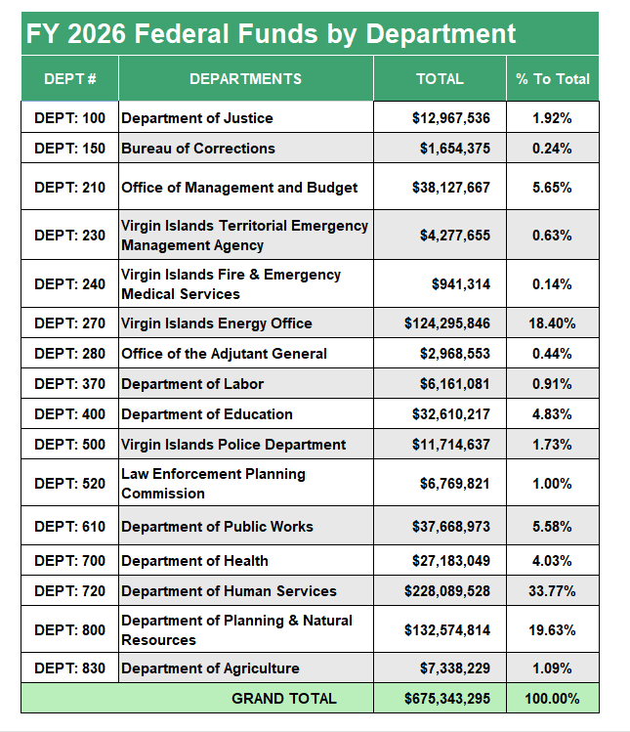
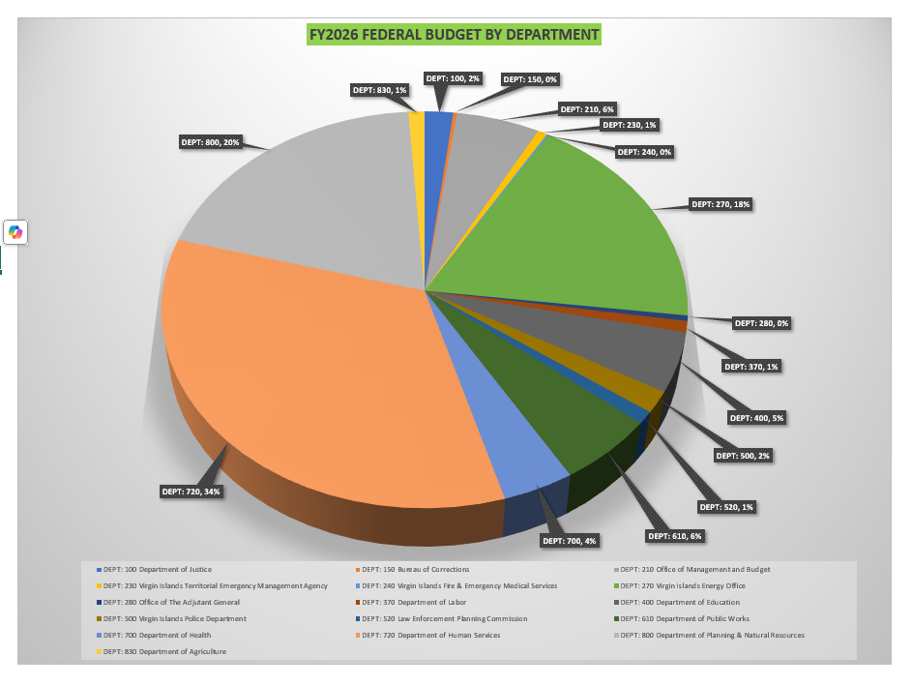

Slide 23
